Slide 1

NHI - The Evidence and Benchmarking
(vs Thailand)
Dr Adiel Chikobvu
15th March 2020

Slide 2
Outline
Where are we?
Where do we want to be? : Thailand
Benchmarking
PHC Model
Key Lessons
State of readiness
Key Issues
Conclusion
Quote: PMAC 2020

Slide 3
Where are we?
Parliament published the NHI Bill for public consultations on 8th August 2019
The Bill is currently being consulted on in the National Assembly through the Portfolio Committee on Health
Thereafter, the Bill will also be debated in the NCP through the Select Committee on Health and Social Services
The Bill may be amended as the Committee deems it fit or accepted, thereafter approved for tabling to the National Assembly
The National Assembly would then either pass, amend or reject the Bill
If the NCOP passes the Bill, it goes to the President for his assent and signature.
If the NCOP rejects or amends the Bill it goes back to the National Assembly for reconsideration.

Slide 4
Where do we want to be? : Thailand
 | Thailand | South Africa
Population (2018) | 69,5 million | 57,7 million
Classification | Upper middle income | Upper middle income
GINI index (World Bank estimate) | 36.5 | 65.0
GDP / 2018 | 504, 993 Billion | 368, 289 Billion
GDP per capita (U$) / 2018 | 7 273 | 6 374
GNI per capita / 2018 | 6 610 | 5 750
Life expectancy (2017) | 76.6 | 63,5
Mortality rate, neonatal (per 1,000 live births) / 2018 | 5 | 11
Maternal mortality ratio (modelled estimate, per 100,000 live births) - 2017 | 37 | 119
THE as a % of GDP (2016) | 3.7 % of GDP | 8.4 % of GDP
THE per capita (U$) – 2015 & 2016 | 214.4 & 221.9 | 470.8 & 428.2
Public sources | 78.1 % of THE | 53.7 % of THE
GGHE (Gen. Gvt. Health Expenditure) -2016 (measures the priority of the government to spend on health from own domestic public resources) | 15.3 % of GGE | 13.3 % of GGE
VHI (2017) PRIVATE Out of Pocket | 6.8 % of THE | 36.1 % of THE
 | 12.1 % of THE (4rm 65 %-70 %) | 7.8 % of THE
Net migration / 2017 | 97,222 | 727,026
Hospital beds (per 1,000 people) | 2.1 (2010) | 2.8 (2005)
Completeness of birth registration (%) - 2017 | 100 | 89
Urban population (% of total population) - 2018 | 50 | 66
Unemployment total (% of total labor force) - 2019 | 0.7 | 27.3
https://data.worldbank.org/indicator
https://knoema.com/atlas

Slide 5
Where do we want to be? : Thailand
Thailand is more efficient, economical and more effective both in the spent and outcomes per $. With 11,8m more people than SA, the THE per capita is close to a half that of SA but with better outcomes (LE of 76,6 vs 63,5; neonatal mr 5 v11; maternal mr 37 vs 119).
Net Migration: Thailand advises that barring undocumented foreigners once inside is less effective in that once they complicate and come for EMS, they cost more (increased acuity, ALOS etc. and less probability for a favourable outcome). Rather, tighten boarder controls and enforce regulation wrt purchasing of Travel Insurance.

Slide 6
Benchmarking: International

Slide 7
Benchmarking: International
The GGHE in South Africa, already exceed the international benchmark of $112 per capita, in 2017. So the issue especially wrt NHI is not so much about more money!!!

Slide 8
Benchmarking: International
WHO, 2010 “It is impossible to achieve universal coverage through insurance schemes when enrolment is voluntary”.
VHI only exceeds 30% in USA and SA (but 64% vs 16% on population coverage).
SA’s immediate challenge “shifting” funds from Voluntary to Mandatory Pre - payment
The “triangle that moves the mountain” (= signature phrase for NHS) was key to to overcoming obstacles in order to achieve meaningful reforms. The triangle is formed by 3 elements all working together to create a powerful wedge to move society.
Biggest lesson from Thailand’s UHC journey = social participation and broad-based ownership by the citizens. Mobilize domestic finance for UHC as the most progressive and sustainable source. Expand population coverage and financial protection through a rights-based approach and social solidarity.

Slide 9
Benchmarking: Thailand’s “triangle that moves the mountain”
The Mountain means a big and very difficult problem, usually unmovable. The most difficult one was to rewrite the Constitution for political reform. The Triangle consists of the creation and interaction of (1) Relevant knowledge through research (2) Social movement or social learning and (3) Political involvement.
Brought to fore, knowledge of problems to be solved
Mobilizing civil society – the public mobilization element was achieved by involving groups across many sectors, and culminating with the gathering of 50 000 signatures required by the constitution to compel Parliament to act on the proposed law
Catalyse new approaches to public health management
Ensure political support within the legislative arena to solve problems

Slide 10
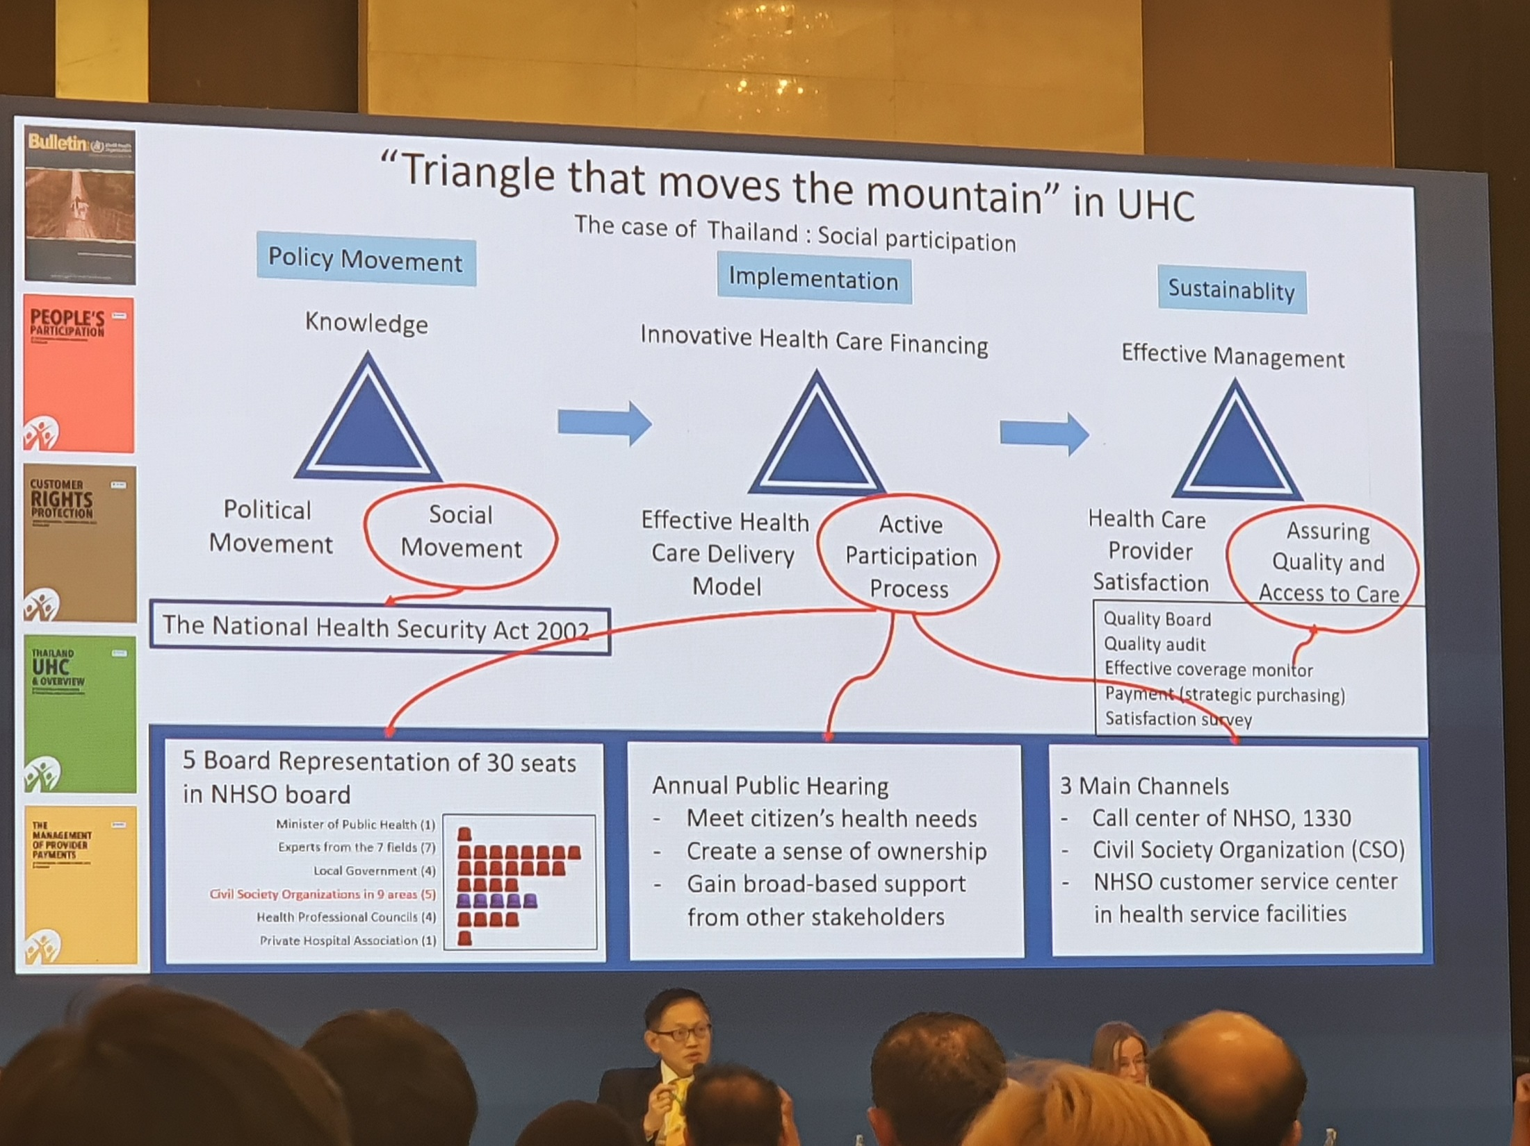
Benchmarking: Thailand’s “triangle that moves the mountain”

Slide 11
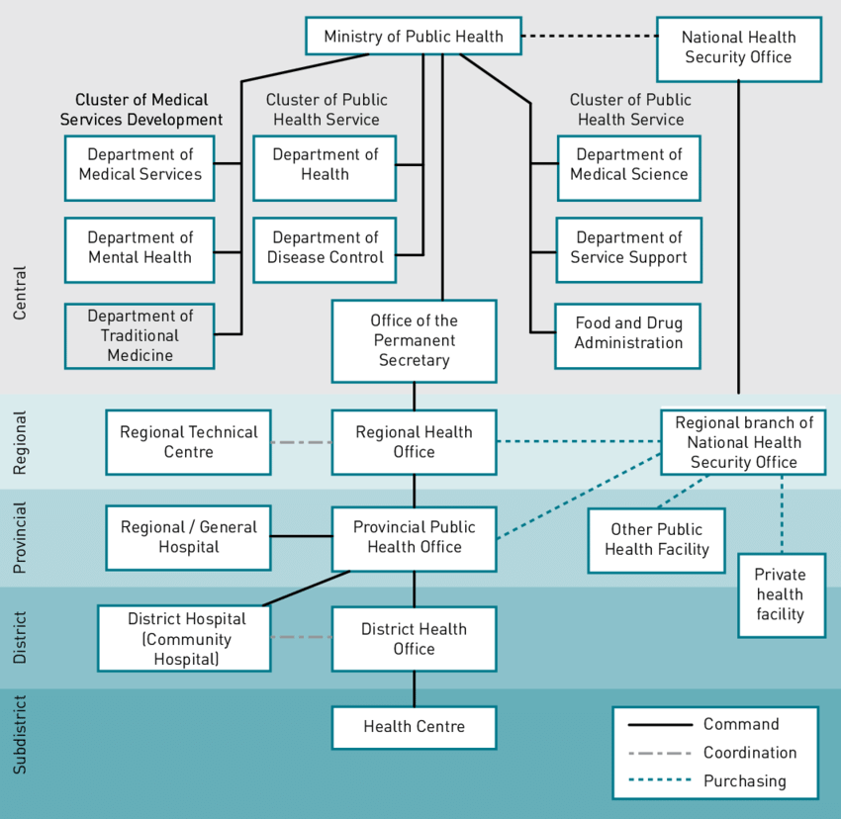

Benchmarking: National Health Security Office (NHSO)
Why “KEEP THE PROMISE”?
When Thailand began the reforms, IMF & World Bank said “don’t” UHC

Slide 12
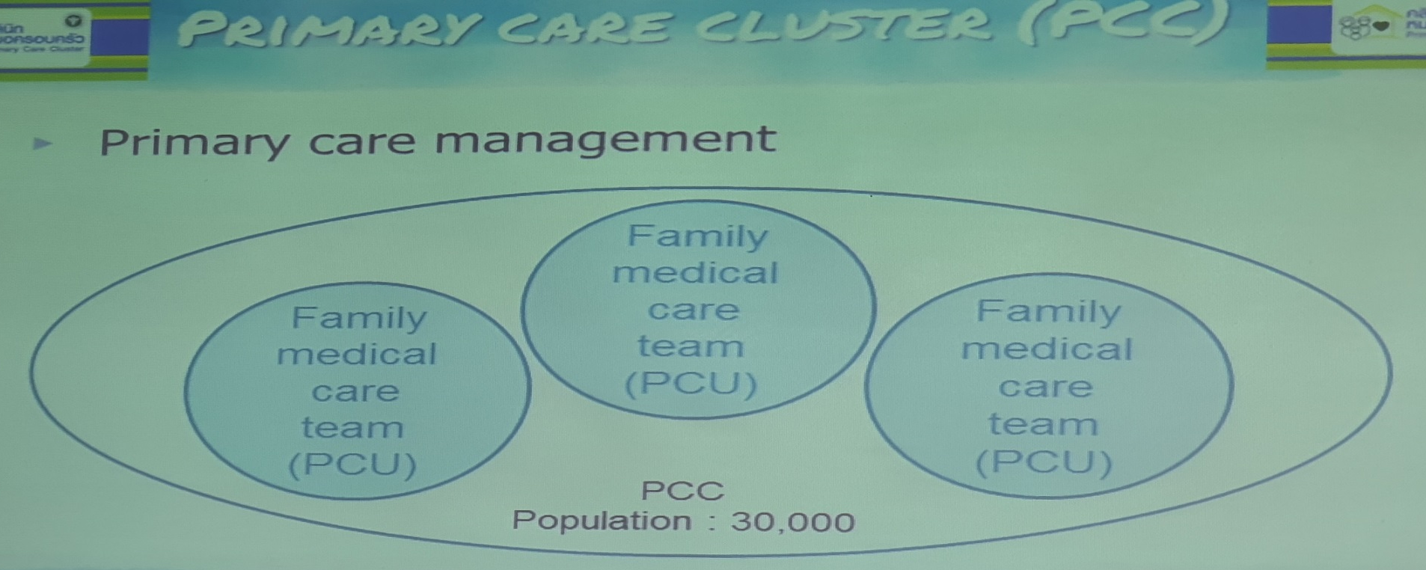
PHC Model: Lowest service unit or point of care = PCU (Primary Care Unit) and these units are within clusters = PCC (Primary Care Clusters)
The PCCs range from 30 000 to 100 000 with Family Medical Care teams at PCU level. The PCCs must be self-sustaining operationally, efficient, equitable and effective UHC agents. However budgets for PCU and PCC are administered at Hospital level.
PCU plays a gatekeeper role and inhibits bypassing registration to higher levels of health facilities in the UCS. The main contractor subsequently assembles a network of primary care units (PCUs) to provide better access to health services to the registered population at the sub-district level.

Slide 13
PHC Model: Thailand Health System:
The District Hospital contracts directly with the various funds and manages the budget administration and support services for the PCUs in the PCCs, as well as the various hospital units. The CHW programme forms a very strong basis for the PHC system. The Primary Health Care Performance Initiative (PHCPI) has 38 core indicators organised in 5 components:
  System - Is PHC prioritized in the country’s health system?
  Inputs - Does the PHC system offer sufficient facilities, health care professionals, and supplies?
  Service Delivery - Are services accessible, effectively organized and managed to deliver high quality care?
  Outputs - Does the PHC system provide the essential services a person needs throughout each phase of life?
  (v) Outcomes - Does the PHC system deliver better outcomes and greater equity?

Slide 14
PHC Model: Thailand Health System
The National Health Security Office (NHSO) allocates the capitation budget to CUPs to cover outpatient service according to registration size with age adjustment.
Once the CUP and PCU receive their capitation budget from the NHSO, they have autonomy to spend the budget, but the hospitals still monitor them as the CUPs are aligned to hospitals in order to align the money to health outputs and outcomes
NHSO allocates a separate inpatient budget to hospitals according to diagnosis- related group (DRG) of hospitalized patients with the global budget (GB) or the available budget ceiling for inpatient expenditure to contain the total cost of the UCS
The Ministry of Public Health (MOPH) remains responsible for delivering public health services on disease prevention and control, and therefore, continues to manage the overall public health budget

Slide 15
Key Lessons: Thailand
Invest in social participation and citizen ownership, as the cornerstone of the health system transformation process
Build a strong PHC system, with a strong health promotion and prevention focus, as the fundamental building block of the healthcare system
Implement strong governance for strategic purchasing of appropriate interventions for population health outcomes
Invest in and build strong health intelligence and policy evidence generation capabilities
Leverage the potential of technology to strengthen the health care system, with a special focus on the PHC system. Excellent integrated IT / electronic infrastructure as evidenced by 100% Completeness of birth registration.
Allocation towards Health depict an investment in “public goods” should be the first priority for the financing system, followed by “equity considerations to reach the most vulnerable” and then “reform strategies towards PHC services”

Slide 16
State of readiness: NHA
System of Health Accounts (Institutional units providing revenue to financing schemes)
Institutional units providing revenues to financing schemes | Percentage
Government | 56,5%
Corporations | 9,4 %
Households | 31,2 %
Rest of the world | 2,4 %
Bilateral donors | 2,4 %
Multilateral donors | 0.01 %
Global Fund | 0.01 %
Other and Unspecified multilateral donors (n.e.c.) | 0 %

Slide 17
State of readiness: HRH
Christo Heunis, Dingie van Rensburg, Gladys Kigozi & Edwin Wouters, 2018
 | Physicians* per 1 000 pop | Nurses & midwives† per 1 000 pop | Per capita spending on health (US$) | % of GDP spend on health | Gini coefficient
High income
Sweden | 3.9 | 11.9 | 6 808 | 11.9 | 27.3
Germany | 3.9 | 11.5 | 5 411 | 11.3 | 30.1
Canada | 2.7 | 9.3 | 5 292 | 10.5 | 33.7
USA | 2.5 | 9.8 | 9 403 | 17.1 | 41.1
Middle income
Argentina | 3.9 | 0.5 | 605 | 4.8 | 42.7
India | 0.7 | 1.7 | 75 | 4.7 | 35.2
South Africa | 0.8 | 5.1 | 570 | 8.8 | 63.4
Low income
Burkina Faso | 0.0 | 0.6 | 35 | 5.0 | 35.3
Afghanistan | 0.2 | 0.1 | 57 | 8.2 | nd‡
Tanzania | 0.0 | 0.4 | 52 | 5.6 | 37.8
World
All | 1.5 | 3.3 | 1 059 | 9.9 | nd
*Includes generalist & specialist medical practitioners. †Includes professional nurses, professional midwives, auxiliary nurses, auxiliary midwives, enrolled nurses, enrolled midwives & other associated personnel, such as dental nurses & primary care nurses. ‡ nd = no data.

Slide 18
State of readiness: Inequalities & Inequities
Christo Heunis, Dingie van Rensburg, Gladys Kigozi & Edwin Wouters, 2018
 | African/Black | Coloured | White | Indian/Asian | Other/Unspeci-fied
Population share | 80.7 | 8.8 | 8.1 | 2.5 | nd
Physicians* | 53.2 | 5.7 | 26.3 | 14.1 | 0.7
Nurses & midwives† | 88.3 | 7.7 | 2.2 | 1.5 | 0.3
Pharmacists | 57.5 | 11.9 | 16.9 | 13.1 | 0.5
Dental practitioners | 50.1 | 10.0 | 20.4 | 19.1 | 0.4
Environmental health practitioners | 92.0 | 2.3 | 2.5 | 2.3 | 1.0
Occupational therapists | 44.7 | 10.9 | 35.4 | 8.6 | 0.4
Physiotherapists | 45.9 | 14.3 | 24.8 | 14.4 | 0.6
Radiographers | 57.8 | 17.3 | 10.7 | 13.8 | 0.4
*Including Medical Practitioners & Specialists. †Including Enrolled, Assistant, Pupil Auxiliary, Professional & Student Nurses.
The HRH are concentrated not around the need but around the money= we need Social Solidarity!!!

Slide 19
The Seemingly Innocent Numbers: Healthcare Services inequalities & inequities (%) (2018)
State of readiness: Inequalities & Inequities
Inequality & inequity in supply of HCWs in SA, p.9
*Stats SA – Statistical Release P0318 – General Household Survey 2017.

Slide 20
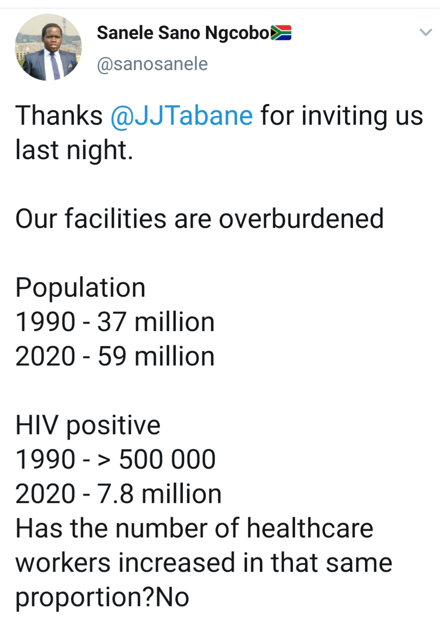
State of readiness: (First Fix the Public Healthcare Delivery Platform)
But what broke it in the first place if indeed its broken?
Is THE Redistribution (R20K vs R4K) under NHI a part of releasing the strain? Social Solidarity / Social Participation = Thailand.

Slide 21
State of readiness: President & Actions from the Social Compact
The Commission adopted the 9 pillars as the context and background for our discussion on the implementation of the NHI
  Pillar 1: Human Resource Operational Plan
  Pillar 2: Supply Chain of Medicines, Medical Products and Equipment
  Pillar 3: Health Infrastructure
  Pillar 4: Private Sector Engagement
  Pillar 5: Improve access + quality and quantity of health services provided
  Pillar 6: Public Sector Financial Management
  Pillar 7: Governance and Leadership
  Pillar 8: Community Engagement
  Pillar 9: Robust Health Information Systems

Slide 22
Key Issues: Services
Public sector will continue to be backbone of health service delivery with community accountability mechanisms as part of strategic drive
Delegate management authority to individual Structures: public hospitals / DHMOs / CUPs
Provincial Departments of Health delegated management agencies
Focus must be on PHC services: must be first point of contact and follow the referral route, except in emergencies (PHC gatekeeping). What happens otherwise?
International Experience shows OOPs increase under UHC meaning …..

Slide 23
Key Issues: Funding
Current allocation on Health. 3 additional options as listed in the Bill (Treasury to release actual financing mechanism)
So the issue especially wrt UHC is not so much about more money but the distributivity of that which is available based on need!!!
No country has an infinite pool of resources so a sequenced / phased in approach is followed based on available resources. Thailand took 27 years in their roll-out.
“NHI will cost as much as the country can afford” – Depending on your pocket, you choose what items you put in your (shopping) basket – Dr A. Pillay (Acting DG)

Slide 24
Key Issues: Private Providers
Bill says only from 2022
Focus initially on PHC level:
  GPs where doctor services needed
  Wide range of other PHC providers – optometry, dental, rehabilitation, mental health
Key issue is distribution of private providers, concentrated in urban areas
  ‘Selective contracting’
  Equitable allocation of financial resources

Slide 25
Key Issues: Accreditation
Service Providers must be accredited and registered
    Accredited for quality – certified by OHSC
    Registration – with NHIF (the sole purchaser)
‘Selective’ contracting according to population needs
Provide specified range of services and appropriate staffing
Adhere to treatment guidelines and referral pathway
Adhere to prescribed payment rates (NHI Basket)
Submission of information – patient ID, diagnosis, treatment, referral, etc.
Contract reviewed every 5 years (Thailand = 3 years)

Slide 26
Key Issues: Poor Governance & Accountability / SOEs
NHIF will be a Section 3(A) Public Entity. These entities have on the average actually done well but …..
  Lessons ought to be learnt from what is in the public domain
  Governance issues and the power of the Minister …….
  The state footprint ought to be more visible ……
Avoid a complete monopoly:
  Promote Internal and External competition
  Composition and role of CUPs / DHMOs vs Provinces (SCM)
  The Future role of Medical Schemes
  Purchasing of Services and Provider Payment Mechanisms
  Envisaged mix of public and private service providers = Hybrid models

Slide 27
Key Issues: Skills Flight
https://youtu.be/-ywP8wjfOx4 - “The NHS: A Difficult Beginning”. NHS’s most vicious and vocal opponents were the very people its existence depended on - surgeons, nurses, dentists and Britain's doctors. About 70% only signed up 6 weeks before its 5th July 1948 roll-out
https://www.tandfonline.com/doi/full/10.4161/23288604.2014.991211 - Countries that embarked UHC, did so at a point when their economies where at a low ebb. Trials, tears and tribulations are an integral part of the journey
http://worldpopulationreview.com/countries/countries-with-universal-healthcare/ - shows 112 Countries that have gone the UHC route???

Slide 28
Key Issues
What are key issues to ensure certification and accreditation of health facilities (i.e. Ideal Clinic Programme and Ideal Hospital Programme with OSHC requirements) and those that are unable to meet the set criteria?
What is the role of “everybody else” to ensure that NHI happens from today towards 2025 and beyond especially for District office and sub-district offices? How should or how will this happen? “Integrated District Model”???
What other stakeholders will enhance the implementation of NHI in the next five years? If other stakeholders are mentioned, how and why should they be involved and which roles will they play in realising NHI?

Slide 29
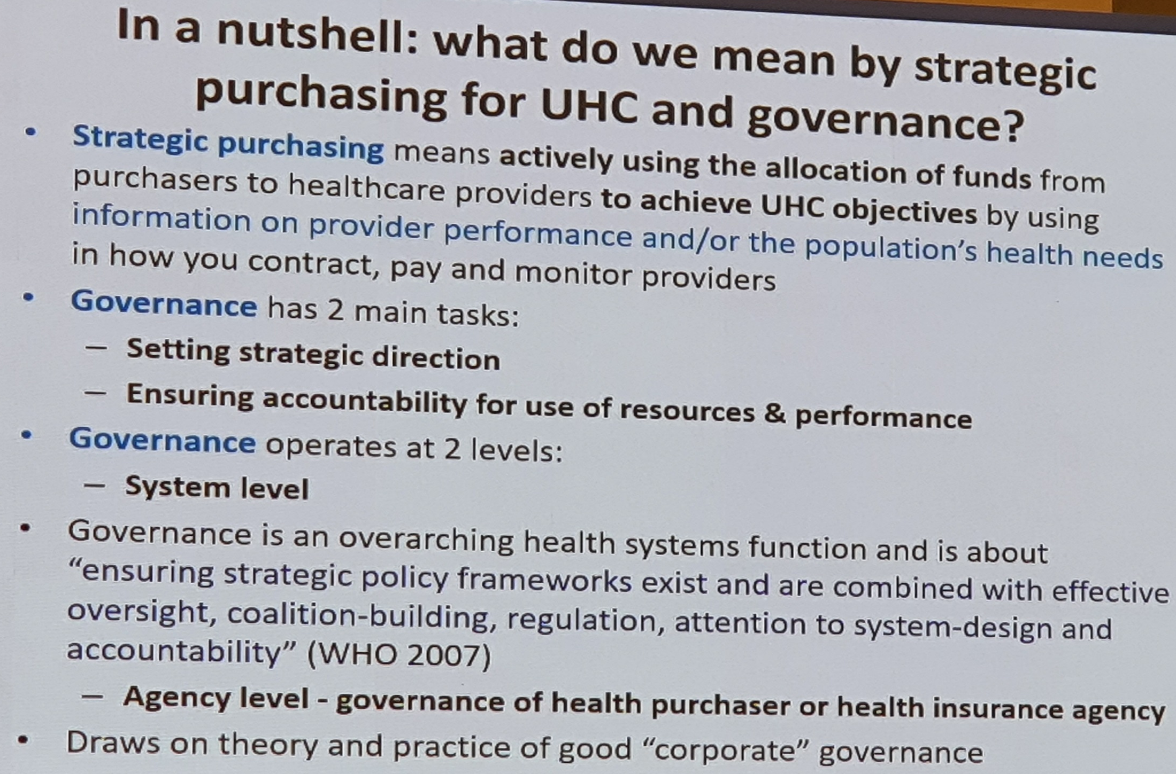
Thailand Health System: Strategic Purchasing
Key Issues: Strategic Purchasing

Slide 30
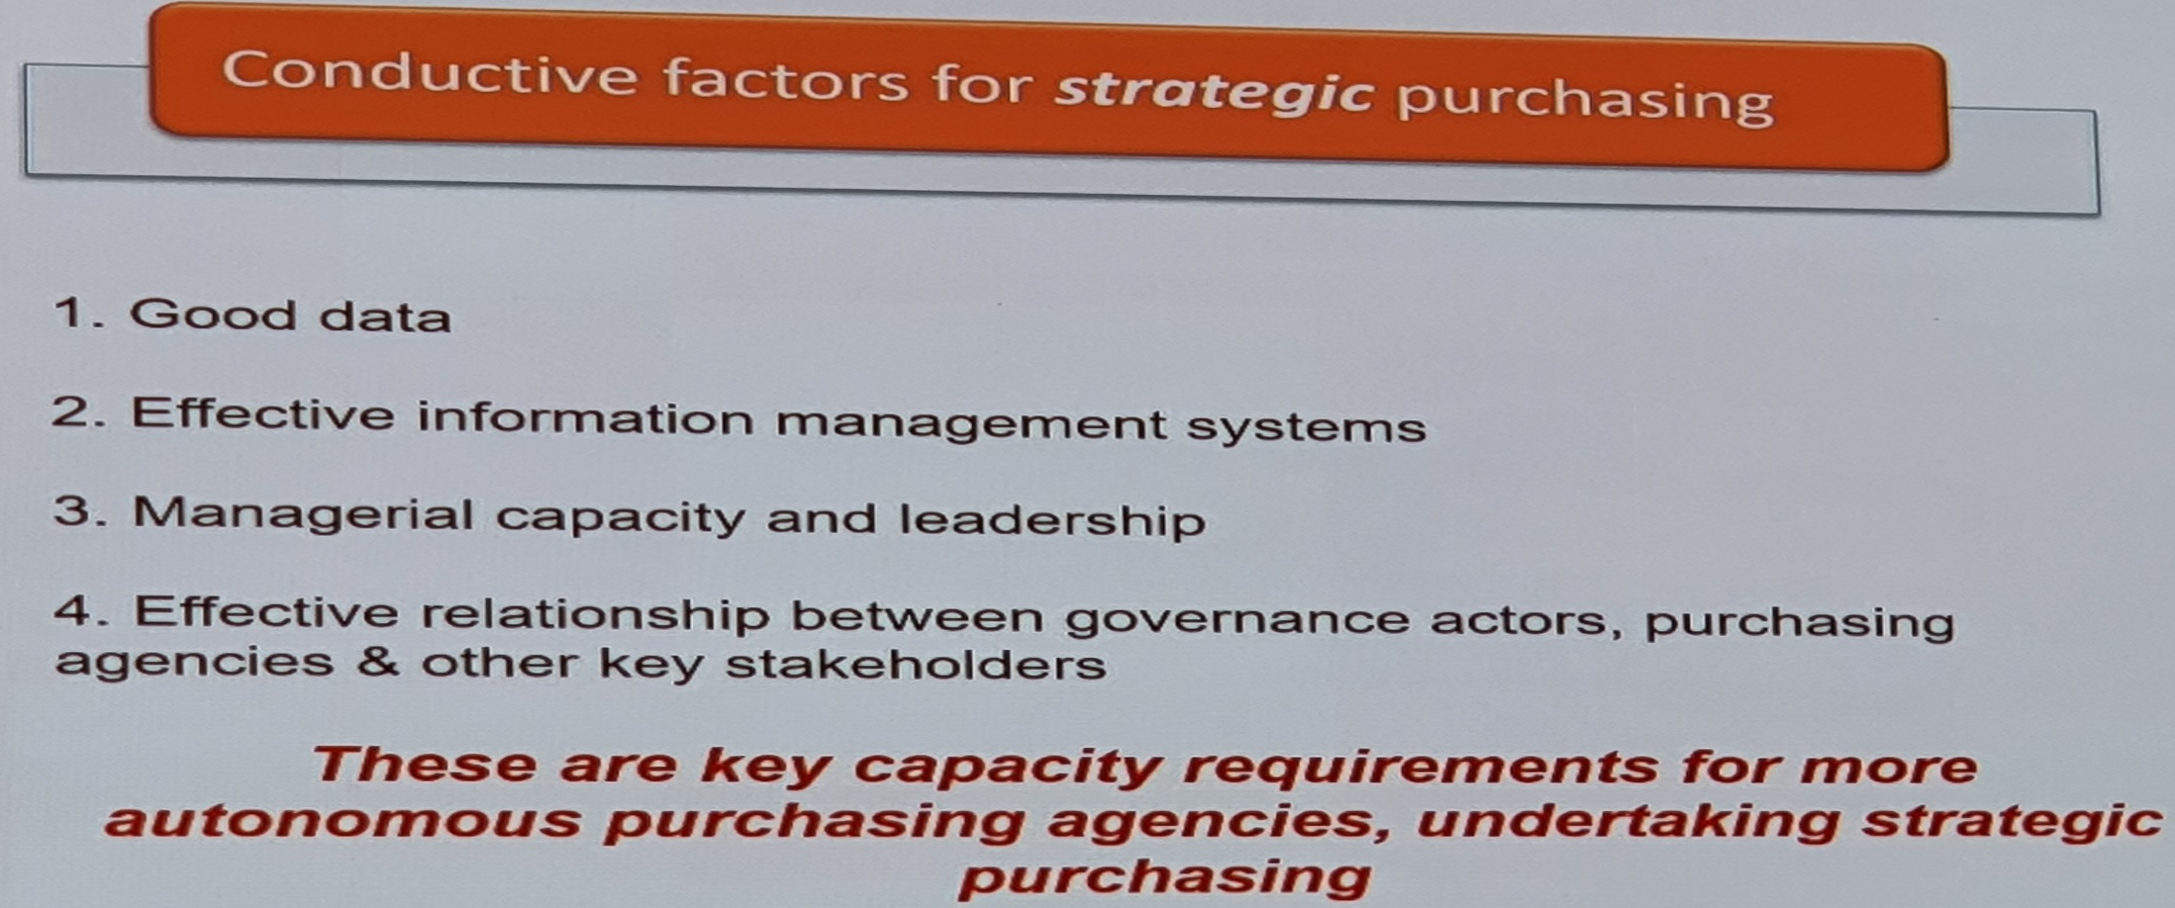
Thailand Health System: Strategic Purchasing
Key Issues: Strategic Purchasing
Change in the demand for health care services as well as changes in the supply of health care services must at all times be tracked / measured and inferences made on the performance of the system. In order to use the data to evaluate the quality of the PHC system, detailed health profiles of individuals on the registration list, available to main contractors, became essential.
This resonates with strategic profiling which is used for strategic purchasing. Capitations are reconciled monthly in Thailand.

Slide 31
Conclusion
NHI is for everyone
Universal Health Coverage can be achieved if current resources are better utilised
New models for service delivery will be required
NHI will provide everyone with financial protection from the costs of health care
NHI will purchase health services from both public and private health care providers
New methods of paying for services need to be tested and implemented
People who wish to purchase care not provided by NHI will be able to do so
Institutional and administrative changes will evolve – not an event
All stakeholders may make inputs - changes will be influenced by learning
Full NHIF Office will be implemented systematically once the Bill is enacted

Slide 32
“If we wait for the moment when everything, absolutely
everything is ready, we shall never begin”
– Ivan Turgenev
Conclusion … PMAC 2020 conference speakers

Slide 33
“If we wait for the moment when everything, absolutely
everything is ready, we shall never begin”
– Ivan Turgenev
“If we wait for the moment when everything, absolutely everything, is ready we shall never begin” – Ivan Turgenev
THANK YOU

