Slide 1




Iron Deficiency Anaemia in South African Infants and Children: The hidden costs
What can we do?
Claire Tolmay
BSc (Physiology & Microbiology), BSc(Hons) Physiology, MSc Physiology, PGPN, MSc (Psychology)
For Healthcare Professionals Only

Slide 2
INTRODUCTION
IMPORTANT NOTICE.
A well-balanced diet, both during pregnancy and after delivery, helps sustain an adequate supply of breastmilk. Exclusive breastfeeding is recommended during the first 6 months of life followed by the introduction of adequate nutritious complementary foods, along with sustained breastfeeding up to two years of age and beyond.
* See: International Code of Marketing of Breastmilk Substitutes, adopted by the World Health Assembly in Resolution WHA 34.22, May 1981.
Breastfeeding is best for babies.

Slide 3
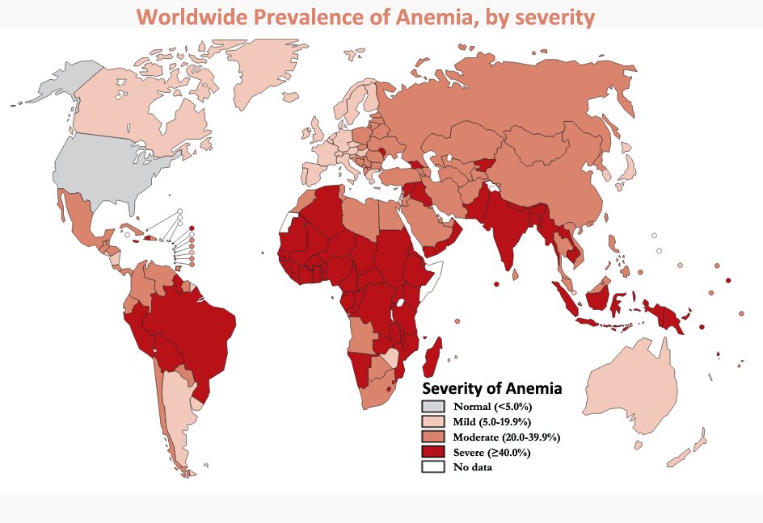
At least half of the anaemia worldwide is directly due to dietary iron-deficiency²
293 million children <5 years¹
Image sourced from: https://www.k4health.org/sites/default/files/anemia-map_updated.png
Balarajan et al. Anaemia in low and middle-income countries. Lancet. 2011. 378: 2123- 2135.
Jacobson. Prevention and treatment of iron deficiency in children. CME. May 2008. 26(5); 242-244
For Healthcare Professionals Only
Notes:
Iron deficiency anemia (IDA) affects one-third of the world's population, and $50 billion in GDP is lost annually due to iron deficiency anemia, according to the World Bank. About 47% of children under 5 years of age (293 million) have anaemia. At least half of the anaemia worldwide is directly due to dietary iron-deficiency.

Slide 4
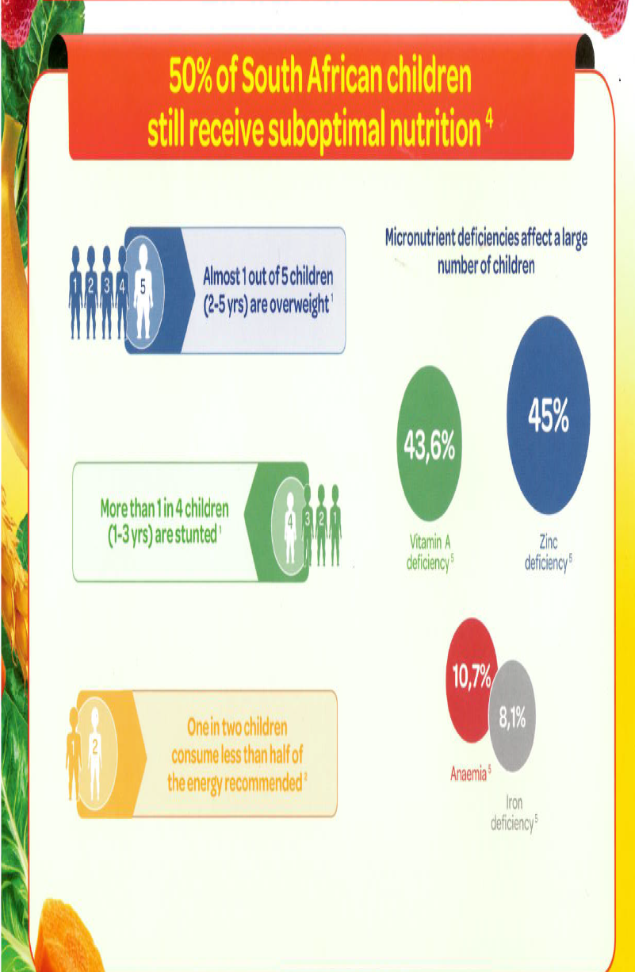
1. 1,000 Days. [online] [cited 2014 Jan 27]. Available from: URL: http://www.thousanddays.org/about/.
2. World Health Organization. Infant and young child feeding. Model Chapter for textbooks for medical
students and allied health professionals.[online] [cited 2014 Jan 27]. Available from: URL: http://www.who.int/nutrition/.../infantfeeding/.../en/index.html.
3. Fleischer Michaelsen K, Weaver L, Branca F, Robertson A. Feeding and Nutrition of Infants and Young Children. Guidelines for the WHO European Region, with emphasis on the former Soviet countries. WHO Regional Publications, European series, No. 87. [online] [cited 2014 Jan 27]. Available from: URL: http://www.euro.who.int/_data/assets/pdf_file/.../WS_115_2000FE.pdf.
4. Labadarios D, Swart R, Maunder EMW, et al. Executive summary of the National Food Consumption Survey Fortification
Baseline (NFCS-FB-I) South Africa, 2005. S Afr J Clin Nutr 2008;21(3)(Suppl 2):245-300.
5. South African National Health And Nutrition Examination Survey (SANHANES-1) presentation. [online] [cited 2014 Jan 27]. Available from: URL:http://www.hsrc.ac.za/uploads/pageContent/3896/SANHANES-1%20Report%20%20Launch%20Presentation%20%206%20August%202013%20FINAL.pdf.
For Healthcare Professionals Only
Notes:
So if Nutrition is so important what are the issue in South Africa? In South Africa we still face the triple-burden of malnutrition with about 11% of infants suffering from iron deficiency.

Slide 5
Other IDA prevalence studies in South Africa
33% of children between 2 to 5 years in rural areas in South Africa are iron-deficient¹
Another study found that 43.2% of rural children aged 4-24 months were iron deficient¹
A study in Western Cape disadvantaged communities showed 32% of coloured infants and 46% of black infants had iron-deficiency anaemia (IDA)¹
52% of HIV-infected children in SA are iron-depleted, with 18% showing symptoms of IDA¹
1. Jacobson. Prevention and treatment of iron deficiency in children. CME. May 2008. 26(5); 242-244

Slide 6
Short-term risks associated with IDA
Reduced performance^{1,2}
Diminished attention^{1,2}
Memory loss¹
Learning disability¹
Growth retardation ^{1,2}
Delays in development can vary from apathy to extreme listlessness¹
Compromised immune systems and increased infections^{1,2}
Cognitive and motor deficits²
Jacobson. Prevention and treatment of iron deficiency in children. CME. May 2008. 26(5); 242-244
Hlatswayo et al. The effects of iron-deficiency and anaemia on primary school learners’ scholastic performance. SAJCH. July 2016. 10 (2): 111-115

Slide 7
Long-term risks associated with IDA
Preschool school children with IDA display wary/inhibited behavioural patterns which may lead to internalizing problems (e.g. anxiety, depression) later in life¹
Preschool school children with IDA show lower activity and lower positive affect when compared to non-IDA preschoolers. This may lead to poorer behavioural and developmental problems later in life (e.g. ADHD).¹
Primary school learners with IDA in South Africa have less scholastic performance when compared to non-IDA learners. ²
  This may lead to higher risks for school failure, drop-out and poor productivity in adulthood
Adult functioning after having IDA in childhood has long-term effects:³
  Less likelihood of not completing high school (58.1% IDA vs 19% in iron-sufficient group)
  Less likelihood of not pursuing further education/training (76.1% IDA vs 31.5% in iron-sufficient group)
  More adults were single! (83.9% IDA vs 23.7% in iron-sufficient group)
  Poorer emotional health, more negative emotions and more feelings of detachment/dissociation
Lozoff et al. Preschool-aged children with iron-deficiency anemia show altered affect and behavior. J Nutr. 2007 March. 137(3): 683-689
Hlatswayo et al. The effects of iron-deficiency and anaemia on primary school learners’ scholastic performance. SAJCH. July 2016. 10 (2): 111-115
Lozoff eta l. Fucntional significance of early-life iron defciciency: Outcome s at 25 years. J Pediatr. 2013 November. 163(5)

Slide 8
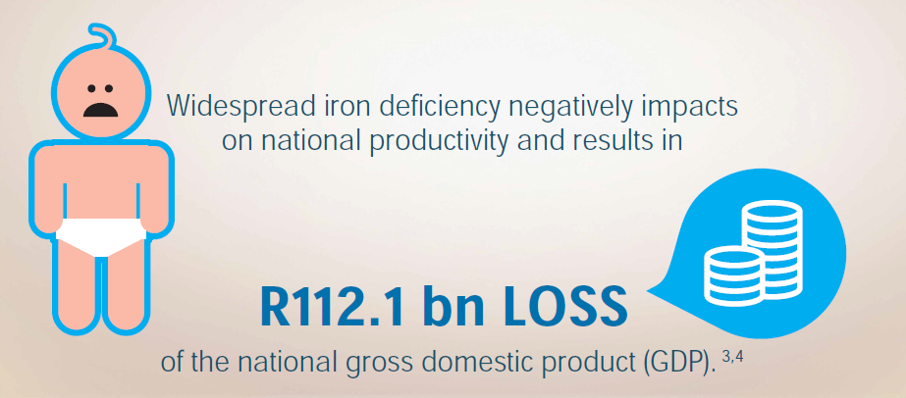
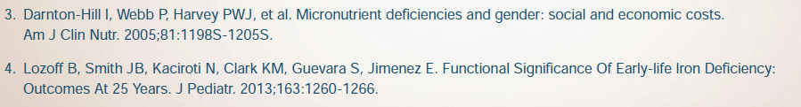
The cost of iron deficiency

Slide 9
Who is at risk?
Preterm or low-birth-weight infants.¹
Children who are strict vegetarians.¹
Children suffering from a chronic disease.¹
Infants of iron-deficient mothers.¹
Infants who are introduced to solids inappropriately.¹
Infants who are introduced to solids too late.¹
Infants and children who are failing to thrive¹
Male infants/children show higher risk compared to their female counterparts ²
Birth order above the second order³
1. Jacobson. Prevention and treatment of iron deficiency in children. CME. May 2008. 26(5); 242-244
2. Thejpal. Iron deficiency in children. SAMJ. July 2015. 105 (7).
3. Elalfy et al. Pattern of milk feeding and family size as risk factors for iron-deficiency anemia among poor Egyptian infants 6 to 24 months old. Nutrition Research. 2012. 32: 93-99.
Notes:
Preterm or low-birth-weight infants. The amount of stored iron an infant is born with depends on its size. On average, the iron store in a full-term infant meets the infant’s iron requirement until 4 - 6 months. Low-birth-weight infants are at risk of early ID because their iron store is lower.
• Children who are strict vegetarians. All dietary iron in a vegetarian diet is from non-haem sources and the intake of phosphates, oxalates and phytates, known to reduce iron absorption, is high.
Children suffering from a chronic disease.
Infants of iron-deficient mothers. ID during pregnancy is related to maternal and fetal mortality and premature delivery. It has been found that infants of mothers with moderate to severe anaemia at 37 - 41 weeks of pregnancy had significantly lower cord serum ferritin levels and hence poor iron stores at birth.
Infants who are weaned inappropriately.
Infants who are weaned late.
Infants and children who are failing to thrive

Slide 10
Common causes of iron deficiency anaemia in children
Early introduction and excessive use of cow’s milk. Cow’s milk should only be introduced at 1 year and approximately 500 ml per day.¹
Excessive intake of juice – leaving no space for adequate food intake.¹
Predominant bottle or breastfeeding beyond 6 months of age– leaving no space for adequate food intake¹
Late introduction of solid foods with low iron content.¹
Sensitivity to cow’s milk protein can result in gastrointestinal occult blood loss.¹
Parasitic infection can cause gastrointestinal blood loss. (mainly hookworm infection)^{1.2}
Gastrointestinal disorders such as peptic ulcer and inflammatory bowel disease.¹
Often related to poor appetites- so called “picky eaters” ¹
Consuming cow’s milk in the first year of life³
1. Jacobson. Prevention and treatment of iron deficiency in children. CME. May 2008. 26(5); 242-244
2. Thejpal. Iron deficiency in children. SAMJ. July 2015. 105 (7).
3. Elalfy et al. Pattern of milk feeding and family size as risk factors for iron-deficiency anemia among poor Egyptian infants 6 to 24 months old. Nutrition Research. 2012. 32: 93-99.

Slide 11
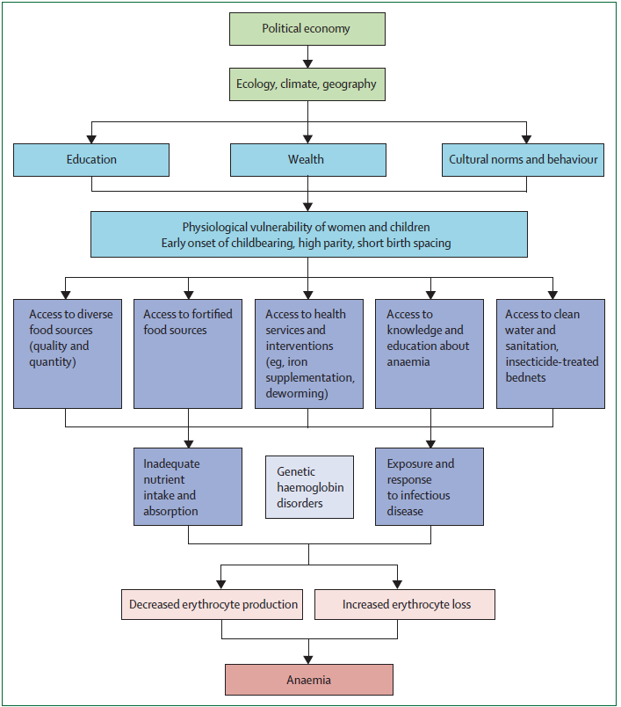
Balarajan et al. Anaemia in low and middle-income countries. Lancet. 2011. 378: 2123- 2135.
Notes:
In summary- it is the nutrient intake that is a large determinant of why we see the prevalence of IDA in infants and children in SA> and thus by only dealing with this cause could we possibly deal with how to manage the possible consequences from IDA.

Slide 12
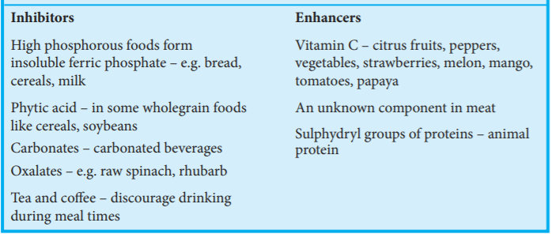
Iron Absorption
Three factors determine the amount of iron absorbed from the diet:¹
The amount of dietary iron ingested – the most common reason for ID
The iron status of the child
The bio-availablity of iron consumed
1. Jacobson. Prevention and treatment of iron deficiency in children. CME. May 2008. 26(5); 242-244
Notes:
Foods containing low bio-availability iron (non-haem) include plant protein sources (e.g. maize-meal and bread) and vegetables. The bio-availability of iron from these foods is further diminished when consumed with tea or coffee at meal times. Vitamin C (ascorbic acid) is a potent enhancer of nonhaem iron. When eating foods containing non-haem iron, a vitamin C-containing food should be included in the meal.

Slide 13
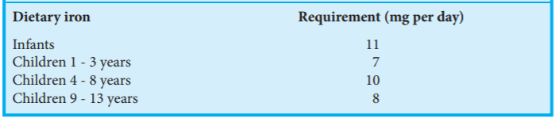
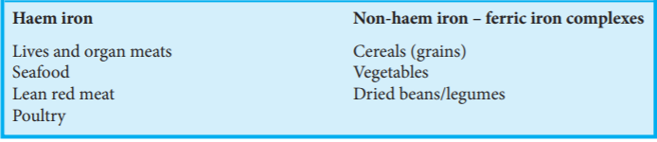
Dietary iron requirements and sources of iron in the diet
Dietary Iron Requirements
18
1mg/kg of iron per day to a maximum of 15mg
Dietary Iron Sources
1. Jacobson. Prevention and treatment of iron deficiency in children. CME. May 2008. 26(5); 242-244

Slide 14
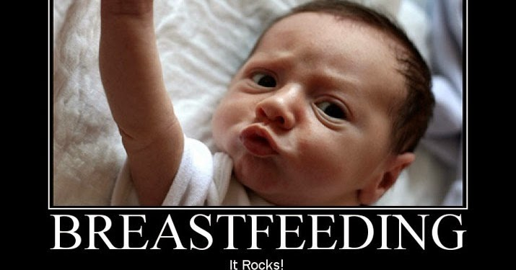
Prevention is better than cure
Infants should be given breastmilk or iron-fortified infant formula. About 50% of iron in breastmilk is absorbed compared with about 10% of iron in ordinary cow’s milk.¹
Low-iron formula, iron-free formula or unfortified goat’s milk should NOT be used.¹
1. Jacobson. Prevention and treatment of iron deficiency in children. CME. May 2008. 26(5); 242-244

Slide 15
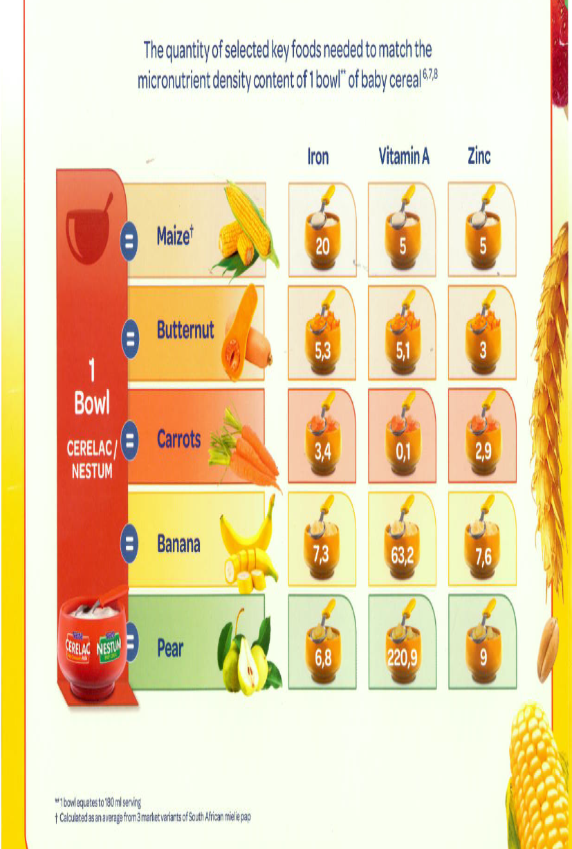
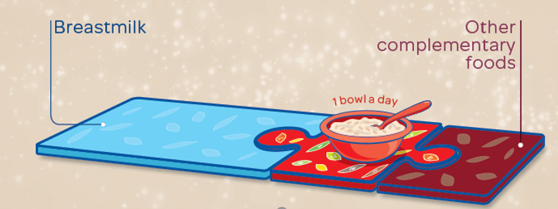
Prevention is better than cure
Infants need an additional source of iron (apart from breastmilk or fortified formula) by 6 months (approximately 1 mg/kg/day).
Iron-fortified cereals are a good source of iron for initial introduction of iron-containing food. An average of 2 servings (15 g per serving) of dry cereal is needed to meet their daily requirement.¹
1 Bowl
Infant Cereal
Infant Cereal
1. Jacobson. Prevention and treatment of iron deficiency in children. CME. May 2008. 26(5); 242-244

Slide 16
Prevention is better than cure
If an infant is unable to consume sufficient iron from dietary sources after 6 months, elemental iron (1 mg/kg/day) can be used.¹
Low-birth-weight infants should receive 2 - 4 mg/kg/day. The amount of supplementation depends on the weight of the infant at birth and the type of feed that is being used.¹
Dietary Iron Requirements
18
1. Jacobson. Prevention and treatment of iron deficiency in children. CME. May 2008. 26(5); 242-244

Slide 17

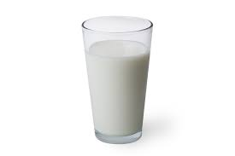
Prevention is better than cure
Do not introduce juice – encourage water. If juice is necessary, allow only 1 cup (250 ml) per day of diluted juice.¹
Give appropriate amounts of milk (500 - 700 ml per day) after 1 year. Excessive intake of milk should be discouraged.¹
500-700ml
1. Jacobson. Prevention and treatment of iron deficiency in children. CME. May 2008. 26(5); 242-244

Slide 18
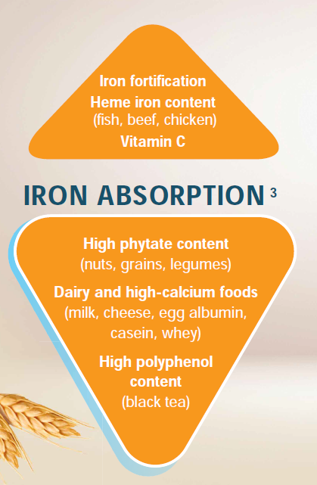
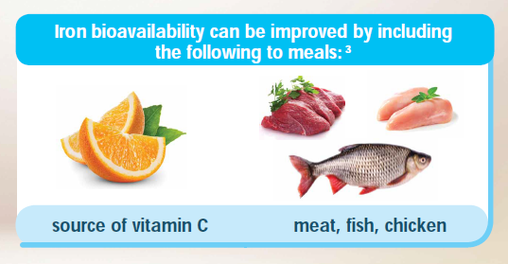
Prevention is better than cure
Introduce haem sources of iron at 6 months (strained meat). The iron in haem iron sources of foods is absorbed about 2 - 3 times more efficiently than nonhaem iron food sources.¹
Combine non-haem sources of iron with vitamin C-rich foods at meal times.¹
1. Jacobson. Prevention and treatment of iron deficiency in children. CME. May 2008. 26(5); 242-244

Slide 19
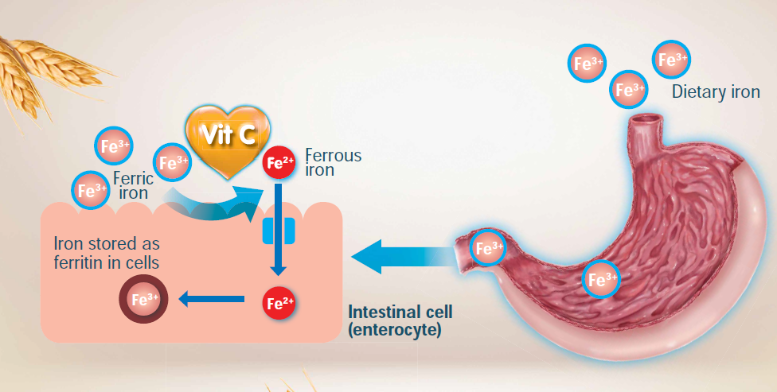
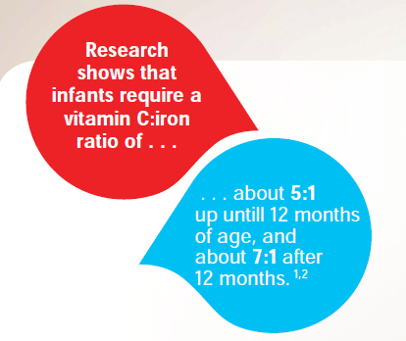
Prevention is better than cure!
Notes:
Explain how vitamin C is necessary to convert Ferric Iron to Ferrous iron so that it can be absorbed, stored and utilised in the body.

Slide 20
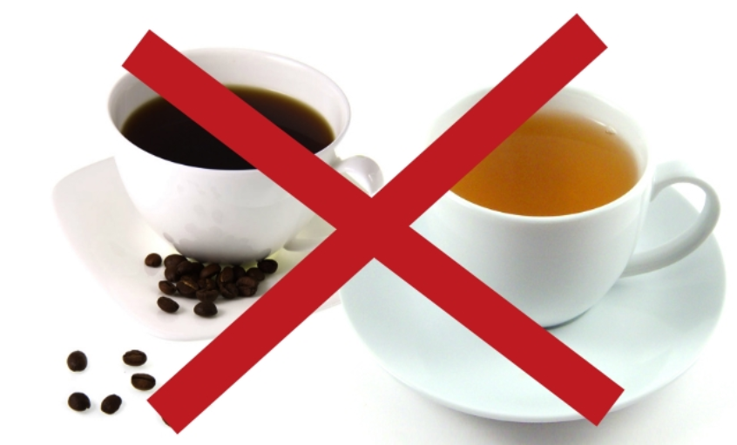
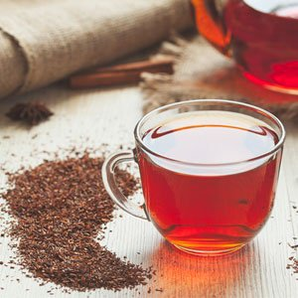
Prevention is better than cure
Tea and coffee: only rooibos tea should be given (no regular tea or coffee) – about 1 cup (250 ml) per day after 2 years of age.¹
1 cup (250ml per day) after 2 years
1. Jacobson. Prevention and treatment of iron deficiency in children. CME. May 2008. 26(5); 242-244

Slide 21
Prevention is better than cure
When a child is able to chew and swallow well, animal protein (red meat, poultry or fish) should be eaten daily.
If they are not able to include this in their diet and they do not eat iron-fortified cereals, a daily iron supplement should be considered (based on the NRV).¹
Dietary Iron Requirements
18
NRV= Nutrient Reference Value
1. Jacobson. Prevention and treatment of iron deficiency in children. CME. May 2008. 26(5); 242-244

Slide 22
Food Fortification with Iron: What source is best?
It is not just the amount that determines bioavailability but also the quality of the source of iron used!¹
World Health Organisation (WHO) recommends fortifying foods with the following iron compounds:¹
  Ferrous Sulphate, Ferrous Fumarate, Ferric Pyrophosphate
  Many cereal foods are, however, fortified with low cost elemental iron powders which are not recommended by WHO.
Multi-micronutrient fortified milk and cereal products have been shown to be an effective option to reduce anaemia of children up to 3 years of age in developing countries²
Hurrel et al. Iron bioavailability and dietary reference values. Am J Clin Nutr. 2010. 91(suppl): 1461S- 1467S.
Eichler et al. Effects of micronutrient fortified milk and cereal food for infants and children: a systematic review. BMC Public Health. 2012. 12: 506.
Notes:
Bioavailabilty varies with the source of iron used. Many cereal foods are, however, fortified with low cost elemental iron powders which are not recommended by WHO. SO keep an eye out for what is used!

Slide 23
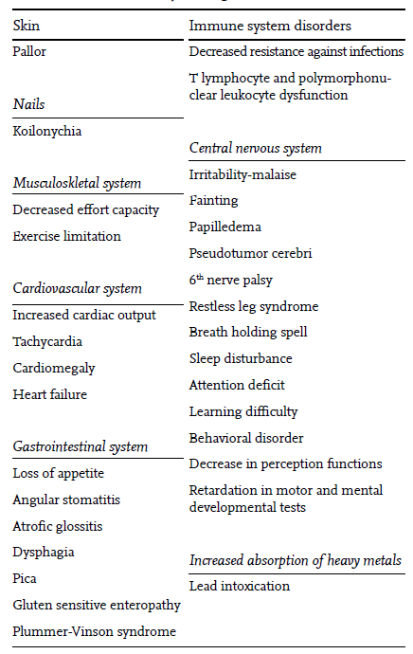
Clinical findings associated with IDA in infants and children
Ozdeimer. Iron deficiency anemia from diagnosis to treatment in children. Turkish Archives of Pediatrics. 2015. 50: 11-19.

Slide 24
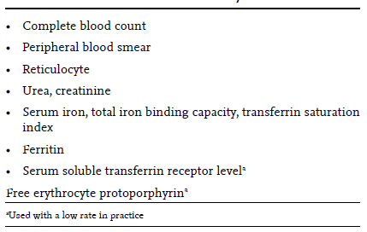
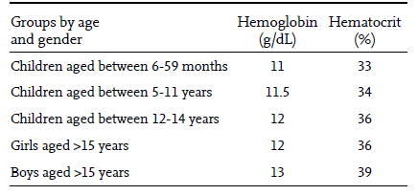
Investigations that can be ordered when IDA is considered
Ozdeimer. Iron deficiency anemia from diagnosis to treatment in children. Turkish Archives of Pediatrics. 2015. 50: 11-19.
Notes:
Describe the test sthat may be ordered but focus on the bloods and the hemoglobin and hematocrit levels that must be considered. Go to next slide for further information.

Slide 25
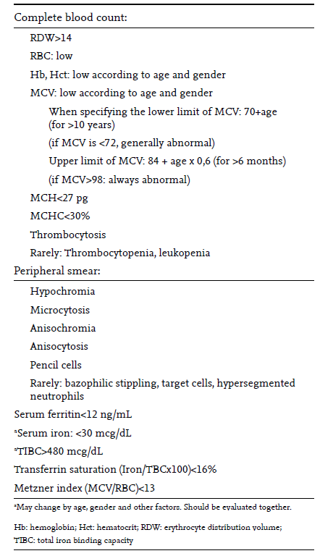
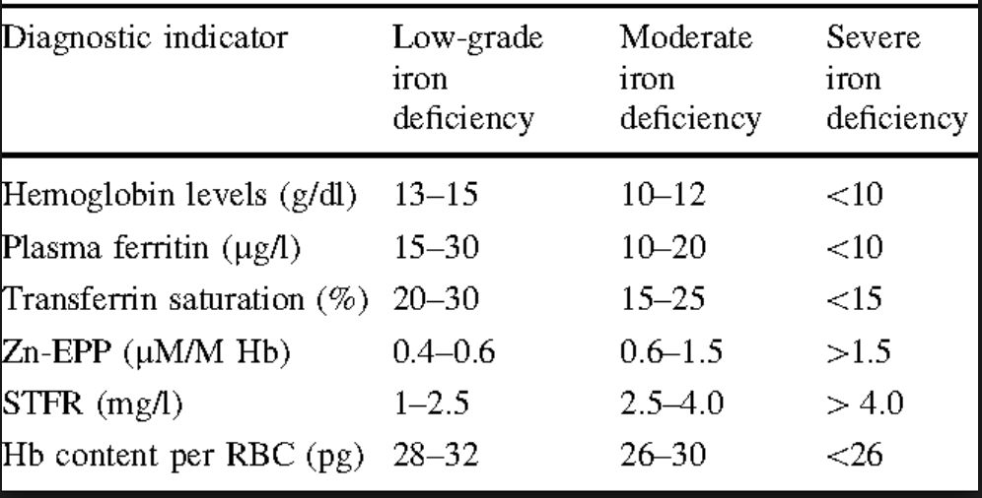
Laboratory findings in iron deficiency
Ozdeimer. Iron deficiency anemia from diagnosis to treatment in children. Turkish Archives of Pediatrics. 2015. 50: 11-19.

Slide 26
Management of IDA
Management of IDA includes:¹
  Improved dietary intake (as per previous recommendations)
  Gastrointestinal examination
  Oral supplementation- if necessary.
Iron Supplementation recommendations:¹
  To enhance absorption, iron supplementation should be taken between meals and at different times to other vitamin and mineral supplementation.
    Premature infants less than 1.5 kg: 2 - 3 mg per kg. Supplementation should occur once the child is stable and without infection. The supplemental dose is 2 - 3 mg per kg up to a maximum of 15 mg per day
    Infants 5 -10 kg: 25 mg per day.
    Children 2 - 6 years: 50 mg per day or 3 - 5 mg/kg/day.
    Children 6 - 12 years: 50 -100 mg per day or 3 - 5 mg/kg/day.
1. Jacobson. Prevention and treatment of iron deficiency in children. CME. May 2008. 26(5); 242-244
Notes:
This should continue until the end of the first year. However, if infants drink sufficient quantities of appropriate formula, this may not be necessary. Excess iron is associated with risk of bacterial infection and haemolysis if vitamin E is inadequate.

Slide 27
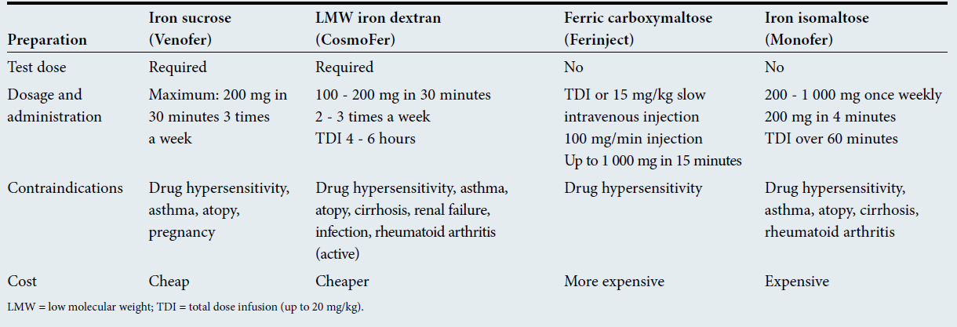
Indications for Parenteral Iron
Refractory IDA requires exclusion of bowel pathology (coeliac disease, gastritis, Helicobacter pylori infection, bleeding) and often an endoscopic examination is indicated.¹
True malabsorption is rare.¹
Indications for PN Iron: Oral iron intolerance, poor compliance, kidney disease with erythropoietin, bowel disease and ongoing blood.¹
1. Thejpal. Iron deficiency in children. SAMJ. July 2015. 105(7)
Notes:
True malabsorption is rare, but rapid transit times and failure to absorb enteric-coated tablets may occur.Various intravenous preparations are available. The more expensive preparations enable total dose infusions within an hour.

Slide 28
Summary
Iron deficiency anaemia is the most common nutritional disorder worldwide.
The most common reason for iron deficiency is inadequate dietary iron intake.
Infants with low birth weight and with iron-deficient mothers are at high risk of developing IDA.
Infants who are introduced to inappropriate solid foods have high risk of developing IDA.
IDA in children leads to reduced cognitive, behavioural and growth performance.
Correct eating practices and nutrition in infancy can prevent IDA.
Early introduction and excessive use of cow’s milk is a common cause of IDA in young children.
Vitamin C is an important enhancer of iron absorption

Slide 29


For Healthcare Professionals Only
Notes:
Thank you! Let us ensure our children start strong so that they can stay strong by ensuring the correct nutrition in the first 100o days!

