Slide 1
HIV 2020:
Time for change
overall_1_132245246515670924 columns_1_132245246515670924
Dr Kay Mahomed
Netcare Garden City Clinic
Mayfair West
083 294 7007
011 495 5243

Slide 2
Goals of Treatment
overall_1_131961098581929933 columns_1_131961098581929933
ART is the cornerstone of HIV management
Maximal suppression of viral replication (undetectable VL)
Restoration of immune function (CD4 cell count)
Reduction in HIV related morbidity and mortality
Preservation of future therapeutic options
Improvement in quality of life
ART is lifelong, 100% adherence is essential
New drugs have lesser s/e and toxicity profile
Greater selection of drugs to fit into patient’s profile
FDC and daily dosing

Slide 3
What is expected of an Ideal ART regimen
overall_1_132285909747752592 columns_1_132285909747752592 10_1_132285910294151048
Co-administration with other medications especially TB t/t
Specific populations: women- children, adolescent, aging
Efficacy
Safety, tolerability (minimal ADEs)
Minimal Drug-drug interaction
Affordability and global access
Potent enough to bring down VL to undetectable level ASAP
Pill Burdon : STR or minimal number of pill
No or minimal food restrictions
Suitable dosage convenience
Cheaper, acceptable and tolerable ART is essential to increase retention in care and viral suppression, to achieve the 90-90-90

Slide 4
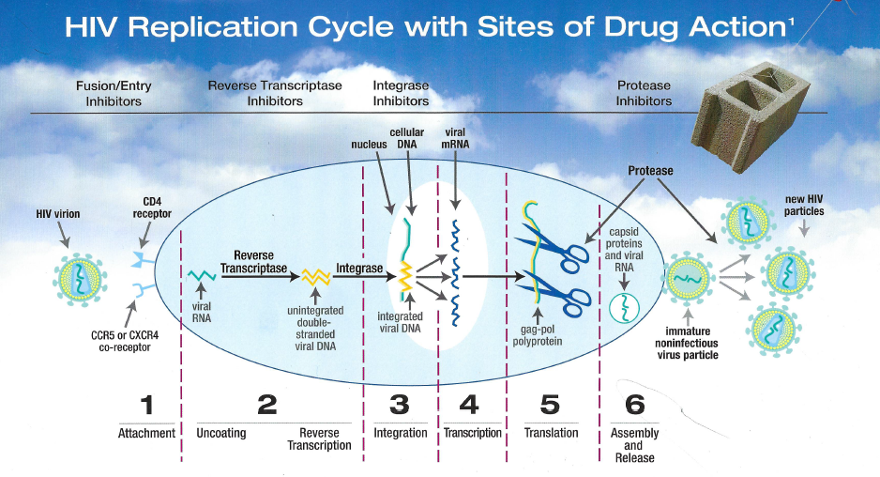
overall_1_131944393982961746 columns_1_131944393982961746

Slide 5
Therapeutic Strategies
overall_1_131961098581929933 columns_1_131961098581929933
Always use three agents.
2 NRTIs + 1 NNRTI.
2 NRTIs + 1 PI + low dose RTV
2 NRTIs + 1 Integrase Inhibitor
2 NRTIs + 1 Integrase Inhibitor + 1 PI + low dose RTV
1 NNRTIs + 1 Integrase Inhibitor + 1 PI + low dose RTV
Triple therapy has a pronounced and prolonged Impact on viral load.
Can do a one drug switch for side effects. Need to do a regimen
change if there is no viral suppression.

Slide 6
ARVs
overall_1_131961098581929933 columns_1_131961098581929933
Nucleoside reverse transcriptase inhibitors(NRTI)
  TDF, 3TC, FTC, AZT, ABC
Non-nucleoside reverse transcriptase inhibitors(NNRTI)
  EFV, RPV
Protease inhibitors (PI)
  ATV, DRV, (RTV)
Integrase inhibitors
  DTG, RTG

Slide 7
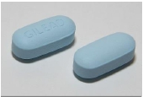
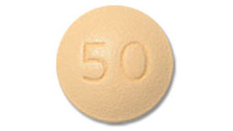
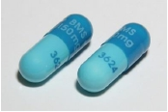
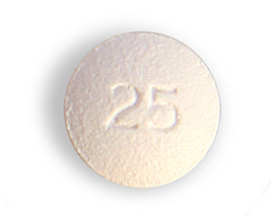
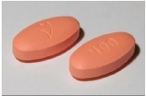
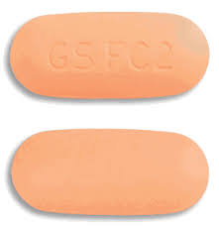
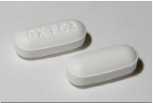
overall_0_131944394064381023 columns_1_131944394064381023
ART: NEW DRUGS, NEW REGIMENS, NEW DIRECTIONS
NRTIs
NNRTIs
INSTIs
PIs
NRTIs
INSTIs
TDF+FTC
Atazanavir
Truvada
Rilpivirine
Dolutegravir
ABC+3TC
Dumiva
Darunavir
Ritonavir
AZT+3TC
Lamzid

Slide 8

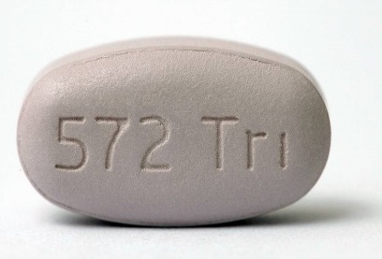

overall_0_132245228807040646 columns_4_132245228824657701
ART
TDF+FTC/3TC
TDF+3TC+DTG
ABC+3TC+DTG
TDF+3TC+RPV
ABC+3TC+RPV
Acriptega
Trelavue
Truvada + RPV
Dumiva + RPV
TDF+3TC+ATV/RTV
ABC+3TC+ATV/RTV
TDF+3TC+DRV/RTV
ABC+3TC+DRV/RTV
Truvada + ATV/RTV
Dumiva + ATV/RTV
Truvada + DRV/RTV
Dumiva + DRV/RTV

Slide 9
NRTIs
overall_0_131944393991898498 columns_2_132249552770440910
Stavudine (D4T)
  3/12 if renal failure/ anaemia
Lamivudine (3TC), Emtricitabine(FTC)
Zidovudine (AZT)
  TDF C/I, no anaemia/bone marrow failure
Abacavir (ABC)
  TDF C/I, watch VL
Tenofovir (TDF)
  Monitor creat, cautious bone marrow, not in kids
TAF(25mg daily, less renal and bone density)
The back bone of haart
Drugs with high and low barriers to resistance
NRTIs inhibit viral reverse transcriptase enzyme, by incorporating into newly developed chain of viral DNA competitively as building blocks.
High genetic barrier for ARV resistance
(ZDV, d4T, TDF, PI)
Relative resistance
1
2
3
4
5
Number of mutations

Slide 10
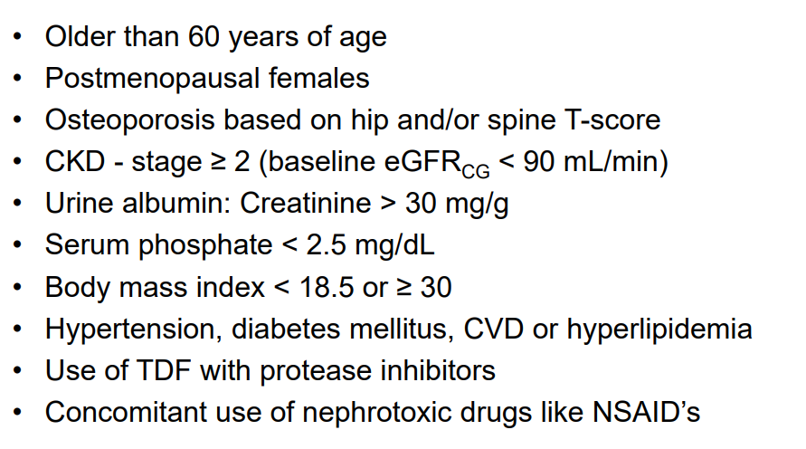
overall_1_132285911176694876 columns_1_132285911176694876
TDF risk factors for bone disease and renal dysfunction

Slide 11
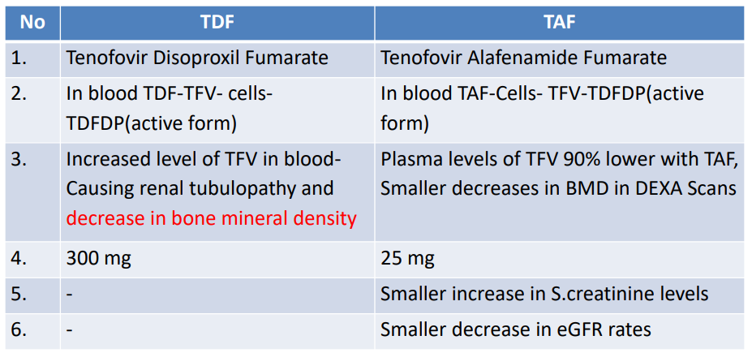
overall_1_132285911915021558 columns_1_132285911915021558
TDF vs TAF

Slide 12
NNRTIs
overall_0_131944393995326689 columns_2_132249556186078775
Efavirenz(EFV)
  (Boobs, hepatoxic, CNS)
Rilpivirine (Edurant)
  Cautious TB/ VL/Ulcers
  Weight gain
Etravirine
Doravarine (less neuro, active
even with resistance in this
class, effective regardless of CD4 / VL
Part of the ‘First line’ of HAART
Cross–resistance
“Low genetic barrier” to resistance (Resistance
develops rapidly).
NNRTIs inhibit the viral reverse transcriptase enzyme.
Low genetic barrier for ARV resistance (3TC, EFV)
Relative resistance
1
2
3
4
5
JOH
Number of mutations

Slide 13
Protease Inhibitors (PI)
overall_0_131944394056215543 columns_2_132249557715298547
Lopinavir/Ritonavir (Aluvia)
  Raise cholesterol
  BD
  GIT s/e
  Double dose TB
Atazanavir (yellow eyes)
  Ritonavir boosting
  No TB
Darunavir
  Daily dosing
  BD dosing (third line)
  Ritonavir boosting
Protease enzymes are responsible forcleaving larger polyproteins intostructuralproteins and is needed to form a fully mature functional virus.
Major mutations are V32I,147V/A ,V82A
7 or 8 mutations confers complete resistance.

Slide 14
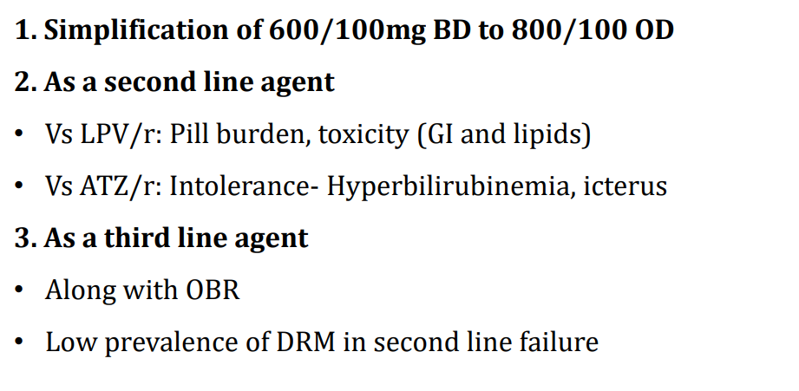
overall_1_132285916977106998 columns_1_132285916977106998
Positioning of DRV/r

Slide 15
Integrase inhibitors
overall_1_131961081119076224 columns_1_131961081119076224
Dolutegravir (DTG)
  50mg once daily
  Double dose with RIF/EFV
  FDC WITH ABC/3TC requires HLA testing
  Care with antacids, 2rs before 5 and 6hrs after
  Increases metformin levels
  Shift workers
  High barrier to resistance
Juluca (Dolutegravir 50mg / Rilpivirine 25mg)
Carbitegravir
  Oral non-inferior
  Reformulated, can be given as an injection

Slide 16
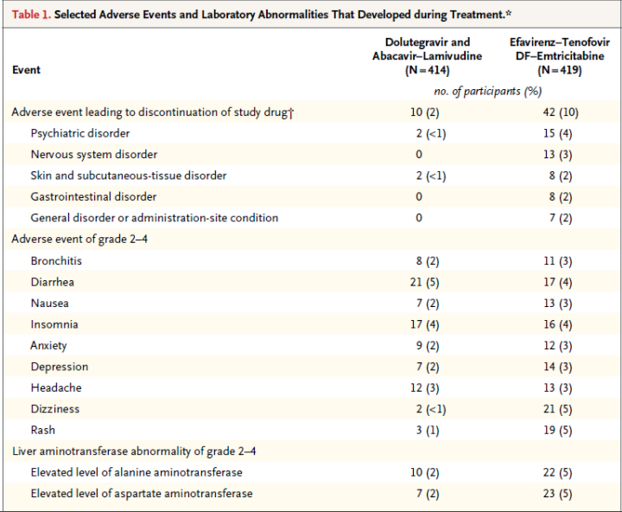
SINGLE : adverse events of DTG Vs EFV
overall_1_132285913135846273 columns_1_132285913135846273

Slide 17
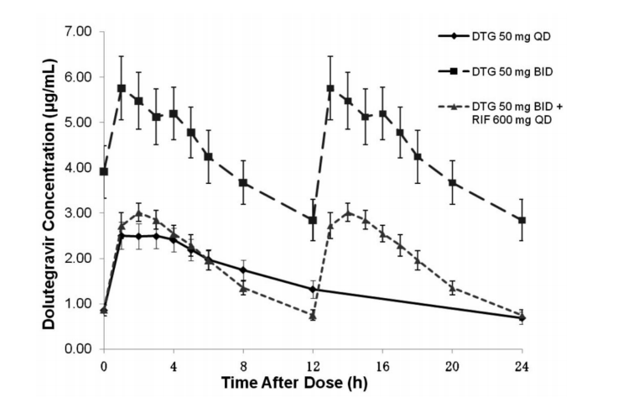
TB: DTG with RMP interaction
overall_1_132285913402572803 columns_1_132285913402572803

Slide 18
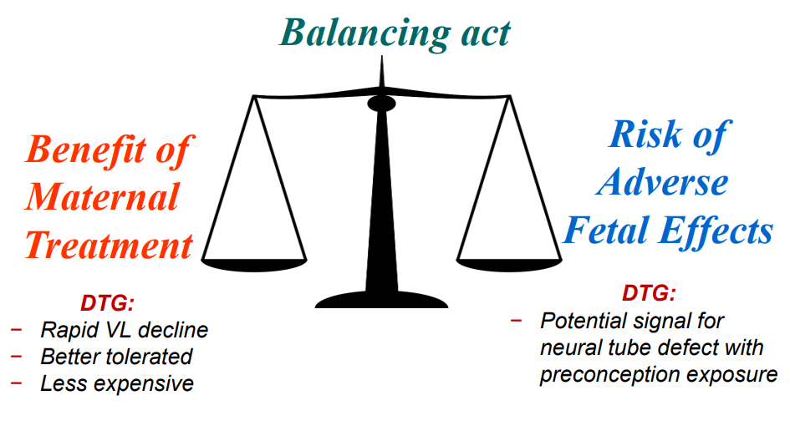
Dolutegravir in Pregnancy
overall_1_132285913957938784 columns_1_132285913957938784

Slide 19
LATTE 2 Study
overall_1_131676402174862198 columns_1_131676402174862198 22_0_131974056421860033 36_0_131974057424931557 37_0_131974057553559000 12_1_131974060163023144
Induction phase
Maintenance phase
Week 16
Week 20
CAB 400mg IM 1/12 +
RPV 600 mg IM 1/12
Cab 30mg +
ABC/3TC
Add RPV
25mg
CAB 600mg IM 2/12 +
RPV 900 mg IM 2/12
Cab 30 mg + ABC/3TC

Slide 20
Previous treatments had 3 consecutive stages
overall_0_131969641589018051 columns_1_131969638180641873 44_1_131969641135914914
Regimen 1
TDF
XTC
EFV
+
+
Regimen 2
AZT
XTC
PI
(LPV/r)
+
+
Regimen 3
(much later on)
Darunavir
Raltegravir
Etravirine/
Rilpivirine
+
+
Optimized background therapy

Slide 21
New regimen allows for more flexibility
overall_0_131969641589018051 columns_1_131969638180641873 44_1_131969641135914914 66_1_131969646109594877
NNRTI-based regimen
PI-based regimen
INSTI-based regimen
First line
Preferred regimens
FDC: TDF+ FTC/3TC+ EFV
TDF + 3TC + RPV
TDF/AZT+ 3TC+LPV/r or ATV/r
FDC: ABC+ 3TC+ DTG
TDF + 3TC + DTG
Second line
Recommended regimens
INSTI (1 or 2) ± LPV/r ± 2 active NRTIs
INSTI ± NNRTI or DRV/r ± 2 active NRTIs
NNRTI ± LPV/r + 2 active NRTIs
Third line
Recommended regimens
DRV/r ± INSTI ± NNRTI ± 2 active NRTIs
NNRTI(2) ± INSTI(2) ± 2 active NRTIs
NNRTI(2) ± DRV/r ± 2 active NRTIs
Salvage
Individualize ART according to genotype result, known drug toxicity profile and past drug history

Slide 22
Drug potency and genetic barrier to resistance
overall_1_131970356238751664 columns_1_131970356238751664 27_1_131970358011780321 28_1_131970358495723451
DTG
DRV/
RTV
3 log
EVG
RAL
EFV
ATV/R
TV
Potency (estimated log
change in viral load)
RPV
2 log
FTC
3TC
1 log
ABC
TDF
1
2
3
4
Genetic barrier to resistance
(Approximate number of mutations needed to fail)
Source: Danielle Ciuffetelli, Pharm.D CROI, 2016; Ambulatory Hepatology/Infectious Diseases Clinical Pharmacist; Hospital of the University of Pennsylvania, Philadelphia, Pennsylvania

Slide 23
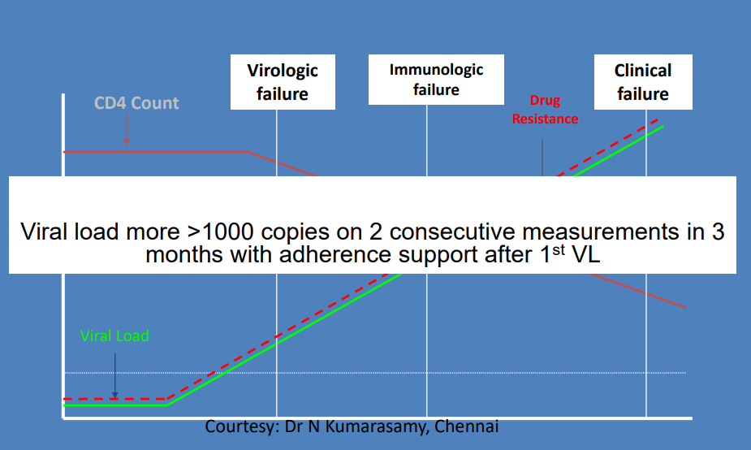
Treatment Failure
overall_1_132285914554690337 columns_1_132285914554690337

Slide 24
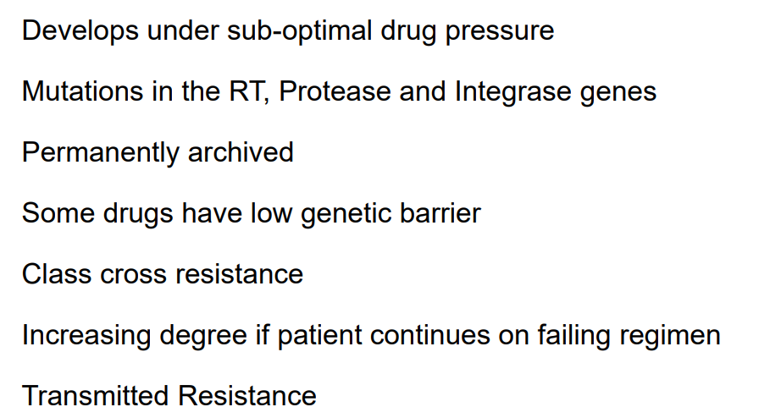
About resistance
overall_1_132285914650827202 columns_1_132285914650827202

Slide 25
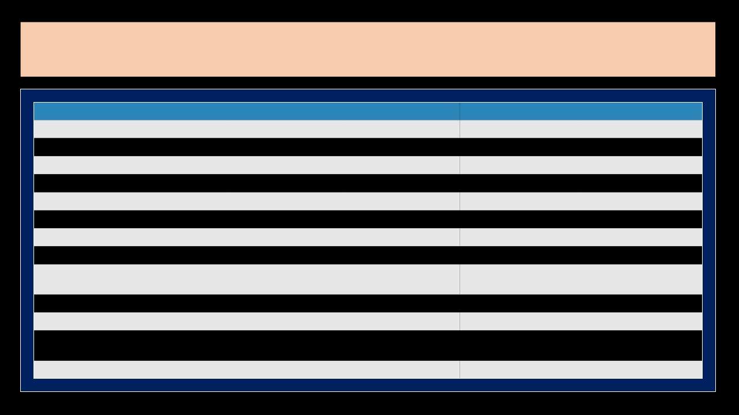
overall_0_131944394743700193 columns_1_131944394743700193
Comparing Fixed-Dose Regimens
Characteristic
Clinical experience
Virologic efficacy
Tolerability
Switch data
Absence of meal restrictions
Absence of DDIs
Use in HLA-B*5701+
Use in advanced HIV
Use in pts with renal
impairment
Use in pts with HBV/HIV
Use in pts with bone disease
Use in pts with CVD risk
factors
Use in pregnancy
EFV/TDF/FTC
+++
++
+
-
+
+
+++
++
-
+++
+
++
++
RPV/TDF/FTC
++
+(+)
+++
++
-
+
+++
+
-
+++
+
+++
++
EVG/C/TDF/FTC
++
++
++
++
++
+
+++
+++
-
+++
+
++
++
DTG/ABC/3TC
+
++(+)
+++
-
+++
+++
-
+++
+++
-
++
+
++

Slide 26
HIV 2020
overall_0_131944395341477432 columns_1_131944394801680293 7_1_131944395703714022 14_1_131944396114541942 15_1_131944396114732830 33_1_131944397730980639 20_1_132249560749542897
Viral load (normal creat)
VL <100 000
VL >100 000
Truvada (TDF / FTC) Edurant
Acriptega (TDF / FTC / DTG)
Viral load (abnormal creat)
VL <100 000
VL >100 000
Dumiva (ABC / FTC) Edurant
Trelavue (ABC / FTC / DTG)

Slide 27
overall_0_132245244351625460 columns_1_132245244287956709 8_1_132245244320308234
HIV 2020
Pitfalls
Edurant
Not with TB
Not with high VL
Weight gain
Acriptega:
Creat (TDF)
TB double dose
Dili
TDF:
Creat
Off TDF, do
Hep B S ag
If +, keep TDF

Slide 28
PEP and PrEP
overall_0_132276082088882983 columns_2_132276082045519054 8_1_132276082065782499 11_1_132276082065938711 12_1_132276082074657638 17_1_132285908860635267
Then -“Prevention is the only Treatment” Now - “Treatment as Prevention”
PEP – Post Exposure Prophylaxis
PrEP – Pre Exposure Prophylaxis
Burst condom, unprotected sex, rapes, needle stick injury, work injury, exposure
Time: 72 hours
Rapid (immediate)
Elisa (lab confirmation)
Acriptega (1 month)
Retest at 6/52
For all HIV –ve individuals who wish to remain –ve, not just high risk & not dependent on partner
Rapid
Elisa
Creat, heb B surface antigen
Tenemine
Can cycle on & off

Slide 29
Comorbidities - TB
overall_0_132249567554273710 columns_1_131961110723317646 7_1_132249567526011803
Diagnosis
  Symptom screen (cough, LOA, LOW, night sweats)
  Urine lam, VL < 50
  Gene expert – Must have culture and DST
  Bactec – Must have culture and DST
Treatment
  Treat TB first (bring on ARVs 2/52 or 2/12 later)
  EFV 600mg
  Aluvia double dose (4bd)
  DTG 50mg bd
Pulmonary TB – 6/12, extra pulmonary – 9/12
MAC (low HB, low CD4, diarrhea)

Slide 30
Comorbidities
overall_1_131961114729749395 columns_1_131961114729749395
PCPs
  Dry cough, short of breath, pyrexial, ill-looking
  CXR – can be normal
  Sputa / bronchoscopy
  Bactrim / steroids
Oesophageal candida
  Diflucan 200mg, 2/52
Crypto meningitis
  IVI, amphotericin 2/52
  Fluconozole

Slide 31
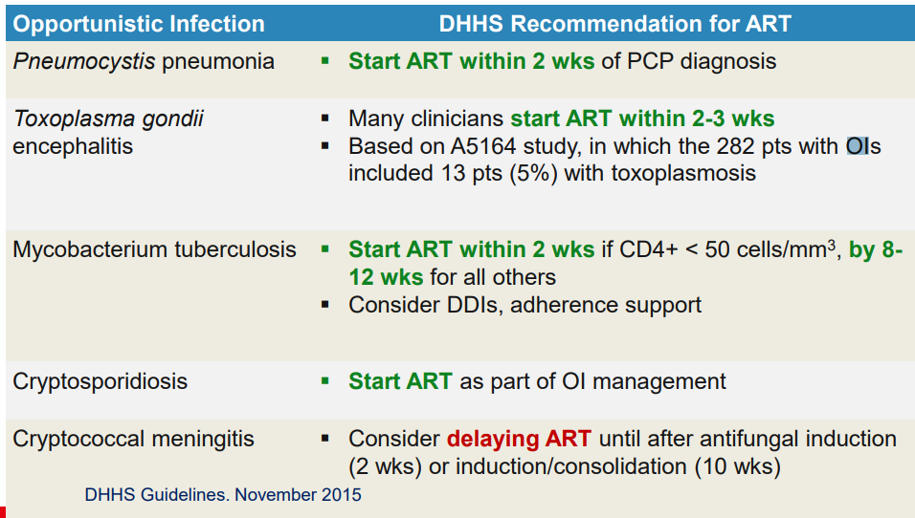
Recommendations for ART in Pts With Selected O.Is
overall_1_132285915915430051 columns_1_132285915915430051

Slide 32
Don’t forget the 5 Ps!
overall_1_131961116483328760 columns_1_131961116483328760
Pap smears
Piepie cut - Circumcisions
PEP (1/12)
Prep
Patients are people

Slide 33
Take-home points
overall_1_131961122812618555 columns_1_131961122812618555
1
Treat comorbidity conditions first & bring on ARVs thereafter
VL is crucial in deciding choice of drugs
Creat is crucial in deciding choice of drugs
Switching of drugs – 1 drug switch for side effects & regimen switch for VF
Treatment for life – education empowers adherence
When switching to dolutegravir, ensure viral undetection
(pregnancy controversial)
2
3
4
5
6

Slide 34
Patient 1
overall_1_132249569688994364 columns_1_132249569688994364
May 2011 - Aluvia Lamzid (pregnant), CD4 31, VL 21420,
June 2012 – Tribus
Jan 2013 – VL 21420, Aluvia, Lamzid
Nov 2018 – Truvada, Edurant
Nov 2019 – Renega, CD4 87, VL 8200
Resistance testing

Slide 35
Patient 2
overall_1_132249575302280162 columns_1_132249575302280162
2015 – Tribus
2018 – ABC/3TC/EFV
2020 – VL 104631, GFR 4,
  Dialysis
  Atazor, Novir, Dolutegravir

Slide 36
Patient 3
overall_1_132249575302280162 columns_1_132249575302280162
Sep 2019
Low white cell, rapid negative
Elisa +,CD4 225, VL 5150000, creat 72
(acute sero conversion)
Jan 2020, CD4 638, VL undetectable, creat 90, GFR 64, Hep B S Ag - Trelavue

Slide 37
Patient 4
overall_1_132249576267304364 columns_1_132249576267304364
August 2018 VL 22 000, Creat 157, GFR 36, HB 7.3, Hep +ve
3/8 2018 Dumiva Edurand, TDF weekly
27/2/2019 Kissing ulcers on buttocks (herpes)
To follow up
9/4/2019 CD4 19, VL 470 000, Creat 120, Trelavue + TDF alternate days
30/9/2019 CD4 56, VL 17 000, Creat 123, Swears adherence
Meds changed: Atizor, Novir, DTG, TDF
03/2020: CD4 267, VL UD, Creat 128

Slide 38

By 3 methods we may learn wisdom
overall_1_132285918324227838 columns_1_132285918324227838

