Slide 1

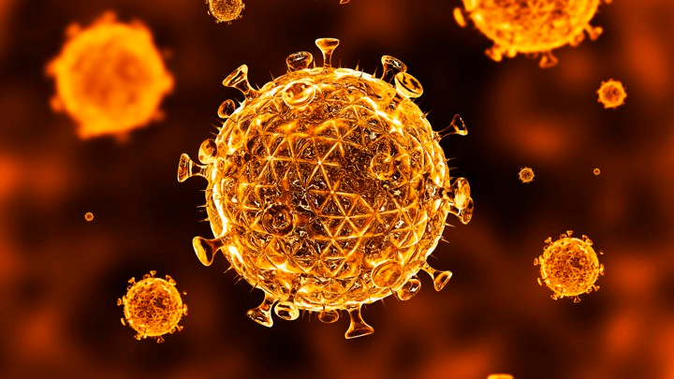

Slide 2
Co-Morbidities in HIV
Patients
Ezio Baraldi

Slide 3
Disclosure
This CME event is sponsored by a Pharma company
I have received compensation for this presentation.
The material content of this presentation represents the views of the presenter and is not influenced by the sponsor

Slide 4
Agenda
Traditional Co-morbidities
HIV aging Co-morbidities
Inflamm- aging
HIV aging the 10 year gap
______
Quick HIV update

Slide 5
Traditional HIV Co-morbidities
Infections
TB, Cryptococcus, Salmonella, Giardia etc
Malignancies
Lymphoma, Ca Cervix, Kaposi Sarcoma,etc
Metabolic
Cachexia, asthenia, wasting,
Multiple organ failure…..

Slide 6
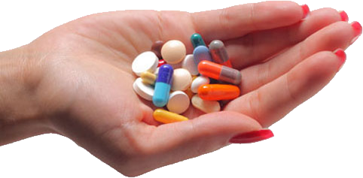
Early treatments - marginally effective
11th International Aids conference Vancouver 1966
Introduction of Protease Inhibitors
1st time life expectancy could be increased from-10 years after infection.
Today - Near normal life expectancy
Longevity has a cost.

Slide 7
Emergent HIV Co-morbidities
HIV Causes premature aging
Mechanism - Inflammation
Estimated at 10 years prior to expected
Increased Disease burden
Increased longevity HIV cohorts
Increased Incidence of HIV in >40
Age related
Inflammation

Slide 8
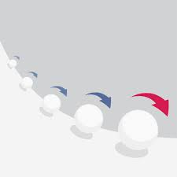
Age Inflammation
Inflammation
the common denominator in many age related diseases
Aging causes
1 Cumulative Exposure to Antigens
2 Genetic tolerance to exposure
( beyond evolutionary expectations)
3.Chronic Inflammation
4. TH1 → TH2

Slide 9
Immune system TH1 + TH2
Aging
TH1 ----> TH2
HIV
TH1 ----> TH2
TH1 Lymphocytes - Cytokines
Cellular responses- NK Cells
Viruses, Other intracellular parasites, Cancer cells, Delayed type hypersensitivity skin reaction
TH2 Lymphocytes - Cytokines
Humoral Responses
Broad Antibody production
Pro-inflammatory

Slide 10
Inflamm-aging
Involved in progression of Alzheimers, Atherosclerosis,
DM II, Chronic Heart diseases
Causes
Increasing age
Chronic infections ( CMV, HIV,Hep B,C, Herpes )
Changes gut microbiome
Intestinal leak syndrome
Inflamm cytokines secreted from fat cells
Chronic stress ( at any time)
chronic low-grade inflammation that develops with advanced age.
Driven by endogenous signals rather than new infections
accelerate the process of biological aging
worsen many age-related diseases.
Increase in Pro - inflammatory Cytokines
IL6, TNF, CRP

Slide 11
TH1 -- > TH2
Sympathetic system
Modulates - The immune system, Inflammation, nociceptors,
Adrenoreceptors on Immune cells - control immune cell functions.
Catecholamines are pro- inflammatory
Age
HIV Infection Itself
Duration of HIV Infection
Sympathetic overactivation

Slide 12
1 0 years earlier
Disease screening routines
Increased risk for
  Cardiovascular disease
  Hypertension
  Diabetes
  Osteoporosis
  Liver disease
  Kidney disease
  General Frailty
  Cognitive decline
  Neoplasms

Slide 13
Iatrogenic
NRTI
Mitochondrial damage, impaired energy production, sarcopenia, generalized wasting.
Kidney dysfunction, Osteoporosis
NNRTI
Liver dysfunction, Hypercholesterolemia
PI
Insulin resistance, diabetes, Hypercholesterolemia
INSTI
Weight gain
Co-morbidities can be induced by HIV treatments

Slide 14
HIV Update

Slide 15
Dolutegravir

Slide 16
INSTI
INSTI
Integrase strand Transfer Inhibitor
Raltegravir, Dolutegravir elvitegravir,Bictegravir
RSA
Raltegravir , Dolutegravir
INSTI - 1st Line Globally
Very low organ toxicities
Powerful Viral suppression
Low side effect profile

Slide 17
Dolutegravir
QD
Higher barrier to resistance
NO CYP (P450) interaction
Inhibits OCT2 - Kidney - Metformin
Inc Creat ( mild)
Pregnancy ?????
Weight gain +++ ?

Slide 18
Changes in RSA
Current first line: TEE
(TEN) (tenofovir dipoxivol Fumarate) +
(FTC) Emtricitabine +
(EFF) Efavirenz
NEW first line: TLD
(TEN) (tenofovir dipoxivol Fumarate) +
(3TC) Lamivudine +
(DTG) Dolutegravir

Slide 19
Summary
HIV patients are aging - rapidly
Mix of Traditional and new co-morbidities
Inflamm-aging -
10 years earlier
Iatrogenic causes - present and mutable
New drugs - new co-morbidities

Slide 20
Thank You
Ezio baraldi
Tel: 012-3425704
Email: eziob@qw.co.za

Slide 21
