Slide 1
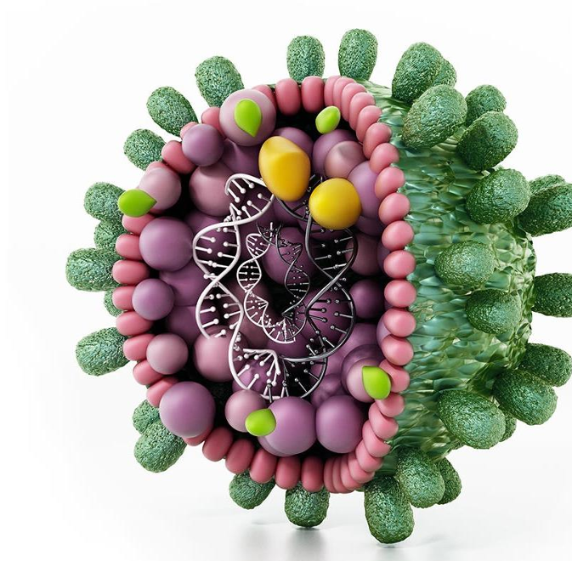
HEPATITIS B
DR NAZEER CHOPDAT
HOD MEDICAL GASTROENTEROLOGY
CHRIS HANI BARAGWANTH HOSPITAL

Slide 2
Disclaimer
No conflict of interest
No conflict of interest

Slide 3
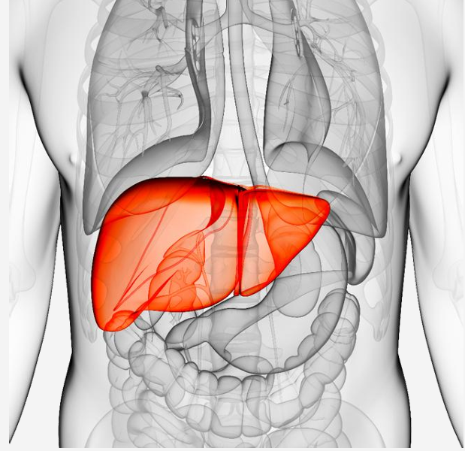
Outline
Viral Hepatitis
Current Epidemiology
Transmission and Virology
Serological markers
Natural history of infection
Extrahepatic manifestations
Treatment guidelines
Coinfections
Special Situations
Vaccination
Looking to the future
Notes:
Chronic hepatitis B (CHB) remains a major global health challenge, affecting an estimated 254 million people and causing 1·1 million deaths worldwide in 2022.1 In 2016, WHO set targets to eliminate viral hepatitis by 2030, aiming for a 90% reduction in new hepatitis B virus (HBV) infections and a 65% reduction in HBV-related mortality.2 Achieving the mortality reduction goal requires 90% diagnosis of infected individuals and 80% treatment coverage among those eligible;3 however, by 2022, only 13·4% of people with CHB were diagnosed globally regardless of treatment eligibility, and among those diagnosed, just 19·5% had received treatment.

Slide 4
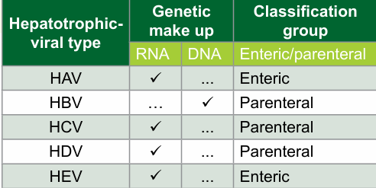
Hepatitis
Hepatitis is a general term referring to an inflammation of the liver.
It occurs as a result of infection with various pathogens; exposure to alcohol, medications, chemicals and toxins; and autoimmune disorders.
The term Viral Hepatitis –implies inflammation of liver with hepatotrophic viruses

Slide 5
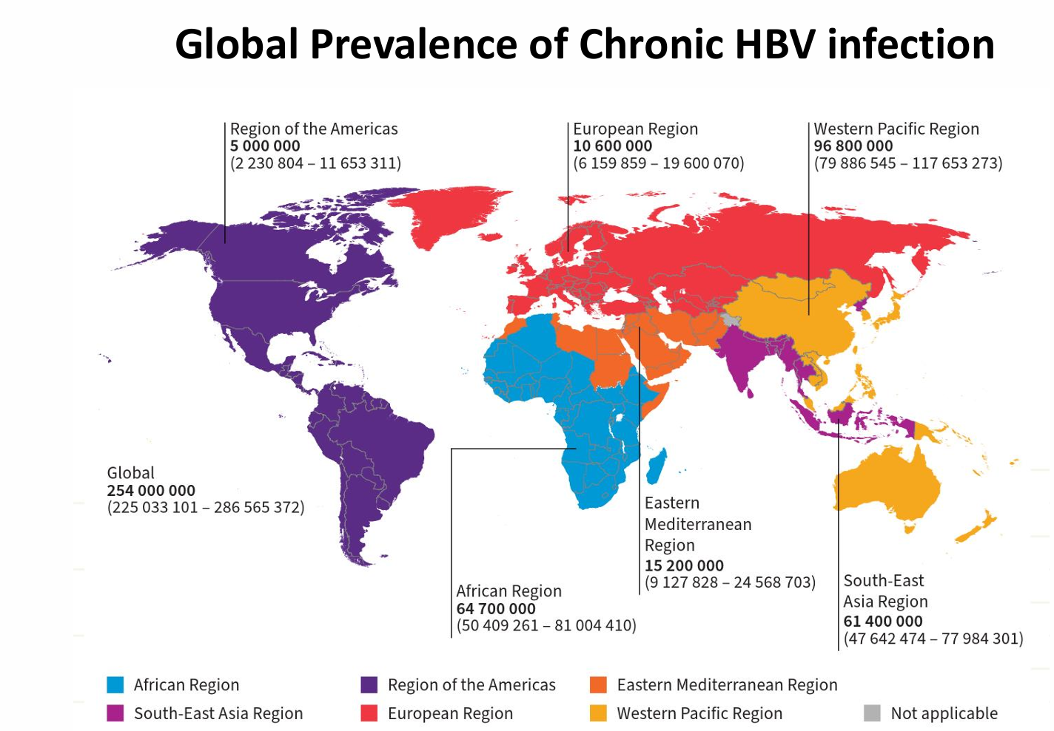
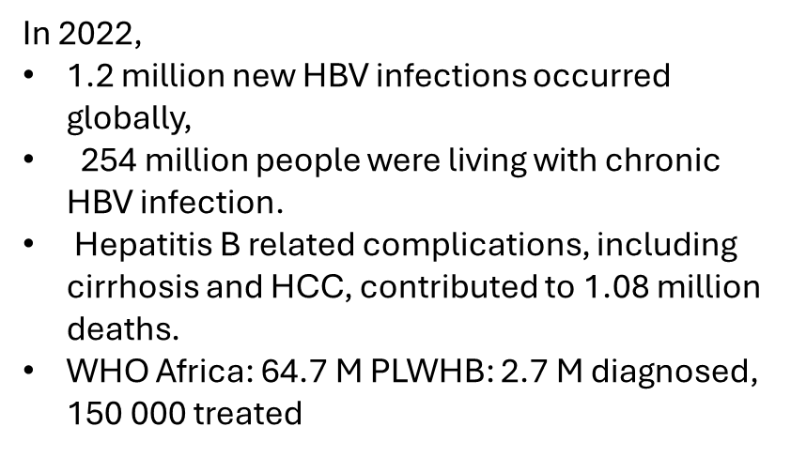
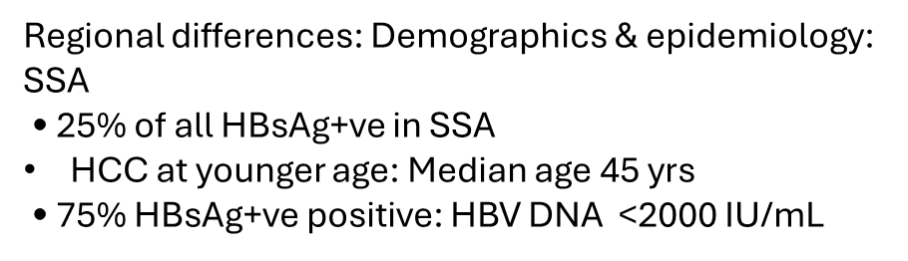
. EASL CPG HBV. J Hepatol 2017;67:370–98; 2. Schweitzer A, et al. Lancet 2015;386:1546–55;
3. Ott JJ, et al. Vaccine 2012;30:2212–9; 4. GBD 2013 Mortality and Causes of Death Collaborators. Lancet 2015;385:117–71;
5. Coppola N, et al. Euro Surveill 2015;20:30009; 6. Hampel A, et al. Bundesgesundheitsblatt Gesundheitsforschung Gesundheitsschutz 2016;59:578–83;
7. Chen C-L, et al. J Hepatol 2015;63:354–63.
Notes:
prevalence of chronic HBV infection shows considerable geographical variation, with the highest rates reported in sub-Saharan Africa, East Asia and the Pacific Islands. In Europe, countries in Eastern and South-Eastern Europe are the most affected, with an intermediate prevalence. Nevertheless, the incidence and prevalence of HBV infection in Europe continues to evolve due to factors such as globalisation, migration and the movement of refugees.

Slide 6
Sub-Saharan Africa and South Africa
Approximately 2.5 million in South Africa
South African prevalence prior to EPI varied from 0.3% - 15%
Hepatitis B vaccine -1995 was introduced into the vaccination programme
BUT
No catch-up vaccination program
Co-infection with HIV results in a more aggressive disease course BUT excellent antivirals available
International guidelines vs Local WHO guidelines

Slide 7
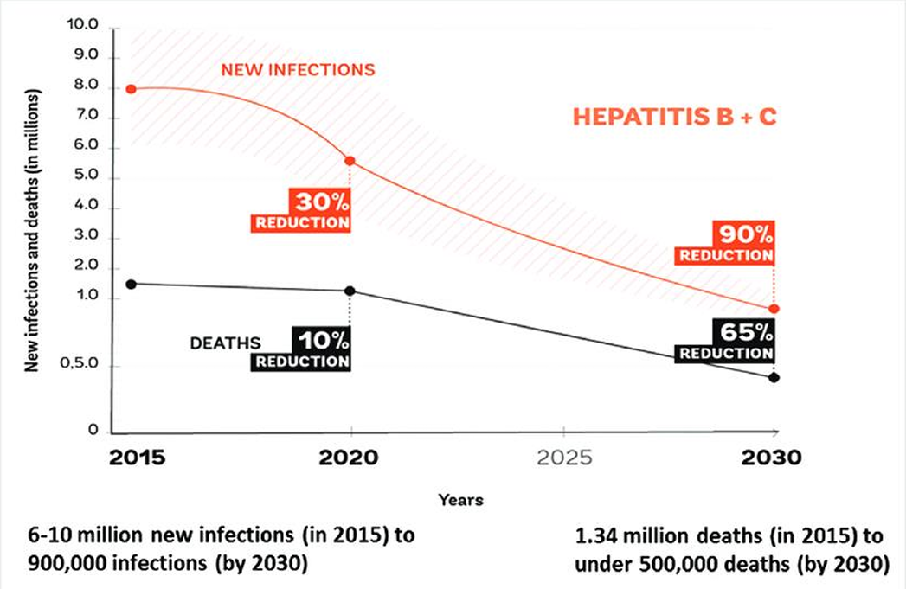

What’s the Plan ?
Eradicate Hep B –various programmes and initiatives
To eliminate viral hepatitis as a global health threat by 2030
90% reduction in new cases of chronic Hep B and C
65% reduction in mortality secondary to HBV and HCV
80% of treatment eligible people to be on treatment for both HBV and HCV
HBV related deaths in sub-Saharan Africa is estimated to be 87,890 annually.

Slide 8
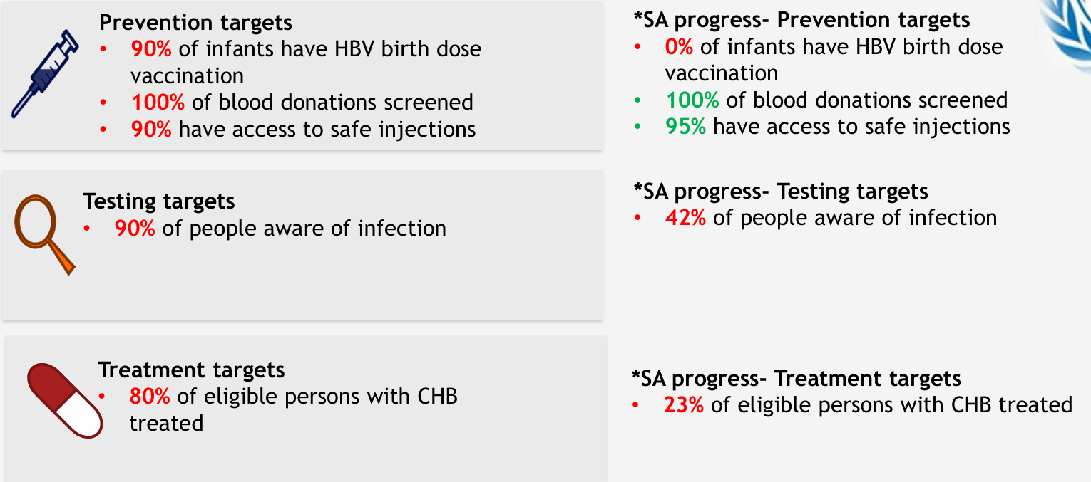
WHO Global Health Sector Strategy: 2030 Targets for HBV
WHO. Global health sector strategy on viral hepatitis 2016–2021
Available at: http://apps.who.int/iris/bitstream/10665/246177/1/WHO-HIV-2016.06-eng.pdf?ua=1
*Polaris Observatory: https://cdafound.org/polaris/dashboard/

Slide 9
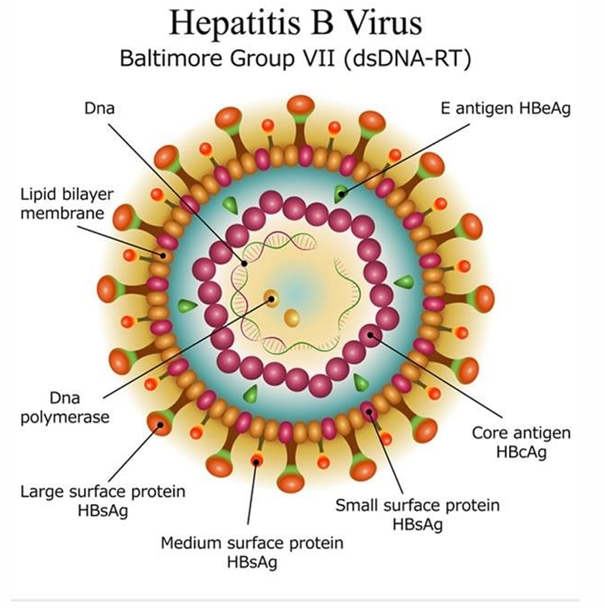
The Virus
Hepadnaviridae family
DNA virus
At least 10 genotypes (A to J)
Not directly hepatotoxic
Liver injury secondary to immune response to infected cells
Considered an oncogenic virus

Slide 10
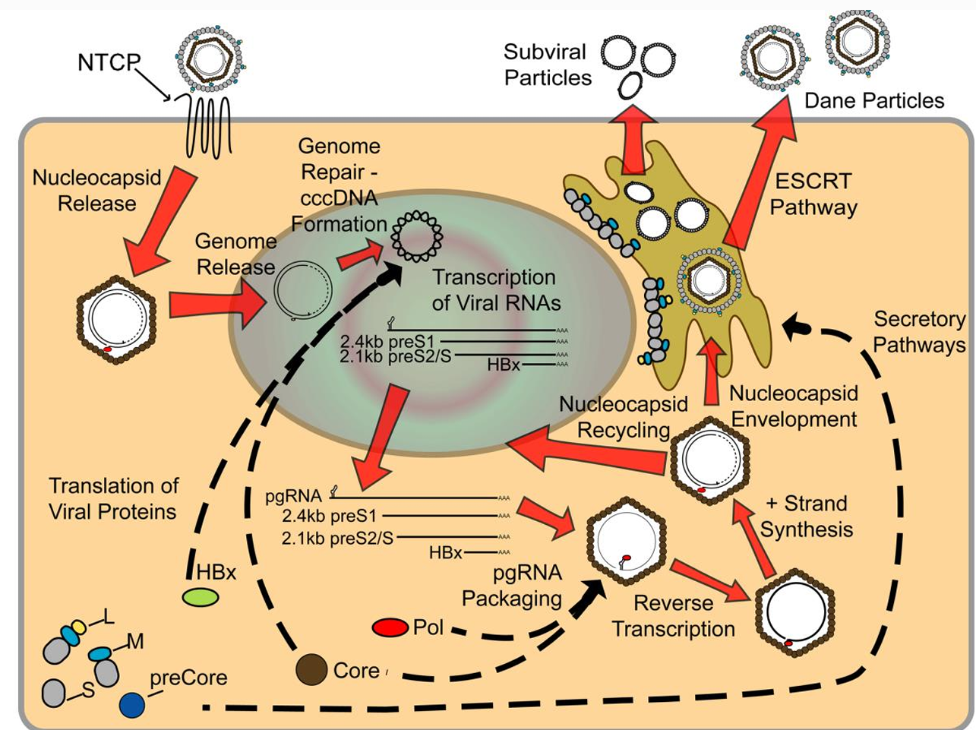
REPLICATION
Virus Enters via NTCP receptor
Dusheiko G, Agarwal K, Maini MK. New Approaches to Chronic Hepatitis B. N Engl J Med. 2023;388(1):55-69

Slide 11
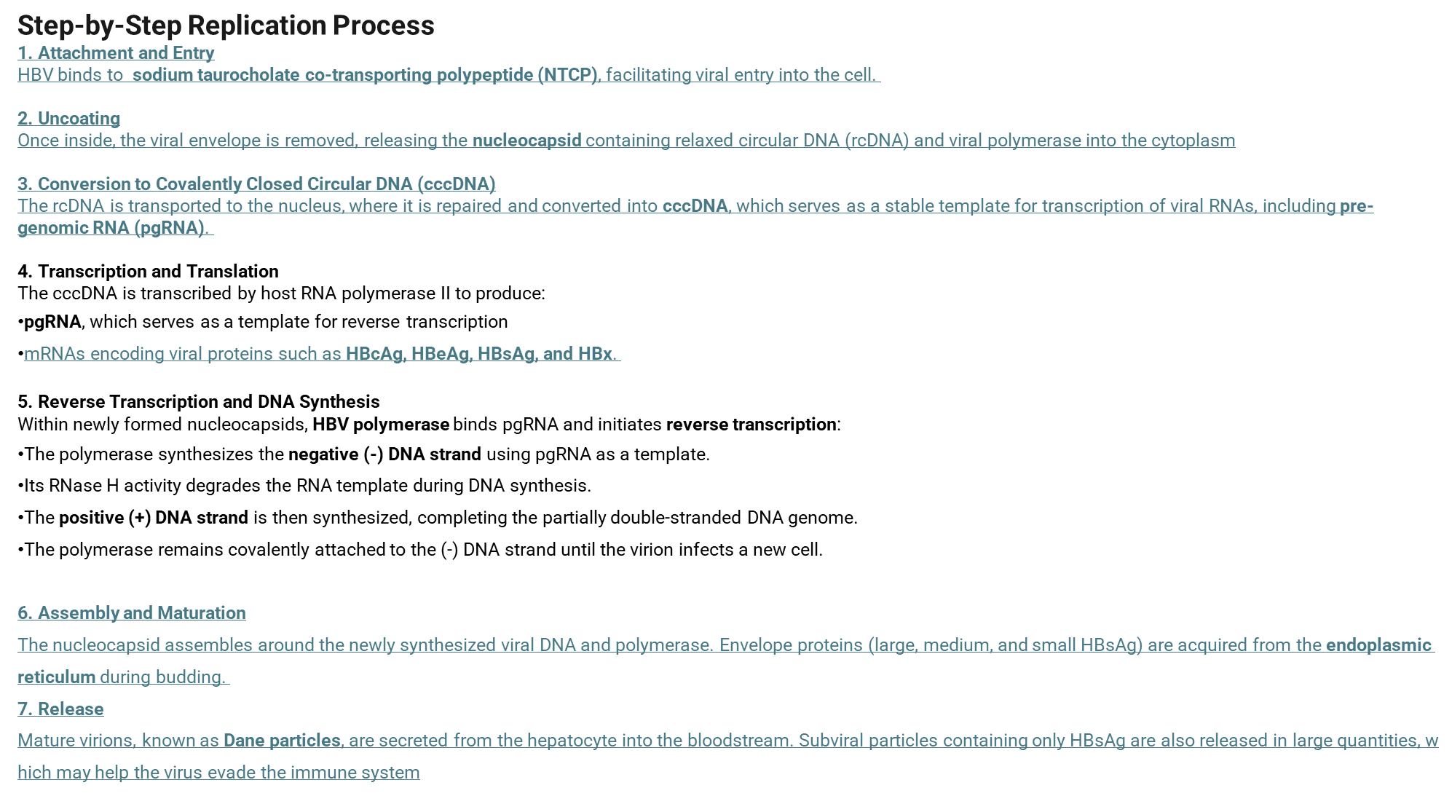

Slide 12
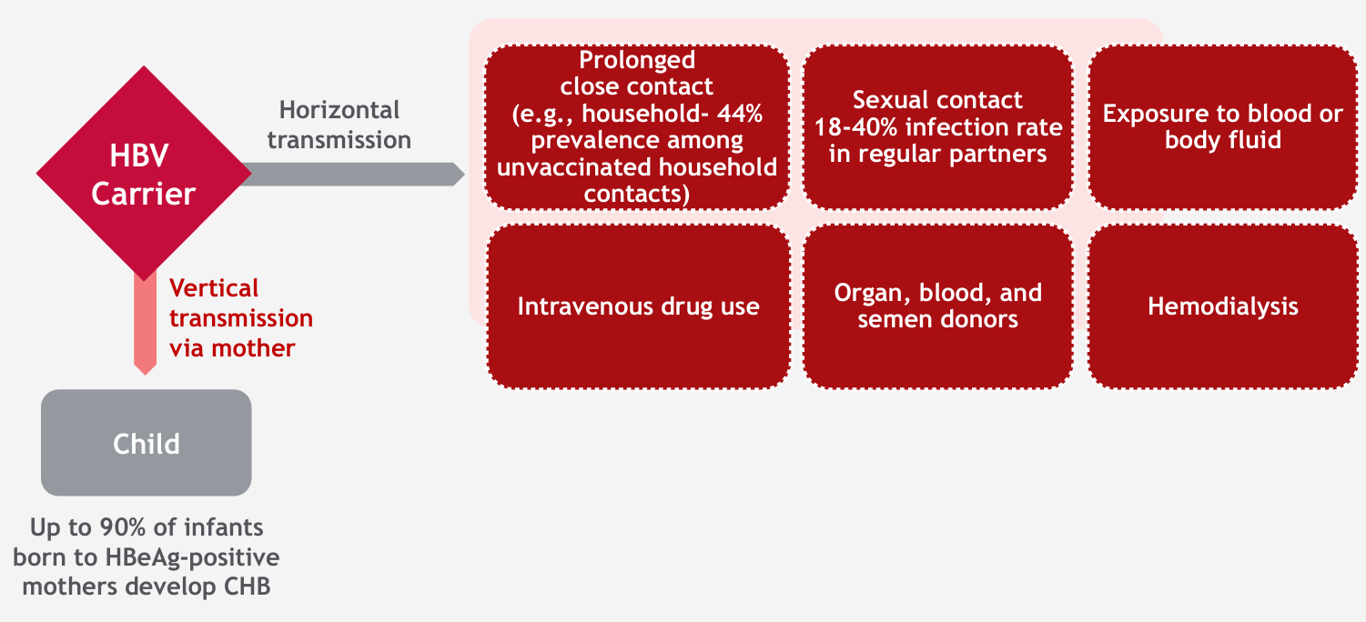
Modes of HBV Transmission and Persons at Risk
WHO 2015. CDC 2015. Mast 2006. Buchanan 2010. Weinbaum 2008.
Notes:
. However, HBV can be transmitted through various routes, including perinatal trans mission, sexual contact, sharing of contaminated needles or other injection equipment, and exposure to infected blood.

Slide 13
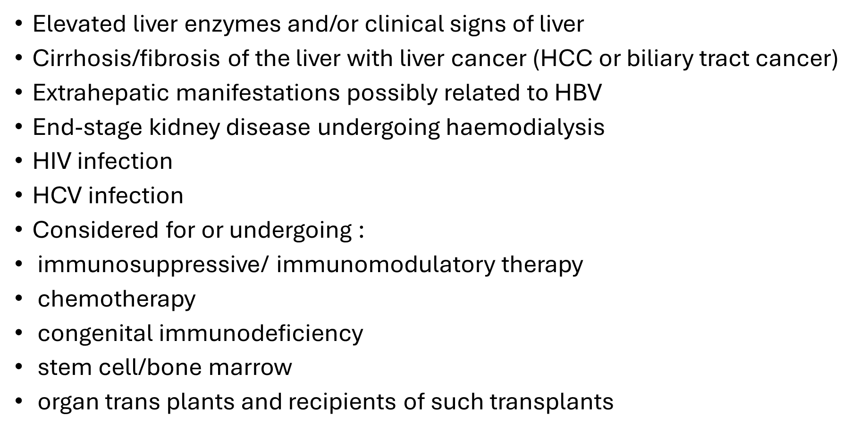
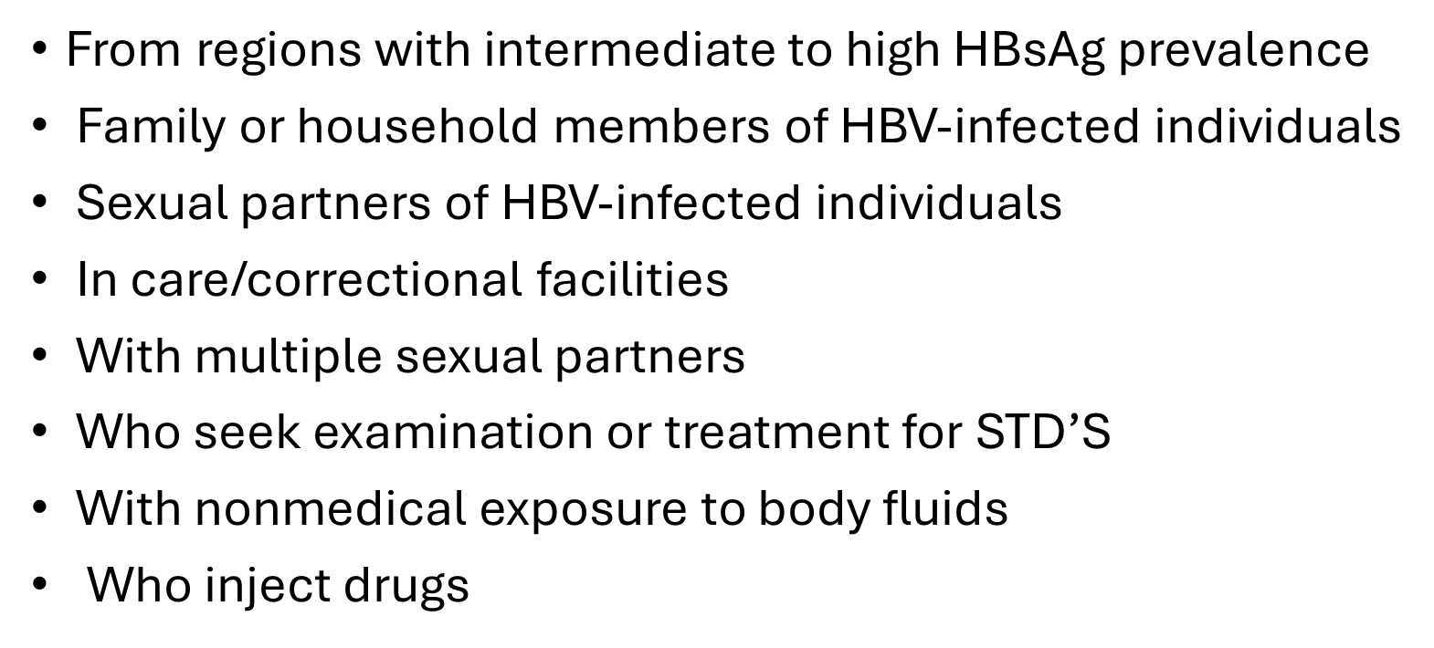
Screening HBV :

Slide 16
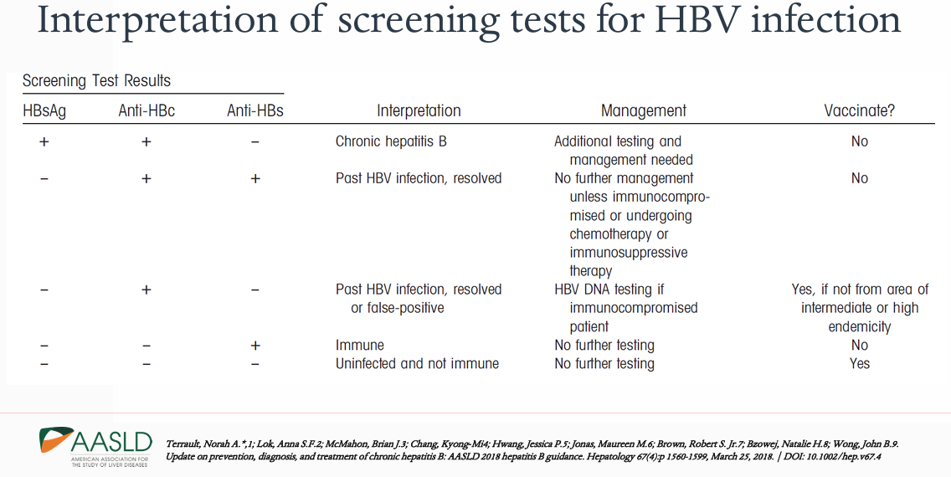

Slide 17

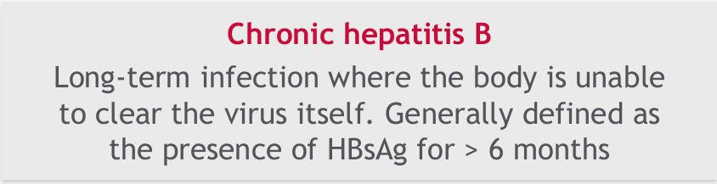
Hepatitis B
Incubation of 4 – 12 weeks
70% asymptomatic
Typical viral prodrome (anorexia, malaise, myalgia)
Many may clear the infection without progression to significant liver impairment
Some develop jaundice and more significant symptoms (serum sickness)
0.1 - 1% present with fulminant hepatitis and liver failure (sAg may be negative)
Diagnosis made with HBsAg + and HBcIgM + (note may also be present in a flare)
>95% of adults should achieve clearance with only supportive treatment
Long term infection
hepB sAg positive after 6 months
May be asymptomatic
Incidental finding
May already present with complications
Notes:
Acute HBV infection is often asymptomatic but can lead to severe hepatitis and, in some adult cases, to fulminant hepatitis and liver failure. It may also progress to chronic infection, particularly if transmitted from mother to child or acquired during childhood or adolescence. In contrast, progression to chronic HBV infection is rare when infection occurs in immu nocompetent adults
. Chronic HBV infection is a significant risk factor for the development of cirrhosis, end-stage liver disease, and HCC, and it may also be associated with extrahepatic manifestations. Both chronic and resolved HBV infections carry a risk of reactivation, leading to severe, potentially fatal out comes in individuals undergoing immunosuppression.5

Slide 18
Acute Hepatitis B Treatment
Supportive:
Bed rest • High caloric diet • Avoidance of hepatotoxins
Initiation of antiviral therapy:
Severe acute infection: coagulopathy (INR > 1.5) or protracted course (>4 weeks of severe jaundice and symptoms)
Any signs of liver failure
Treatment with monotherapy NA (LAM, TDT/TAF or ETV)
Fulminant liver failure
ICU, low protein diet, antiviral therapy, possible prophylactic antibiotics, control bleeding
May need consideration for urgent liver transplant

Slide 19
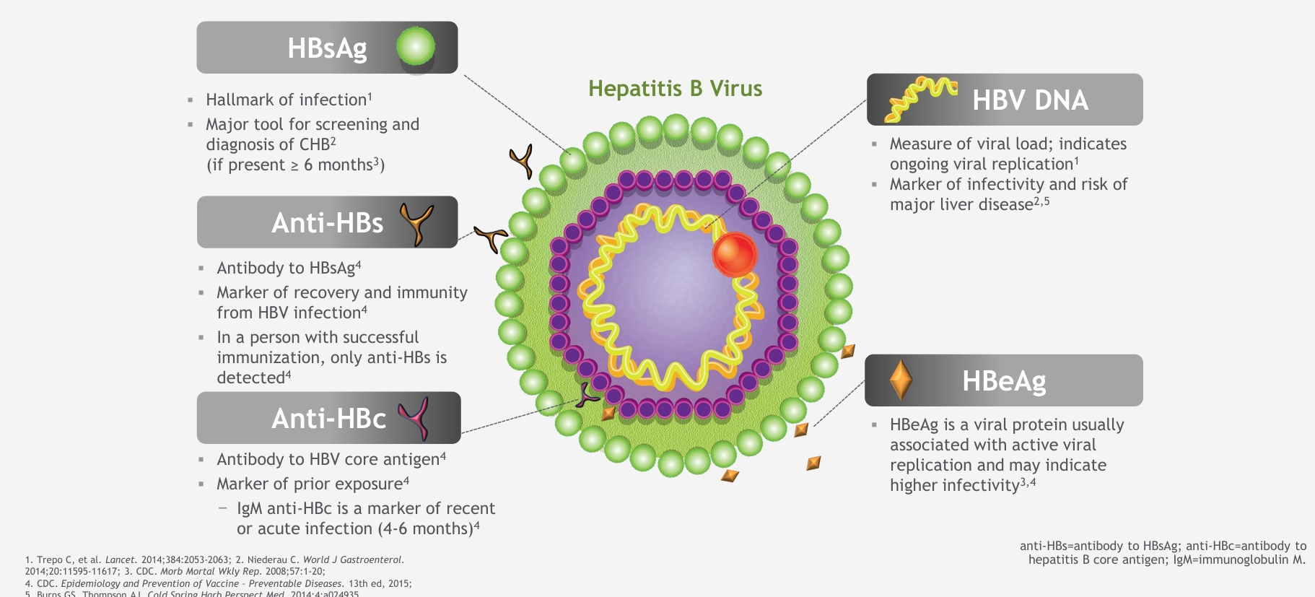
Serologic Markers of HBV Infection

Slide 20
Hepatitis B Serologies
Profile | HBsAg | Total core Ab | Anti-HBs | Core IgM Ab | HBV DNA
Never infected (susceptible) | - | - | - | - | -
Acute infection | + | + | - | + | +
Recovery from past infection | - | + | + | - | -
Chronic infection | + | + | - | - | +
Isolated core antibody | - | + | - | - | +/-
Immunized (or passive Ab receipt) | - | - | + | - | -
Notes:
And finally, the individual who was immunized against hepatitis B should only have surface antibody but nothing else present in their blood.
So that is hepatitis B serologies – there may be exceptions to these rules when you encounter a patient who has a false positive (which occasionally happens) or in those who are transitioning from one phase to another but for the vast majority of patients, they should fall into one of these categories.

Slide 21
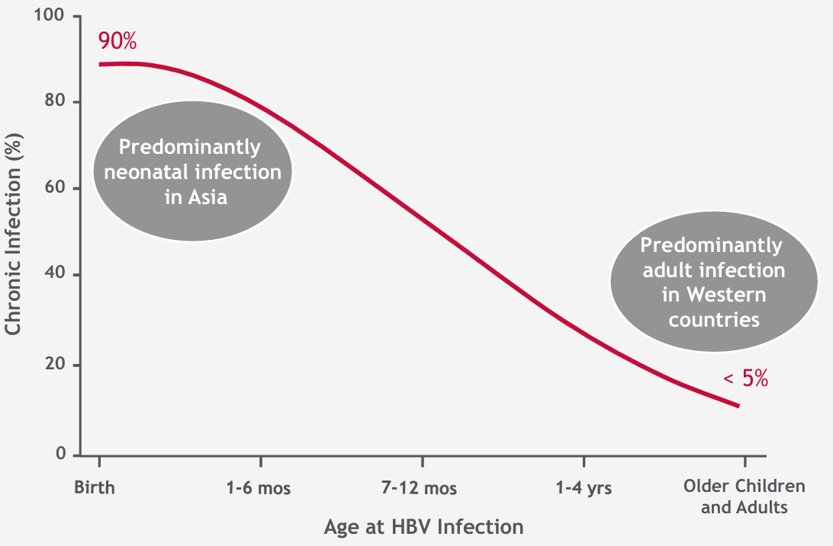
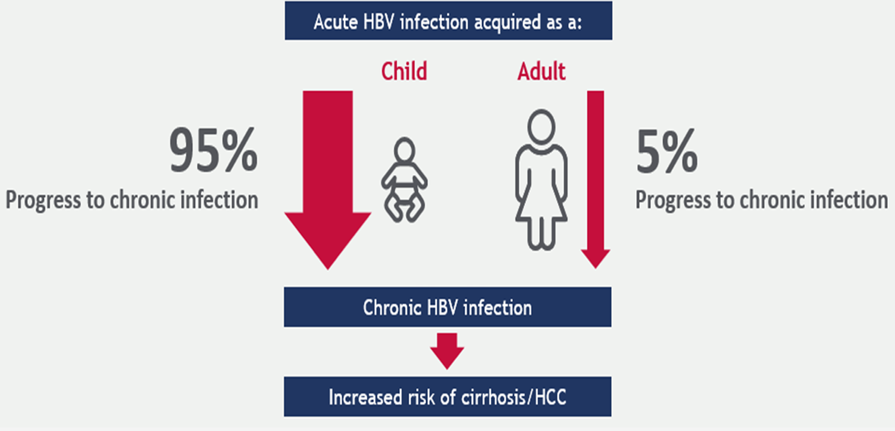
Progression to Chronic Infection is
Dependent on the Age at Acute HBV Infection

Slide 22
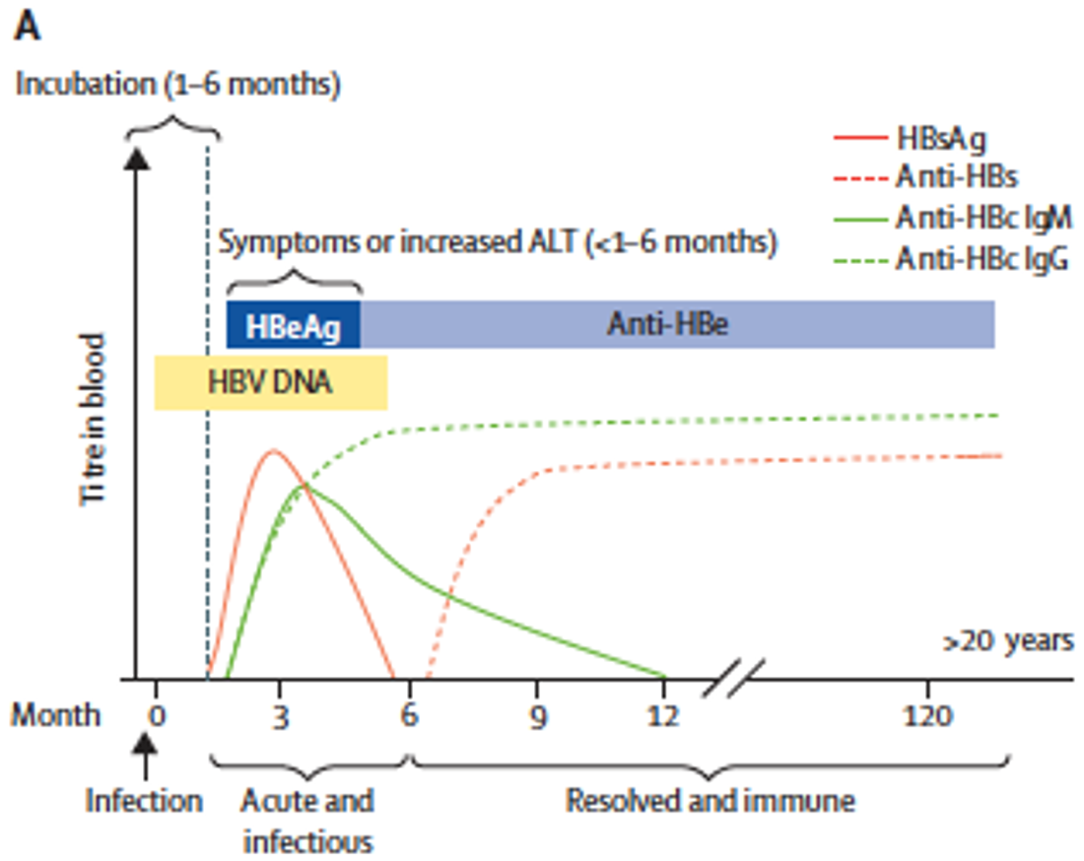

Slide 23
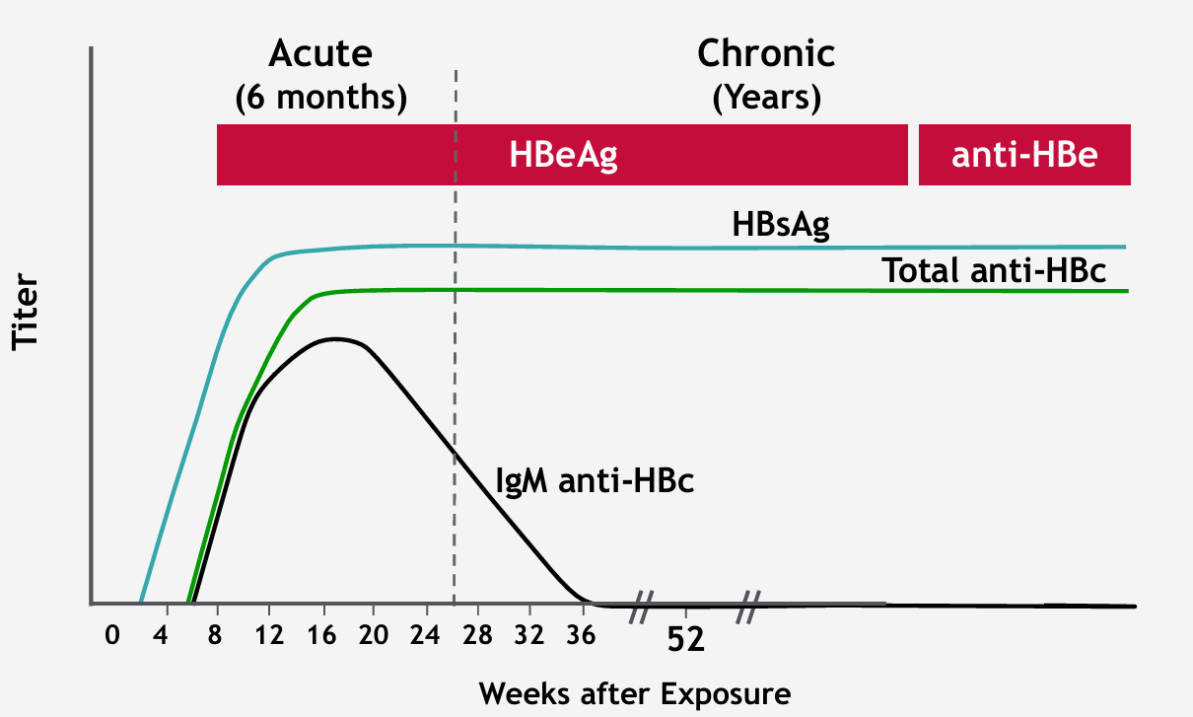
Progression to Chronic Hepatitis B Virus Infection Typical Serologic Course

Slide 24
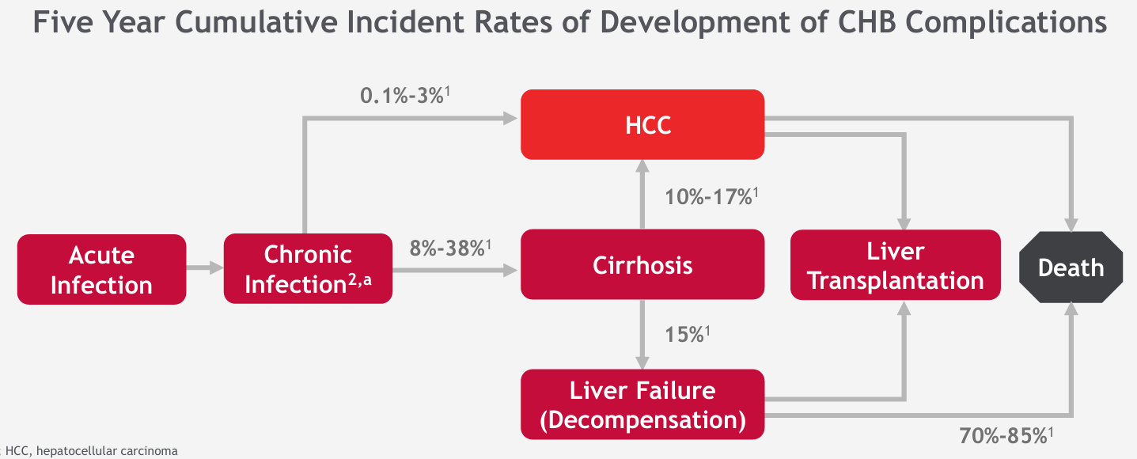
CHB Is Associated With Severe Burden of Disease
CHB, chronic hepatitis B; HCC, hepatocellular carcinoma a Patient is chronically infected if HBsAg+ for ≥ 6 months. 1. Fattovich G, et al. J Hepatol. 2008;48:335-352. 2. Lok ASF, McMahon BJ. Hepatology. 2009;50:1-36. Figure adapted with permission from Fattovich G, et al. In: Marcellin P, ed. Management of Patients With Viral Hepatitis. Paris: APMAHB; 2004.

Slide 26
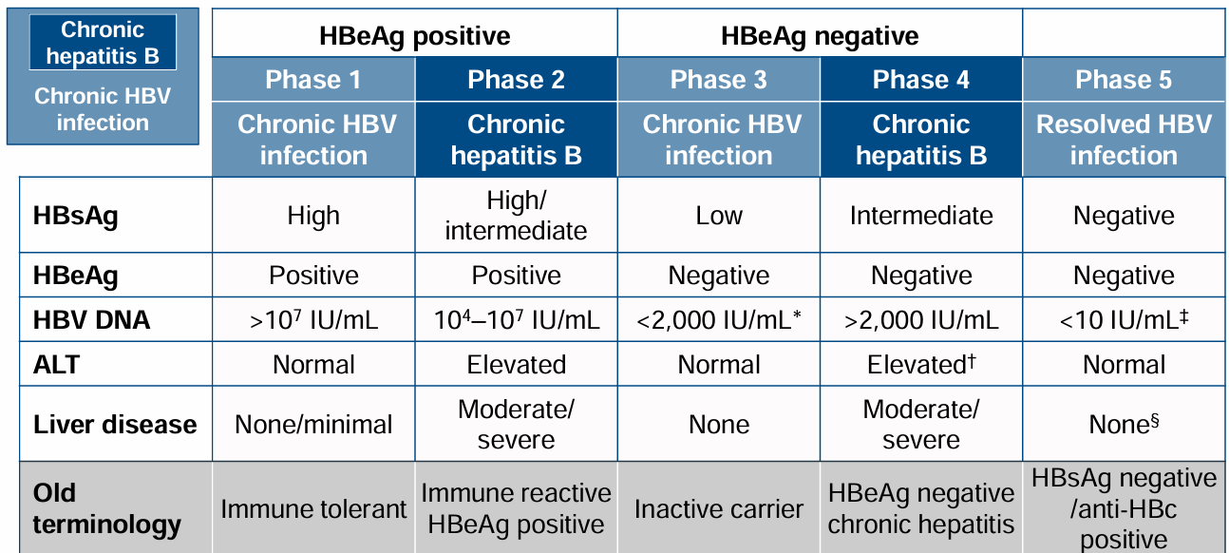
New nomenclature for chronic phases
The natural history of chronic HBV infection has been schematically divided into five phases
Notes:
PHASE 1: HBeAg +ive Chronic HBV Infection• Previous terminology: Immune Tolerant • Characterized by: • Presence of HBeAg • Very high levels of HBV DNA:>200 000 IU/ml • ALT persistently normal (ULN or approx.
PHASE 2: HBeAg +ive Chronic Hepatitis• Previous Terminology: Immune Reactive HBeAg +ive • Characterized by: • Presence of HBeAg • High levels of HBV DNA (but < phase 1): > 20 000 IU/ml • Raised ALT • Moderate to sever liver necroinflammation → accelerated progression to fibrosis • May occur several years after phase 1 but rapidly reaches phase 2 if patients were infected during adulthood
Phase 3: HBeAg negative HBV infection• Prev known as Inactive carrier • Characterized by • Presence of Anti Hbe • HBV DNA –undetectable or low (
Phase 4: HBeAg negative CHB• Characterized by • Presence of Anti Hbe • Persistent or Fluctuating moderate to high HBV DNA > 2 000 IU/ml • Persistent or Fluctuating levels of ALT • Liver histology shows necroinflammation and fibrosis • Most pts have HBV variants in pre-core +/- basal core promoter regions that impair or abolish HBeAg expression
Phase 5: Occult HBV infection
Characterized by: • Serum HBsAg negative, Anti HBc +ve • Normal ALT • HBV DNA usually detectable but < 200 IU/ml • cccNDAcan frequently be detected in liver • HCC risk • Low if no CoL prior to HBsAg loss • Remains if CoL has already developed prior to HBsAg loss, hence need for HCC surveillance only if CoL • Immunosuppression may lead to HBV reactivation

Slide 27
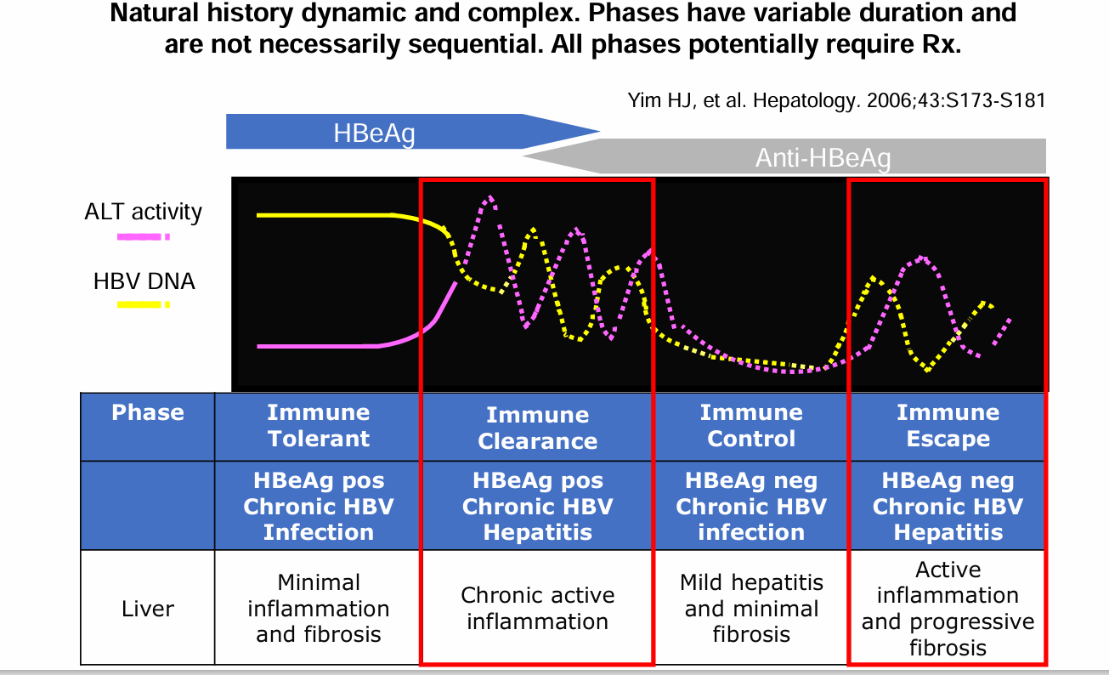
Phases of Chronic HBV Infection
Notes:
Importantly, delaying treatment in individuals perceived as being in the ‘immune-tolerant’ phase can lead to missed therapeutic windows, particularly in older adults or those with metabolic dysfunction-associated steatotic liver disease (MASLD), which exacerbates fibrosis progression

Slide 28
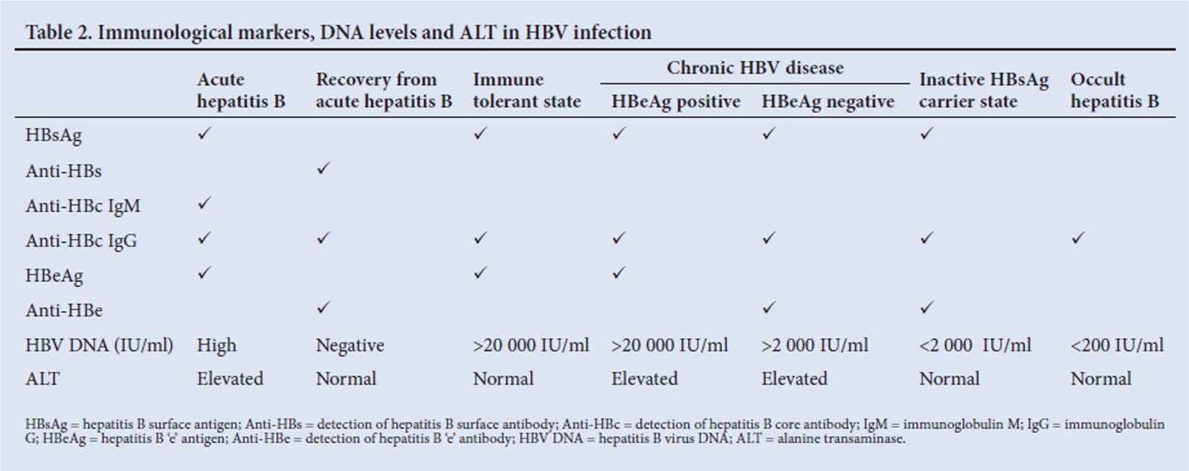

Slide 29
Practical Approach

Slide 30
Practical Approach

Slide 31
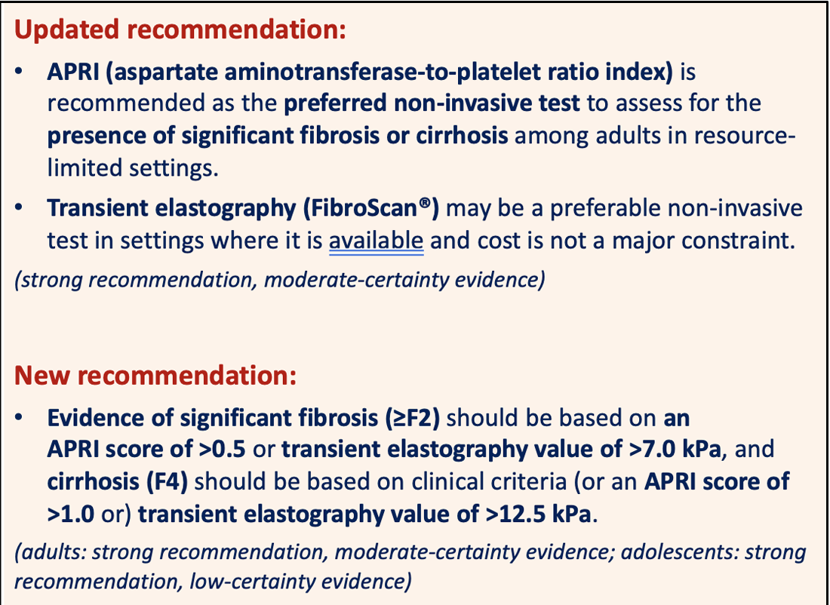
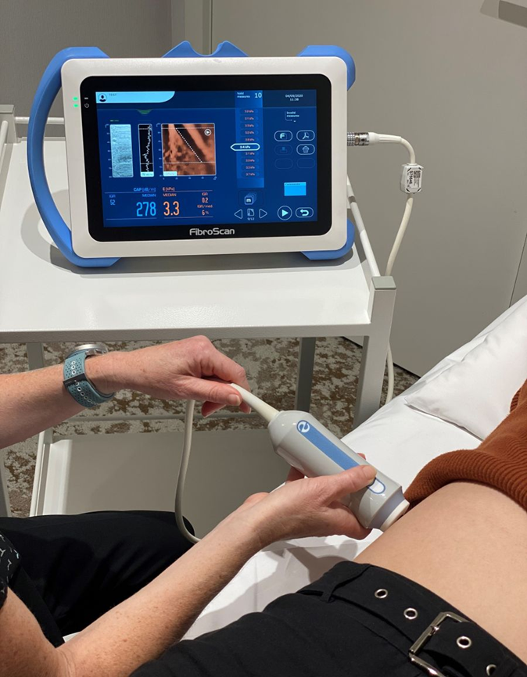
TESTING FOR FIBROSIS : non invasive

Slide 32
Risk factors for HCC
HOST FACTORS
Older age and male
Family history of HCC
MASLD and particularly diabetes mellitus
Longer duration of infection
VIRAL FACTORS
Genotype – particularly A1, C and E
High HBV DNA concentrations
HBeAg +
High HBsAg levels
Basal pre-core and core – promotor mutations
LIVER FACTORS
Persistently raised ALT
Cirrhosis
HIV, HCV and HDV
Concomitant liver disease of any cause
ENVIRONMENTAL FACTORS
Aflatoxin exposure
Smoking and alcohol us

Slide 33
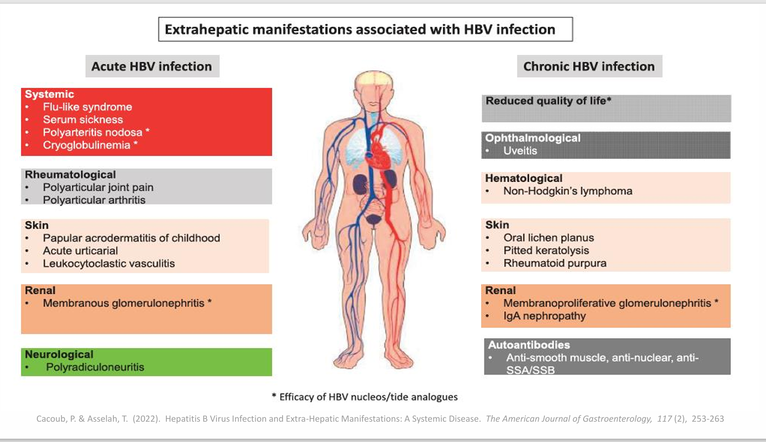

Slide 34

SPECIAL PATIENT GROUPS: PATIENTS WITH EXTRAHEPATIC MANIFESTATIONS
Some extrahepatic manifestations can be associated with HBV infection
  Vasculitis, skin manifestations (purpura), polyarteritis nodosa, arthralgias, peripheral neuropathy and glomerulonephritis
HBsAg-positive patients with extrahepatic manifestations and active HBV replication may respond to antiviral therapy
  PegIFNα can worsen some immune-mediated extrahepatic manifestations
Recommendations
Patients with replicative HBV infection and extrahepatic manifestations should receive antiviral treatment with NAs | II-2 | 1
PegIFNα should not be administered in patients with immune-related extrahepatic manifestations | III | 1
Grade of evidence
Grade of recommendation
EASL CPG HBV. J Hepatol 2017;67:370–98
Notes:
HBsAg, hepatitis B surface antigen; NA, nucleos(t)ide analogue; PegIFN, pegylated interferon

Slide 35
Special Considerations in HBV
HBV & Decompensated Cirrhosis
HBV-HCV co-infection
HBVHIV co-infection
HBV-HDV
Children
Pts undergoing haemodialysis
PMTCT-Mother To Child Transmission
Patients undergoing Immunosuppressive therapy

Slide 36
HBV AND DECOMPENSATED CIRRHOSIS
GOAL: Complete viral suppression- avoid liver transplantation
Treated with NAs as early as possible. ETV or TDF (preferred drugs)
Studies concerning the safety and efficacy of TAF in these patient populations are lacking.
PegIFNa is contraindicated
Referred for liver transplantation
Lifelong treatment is recommended
The risk of developing HCC is high

Slide 37
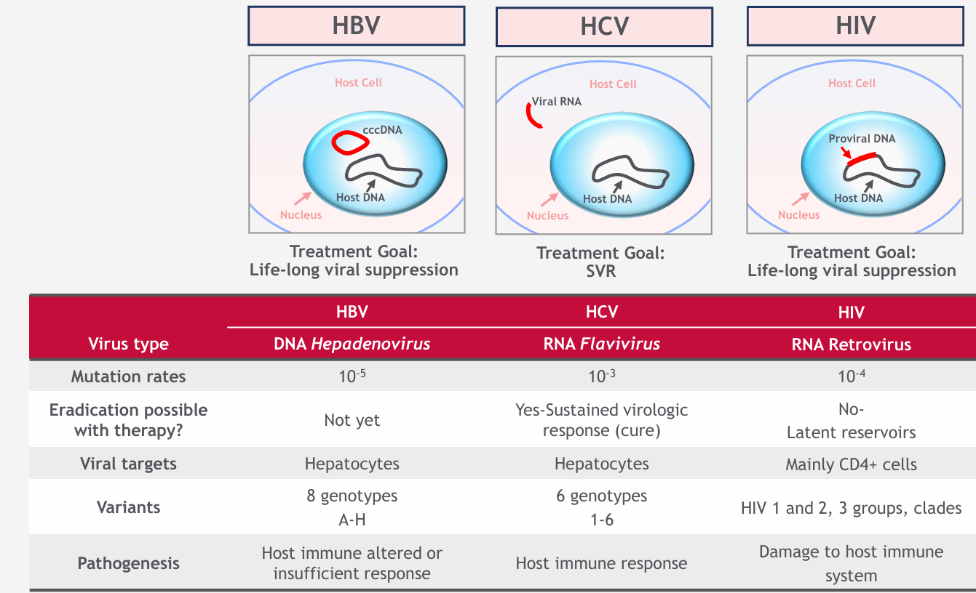
Hep B /Hep C and HIV
Liaw Y-F and Chu C-M. Lancet 2009; 373: 582-592; Dandri M and Locarnini S. Gut 2012; 61(Suppl 1): i6–i17; Locarnini S. 2004; 24(Suppl 1): 3-10; Chinen J and Shearer WT. J Allergy Clin Immunol 2002; 110(2):189 198; Chisari F V. Nature 2005; 436: 930-932

Slide 38
HIV-HBV co-infection
SIGNIFICANTLY MORE AGGRESSIVE DISEASE COURSE
Increasing viral replication and reactivation
Increased risk of acute liver failure
Increased risk of developing CHB or occult hepatitis B
Accelerated progression to fibrosis and cirrhosis
Increased rate of HCC and at a younger age
ART RELATED ISSUES
Increased risk of ART hepatotoxicity
Hepatitis B viral flare possible with IRIS on HAART
Remember to continue HBV treatment if/when changing HAART
HIV-HBV mortality 2x greater than HIV-HCV mortality
CD4 count <200 cells/mL 16 times greater liver-related deaths than CD4 count >350cells/mL
Increased risk of perinatal HBV infection
ART should include either TDF or TAF
Avoid stopping TDF- or TAF-containing ART → d/t high risk of severe hepatitis flares and decompensation following HBV reactivation hepatitis
Monitor Renal functions, liver functions and Bone mineral density closely

Slide 39
HCV-HBV
Accelerates progression of liver disease and HCC
HCV usually greater contributor to liver disease
SVR rates in mono-infected vs co-infected patients comparable
Treat Hepatitis B prior to initiating HCV treatment
All those that qualify for CHB treatment – initiate first
If CHB and do not qualify – consider prophylaxis until 12 weeks post DAA RX
Occult hep B –Monitor closely and investigate for reactivation of rising ALT

Slide 40
HDV-HBV –Delta Hepatitis
Most severe form of chronic viral hepatitis,
increased risk of developing cirrhosis and hepatic complications (HCC)
all HBsAg positive individuals should be screened for HDV
THE RISK GROUPS FOR HBV/HDV INFECTION INCLUDE
people born in HDV-endemic countries, regions, and areas In Asia Africa
people with advanced liver disease, those receiving HBV treatment, and those with features suggesting HDV infection (such as low HBV DNA with high ALT levels
PEOPLE CONSIDERED TO HAVE INCREASED RISK OF HDV INFECTION,
including hemodialysis recipients,
people living with hepatitis C or HIV,
people who inject drugs, sex workers,
men who have sex with men.
mainly transmitted parenterally, predominantly sexually or through contaminated blood (e.g. drug use) or blood
HDV testing should be repeated in case of persistent risk factors or unexplained ALT elevation
HDV co-infection, bulevirtide is the first licensed agent, and further entry inhibitors and immunotherapies are under evaluation.

Slide 41
Special patient groups: children
Recommendations
In children, the course of the disease is generally mild, and most children do not meet standard treatment indications. Thus, treatment should be considered with caution | II-3 | 1
In children or adolescents who meet treatment criteria, ETV, TDF, TAF, and PegIFNα can be used | II-2 | 2
Grade of evidence
Grade of recommendation
EASL CPG HBV. J Hepatol 2017;67:370–98
Notes:
ETV, entecavir; PegIFN, pegylated interferon; TAF, tenofovir alafenamide; TDF, tenofovir disoproxil fumarate

Slide 42
Patients undergoing Immunosuppressive therapy
The risk of HBV reactivation high (>10%), moderate (1–10%) or low (<1%).
All patients should be screened with HBsAg, anti-HBs and anti-HBc prior to
immunosuppression treatment.
Vaccination of HBV seronegative patients is recommended.
Higher doses or reinforced vaccine may be required to achieve anti-HBs response in immunocompromised patients.
All these patients should start potent NA as a treatment or as prophylaxis.

Slide 43
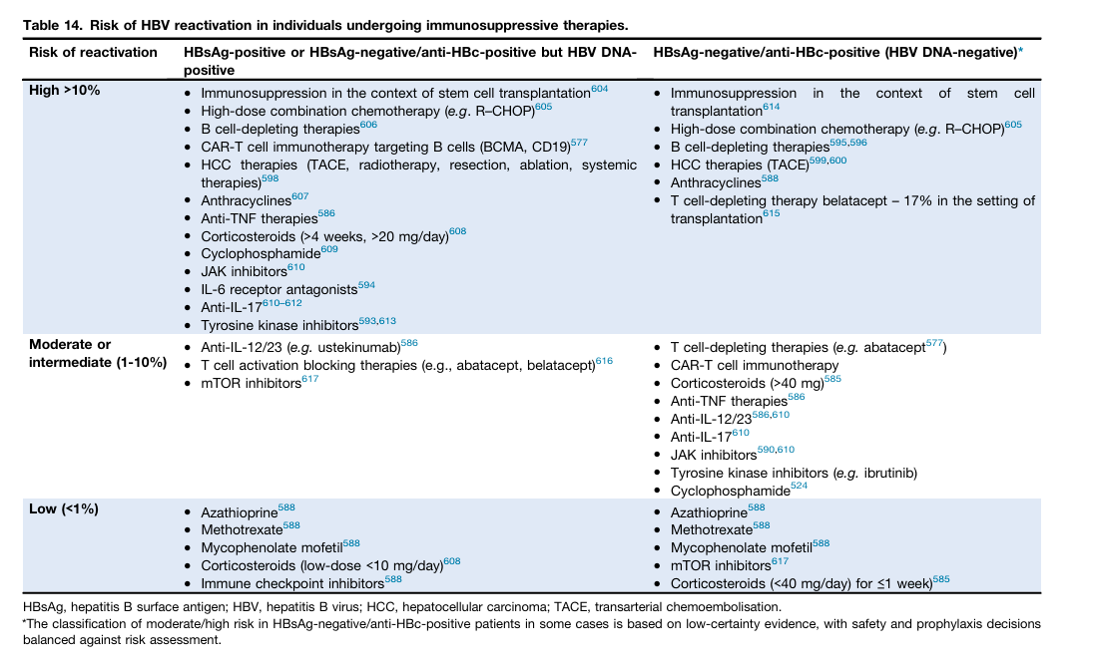

Slide 44
Patients undergoing dialysis and renal transplant
Recommendations
All dialysis and renal transplant recipients should be screened for HBV markers | II-2 | 1
HBsAg-positive dialysis patients who require treatment should receive ETV or TAF | II-2 | 1
All HBsAg-positive renal transplant recipients should receive ETV or TAF as prophylaxis or treatment | II-2 | 1
HBsAg-negative, anti-HBc-positive subjects should be monitored for HBV infection after renal transplantation | III | 1
Grade of evidence
Grade of recommendation
EASL CPG HBV. J Hepatol 2017;67:370–98
Notes:
ETV, entecavir; HBsAg, hepatitis B surface antigen; TAF, tenofovir alafenamide

Slide 45
PREGNANCY
Those established on TDF therapy should continue. ETV or PEG-IFNa should be switched to TDF.
Antiviral prophylaxis with TDF from 28 weeks is recommended in those with HBV DNA ≥200,000 IU/mL.
Neonates should receive birth-dose vaccine and HBIG within 12 h of delivery.
TDF is safe to continue while breastfeeding.
Risk of HBV transmission through breastfeeding is negligible if the newborn has received appropriate immunisation, even if maternal antivirals are discontinued

Slide 46
Prevention and Prophylaxis
Mother-to-Child Transmission Prevention
Antiviral Prophylaxis Among Pregnant Women a Adolescent Girls

Slide 47
PMTCT
HBV screening should be done in 1st trimester
Those not vaccinated should be vaccinated
If HBsAg positive
Referred for further testing, counselling and medical management
Contact tracing to identify others that are infected
If immune tolerant or immune control phase: do not require treatment –
BUT need to
consider risk of transmission with HBV VL >200 000 IU/mL
HBIG + birth dose vaccine within 24 hours of delivery prevent 85-90% of MTCT
Consideration of TDF 300mg for all pregnant CHB in 3rd trimester and 12 weeks post partum – to consider criteria for treatment thereafter
Vertical transmission is common
Co-infection with HIV increases risk 2.5 times
More likely to be HepBeAg + and have higher HBV VL
Annually 1% of newborns are infected with HBV
Currently no formal program for HBsAg screening in pregnancy
WHO recommends screening if prevalence >2%
Spearman CW et al, Gastroenterology and Hepatology Association of sub-Saharan Africa (GHASSA). Hepatitis B in sub-Saharan Africa: strategies to achieve the 2030 elimination targets. Lancet Gastroenterol Hepatol. 2017
Dec;2(12):900-909.

Slide 48
PMTC
Delivery of hepatitis B vaccine within 24 hours of birth should be a performance indicator for all immunization programmes, and reporting and monitoring systems should be strengthened to improve the quality of data on the birth dose
The birth dose should be followed by two or three additional doses to complete the primary immunization series
All pregnant women should be tested for HIV, syphilis, and HBsAg at least once and as early as possible during their pregnancy.

Slide 49
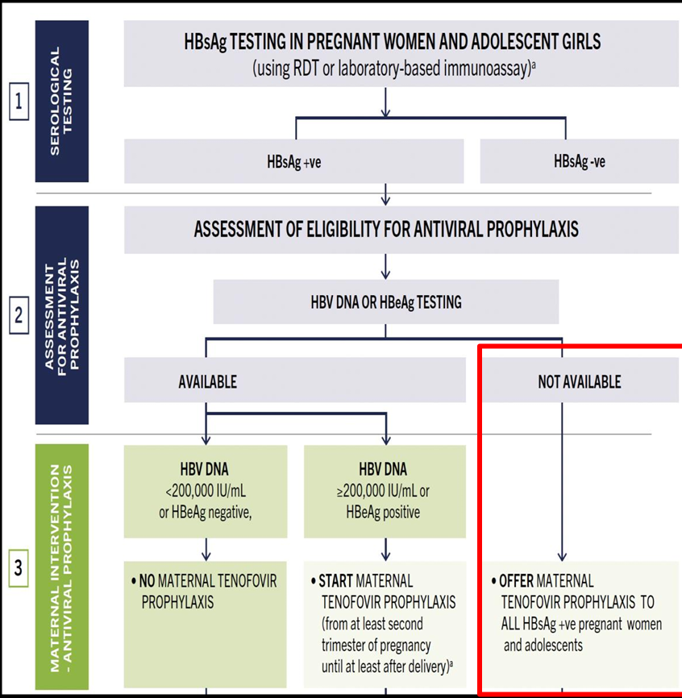
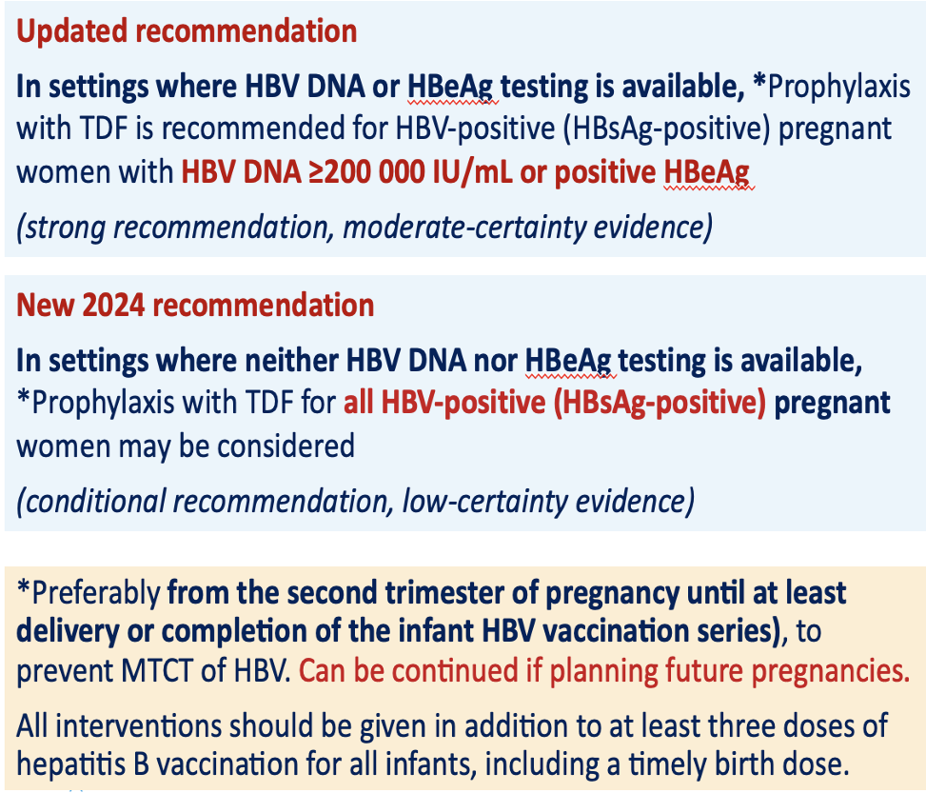

Slide 50
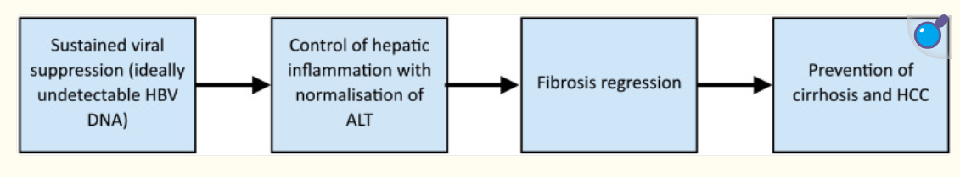
TREATMENT OF CHRONIC HBV
WHO TO TREAT ? Goals of Treatment
WHAT TO TREAT WITH ?
RESPONSE TO TREATMENT
Notes:
In 2015, WHO introduced the first guidelines on treatment of CHB, which focused on low-income and middle-income settings where access to clinical care and HBV DNA assays is insufficient.4 Treatment eligibility criteria focused on two priority groups: individuals with cirrhosis who were diagnosed clinically or on the basis of a non-invasive aspartate aminotransferase-to-platelet ratio index (APRI) score higher than 2, and individuals without cirrhosis but with high HBV DNA concentrations (>20 000 IU/mL) and persistently elevated ALT concentrations. In settings without HBV DNA testing, the guidelines conditionally recommended treatment on the sole basis of persistently abnormal ALT concentrations.
Several key developments have emerged since the publication of these guidelines, driving a re-evaluation of treatment eligibility criteria. These developments include recognition of the need for simplified criteria to promote access to treatment in resource-limited countries with little access to specialists or diagnostic tools required to assess treatment eligibility, growing evidence of ongoing HBV DNA integration during infection and on the oncogenic potential of CHB, and more data on clinical outcomes, especially in sub- Saharan Africa.9

Slide 51
Goals of Treatment
MAIN GOALS OF THERAPY:
To improve survival and QoL and prevent HCC development
ADDITIONAL GOALS:
Prevent mother to child transmission
Prevent hepatitis B reactivation
Prevention & Rx of HBV-associated extrahepatic manifestations
Regression of fibrosis and cirrhosis in patients with established advanced fibrosis or cirrhosis
In pts with HCC, to suppress viral HBV replication & reduce HCC recurrence after potential curative therapy
In Acute Hepatitis, to prevent ALF, improve QoL by shortening the duration of symptoms and lower risk of chronicity

Slide 52
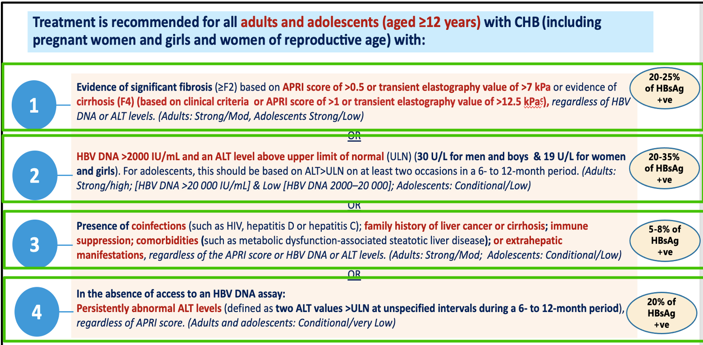
WHO To Treat : WHO 2024

Slide 53
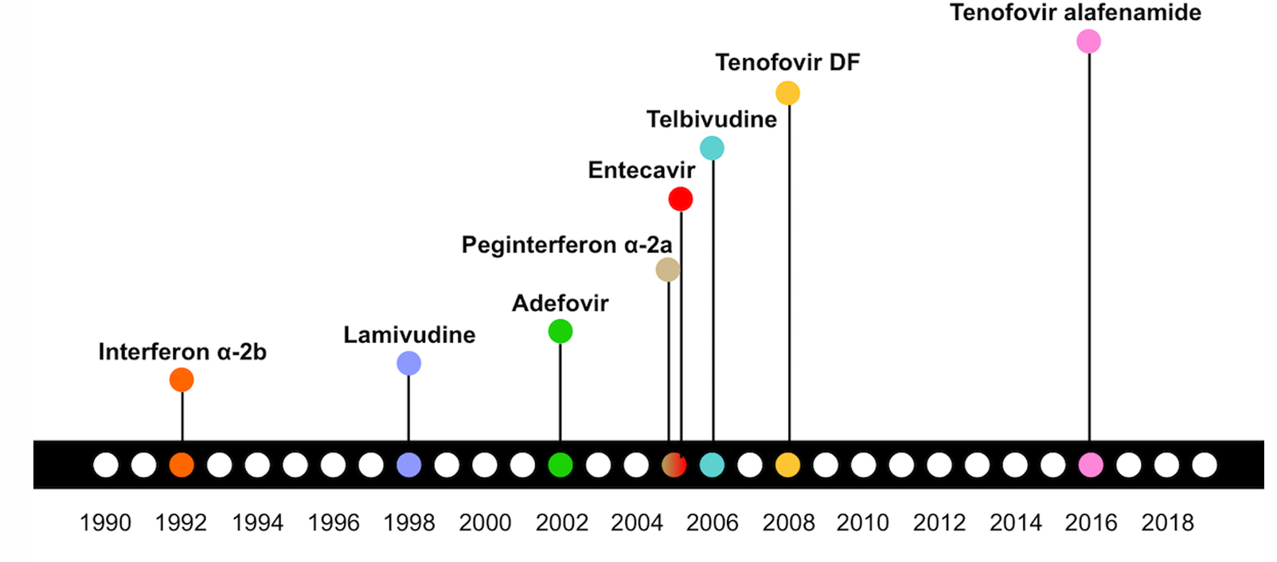

Slide 54
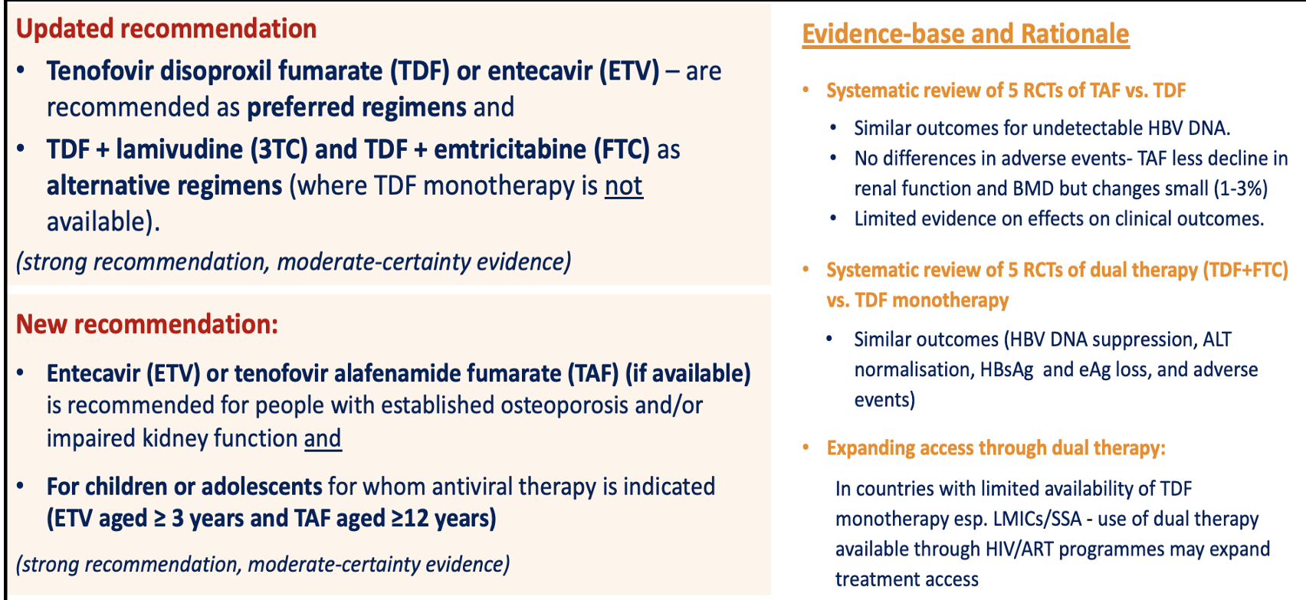
FIRST LINE THERAPY

Slide 55
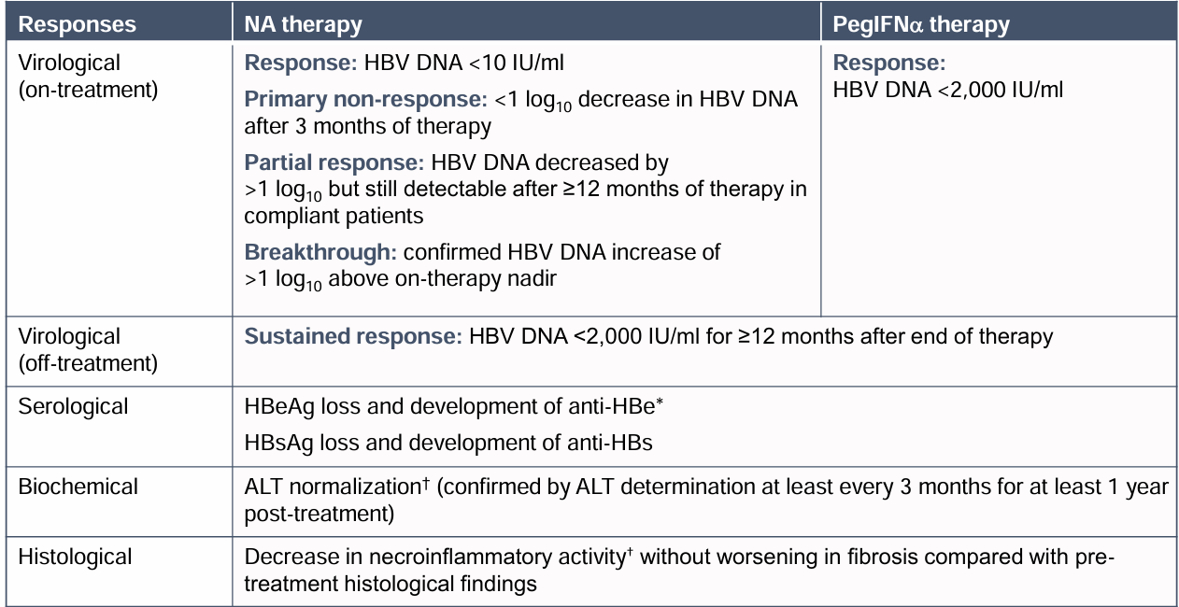
Definitions of response to treatment
European Association for the Study of the Liver. EASL 2017 Clinical Practice Guidelines on the management of hepatitis B virus infection. J Hepatol. 2017 Aug;67(2):370-398.

Slide 56
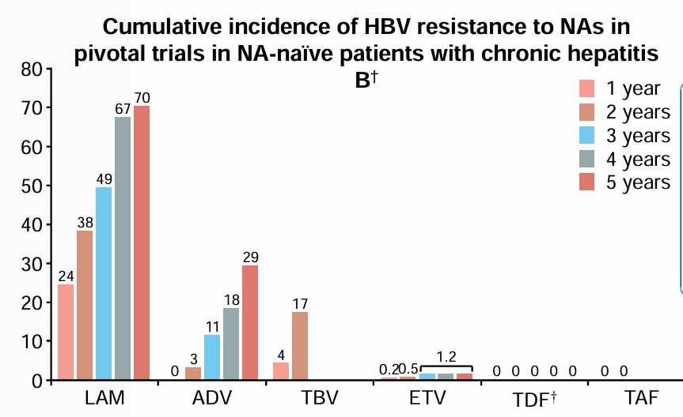
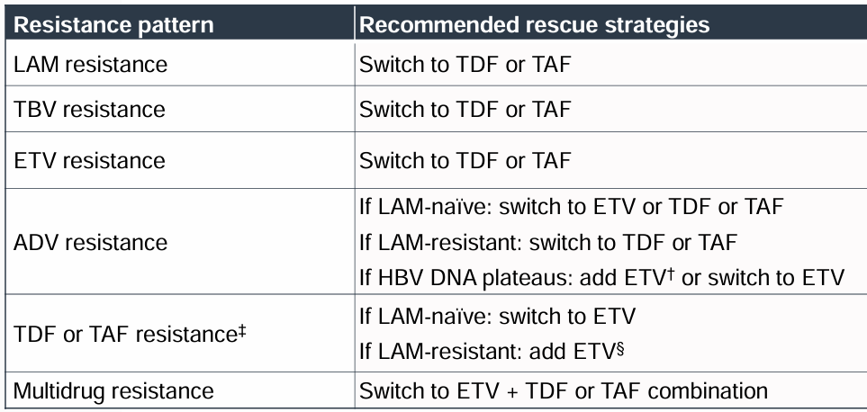
Resistance

Slide 57
Notes:
Management of Suboptimal Response to Antiviral Therapy.[1] There are different forms of suboptimal virologic response to
NA therapy – slow decline, plateau, and breakthrough. In all cases of suboptimal response, the initial steps include evaluation and
reinforcement of adherence, more frequent follow-up of HBV DNA levels to establish pattern and consideration of resistance testing
(particularly if the individual meets criteria for virologic breakthrough). Once adherence confirmed, if a plateau or virological
breakthrough is determined, consideration of an antiviral change should be considered. In most cases, a switch of antiviral is preferred
(lower pill burden) but add-on therapy can also be considered. For those with slow decline, continued monitoring for decline without
change of therapy is recommended.

Slide 58
Current treatment strategies for chronic hepatitis B: main concepts and features
Features | PegIFNα | ETV, TDF, TAF
Route of administration | Subcutaneous injections | Oral
Treatment duration | 48 weeks | Long-term until HBsAg loss*
Tolerability | Low | High
Long-term safety concerns | Very rarely persistence of on-treatment AEs† | Probably not‡
Contraindications | Many§ | None‖
Strategy | Induction of a long-term immune control | Inhibition of viral replication
Level of viral suppression | Moderate | Universally high
Effect on HBeAg loss | Moderate¶ | Low in first year, moderate over long term
Effect on HBsAg levels | Variable¶ | Low**
Risk of relapse after treatment cessation | Low for those with sustained response 6–12 months after therapy | Moderate if consolidation treatment provided after HBeAg seroconversion. High for HBeAg-negative disease
Early stopping rules | Yes | No
Risk of viral resistance | No | Minimal to none††
*Stopping NAs after some years might be considered in selected cases; †Psychiatric, neurological, endocrinological; ‡Uncertainties regarding kidney function, bone diseases for some NAs; §Decompensated disease, comorbidities etc.; ‖Dose adjustments in patients with eGFR <50 ml/min are required for all NAs except for TAF (no dose recommendation for TAF in patients with CrCl <15 ml/min who are not receiving haemodialysis); ¶Depending on baseline characteristics; **Slowly increases with treatment time in HBeAg-positive patients (a plateau in serological responses has been observed beyond treatment Year 4), usually very low in HBeAg-negative patients; ††So far no TDF or TAF resistance development has been detected
EASL CPG HBV. J Hepatol 2017;67:370–98
Notes:
AE, adverse event; CrCl, creatinine clearance; eGFR, estimated glomerular filtration rate; ETV, entecavir; HBeAg, hepatitis B ‘e’ antigen; HBsAg, hepatitis B surface antigen; NA, nucleos(t)ide analogue; PegIFN, pegylated interferon; TAF, tenofovir alafenamide; TDF, tenofovir disoproxil fumarate

Slide 59
Interferons
• Severe side effects (up to 50% of patients)
• Flu-like symptoms following each injection
• fever, headache, muscle aches, pains (articulation, abdominal, back pain)
• General fatigue
• Gastrointestinal disorders
• Thrombocytopenia and neutropenia
• Thyroid dysfunction
• Depressive episodes (can be very severe and lead to suicidal behavior)
• Contraindications
• Fulminant or decompensated liver failure
Pregnancy
• Extra hepatic manifestations, seizures, autoimmune disease

Slide 60
Monitoring patients treated with PegIFNα
Patients treated with PegIFNα require ongoing monitoring during treatment and after
virological response
Recommendations
Periodical assessments of at least full blood count, ALT, TSH, serum HBV DNA and HBsAg levels All patients with chronic hepatitis B treated with PegIFNα | I/II-2 | 1
Periodical assessments of HBeAg and anti-HBe HBeAg-positive patients with chronic hepatitis B treated with PegIFNα | I | 1
Long-term follow-up Patients with a virological response after PegIFNα therapy (risk of relapse) | II-2 | 1
Surveillance for HCC Patients with sustained responses after PegIFNα therapy and high baseline HCC risk (even if they achieve HBsAg loss) | III | 1
Grade of evidence
Grade of recommendation
EASL CPG HBV. J Hepatol 2017;67:370–98
Notes:
ALT, alanine aminotransferase; HBeAg, hepatitis B ‘e’ antigen; HBsAg, hepatitis B surface antigen; HCC, hepatocellular carcinoma; PegIFN, pegylated interferon; TSH, thyroid-stimulating hormone

Slide 61
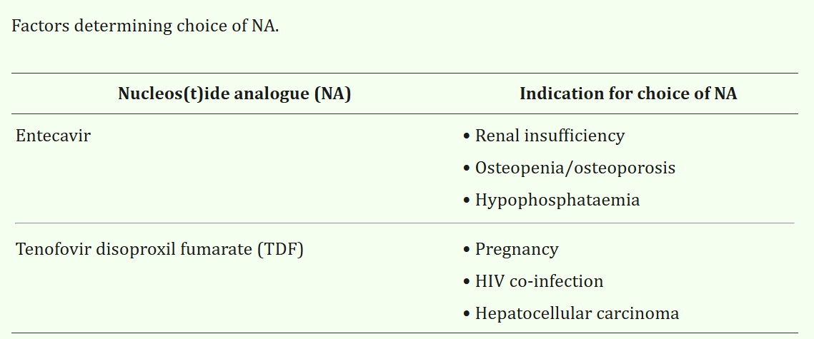
Choice of NA

Slide 62
Indications for selecting ETV or TAF over TDF*
In some circumstances ETV or TAF may be a more appropriate treatment choice than TDF
Age | >60 years
Bone disease | Chronic steroid use or use of other medications that worsen bone density History of fragility fracture Osteoporosis
Renal alteration† | eGFR <60 ml/min/1.73 m² Albuminuria >30 mg/24 h or moderate dipstick proteinuria Low phosphate (<2.5 mg/dl) Haemodialysis
*TAF should be preferred to ETV in patients with previous exposure to NAs; †ETV dose needs to be adjusted if eGFR <50 ml/min; no dose adjustment of TAF is required in adults or adolescents (aged ≥12 years and ≥35 kg body weight) with estimated CrCl ≥15 ml/min or in patients with CrCl <15 ml/min who are receiving haemodialysis
EASL CPG HBV. J Hepatol 2017;67:370–98
Notes:
CrCl, creatinine clearance; eGFR, estimated glomerular filtration rate; ETV, entecavir; NA, nucleos(t)ide analogue; TAF, tenofovir alafenamide; TDF, tenofovir disoproxil fumarate

Slide 63
Combination therapy
Combination therapy is generally not recommended
Recommendations (NA plus NA)
NOT recommended De novo combination therapy of two NAs with a high barrier to resistance (ETV, TDF, TAF) | I | 1
Drug switch or combination may be considered In treatment-adherent patients with incomplete HBV suppression reaching a plateau during ETV or TDF/TAF long-term therapy | III | 2
Recommendations (NA plus PegIFNα)
NOT recommended
De novo combination of NA and PegIFNα | I | 1
Short-term pretreatment with an NA before PegIFNα in treatment-naïve HBeAg-positive patients | II | 1
Adding PegIFNα or switching to PegIFNα in patients with long-term HBV DNA suppression on NA therapy | II | 1
Grade of evidence
Grade of recommendation
EASL CPG HBV. J Hepatol 2017;67:370–98
Notes:
ETV, entecavir; HBeAg, hepatitis B ‘e’ antigen; NA, nucleos(t)ide analogue; PegIFN, pegylated interferon; TAF, tenofovir alafenamide; TDF, tenofovir disoproxil fumarate

Slide 64
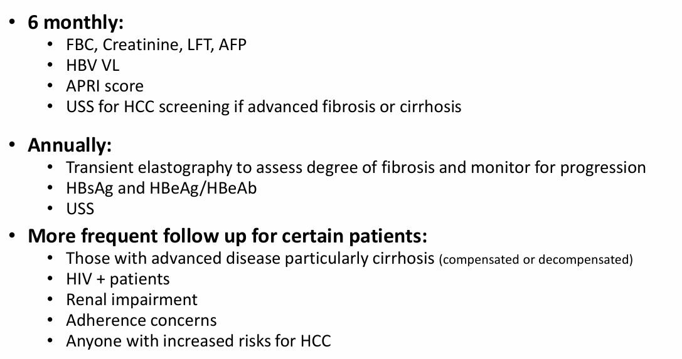
Monitoring on treatment with NAs
Treatment adherence should be monitored regularly and at each visit

Slide 65
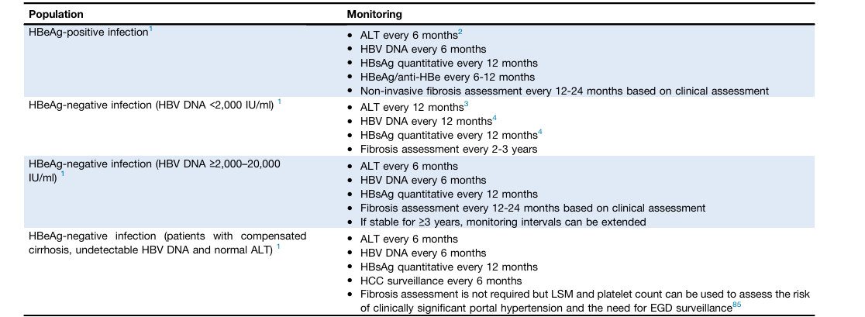
Monitoring Patients NOT Receiving Therapy
Notes:
People who do not currently meet the criteria for antiviral therapy (persistently normal serum aminotransferase results and HBV DNA levels below 2000 IU/mL when HBV DNA testing is available) or who have expressed a desire to defer treatment, may be monitored annually for disease progression and ALT and HBV DNA levels (when HBV DNA testing is available).

Slide 66
Discontinuation of NA treatment
Long-term therapy with NAs is usually required
  HBV eradication is not usually achieved
Recommendations
NAs should be discontinued After confirmed HBsAg loss (± anti-HBs seroconversion) | II-2 | 1
NAs can be discontinued In HBeAg-positive patients, without cirrhosis, who achieve stable HBeAg seroconversion and undetectable HBV DNA and complete ≥12 months of consolidation therapy Close post-NA monitoring is warranted | II-2 | 2
NAs may be discontinued In selected HBeAg-negative patients, without cirrhosis, who achieve long-term (≥3 years) virological suppression, if close post-NA monitoring can be guaranteed | II-2 | 2
Grade of evidence
Grade of recommendation
EASL CPG HBV. J Hepatol 2017;67:370–98
Notes:
HBeAg, hepatitis B ‘e’ antigen; HBsAg, hepatitis B surface antigen; NA, nucleos(t)ide analogue

Slide 67
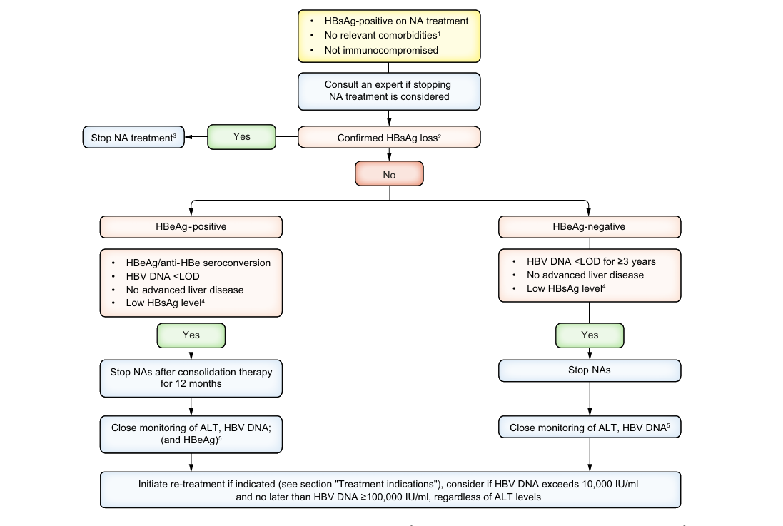
Stopping NA : usually lifelong therapy
Recommendations for stopping NA therapy prior to achieving HBsAg loss remain controversial, particularly due to concerns about clinical relapse.

Slide 68
Screening for HCC
Antiviral therapy reduces risk, it does not eliminate it.
Surveillance with 6- monthly liver ultrasound (with or without AFP) is recommended, in HBsAg positive patients, for:
all patients with cirrhosis
those with intermediate/high risk
patients with metabolic risk factors (eg MASLD, diabetes) even with virological suppression.
Failure to maintain surveillance in at-risk individuals with low viral load or normal ALT represents a common and consequential error.
For the minority of CHB patients who achieve HBsAg seroconversion, HCC surveillance should continue, particularly in those aged > 50, who have cirrhosis or a family history of HCC, due to elevated risk.

Slide 69
Vaccination
Universal HBV vaccination programmes POSITIVE impact
Vaccination at birth and in childhood has proven effective in reducing the prevalence of chronic HBV infection and its associated complications.
The best way to prevent hepatitis B is by getting vaccinated
The vaccine can be given at the same time of other vaccines
When person is exposed to HBV, if given the vaccine as soon as possible
(preferably within 24 hours), it can effectively prevent infection

Slide 70
Who should be vaccinated ?
Universal hepatitis B vaccination for all infants, children and adolescents is recommended as early as possible, preferably before the onset of puberty
Newborns of HBsAg-positive mothers or mothers with unknown HBsAg status should receive the hepatitis B vaccine as early as possible after birth, ideally within 12 hours, in combination with passive immunisation using hepatitis B immunoglobulin to maximise protection against HBV transmission
Individuals in whom a severe course of hepatitis B is to be expected due to an existing or expected immunodeficiency, immunosuppression or CLD And CKD
Individuals with an increased risk of non-occupational exposure, e.g. contact with HBsAg-positive persons (partners and family members of people living with chronic HBV infection),
high-risk sexual behaviour, persons seeking evaluation for treatment of STD
people who inject drugs,
incarcerated persons and patients in psychiatric facilities.
individuals with increased occupational exposure risk,
including healthcare trainees, interns, students, volunteers,
laboratory and cleaning staff in healthcare facilities
paramedics, emergency responders, police officers, fire fighters, soldiers, and staff in facilities with a high prevalence of chronic HBV infection.

Slide 71

WHICH VACCINES ARE AVAILABLE FOR THE PREVENTION OF HBV INFECTION?
Several recombinant hepatitis B vaccines are available worldwide and are used in various immunisation programmes against HBV infection.
The selection of a vaccine may depend on factors such as availability, cost, dosing schedule, efficacy and recommendations from local health authorities
Engerix-B®, Euvax®, and Infanrix-hexa®

Slide 72
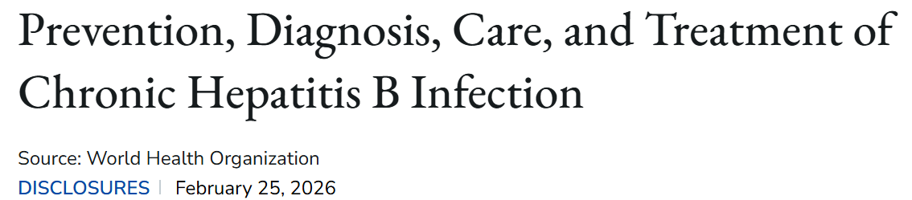
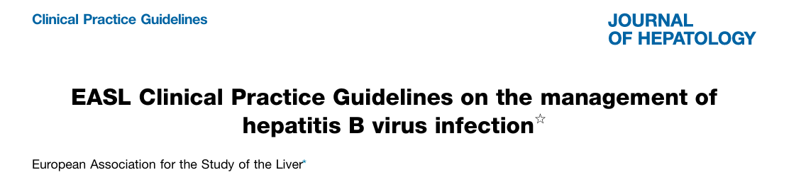


Slide 73
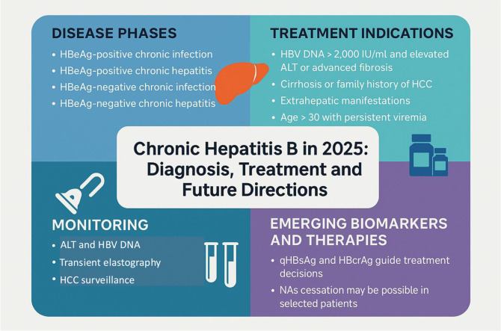
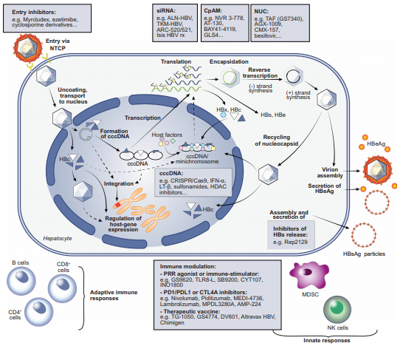
New concepts for antiviral drugs targeting HBV
Durantel D, Zoulim F. J Hepatol 2016;64:S117–31

Slide 74

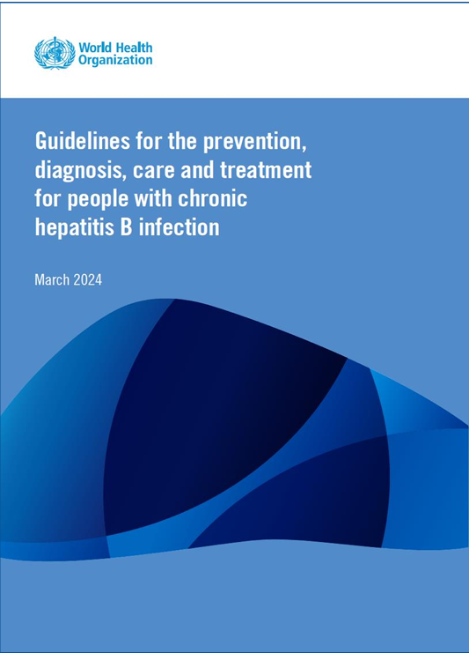
WHO 2024 Hepatitis B Guidelines March 2024

Slide 75
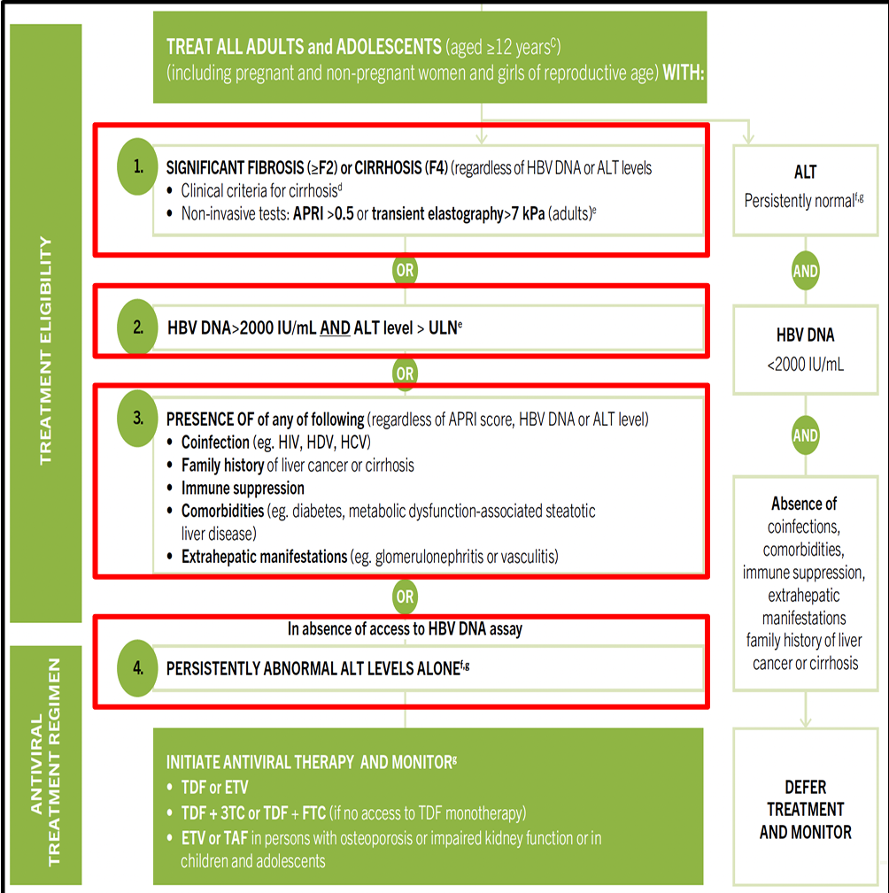

Slide 76
Updated 2024 WHO HBV Guidelines
Provide 4 options for meeting treatment eligibility that will capture higher proportion HBsAg-positive people
New APRI criteria for staging liver disease
Alternative antiviral regimens for treatment
o TDF or entecavir remain preferred first-line regimens
o TDF+lamivudine (3TC) or TDF + emtricitabine (FTC) if TDF monotherapy not available
o Tenofovir alafenamide (TAF) or Entecavir recommended for people with established
osteoporosis and/or impaired kidney function
Expand access to antiviral prophylaxis for HBsAg positive pregnant women
o TDF prophylaxis: All HBsAg-positive pregnant women if lack of access to HBV DNA assays
Use of point-of-care HBV DNA assays
Reflex Hepatitis D co-infection testing

Slide 77

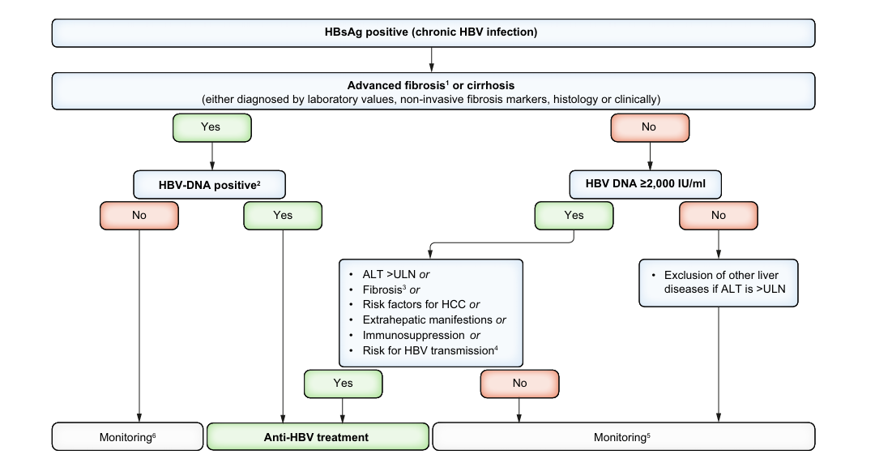

Slide 80
Key Takeaways from the Guidelines
TESTING
Settings with a higher HBsAg seroprevalence routine HBsAg testing
All pregnant women should be tested for HIV, syphilis, and HBsAg at least once and as early as possible during pregnancy
High-risk populations, household/sexual contacts of infected individuals, healthcare workers
HOW TO TEST INCL TESTING FIBROSIS
Laboratory assays are preferred where accessible; RDTs should be used to improve linkage to care in limited-access settings
APRI is the preferred non-invasive test for fibrosis in resource-limited settings;\
Transient elastography may be preferable when available and affordable
WHO TO TREAT
Treat all adults and adolescents (aged ≥12 years) with CHB and evidence of significant fibrosis (≥F2) or cirrhosis (F4), regardless of HBV DNA or ALT levels
When considering treatment based on viral load, treat individuals with HBV DNA >2000 IU/mL and ALT levels above the ULN (30 U/L for males, 19 U/L for females)
Initiate treatment regardless of APRI/DNA/ALT in patients with coinfections (HIV, HDV, HCV), family history of HCC/cirrhosis, immune suppression, or extrahepatic manifestations

Slide 81
Key Takeaways from the Guidelines
WHAT TO TREAT WITH
Preferred first-line therapies: TDF or ETV; avoid drugs with low barriers like lamivudine
Alternative regimens:
TDF + 3TC or TDF + FTC when TDF monotherapy is unavailable
ETV or TAF for patients with osteoporosis or impaired kidney function
Antiviral therapy is generally lifelong; it must never be discontinued in patients with clinical evidence of cirrhosis
  stopping therapy may be considered in non-cirrhotic patients who achieve
  HBeAg seroconversion (plus 1 year of treatment)
  or HBsAg loss, provided they have long-term follow up, normal ALT levels, and undetectable HBV DNA levels

Slide 82
Key Takeaways from the Guidelines
PMTC
All infants must receive the first dose of the hepatitis B vaccine within 24 hours of birth, followed by two or three additional doses
Pregnant women with HBV DNA ≥200,000 IU/mL (or positive HBeAg) should receive TDF prophylaxis from the second trimester until delivery
MONITORING
Quantitative or qualitative NAT (laboratory or POC) is the preferred strategy for assessing treatment eligibility and monitoring response
All HBsAg-positive individuals should ideally be screened for anti-HDV antibodies, followed by HDV RNA NAT to confirm active infection
Patients on treatment require annual assessment of liver fibrosis (APRI/transient elastography), ALT, HBV DNA, HBsAg, HBeAg/anti-HBe, and renal function (specifically for those on TDF)
Perform more frequent monitoring (every 3–6 months) for patients with cirrhosis, HIV coinfection, or renal impairment, and in the first year of treatment
Provide routine HCC surveillance every 6 months for patients with cirrhosis, a family history of HCC, or those over 40 years with high viral loads.

Slide 83
What the future Holds
New Biomarkers
New Therapies
Impact of co-medication and dietary factors
Emerging evidence from retrospective studies suggests
statins, SGLT2 inhibitors ,ACE-I ,ARB and aspirin may offer beneficial effects in patients with HBV, including a reduced risk of HCC.
Similarly, dietary factors, particularly coffee consumtion, have been linked to hepatic benefits, including protective effects
Future treatment options for HDV

Slide 84

NOVEL BIOMARKERS

Slide 85

EMERGING Therapies in HBV

