Slide 1
Addressing the Intention-Behaviour Gap in Healthcare
Jane Ball - head of population health management
Notes:
When looking at the agenda for this symposium, it is clear that there has been plenty of attention given to clinical best practice. Changing tack a bit, I would like to spend some time talking to you about my passion - the human element of patients.

Slide 2
Notes:
Currently many of our healthcare challenges, not least the growing burden of NCDs, can be prevented and managed through very simple changes to our everyday lives. And for most people, these changes are well-known and not under dispute. We all know that we need to exercise more, eat less sugar and that smoking is bad for you. For the majority of people, some education may be required but in the main it is not a lack of knowledge that is driving the increasing prevalence and poor outcomes associated with these conditions. Which really begs the question – why then do these healthcare challenges exist? Is it because we possess the knowledge but not the desire to do what is required or is it that we have the desire to improve our health but fail when it comes to execution?

Slide 3

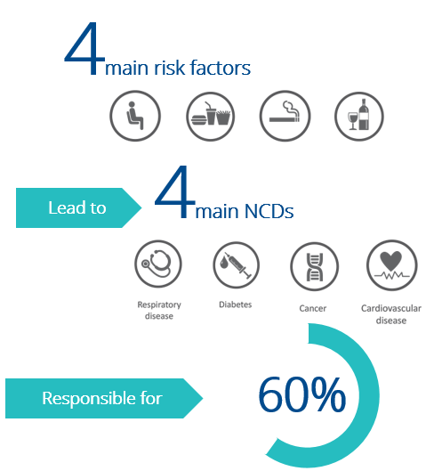
The Intention-Behaviour Gap
Intentions strongly predict behaviour BUT there is a substantial gap between
what people intend to do and what they actually do.
Only 50% of all intended health behaviours are realized.
(Sheeran & Connor, 2017)
Sheeran & Webb, 2016
Notes:
And the healthcare environment is littered with examples of people good intentions who then failing to successfully follow through. Who of us have not wanted to exercise more only to find our bed each morning far too warm and comfortable? Or have decided to cut out sugar only to find ourselves confronted with the dessert menu at dinner? Surveys in the US reveal that 68% of smokers want to quit and 66% of obese adults want to lose weight – and yet these remain significant risk factors. For many of us it feels like we are in a perennial battle with ourselves.
While many prominent psychological models; including the theory of reasoned action and the theory of planned behaviour; hold that intentions strongly predict behaviour (Armitage & Conner, 2001), research has shown that, while intentions may account for some of the resultant behaviour observed, there is a substantial gap between what people intend to do and what they actually do (Sheeran, 2002; Conner & Norman, 2005; Webb & Sheeran, 2006; Sheeran & Conner, 2017).
The sad reality is that less than 50% (one-half) of all intended health behaviours are realised (McEachan et al., 2011; Sheeran & Conner, 2017). A meta-analysis was conducted across multiple health domains and the same effect was seen for cancer screening, physical activity, safe-sex practices, self-examinations and diet. In addition, a meta-analysis of experiments designed to manipulate intentions only demonstrated a small to medium effect on behaviour (Sheeran & Webb, 2016).

Slide 4
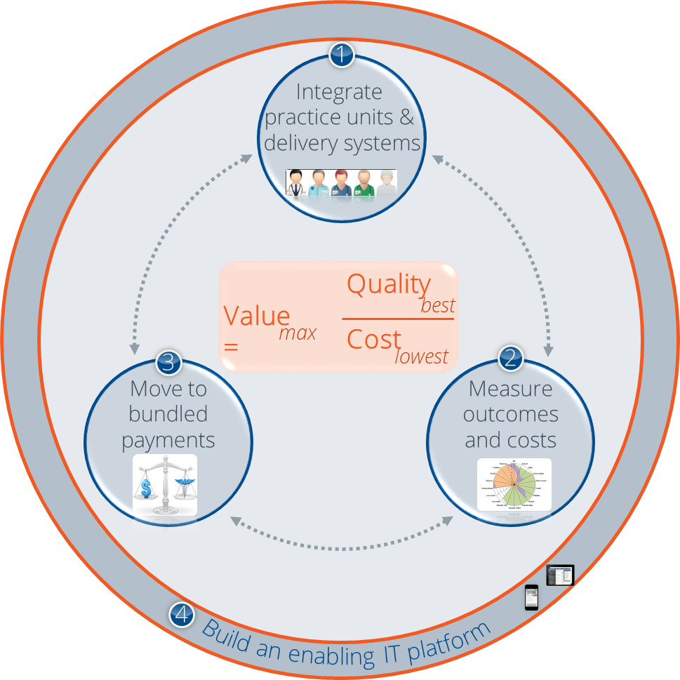

Slide 5


Slide 6
Phases for goal attainment
The rubicon model of action phases (achtziger & Gollwitzer, 2008)
Formation
Initiation
Realisation
Deactivation
“Rubicon”
Motivation pre-decisional
Volition pre-actional
Volition actional
Motivation post-actional
Deliberation
Planning
Action
Evaluation
Goal Setting
Goal Striving
Notes:
The reality is that it is a combination of both. In some cases, we have not yet decided to pursue a specific goal or action (goal setting) while in other cases, we know the goals and the actions that we want to pursue but we struggle with the goal striving phase of the task.
The focus of the presentation today is the latter – understanding the gap between what we intend and actual actions, common reasons in healthcare environment that this gap exists, and an overview of the techniques and mechanisms that, as a family practitioner, can be used to support individuals to successfully overcome these goal striving challenges.
The reason that I have chosen to focus on this particular component is two-fold. (1) campaigns to get people to change their minds have been largely unsuccessful and there are many examples of where these campaigns have resulted in negative unintended consequences. For example, campaigns aimed at reducing teenage pregnancies have in fact been associated with a higher pregnancy rate and the “scared straight” campaign in the United States resulted in more juvenile deliquents ending up in jail. Secondly, recent research suggests that greater potential improving outcomes lies with our ability to support those patients who already have positive intentions to achieve their goals rather than trying to convince people to do something different (Rhodes & De Bruijn, 2013).
Intentions are defined as our conscious decisions and motivations that determine how hard we are willing to try and how much effort we will expend in order to enact a desired behaviour (Ajzen, 1991).

Slide 7
Why does this gap exist?
If we know what is good for us, why don’t we just do it?
Present bias (dynamically inconsistent)
Competing
priorities
Short-term
costs
https://www.youtube.com/watch?v=BvInxjEZD6M
Psychological distance
(construal levels)
Lack of autonomy and self-efficacy
Forgetfulness
Notes:
There are many reasons why our intentions are derailed but I am going to spend some time of the most common reasons given that are relevant to healthcare.
Our preferences are dynamically inconsistent. Traditional economics would have it that any time we need to make a decision we weight up the costs and the benefits and then make the choice that would ultimately deliver the greatest value. But experiments have consistently demonstrated that this is not the case. The classic example is where participants are offered R100 today or R120 tomorrow. Most participants take R100 today. But when the same offer is made for a month later or a month + one day later, most people take the second option and elect to wait for R120. The future tends to be sharply discounted relative to the present. And this is not limited to finances only. An interesting experiment was conducted by Read et al (1999) where participants were asked what type of movies they like to watch. Tonight versus next week.
This clip by Seinfeld perfectly expresses our present-bias and how this is often inconsistent with our future self.
In an environment of limited resources, everyone of us have different priorities all competing for our time, money, cognitive and physical effort. While for us in the healthcare environment it is easy to assume that improving health is a top priority for many patients, this is competing with a multitude of priorities. While we all know that it is important to exercise regularly, this often competes with family time, relaxation, personal admin and work demands. It what is very important is that this phenomenon is even more pronounced in environments of scarcity. It has been well demonstrated, for example, that will power is lower for people in poverty and it has been suggested that individuals who are having to make really hard decisions every day (do I spend my last R50 on a bus ticket to town in the hope I might find a job or do I use it to feed my family), really struggle to follow through on actions that require will power. When we are tired or stressed a similar phenomenon occurs as demonstrated by an experiment that plotted the relationship between hand hygiene and time since the start of shift for care givers hospitals. Both time since the start of a shift as well as the time off between shifts significantly impacted on compliance to hygiene protocols.
Sometimes the initial reluctance to do something is about accepting short-term costs; getting started means losing out on immediate rewards. Delaying gratification means to reject immediate rewards in favour of bigger but more distant rewards. By reducing friction or making it easy to do the right thing reduces the costs of acting.
Remembering to implement intended activities, such as remembering to take medication or attend a meeting relies on our prospective memory. Prospective memory (PM) is the ability to remember to carry out actions (in the near future) that are planned after a delay or interruption. Unpredictability, delays, and interruptions are frequent in health care. During a stressful situation, memory is also likely to be more error-prone. Compounding this, prospective memory reduces as we age while many healthcare issues arise. Common failures of prospective memory are taking medicine daily, going regularly for monitoring tests or arriving for a follow-up appointment.
Autonomy (the feeling of being in control of / choosing your own behaviours) is often associated with better performance outcomes than intentions that result from external pressures or normative standards. Knowing that you are capable of doing something is also an important component.
Health (and improving health) is a relatively abstract concept with multiple dimensions (physical, spiritual, emotional). What we know from construal theory is that abstract concepts are imbued with high value but are also psychologically distant, creating the impression that ‘action can wait for another day’. This makes health actions highly prone to procrastination. In addition, ‘improved health’ does not have a clearly defined start and end point. As a result, this concept may feel less connected to the individual’s current self than an event with a defined deadline or for which defined preparations have already begun. Evidence suggests that the more connected we feel, the more readily we will act now in order to achieve a goal in the distant future. This concept has been used to great effect in financial services where showing people images of themselves at retirement age has significantly increased saving for retirement.
Knowing this, it is clear that there is no single silver bullet that will easily change our behaviour for the better. Rather, there are a number of different aspects to be considered and changes to be made that collectively may help us overcome these challenges.

Slide 8
Strategies to overcome the intention-behaviour gap
THE PREMIER PLUS TOOLKIT FOR FAMILY PRACTITIONERS

Slide 9



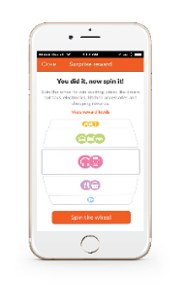












Premier Plus Care Programmes
Access an experienced doctor within network
Unlock additional risk benefits
Track compliance and progress of Diabetes Management Score via member app
Earns rewards to achieving health goals
Member
Unlock special doctor-specific benefits
Track patients’ compliance via Discovery’s
HealthID EHR
Track patients’ management score via Dashboard
Reimbursed for spending time with
the patient
Doctor
Notes:
The Premier Plus Care Programmes have been designed specifically to help overcome the barriers to behaviour change for patients with diabetes, cardiovascular disease, depression and HIV.
As background, doctors within the Premier Plus network are asked to formalize their relationship with the patient – that they are the patient’s primary care provider and will be the patient’s first port of call. Doctors in the network are also asked to spend more time with these patients, make use of Health ID to view and share clinical information and asked to monitor their patients between consultations. For this, Premier Plus GPs have access to funding for an extended consultation on an annual basis and a monthly management fee.
For the member, being registered on a Care Programme means that they have access to additional risk benefits (like biokineticists and diabetic nurse educators), they can track their own performance on the member app and from September they will be able to earn rewards for achieving health goals.

Slide 10
Extended consultation
TIME FOR SHARED DECISION-MAKING
Notes:
Key to overcoming some of the challenges to behaviour change is spending time with the patient – both because this encourages the development of a strong relationship between the Premier Plus doctor and the patient and because it allows for time for shared decision-making.
There is loads of evidence that the messenger strongly influences how / whether people act. Good messengers typically fall into 2 camps – people like us and then people with superior knowledge or authority. From this, we know that doctors make powerful messengers.
Shared decision-making encourages the patient to define their own goals and make plans on how achieve these. People who are autonomously or intrinsically motivated are more wholeheartedly engaged and persistent than when motivations are external and controlled by others.
Practically, when developing a care plan for the patient, the patient needs to be asked to share what health goals they would like to achieve and then together patient-specific actions can be defined. It is also important to note during this process that fear appeals are generally counter-effective.
There are a number of tools that can be used during the extended consultation to support shared-decision making. One such tool that I would encourage is the use of a patient checklist as this has been shown to encourage engagement and responsibility for health. They also help with forgetfulness during the consultation. I think every patient would be able to relate the situation of wanting to ask their doctor something during a consultation and then realizing as they drive away that they forgot to ask about it.
There are many checklists available and these could be given to patients while waiting for their appointment. Common prompts on a checklist for a patient with a chronic condition would be things like:
Do I need to discuss any side effects and whether my medicine should be changed;
What other healthcare services do I need to manage my condition;
What do the blood tests measure and what does the measurement mean;
Can I continue to eat……
Shared decision making can increase the sense of autonomy and competence and make the required actions more concrete.

Slide 11
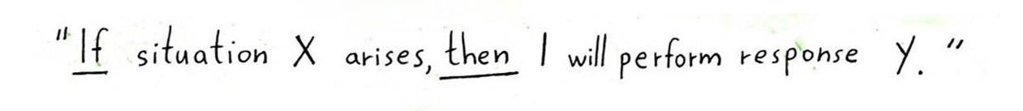
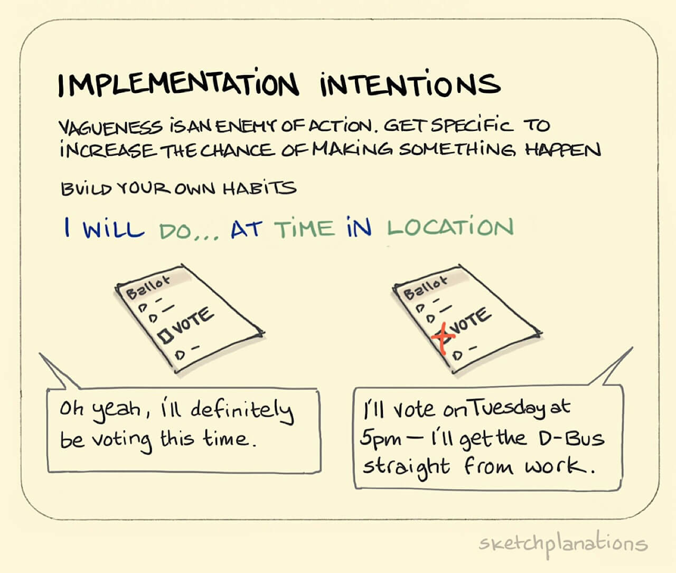
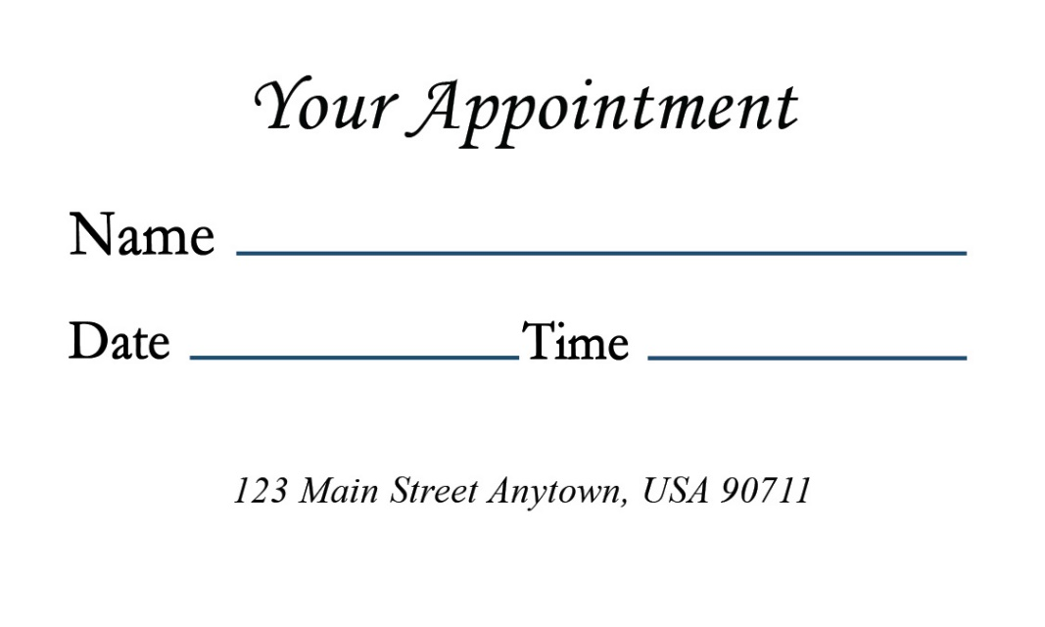
Extended consultation
Help create implementation intentions
Notes:
Once goals have been chosen, there is a very simple technique, known as an implementation intention, that can be used to place the goal at a distinct advantage. Creating an implementation intention increases both the probability that a behaviour will be performed and how quickly the behaviour is activated.
Implementation intentions work by mentally pairing the desired behaviour with a situational cue. To do this a specific structure may be used (‘if-then’ or “when situation 𝑥 arises, I will implement response 𝑦”). An example of an implementation intention would be “when I am having dinner at a restaurant and the waiter asks if I want to see the dessert menu, I will respond that I would just like a coffee please.” Another example would be “If I have not exercised by lunchtime on Sunday, then I will take the dog for a walk once as soon as I have washed the dishes.”
I am sure that many of you in the audience are thinking that this is unlikely to make any difference…. significant improvement in important health related process measures where implementation intentions have been created. I personally have been involved with a randomized controlled experiment which demonstrated that the likelihood of patients at high risk of back surgery attending a back rehabilitation programme was increased by 5% when they were encouraged to create an implementation intention during a scripted telephone call.
The reasons that they work is because they make the mental representation of an opportunity to act very accessible, which makes the individual ready to act immediately in a largely automatic manner when an actual opportunity (situation) arises with less reliance on cognitive processes.. And because it is an automatic response to a cue it is less likely to be derailed by competing priorities or cognitive burden.
Implementation intentions also reduce present bias, make goals more concrete which according to construal level theory makes goals more real and less prone to procrastination. And they also reduce forgetfulness.
One simple application of this concept is, once the patient has expressed a desired goal, to ask them when, where and what they would be doing when they would perform the planned action. If you feel that this line of questioning may be viewed as too invasive, it could be prefaced with an explanation that planning helps us remember when and how to take action.
A simple application of this concept is to have patients write down the date and time of their follow up appointment rather than have your receptionist do this for them. In UK, this simple change in process decreased failure to arrive for a follow up appointments by 18%.

Slide 12
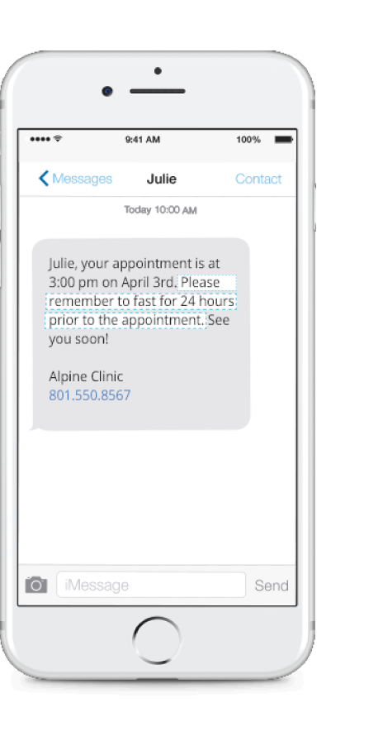
Population Health Management
Proactive reminders
Distribution of text reminders to patients identified with gaps in care can significantly increase adherence to care plans.
 GP endorsement is associated with a positive impact on reminder effects
Notes:
Another action that practices can take is to proactively remind patients to make an appointment for an extended consultation or to present for a specific test. There are many examples that demonstrate that reminders result in reduced missed appointments, and improved adherence to treatment and participation in screening initiatives.
We also know that if the reminder comes from the patient’s GP the reminder effect is heightened.
Lastly, if you implement proactive messaging to patients, the evidence shows that providing additional information over and above the date, time and location of the appointment (‘reminder plus’) may be more effective than simple reminders.
Sims et al found that text message reminders could reduce the number of missed psychiatric appointments by 25–28% in mental health services, where non-attendance is two to three times the rate of other medical specialties.
Systematic review focusing on anti-epileptics found that multiple reminders featuring action planning were more effective than patient education (Al-Aqeel S, Al-Sabhan J. Strategies for improving adherence to antiepileptic drug treatment in patients with epilepsy. Cochrane Database Syst Rev. 2012;1(1) CD008312)
Behavioural text message reminders to improve participation in cervical screening: a randomised controlled trial (Huf et al., 2017)
.

Slide 13
Vitality Active Rewards
Expanded for members with chronic conditions not on vitality
High
risk
Physical Activity | Nutrition | Medicine Adherence | Weight Management | Track your Health
Chronic
Physical Activity | Nutrition | Medicine Adherence | Weight Management | Track Your Health
At risk
Physical Activity | Nutrition | Preventative screening | Medicine Adherence
Well
Physical Activity | Nutrition | Preventative screening
Active Rewards 2.0 has been designed to address a broader range of
health behaviours, risk segments and conditions
Notes:
We know, however, that we cannot place the entire burden for improving the management of chronic conditions on the doctor. It is for this reason that Vitality has taken the learnings from the current Vitality Active Rewards programme and has extended this for members with certain chronic conditions but who are not Vitality members. The conditions initially targeted are diabetes, hypertension, hyperlipidaemia and ischaemic heart disease. The focus for these conditions is on medicine adherence, weight management and adherence to best practice care pathways.

Slide 14
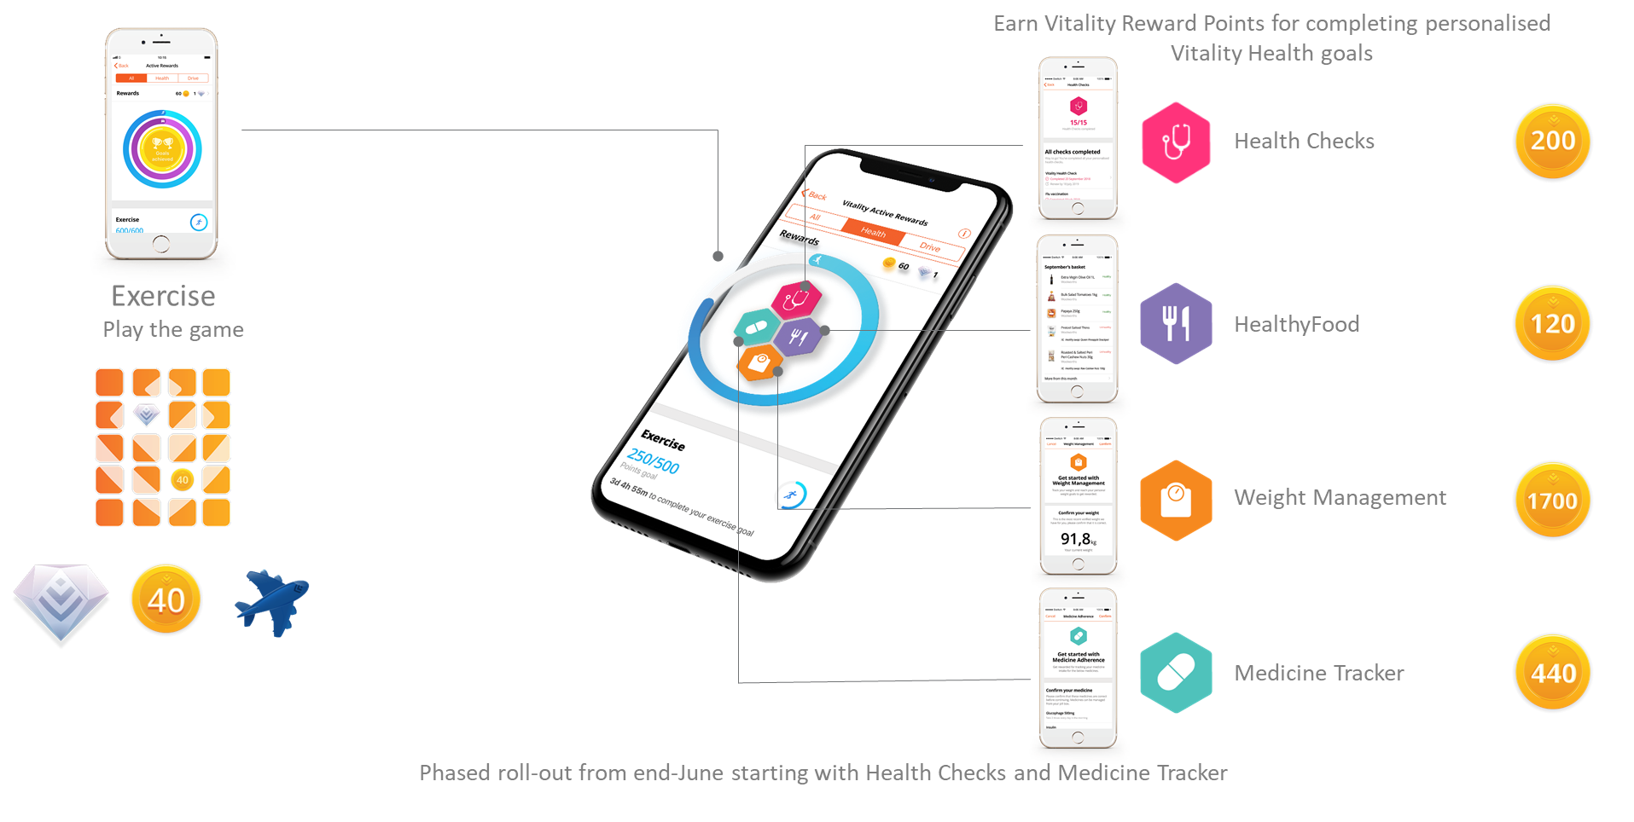
Vitality Active Rewards
Expanded for members with chronic conditions
Phased roll-out from August 2019 starting with Health Checks and Medicine Tracker
Notes:
Active Rewards provides members with points for positive health behaviours. If the goal is achieved, the member gets a play on the game board and wins points or diamonds. Points and diamonds can then be used to purchase different rewards. Importantly goals are calculated on a weekly basis so rewards are realized frequently and almost immediately once the desired actions have been taken.
Patients will be awarded points for completing a number of important health checks like visiting the FP every 6 months, having an HbA1c test or a lipogram, adhering to prescribed medicine, for buying healthy food and, where applicable, achieving weight reduction goals. Phased roll-out with the health check and medicine tracker modules being released first.
By making Active Rewards available to patients with these chronic conditions, we introduce a number of behavioural insights that support goal attainment.
Incentives create a more immediate reward playing to our present bias. Once a goal is successfully completed, patients will be able to immediately access the reward. This simultaneous goes some way to reducing the pain of short-term costs.
Short-term incentives help habitualise actions so that they are less likely to be derailed by competing priorities. As people respond repeatedly in a stable context (e.g. taking my medicine every day or exercising regularly), they form direct associations in memory between that response and contextual cues. Over time, the context can trigger the response directly, and deactivate competing responses.
By visually displaying progress towards a goal, we enhance the sense that a goal is within our reach. This is important as research shows that the tendency to achieve a goal increases with proximity to the goal.
At the end of the month, we will be rolling out changes to Health ID to enable you to recommend, as part of your treatment plan, that your patient activates Active Rewards and to view who has registered and how they are progressing on Active Rewards.

Slide 15

Access to Telephonic Coaching
Self-management support
Structured outbound telephone calls that focus on self-management and supporting behaviour change
Motivational Interviewing
Goal setting
Goal tracking
Education
Risk
Stratification
Navigation
Notes:
The other recent introduction to the Diabetes Care programme is providing access to a telephonic diabetes coach. These coaches are experienced diabetic educators who have also been trained in motivational interviewing and other tools that facilitate behaviour change. In essence, the diabetes coach works with the patient to identify barriers and to put a plan in place to overcome these barriers.
It is important to note that the aim of this service is not to take over the management of the patient but rather to help the patient execute your treatment plan and to improve their diabetes management skills.
By increasing the patient’s self-efficacy and setting out a formal plan, the challenges of competing priorities, lack of autonomy and competence and psychological distance can be reduced.
Currently patients are identified for this programme based on their risk profile. You will be notified when your patient has been identified for the progrmme and I appeal to you to encourage your patient to make use of the service. We are hoping that in future we will be able to open this up to all patients on referral from their doctor.
Increase self-efficacy (SDT).

Slide 16
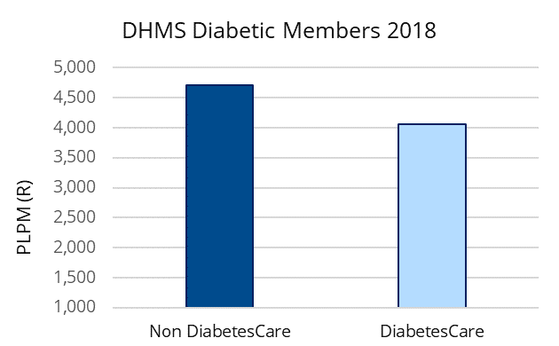
DiabetesCare Process and Financial Outcomes
19%
19%
-6.4%
risk-adj
-6.4%
risk-adj
-7%
21%
Notes:
While the programme comes at a considerable upfront cost to the funder, it has been implemented because it is clear that programme will add value to both the patient and doctor and it is anticipated that as quality of care improves, the cost of long-term complications will reduce which provides value to all parties.
Initial quality outcomes from the programme are very promising. We are seeing big improvements in process measures with many more patients seeing their GP regularly and monitoring their condition. In 2018, we also saw a lower all-cause hospital admission rate for members on the Diabetes Care programme.

Slide 17

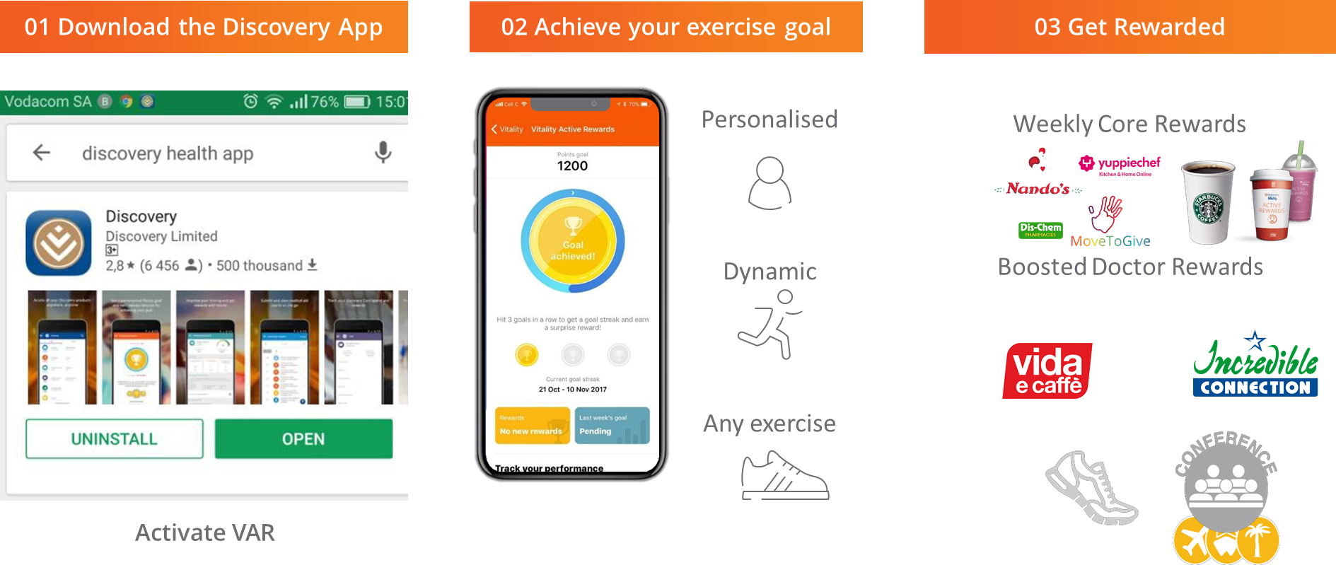
Vitality Active Rewards for Doctors
The messenger effect
Notes:
Lastly, knowing that doctors are also humans and subject to these same challenges, I would like encourage you to join Vitality Active Rewards for Doctors. We know that healthcare professionals are more likely to prescribe treatment (which includes lifestyle changes) if they themselves perform these actions. By understanding Active Rewards, you will also enhance your status as that trusted and respected messenger.

Slide 18
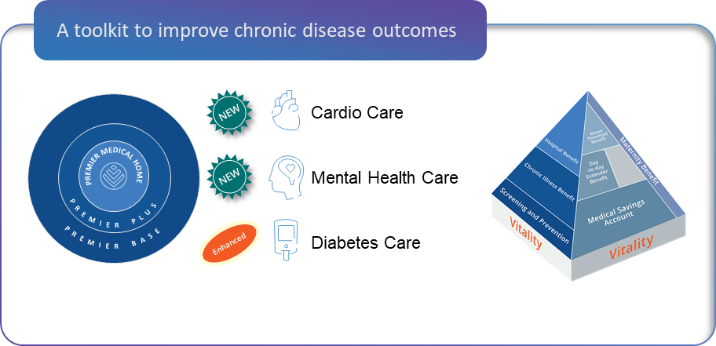

Slide 19
Addressing the Intention-Behaviour Gap in Healthcare
Jane Ball - head of population health management

Slide 20

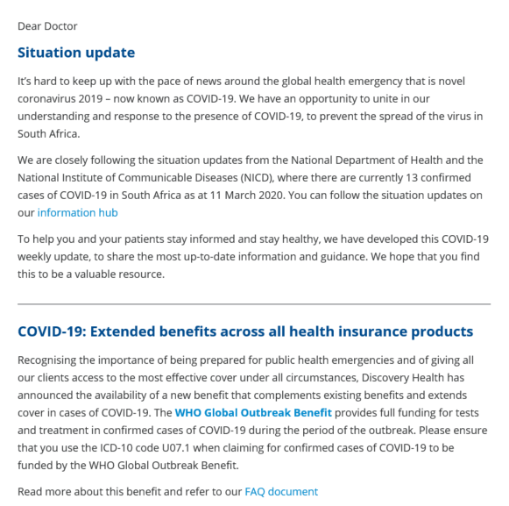
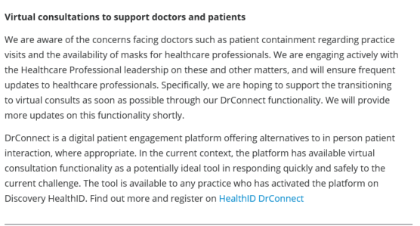
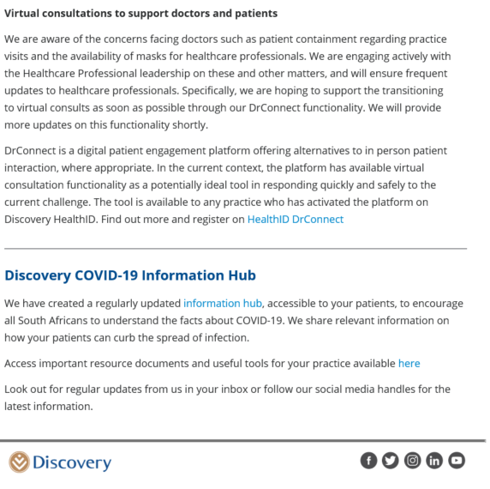
Support through Virtual consultations

