Slide 1
The Obesity Puzzle:
Linking cause, effect and treatment
Dr Charlene Wolberg
GGPF: Gallagher estate - Mirand
19 April 2026

Slide 2
Novo Nordisk Disclaimer and Disclosure
This event is funded by Novo Nordisk South Africa as part of their medical education program for healthcare professionals, aiming to foster scientific and clinical knowledge exchange. The views and content presented by the speakers are solely their own, and do not necessarily reflect those of Novo Nordisk South Africa. Novo Nordisk advocates for the use of their products strictly as per the approved local guidelines and package insert.
The speaker/s have received an honorarium from Novo Nordisk South Africa. Their relationship with the company, including any services, research involvement, advisory positions, shareholding, or board memberships, is disclosed to maintain transparency and uphold the integrity of this event.

Slide 3
OBESITY PARADIGM
01
Notes:
Before we go onto the mechanisms undelaying obesity , we need to understand the very essence of the condition and that is the often-misrepresented
Ant this is looking at Adipose tissue (know as fat) and its importance

Slide 4
DEFINITION
OBESITY IS DEFINED AS A CHRONIC, RELAPSING, PROGRESSIVE DISEASE STATE¹
Christensen, S., & Nelson, C. (2025). Chronicity of obesity and the importance of early treatment to reduce cardiometabolic risk and improve body composition. Obesity Pillars, 15, 100175. https://doi.org/10.1016/j.obpill.2025.100175

Slide 5










Obesity is recognised as a disease and a health issue
ESC
Obesity included in International Classification of Diseases¹
“Obesity and overweight as a chronic medical condition
(de facto disease state) and urgent public
health problem…”²
“The Treat and Reduce Obesity Act would allow a variety of qualified practitioners, including registered dietitian nutritionists, to more effectively treat this disease, which impacts more than one-third of our nation.“⁵
“It (obesity) is not a lifestyle choice caused by individual greed but a disease caused by health inequalities, genetic influences and social factors..”⁷
“Obesity is a progressive chronic disease, similar
to diabetes or high blood pressure, …”⁸
“…obesity has been declared a disease per se that results in impaired quality of life and reduced life expectancy…”¹⁰
1948
>>
>>
2012
2016
2019
2021
2024
“A progressive disease, impacting severely on individuals and society alike,… obesity is the gateway to many other disease areas…”³
“A pathological state (obesity disease) in which a person suffers health problems caused by or related to obesity thus making weight loss clinically desirable …”⁴
“Obesity is a chronic, relapsing, progressive disease process ….need for immediate action for prevention and control of this global epidemic”⁶
“Obesity is a chronic relapsing disease, which in turn acts as a gateway to a range of other non-communicable diseases, such as diabetes, cardiovascular diseases and cancer.”⁹
Obesity recognised as a chronic disease¹
1997
2015
2017
European
Commission
1. Burki T. Lancet Diabetes-endocrinol. In Focus. 2021;9:418; 2. AMA resolutions. June 2012. Available at https://www.ama-assn.org/sites/ama-assn.org/files/corp/media-browser/public/hod/a12-resolutions_0.pdf. Accessed June 2024; 3. EASO: 2015 Milan Declaration: A Call to Action on Obesity. Available at https://easo.org/2015-milan-declaration-a-call-to-action-on-obesity/. Accessed June 2024; 4. AOASO position statement, Nagoya Declaration 2015. https://www.c-linkage.co.jp/aoco2015/data/declaraN-en.pdf; 5. Raynor et al. J Acad Nutr Diet 2016;116:129‒47; 6. Bray et al. Obes Rev 2017;18:715–23; 7. Royal College of Physicians. Anon. BMJ 2019;364:l45; 8. Obesity Canada. Available at https://obesitycanada.ca/obesity-in-canada/. Accessed June 2024; 9. European Commission. Obesity prevention. Available from https://knowledge4policy.ec.europa.eu/health-promotion-knowledge-gateway/obesity_en. Accessed June 2024; 10. Konstantinos CK et al. Eur Heart J 2024;45(38):4063–98.
Notes:
SPEAK ABAOUT SA GUIDELINES
Obesity is classed as a non-communicable disease.¹
These definitions for obesity are similar in that they highlight the chronic and progressive nature of this condition:
The AMA (American Medical Association) definition presents this condition as a public health problem²
The Royal College of Physicians' definition includes factors other than lifestyle choice such as health inequities, genetic influences, and social factors³
The European Commission and EAS definitions illustrate obesity as a gateway to other non-communicable diseases such as diabetes and cancer⁴
Academy of Nutrition and Dietetics definition mentions the role of qualified practitioners such as registered dietitians and nutritionists in treating this condition⁵
EASO: European Association for the Study of Obesity
WO: World Obesity Federation
AOASO: Asia Oceania Association for the Study of Obesity
1. Burki T. Lancet Diabetes-endocrinol. In Focus. 2021;9:418.
2. AMA resolutions. June 2012. Available at https://www.ama-assn.org/sites/ama-assn.org/files/corp/media-browser/public/hod/a12-resolutions_0.pdf. Accessed June 2024.
3. Royal College of Physicians. Anon. BMJ 2019;364:l45.
4. European Commission. Obesity prevention. Available from https://knowledge4policy.ec.europa.eu/health-promotion-knowledge-gateway/obesity_en. Accessed June 2024.
5. Raynor et al. J Acad Nutr Diet 2016;116:129‒47.

Slide 6

Prevalence of obesity
1bn
people
with obesity
as of 2022¹
SA Prevalence over time²
South Africa obesity prevalence by 2025:
Men:
Women:
23.3%
46.7%
SA Adolescent obesity³
Adolescent obesity prevalence in 2016:
Adolescents:
27.4%
BMI, body mass index; bn, billion.
1. NCD Risk Factor Collaboration (NCD-RisC). Worldwide trends in underweight and obesity from 1990 to 2022: a pooled analysis of 3663 population-representative studies with 222 million children, adolescents, and adults. Lancet. 2024 Mar 16;403(10431):1027-1050. doi: 10.1016/S0140-6736(23)02750-2. Epub 2024 Feb 29. PMID: 38432237; PMCID: PMC7615769.
2. Lobstein T, Brinsden H. Obesity: Missing the 2025 global targets – Trends, costs and country reports. [cited 2020 March]. Available from http://s3-eu-west-1.amazonaws.com/wof-files/WOF_Missing_the_2025_Global_Targets_Report_FINAL_WEB.pdf [Ref list]
3. Nwosu E, Fismen AS, Helleve A, Hongoro C, Sewpaul R, Reddy P, Alaba O, Harbron J. Trends in prevalence of overweight and obesity among South African and European adolescents: a comparative outlook. BMC Public Health. 2022 Dec 6;22(1):2287. doi: 10.1186/s12889-022-14724-2. PMID: 36474229; PMCID: PMC9727950.
Notes:
According to World Obesity Atlas 2022, the global prevalence of obesity is expected to reach 1 billion people by 2030
17.5% of adults are expected to have BMI≥30kg/m² by 2030
5.7% of adults are expected to have BMI ≥35kg/m² by 2030
And 1.9% of adults are expected to have BMI ≥40kg/m² by 2030
References:
World Obesity Federation: World Obesity Atlas, 2022. Available from: https://s3-eu-west-1.amazonaws.com/wof-files/World_Obesity_Atlas_2022.pdf. Accessed October 2022
1. Lobstein T, Brinsden H. Obesity: Missing the 2025 global targets – Trends, costs and country reports. [cited 2020 March]. Available from http://s3-eu-west-1.amazonaws.com/wof-files/WOF_Missing_the_2025_Global_Targets_Report_FINAL_WEB.pdf [Ref list]

Slide 7
AETIOLOGY OF OBESITY
DIETARY⁶
Intrauterine
Breast feeding
Processed foods
Palatability
Lack of time (shopping; preparation)
Education
Alcohol
Epigenetics²
GENETICS¹
40-70%
Neuro-
endocrine³
PHYSICAL ACTIVITY⁷
Time
Education
Society
AGING³
HORMONAL
Puberty
Pregnancy
Menopause⁴
EMOTIONAL⁸
Anxiety, depression
Stress
Sleep
SMOKING⁵
MEDICATION⁹
Locke, A. E., et al. (2015). Genetic studies of body mass index yield new insights for obesity biology. Nature, 518(7538), 197-206.
Waterland, R. A., & Michels, K. B. (2007). Epigenetic epidemiology of the developmental origins hypothesis. Annual Review of Nutrition, 27, 363-388.
Schwartz, M. W., et al. (2000). Central nervous system control of food intake. Nature, 404(6778), 661-671.
Villareal, D. T., et al. (2005). Obesity in older adults: Technical review and position statement of the American Society for Nutrition and NAASO, The Obesity Society. Obesity Research, 13(11), 1849-1863.
Kaplowitz, P. B. (2008). Link between body fat and the timing of puberty. Pediatrics, 121(Suppl 3), S208-S217.
Filozof, C., et al. (2004). Smoking cessation and weight gain. Obesity Reviews, 5(2), 95-103.
Harder, T., et al. (2005). Duration of breastfeeding and risk of overweight: A meta-analysis. American Journal of Epidemiology, 162(5), 397-403.
Tremblay, M. S., et al. (2011). Systematic review of sedentary behaviour and health indicators in school-aged children and youth. International Journal of Behavioral Nutrition and Physical Activity, 8, 98.
Scott, K. M., et al. (2008). Obesity and mental disorders in the general population. Archives of General Psychiatry, 65(1), 24-31. #
Allison, D. B., et al. (1999). Antipsychotic-induced weight gain: A comprehensive research synthesis. American Journal of Psychiatry, 156(11), 1686-1696.
Notes:
asdfsadfasdfsdf

Slide 8
Hard truth: BMI – mortality link
100
Normal BMI =
almost 80% chance of reaching age 70
80
60
BMI 35–40 kg/m² =
~60% chance of
reaching age 70
Proportion still alive (%)
40
BMI range (kg/m²)
22.5–25
25–30
BMI 40–50 kg/m² =
~50% chance of
reaching age 70
20
30–35
35–40
40–50
0
35
40
50
60
70
80
90
100
Age (years)
Data are based on male subjects; n=541,452.
BMI, body mass index.
Prospective Studies Collaboration. Lancet. 2009;373:1083–96.
Notes:
Obesity has a major impact on life expectancy
It is estimated that almost 80% of people in the normal BMI range at age 35 will reach 70 years of age. However, this falls to approximately 70% for those with a BMI of 30–35 kg/m², ~62% for a BMI of 35–40 kg/m², and ~50% for a BMI of 40–50 kg/m²
This equates to an increase in mortality of around 30% for every 5 kg/m² increase in BMI (hazard ratio: 1.29 per 5 kg/m² [95% CI 1.27-1.32]), and at 30–35 kg/m², median survival is reduced by 2–4 years, which increases to 8–10 years with a BMI of 40–45 kg/m²
References:
Prospective Studies Collaboration, Whitlock G, et al. Body-mass index and cause-specific mortality in 900 000 adults: collaborative analyses of 57 prospective studies. Lancet 2009;373:1083–96.
14

Slide 9
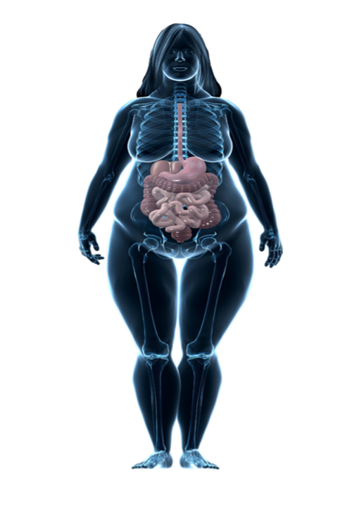

Obesity is associated with multiple comorbidities and complications
Metabolic, mechanical and mental
Sleep apnoea
Metabolic
Depression
CVD and risk factors
Stroke
Dyslipidaemia
Hypertension
Coronary artery disease
Coronary heart failure
Pulmonary embolism
Mechanical
Anxiety
Asthma
Mental
NAFLD
Gallstones
Infertility
Subfertility
hypogonadism (male)
PCOS
pregnancy complications
Chronic back pain
T2D
Prediabetes
Cancers*
Thrombosis
Physical functioning
Incontinence
Knee osteoarthritis
Gout
CVD, cardiovascular disease; NAFLD, non-alcoholic fatty liver disease
*Including breast, colorectal, endometrial, oesophageal, kidney, ovarian, pancreatic and prostate; T2D, type 2 diabetes
Adapted from Sharma AM. Obes Rev. 2010;11:808-9; Guh et al. BMC Public Health 2009;9:88; Luppino et al. Arch Gen Psychiatry 2010;67:220–9; Simon et al. Arch Gen Psychiatry 2006;63:824–30; Church et al. Gastroenterology 2006;130:2023–30; Li et al. Prev Med 2010;51:18–23; Hosler. Prev Chronic Dis 2009;6:A48
Notes:
Not only is obesity associated with increased mortality, it is also associated with significantly increased morbidity, which can affect almost every organ system
The organs affected by obesity can be broadly grouped into three classes: metabolic [click], mechanical [click], and mental [click]

Slide 10
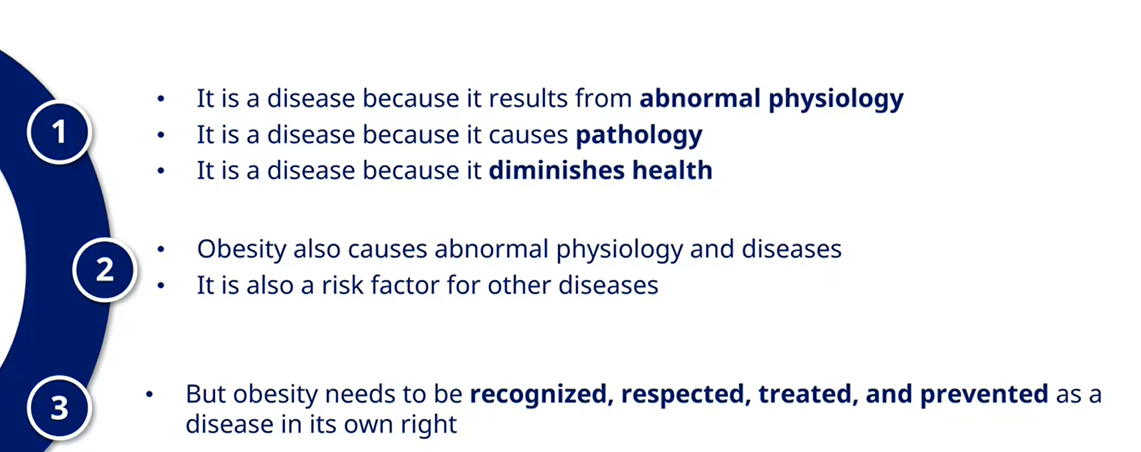
Obesity is a DISEASE
Summary of previous slides

Slide 11






Obesity remains underdiagnosed and undertreated
People living
with obesity
(100%)
People diagnosed
with obesity
(<40%)
People receiving evidence-based
anti-obesity treatment*
(<20%)
People prescribed
anti-obesity medication
(1.6%)
*Includes lifestyle and behavioral counselling, anti-obesity medications and bariatric surgery.
1. Adapted from: Colby and Ortman. 2014. Available from www.census.gov/content/dam/Census/library/publications/2015/demo/p25-1143.pdf. Accessed October 2022; 2. Centers for Disease Control and Prevention. Available from www.cdc.gov/nchs/fastats/obesity-overweight.htm. Accessed on October 2022; 3. Ma et al. Obesity (Silver Spring) 2009;17:1077–85;
4. IMS Xponent Dec-15; 5. Caterson et al. Diabetes Obes Metab 2019; 21:1914–24; 6. Saxon et al. Obesity (Silver Spring, Md.) 2019;27:1975–81.
Notes:
There are significant gaps in obesity treatment.
It is estimated that 37.9% of the US adult population has obesity.^{1,2} Despite this high prevalence, less than 30% of patients with obesity actually received a formal diagnosis.³ Compounding this problem, even fewer patients are being treated with an evidence-based anti-obesity treatment.^{4,5}
References
Colby SL and Ortman JM. Projections of the Size and Composition of the U.S. Population: 2014 to 2060, Current Population Reports, P25-1143, U.S. Census Bureau, Washington, DC, 2014. https://www.census.gov/content/dam/Census/library/publications/2015/demo/p25-1143.pdf.
Centers for Disease Control and Prevention. Obesity and Overweight. https://www.cdc.gov/nchs/fastats/obesity-overweight.htm. Last updated on June 13, 2016. Accessed October 2022
Ma J, Xiao L, Stafford R. Adult Obesity and Office-based Quality of Care in the U.S. Obesity (Silver Spring). 2009;17(5):1077–85. 4. IMS Xponent Dec-15.
Caterson et al. Gaps to bridge: Misalignment between perception, reality and actions in obesity. Diabetes Obes Metab 2019; 21:1914–24.
Saxon et al. Antiobesity Medication Use in 2.2 Million Adults Across Eight Large Health Care Organizations: 2009-2015. Obesity (Silver Spring, Md.) vol. 27,12 (2019)
Gasoyan H, Pfoh ER, Schulte R, Sullivan E, Le P, Rothberg MB. Association of patient characteristics and insurance type with anti-obesity medications prescribing and fills. Diabetes Obes Metab. 2024 May;26(5):1687-1696. doi: 10.1111/dom.15473. Epub 2024 Jan 29. PMID: 38287140; PMCID: PMC11001528.

Slide 12
PATIENT CHALLENGES
03
Notes:
Before we go onto the mechanisms undelaying obesity , we need to understand the very essence of the condition and that is the often-misrepresented Adipose tissue (know as fat)

Slide 13
How successful are lifestyle interventions in chronic weight management?
Patients with obesity
Maintenance of weight loss¹:
110
~10%
Male
53%
At 2 years
100
Mean weight change (%)
90
80
~10%
Female
78%
At 5 years
Pre-
treatment
Post-
treatment
1
2
3
4
5
Years after intervention
Stalonas (1984)
Vogels (2005)
Wadden (1989)
Schwarzfuchs (2012)
Cooper (2010)
Hensrud (1994)
% of patients that regained weight at 2 or 5 years
% of patients that achieved
>5% weight loss
Olszanecka-Glinianowicz (2012)
Pekkarinen (1997)
T2D, type 2 diabetes; HbA1c, glycated hemoglobin.
1. Facts & Stats: Diabetes UK 2016; 2. Fildes et al. American Journal of Public Health 2015;105:9.
1. Nordmo et al. Obes Rev 2020;21:e12949; 2. Horn et al. Postgrad Med 2022;134:359–75; 3. 1. Hall et al. Med Clin North Am 2018; 102(1): 183-197
Notes:
35% of patients with T2D achieve glycemic target of HbA1c <6.5%
According to a study conducted by Fildes et al., analysing data from United Kingdom’s Clinical Practice Research Datalink, the probability of patients with obesity achieving and maintaining weight loss is low
10% of males and 10% of females with obesity achieved >5% weight loss however, 53% of patients regained weight after 2 years and 78% regained weight after 5 years
Successful achievement of health goals is more likely for patients with T2D than patients with obesity
Liraglutide launched om UK in January 2017
Data United Kingdom’s Clinical Practice Research Datalink from 2004 to 2014.
“Data for 76 704 obese men and 99 791 obese women. We excluded participants who received bariatric surgery. We estimated the probability of attaining normal weight or 5% reduction in body weight.
Results. During a maximum of 9 years’ follow-up, 1283 men and 2245 women attained normal body weight. In simple obesity (body mass index = 30.0–34.9 kg/m²), the annual probability of attaining normal weight was 1 in 210 for men and 1 in 124 for women, increasing to 1 in 1290 for men and 1 in 677 for women with morbid obesity (body mass index = 40.0–44.9 kg/m²). The annual probability of achieving a 5% weight reduction was 1 in 8 for men and 1 in 7 for women with morbid obesity.
Conclusions. The probability of attaining normal weight or maintaining weight loss is low. Obesity treatment frameworks grounded in community-based weight management programs may be ineffective.
“
References:
Facts & Stats: Diabetes UK 2016.
Fildes A et al. Probability of a Person with Obesity Attaining Normal Body Weight: Cohort Study Using Electronic Health Records.American Journal of Public Health 2015:105;9.

Slide 14
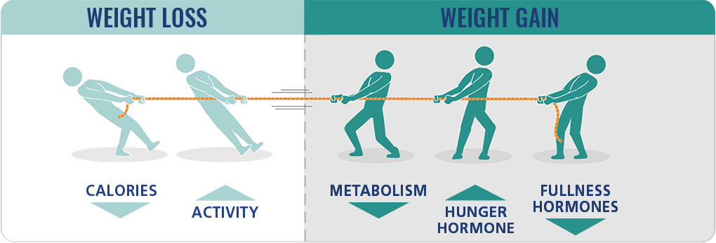


Weight loss following lifestyle interventions is not sustainable in the long-term
I went on a diet and exercise programme last year and lost 30 kg, but despite continuing to exercise and eat well, I started regaining weight. I felt like a failure and it affected my mental health.
Despite patient’s best efforts, metabolic changes to weight loss promote weight regain
https://www.rethinkobesity.global/weight-and-health/pathophysiology-of-obesity.html
Notes:
When we think of weight management, the first thing that comes to mind is diet and exercise. Weight loss through diet and exercise relies on the executive function of the brain, influencing self-regulatory processes related to eating habits.
However, Losing and maintaining weight loss with diet and exercise alone is a constant struggle. Weight loss achieved through lifestyle changes is often difficult to sustain over the long term.
Weight loss relies on reduced calories and increased physical activity, while weight gain is influenced by a slower metabolism, decreased feelings of fullness, and increased feelings of hunger. Thus, despite a patient's best efforts, these metabolic changes often lead to weight regain, making long-term weight management challenging.
Once obesity is established, the body demonstrates a variety of adaptations to weight loss that promote weight regain.
Chronic weight management requires interventions that address these metabolic adaptations.
Decrease energy expenditure, decrease satiety hormones and increased hunger hormones like Ghrelin (which stays elevated life long – per patient baseline pre-obesity)

Slide 15
OBESITY MANAGEMENT
04
Notes:
Before we go onto the mechanisms undelaying obesity , we need to understand the very essence of the condition and that is the often-misrepresented Adipose tissue (know as fat)

Slide 16
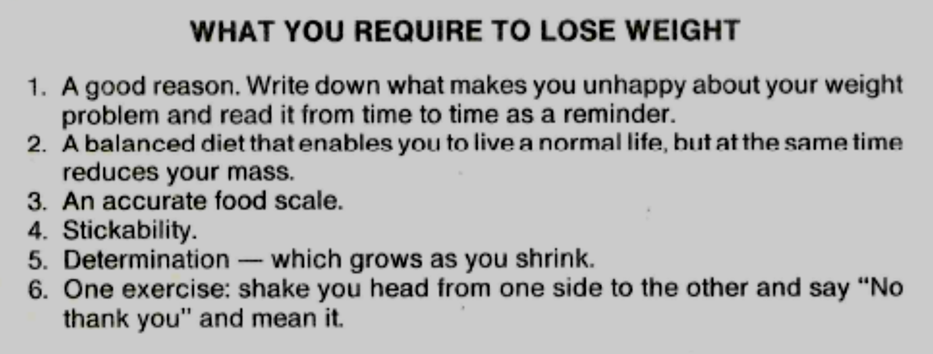
WEIGH LESS WEIGHTLOSS TIPS 1985¹
1: Personal article snippet from 1985 – Dr S Wolberg

Slide 17
The effect of weight loss on complications
0–5%
Hypertension¹
Hyperglycemia¹
5–10%
Prevention of T2D¹
Dyslipidemia¹
PCOS¹
NAFLD¹
10–15%
OSAS¹
GERD¹
NASH¹
Cardiovascular disease¹
Urinary stress incontinence²
Knee osteoarthritis¹
Weight loss
Towards greater weight loss and overall health improvement
15–20%
CV mortality³
T2D remission⁴
Hepatic steatosis⁵
HFpEF⁶
Advanced T2D remission^{7,8*}
Postural instability⁹
>20%
BP, blood pressure; CV, cardiovascular; GERD, gastro-oesophageal reflux disease; HbA1c, glycated hemoglobin; HFpEF, heart failure with preserved ejection fraction; NAFLD; non-alcoholic fatty liver disease; NASH, non-alcoholic steatohepatitis; OSAS, obstructive sleep apnoea syndrome; PCOS, polycystic ovary syndrome; T2D, type 2 diabetes; TG, triglycerides.
1. Horn D et al. Postgrad Med. 2022;134:359–75; 2. Garvey WT et al. Endocr Pract. 2016;22(Suppl. 3):1–203; 3. Look AHEAD Research Group, Gregg EW et al. Lancet Diabetes Endocrinol. 2016;4:913–21; 4. Lean ME et al. Lancet. 2018;391:541–51; 5. Benraoune F & Litwin SE. Curr Opin Cardiol. 2011;26:555–61; 6. Sundström J et al. Circulation. 2017;135:1577–85; 7. Ryan DH & Yockey SR. Curr Obes Rep 2017;6:187–94;
8. Meerasa A & Dash S. Weighing in on Type 2 Diabetes Remission. Diabetes Care 2022;45:28–30.
Notes:
Hepatic steatiosis on MASH numer one cause of liver cirrhosis in the world
Increased weight loss is associated with improvement in various comorbidities related to obesity
As low as 5% weight loss is associated with reduction in systolic and diastolic blood pressure and reduced HbA_{1c} ¹
5-10% weight loss is associated with a reduction of intrahepatocellular lipids in non-alcoholic fatty liver disease; reduction in triglycerides, increase in HDL-c, reduction in non-HDL-c; improvements in ovulation and regularisation of menses; prevention of type 2 diabetes¹
10-15% reduction improves symptomatology and increases function for people with osteoarthritis, GERD, and OSAS; reduced inflammation and fibrosis in NASH; reduced frequency pf incontinence, and improvements in cardiovascular disease^{1,2}
Over 15% weight loss can lead to remission of type 2 diabetes, especially when diabetes duration is short, improvements in heart failure and reductions in cardiovascular mortality^{3,4,5}
Improvements in triglycerides, HbA_{1c}, and blood pressure are direct and linear, with greater weight loss being associated with greater risk factor benefit⁶
T2D remission rates have been found to plateau at 20-25% total weight loss where 25% total weight loss did not confer additional benefits⁷
References
Garvey WT et al. AMERICAN ASSOCIATION OF CLINICAL ENDOCRINOLOGISTS AND AMERICAN COLLEGE OF ENDOCRINOLOGY COMPREHENSIVE CLINICAL PRACTICE GUIDELINES FOR MEDICAL CARE OF PATIENTS WITH OBESITY. Endocr Pract 2016;22(Suppl. 3):1–203
Look AHEAD Research Group. Association of the magnitude of weight loss and changes in physical fitness with long-term cardiovascular disease outcomes in overweight or obesity with type 2 diabetes: a post-hoc analysis of the Look AHEAD randomised clinical trial. Lancet Diabetes Endocrinol 2016;4:913–21.
Lean ME et al. Primary care-led weight management for remission of type 2 diabetes (DiRECT): an open-label, cluster-randomised trial. Lancet 2018;391:541–51
Benraoune F and Litwin SE. Reductions in cardiovascular risk after bariatric surgery. Curr Opin Cardiol 2011;26:555–61
Sundström J et al. Weight Loss and Heart Failure: A Nationwide Study of Gastric Bypass Surgery Versus Intensive Lifestyle Treatment. Circulation 2017;135:1577–85.
Ryan DH and Yockey SR. Weight Loss and Improvement in Comorbidity: Differences at 5%, 10%, 15%, and Over. Curr Obes Rep 2017;6(2):187–94.
Meerasa A and Dash S. Weighing in on Type 2 Diabetes Remission. Diabetes Care 2022;45(1):28–30.

Slide 18


What are the pillars of obesity management¹?
The approach to
obesity management
Lifestyle recommendations
Medical nutrition therapy
Physical activity
Lifestyle changes are a foundation for any chronic disease management.
However, as with other chronic diseases like hypertension or diabetes, pharmacotherapy is needed to address the biology of obesity and is intended as part of a long-term treatment strategy.
Behavioral interventions: ~5% weight loss
Behavior modification
Cognitive behavioral therapy
Counselling
Three-tiered approach
Pharmacotherapy: ~5‒15% weight loss
Naltrexone/bupropion*†
Phentermine†
Orlistat*†
Liraglutide 3.0mg*
Semaglutide 2.4†
Tirzepatide
Endoscopic / Surgical interventions: ~12‒30% weight loss
Endoscopic procedures: ~12-20% weight loss
Bariatric surgery: ~20-30% weight loss
Diet & exercise alone
<5% weight loss²
New generation pharmacotherapy
15--17% weight loss³⁻⁷
Adapted from Horn DB et al. Postgrad Med. 2022;134:359–75. Approved in the EU* and US† 1. Horn DB et al. Postgrad Med. 2022;134:359–75; 2. Wadden TA et al. N Engl J Med. 2005;353:2111–20;
3. Wilding JPH et al. N Engl J Med. 2021;384:989–1002; 4. Torgerson JS et al. Diabetes Care. 2004;27:155–61; 5. Apovian C et al. Obesity. 2013;21:935–43; 6. Pi-Sunyer X et al. N Engl J Med. 2015;373:11‒22; 7. Allison DB et al. Obesity. 2012;20:330–42; 8. Wharton S et al. CMAJ. 2020;192:E875-91.
Notes:
Only biologics available for obesity is Lira and and sema 2.4 mg
Lifestyle changes are a foundation for any chronic disease management.
However, as with other chronic diseases like hypertension or diabetes, pharmacotherapy is needed to address the biology of obesity and is intended as part of a long-term treatment strategy.

Slide 19
Semaglutide mechanism of action
Appetite and weight regulation
Amino acid substitution at position 8
(alanine to alpha-aminoisobutyric acid)
protects against DPP-4 degradation¹
8
Semaglutide is a human GLP-1 analogue
94% homology to human GLP-1
t_{½} of approximately 1 week
His
Aib
Glu
Gly
Thr
Phe
Thr
Ser
Asp
Val
COOH
spacer
Ser
Glu
Lys
Ala
Ala
Gln
Gly
Glu
Leu
Tyr
Ser
Spacer and C-18 fatty di-acid chain to lysine in position 26 provide strong binding to albumin
Phe
26
34
Ile
Ala
Trp
Leu
Val
Arg
Gly
Arg
Gly
OH
Amino acid substitution at position 34 (lysine to arginine) prevents C-18 fatty di-acid binding at the wrong site
Direct activation of the hindbrain (AP/NTS)
Direct acess to
lateral septum
-
PB
Reduced appetite & cravings, improved control of eating
Reduced
energy intake
Septum
+
AP
Semaglutide
NTS
HYP
Direct activation of the hypothalamus (HYP)
Other metabolic
& CV effects
Reduced
body weight
AP/NTS, area postrema/nucleus of the solitary tract; BST, bed nuclei of the stria terminalis; CEA, central amygdala nucleus; CV, cardiovascular;
GLP-1, glucagon-like peptide-1; PB, parabrachial nucleus; t1/2, half life, Modified from Campos et al. Cell metabolism 2016;23(5):811-820
Merchenthaler et al. J Comp Neurol 1999;403:261–80; Baggio and Drucker. Gastroenterology 2007;132:2131–57; Drucker and Nauck. Lancet 2006;368:1696–705.
Notes:
Let’s take a moment to understand how semaglutide works to regulate appetite and promote weight reduction. Semaglutide is a GLP-1 analogue, meaning it mimics the activity of the natural hormone GLP-1, with 94% structural similarity. Its design includes modifications such as an amino acid substitution at position 8, which protects it from degradation by DPP-4 enzymes, and a C-18 fatty di-acid chain, which enhances binding to albumin, giving it a long half-life of nearly one week.
Semaglutide interacts with key brain regions involved in appetite control. Specifically, it directly activates the hypothalamus and the hindbrain’s area postrema and nucleus tractus solitarius (AP/NTS) — regions central to regulating hunger, satiety, and energy intake. These actions reduce appetite, help control food cravings, and lead to less energy intake overall.
Over time, these effects contribute to reduced body weight, alongside other benefits such as metabolic improvements and cardiovascular effects. This multi-faceted mechanism makes semaglutide a powerful tool in addressing obesity and related conditions.
Postion 38
exendin-4

Slide 20
The cardiometabolic effects of GLP-1RAs
GLP-1RAs have a multitude of pharmacological effects and CV benefits
Pancreas
Brain
Trials of semaglutide
in T2 and obesity indicate:¹³
↑ Beta-cell function¹
↑ Insulin biosynthesis¹
↑ Glucose-dependent
insulin secretion¹
↓ Glucose-dependent glucagon secretion¹
↓ Body weight⁵
↓ Food intake⁶
↑ Satiety^{7,8}
GLP-1RAs
↓ Risk of MACE
Stomach
↓ Risk of myocardial infarction
↓ Gastric emptying⁹
↓ Risk of stroke
Heart
↓ Cardiovascular risk²
↓ Fatty acid metabolism³
↑ Cardiac function³
↓ Systolic blood pressure³
↓ Inflammation⁴
Liver
↓ Risk of death from CV causes
↓ Endogenous glucose
production¹⁰
↑ Hepatic insulin sensitivity¹⁰
↓ De novo lipogenesis¹⁰
↓ Lipotoxicity¹⁰
↓ Steatosis¹¹
Kidneys
↓ Risk of hospitalisation due to heart failure
↑ Natriuresis^{1,2,12}
↓ Risk of worsening kidney function¹³
↓ Risk of adverse kidney outcomes*
*Reduction in the risk of a composite kidney outcome of development of macroalbuminuria, worsening kidney function, kidney replacement therapy and death due to kidney disease.
CV, cardiovascular; GI, gastrointestinal; GLP-1RA, glucagon-like peptide-1 receptor agonist; MACE, major adverse cardiovascular events.
Adapted from Campbell, Drucker. Cell Metab 2013;17:819–37 and Pratley, Gilbert. Rev Diabet Stud 2008;5:73–94.
1. Campbell JE, DJ Drucker. Cell Metab 2013;17:819–37; 2. Marso SP et al. N Engl J Med 2016;375:311–22; 3. Ryan D, Acosta A. Obesity 2015;23:1119–29; 4. Hogan AE et al. Diabetologia 2014;57:781–4; 5. Baggio LL, Drucker DJ. J Clin Invest 2014;124:4223–6; 6. Bagger JI et al. Clin Endocrinol Metab 2015;100:4541–52; 7. Flint A et al. J Clin Invest 1998;101:515–20; 8. Blundell J et al. Diabetes Obes Metab. 2017;19(9):1242–51; 9. Tong J, D'Alessio D. Diabetes 2014;63:407–9;
10. Armstrong MJ et al. J Hepatol 2016;64:399–408; 11. Armstrong MJ et al. Lancet 2016;387:679–90; 12. Muskiet MHA, et al. Nat Rev Nephrol. 2017;13:605–628; 13. Sattar N, et al. Lancet Diabetes Endocrinol. 2021;9:653–662.

Slide 21
Weight loss across STEP 1-4
Semaglutide Treatment Effect in People with Obesity
Semaglutide 2.4 mg once-weekly in subjects with overweight or obesity
 | STEP 1 | STEP 3 | STEP 4
 | Weight management | Weight management with IBT | Sustained weight management
Baseline BW | 105.3 kg | 105.8 kg | 107.2 kg | 96.1 kg
After 68 weeks
After 68 weeks
After 68 weeks
20–68 weeks
*
*
*
*
Placebo
Trial product estimand: Evaluates the treatment effect under the assumption that the trial product is taken as intended
*Statistically significant vs placebo. BW, body weight; IBT, intensive behavioural therapy; T2D, type 2 diabetes
Wilding JPH et al. NEJM 2021;384:989–1002; Davies M et al. Lancet 2021; 397: 971–84;; Wadden TA et al. JAMA 2021; doi: 10.1001/jama.2021.1831. Online ahead of print; Rubino DM et al. Presented at the Endocrine Society (ENDO) virtual meeting, March 20-23, 2021.
Notes:
It is very effective to result in powerful and clinically very significant weight loss, as you can see here from the key trials in the phase 3 STEP trial program. Here we have the STEP1 trial, the largest trial in people with obesity, NEJM; STEP3 which was wt mgmt. with intensive behavioural Rx; STEP4, where pts all received sema for 20 weeks, then randomized to continuing sema vs placebo. We see that in these trials, there was a 16-18% wt loss seen with sema. In STEP2, wt mgmt. in pts with T2DM, there was less wt loss seen than in the non DM studies, which is typical in that we know that people with DM2 have a harder time losing wt than people without DM2, but still, over 10% wt loss was achieved with sema 2.4mg after 68 weeks.
**************************
Semaglutide 2.4 mg taken once-weekly in adults with overweight or obesity, with or without T2D, resulted in significant and sustained weight loss compared to the placebo group. Data are the trial product estimand.

Slide 22
Categorical body weight loss
STEP 1
In-trial
On-treatment
1 in 3 patients will achieve > 20% Weight Loss
≥5%
≥10%
≥15%
≥20%
≥5%
≥10%
≥15%
≥20%
Semaglutide 2.4 mg
Semaglutide 2.4 mg
Placebo
Placebo
§ Proportions are based on observed data.
Wilding et al. N Engl J Med 2021;384:989-1002.

Slide 23
STEP 1 extension: Treatment approach of obesity as chronic disease
PwO require ongoing treatment in order to sustain weight loss and other health benefits
Observed body weight change from week 0 to week 68
(Mean at week 0: 107.2 kg)
After one year of withdrawal of OW semaglutide 2.4 mg and lifestyle intervention,
2
0
-2
-5
participants regained approx
2/3rd
-6
Body weight change from baseline* (%)
Body weight change from baseline (kg)
-10
-10
of their prior weight loss
-14
-15
Weight remained 5.6% below baseline in the semaglutide arm
-18
0
4
8
12
16
20
28
36
44
52
60
68
75
80
104
120
Weeks since randomisation
Semaglutide 2.4 mg
Placebo
OW, once weekly; PwO, people with obesity
1. Wilding JPH et al. Diabetes Obes Metab. 2022. doi: 10.1111/dom.14725; 2. Rubino D et al. JAMA. 2021; 325:1414–25.
Notes:
In STEP-1 trial, From week 0 to week 68, mean weight loss was 17.3% with semaglutide and 2.0% with placebo. Following treatment withdrawal, semaglutide and placebo participants regained 11.6% and 1.9% of lost weight, respectively. One year after withdrawal of semaglutide 2.4 mg and lifestyle intervention, participants regained two-thirds of their prior weight loss, with similar changes in cardiometabolic variables
These results reaffirm obesity as a chronic disease. Like in other chronic diseases, such as hypertension or diabetes, patients with obesity require ongoing treatment in order to sustain weight loss and other health benefits.

Slide 24
Body weight change (week 0–68)
STEP 4
Observed body weight change over time
(Mean at week 0: 107.2 kg)
Estimated change from week 0 to week 68
All participants#
If treatment adherent§
Body weight change (%)
Run-in period
ETD: –12.4 %-points
95% CI: [–13.7; –11.0]
ETD: –13.0 %-points
95% CI: [–14.3; –11.7]
Time (week)
Semaglutide (run-in)
Semaglutide 2.4 mg
Placebo
Semaglutide 2.4 mg
Placebo
In-trial:
In-trial:
On-treatment:
#Treatment policy estimand (regardless of treatment adherence). §Trial product estimand.
Error bars are +/- standard error of the mean.
CI, confidence interval; ETD, estimated treatment difference; IT, in-trial; OT, on-treatment.
Rubino et al. JAMA. 2021;325:1414-25.

Slide 25
Body weight change (week 20–68)
STEP 4
Observed body weight change over time
(Mean at week 20: 96.1 kg)
Estimated change from week 20 to week 68
ETD: -14.8 %-points
95% CI: [-16.0;-13.5]; p<0.001
ETD: -15.3 %-points
95% CI: [-16.5;-14.1]; p<0.001
Semaglutide 2.4 mg
Placebo
Semaglutide 2.4 mg
Placebo
In-trial:
Treatment policy estimand:
Trial product estimand:
Error bars are +/- standard error of the mean.
CI, confidence interval; ETD, estimated treatment difference.
Rubino et al. JAMA. 2021;325:1414-25.

Slide 26
Categorical body weight loss (week 0–68)
STEP 4
In-trial
20 weeks of semaglutide run-in + 48 weeks of continued semaglutide 2.4 mg/wk (n=520)
20 weeks of semaglutide run-in + 48 weeks of placebo (n=250)
≥5%
≥10%
≥15%
≥20%
Rubino et al. JAMA. 2021;325:1414-25.

Slide 27
Waist circumference
STEP 4
Waist circumference# week 0–68
0
ETD (week 20–68):
–9.7 cm
95% CI: [–10.9; –8.5];
p<0.001
-2
-4
-6
-8
Waist circumference (cm)
-10
+3.3
-12
–6.4
-14
-16
Run-in period
-18
0
4
8
12
16
20
24
28
36
44
52
60
68
68§
Time (week)
Semaglutide (run-in)
Semaglutide 2.4 mg
Placebo
#Observed data for the in-trial period and estimated data for all participants. §Estimated values at week 68 for all participants (treatment policy estimand [regardless of treatment adherence]).
Error bars are +/- standard error of the mean.
BMI, body mass index; CI, confidence interval; ETD, estimated treatment difference.
Rubino et al. JAMA. 2021;325(14):1-12; Rubino et al. Presented at the Endocrine Society (ENDO) virtual meeting, March 20-23, 2021.

Slide 28

Overweight or obesity increases the risk of CV events even in the absence of other metabolic abnormalities
Body size, metabolic status and CVD events in 3.5 million UK adults*
V
Weight
class
Metabolic
abnormalities
Coronary heart disease
Cerebrovascular disease
Heart failure
3
Obesity
2
1
0
3
Overweight
2
1
0
3
Normal weight
2
1
0
0.8
1.0
1.2
1.4
1.6
1.8
2.0
2.2
2.4
2.6
2.8
1.0
1.2
1.4
1.6
1.8
1.0
1.5
2.0
2.5
3.0
3.5
4.0
Adjusted HR (95% CI)
Adjusted HR (95% CI)
Adjusted HR (95% CI)
The three metabolic abnormalities (diabetes, hypertension and hyperlipidaemia) were summed to create ametabolic abnormalities score (0, 1, 2, and 3). *Analyses adjusted for age, sex, smoking status, and social deprivation.
The reference category is normal weight, no metabolic abnormalities.
CI, confidence interval; CHD, coronary heart disease; CVD, cardiovascular disease; HR, hazard ratio; PVD, peripheral vascular disease; UK, United Kingdom.
Caleyachetty R et al. J Am Coll Cardiol 2017;70:1429–37.
Notes:
This data challenges the notion of 'healthy obesity’ or even “metabolically healthy obesiy”by emphasizing that excess weight alone—without any other metabolic issues—is a critical, standalone driver of cardiovascular risk. It underscores the importance of weight management as a key intervention for reducing CV events, even in people who might appear 'metabolically healthy.’”
Using data from 3.5 million UK adults, we can see that individuals classified as overweight or obese have a higher adjusted hazard ratio (HR) for major CV events—including coronary heart disease, cerebrovascular disease, and heart failure—compared to those with a normal weight. Notably, this increased risk is independent of traditional metabolic risk factors.

Slide 29
Weight loss improves CV risk factors
V
Blood pressure^{1,2}
Blood lipids^{1,2}
Blood glucose^{1,2}
Insulin resistance^{1–3}
Body
weight
Inflammation⁴
BMI, body mass index; CV, cardiovascular.
1. US National Institutes of Health. Managing Overweight and Obesity in Adults: Systematic Evidence Review From the Obesity Expert Panel, 2013. Available at: https://www.nhlbi.nih.gov/sites/default/files/media/docs/obesity-evidence-review.pdf. Accessed October 2023; 2. Pasanisi F et al. Nutr Metab Cardiovasc Dis 2001;11:401–6; 3. Yokose C et al. Diabetes Care 2020;43:2812–20; 4. Bianchi VE. Clin Nutr ESPEN 2018;28:21–35.

Slide 30
Primary objective
SELECT
To demonstrate that once weekly s.c.
semaglutide 2.4 mg lowers the incidence of
MACE versus placebo, both added to standard of care, in participants with established CV disease and overweight or obesity
Three-component MACE consisted of non-fatal myocardial infarction, non-fatal stroke, CV death.
Established CV disease included ≥1 prior myocardial infarction, ischemic/haemorrhagic stroke, symptomatic peripheral arterial disease, peripheral arterial revascularisation procedure or amputation due to atherosclerotic disease.
CV, cardiovascular; MACE, major adverse cardiovascular event; s.c., subcutaneous.
Notes:
2/3 obecviy 4 million , his

Slide 31
Cumulative incidence of MACE
SELECT: Primary cardiovascular composite endpoint
20%
reduction in
risk of MACE*
HR 0.80 (95% CI: 0.72; 0.90)
p<0.001 for superiority
Semaglutide 2.4 mg significantly reduced
the risk of MACE by 20%
compared with placebo in people with obesity and established CVD, without T2D^{1,2}
Cumulative incidence (%)
All three components (death from CV causes, non-fatal MI and
non-fatal stroke) contributed to MACE risk reduction
Mean follow-up time was 39.8 months
No. at risk
Months since randomisation
Semaglutide
Placebo
8,803
8,801
8,695
8,652
8,561
8,487
8,427
8,326
8,254
8,164
7,229
7,101
5,777
5,660
4,126
4,015
1,734
1,672
Semaglutide 2.4 mg
Placebo
Cumulative incidence (using the Aalen–Johansen method) of the composite MACE primary endpoint. The HR was estimated using a Cox proportional hazards regression model. The proportion of participants with MACE was 6.5% with semaglutide 2.4 mg and 8.0% with placebo. MACE was defined as death from CV causes, non-fatal myocardial infarction, or non-fatal stroke.
CI, confidence interval; HR, hazard ratio; MACE, major adverse cardiovascular events; MI, myocardial infarction.
1. Lincoff AM et al. N Engl J Med 2023;389:2221-2232; 2. Novo Nordisk A/S. Company announcement, 8 August 2023. Available at: https://www.novonordisk.com/content/nncorp/global/en/news-and-media/news-and-ir-materials/news-details.html?id=166301. Accessed October 2023.

Slide 32
SEMALEAN study
Impact of Semaglutide on fat mass, lean mass and muscle function in patients with obesity

Slide 33
Trial design
SEMALEAN: prospective, longitudinal, real-world cohort
Key inclusion criteria
Grade 3 of obesity, BMI: ≥40 kg/m² and ≥1 comorbidity
Documented failure of lifestile interventions
Key exclusion criteria
Active cancer
History of pancreatitis
Premature discontinuation of treatment before the 7th month
Incomplete follow-up data
Semaglutide 2.4 mg s.c. OW#
N = 106
Month
M0
Baseline
Intensive behavioural therapy (IBT)
M12
M7
End of trial
Trial objectives
Impact of Semaglutide 2.4mg in PwO on lean mass, muscle function,and metabolic adaptations
Data Collections at M0, M7 and M12
Body weight, waist circumference
Body composition DXA
Energy expenditure
Muscle function
BMI, body mass index; OW, once-weekly; s.c., subcutaneous;
Alissou M. Diabetes Obes Metab. 2025;1–10. DOI: 10.1111/dom.70141

Slide 34
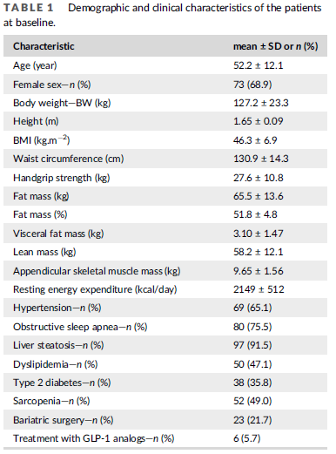


Baseline characteristics of trial participants
N=106
SEMALEAN
Clinical characteristics
SEMALEAN
STEP 1
Mean BMI
Mean Body Weight
Waist Circumference
Mean BMI
Mean Body Weight
Waist Circumference
46.3 kg/m²
127.2 kg
130.9 cm
37.8 kg/m²
105.4 kg
114.6 cm
Mean Fat Mass
Mean Lean Mass
Mean Fat Mass
Mean Lean Mass
65.5 Kg / 51.8 %
58.2 Kg
42.5 Kg / 43.8 %
52.1 Kg
SEMALEAN
Resting energy expenditure
Sarcopenia
Type 2 Diabetes
2149 kcal/day
52 (49%)
38 (35.8%)
BMI, body mass index;
Alissou M. Diabetes Obes Metab. 2025;1–10. DOI: 10.1111/dom.70141

Slide 35
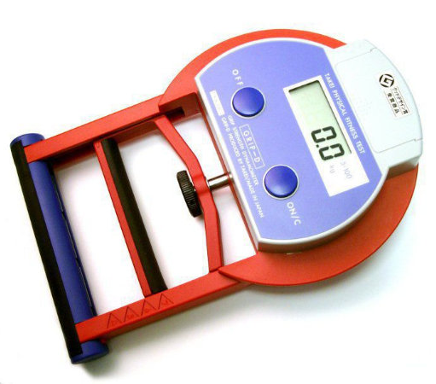
Muscle Function
Hand grip and Sarcopenia
For Hand grip strength: Three attempts were recorded, with the highest value used for analysis.
Sarcopenia was defined as reduced grip strength (<27 kg for men and <16 kg for women) coupled with reduced ASMM.
Dynapenia defined solely as reduced grip strength.
ASMM, Appendicular skeletal muscle mass (ASMM) was evaluated to diagnose sarcopenia based on standardised cut-offs: ASMM/body weight <25.7% for men and <19.4% for women.13 Cruz-Jentoft AJ, Bahat G, Bauer J, et al. Sarcopenia: revised European
consensus on definition and diagnosis. Age Ageing. 2019;48(4):601.
Alissou M. Diabetes Obes Metab. 2025;1–10. DOI: 10.1111/dom.70141

Slide 36
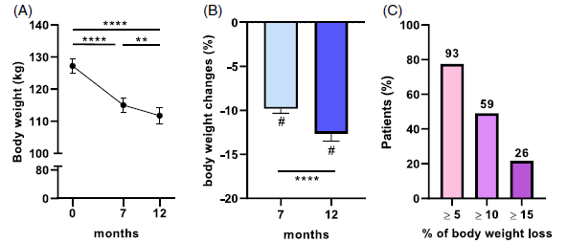
Results
Body Weight
Weight loss was significant during the first 7 months and continued up to 12 months.
Mean body weight loss was 9.8% at M7 and 12.7% at M12.
59% and 26% of the patients lost, respectively, at least 10% and 15% of body weight at the end of the study
Alissou M. Diabetes Obes Metab. 2025;1–10. DOI: 10.1111/dom.70141

Slide 37
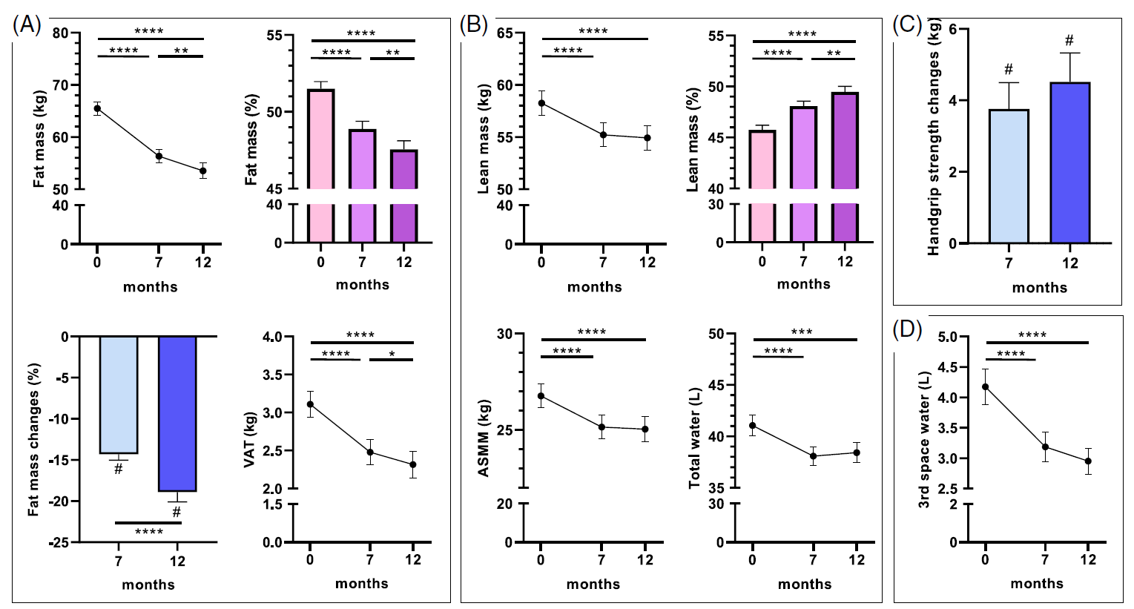
Results
Change in Body Composition (DXA) and Hand grip Strenght
Significant decrease in fat mass and VAT at M7, which continued to decrease until M12. However, lean mass showed a different trajectory, with an initial significant decrease at M7, followed by stabilisation through M12
ASMM decreased significantly at M7. However, this quantitative reduction was associated with a relative increase in lean mass proportion and an improvement in handgrip strength
VAT, Visceral adipose Tissue; ASMM, Appendicular skeletal muscle mass
Alissou M. Diabetes Obes Metab. 2025;1–10. DOI: 10.1111/dom.70141

Slide 38
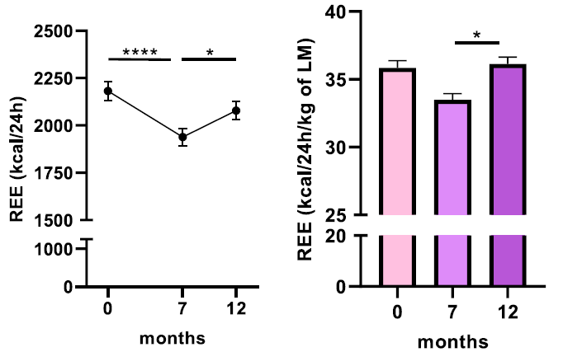
Results
Change in resting energy expenditure (REE)
Semaglutide maintains metabolic activity despite weight loss, thereby aiding in prolonged weight loss or maintenance.
Recent data indicate that weight loss with Semaglutide treatment increases skeletal muscle mitochondrial efficiency in mice¹
REE, Resting Energy Expenditure; LM, Lean Mass
Alissou M. Diabetes Obes Metab. 2025;1–10. DOI: 10.1111/dom.70141
1. Choi RH, Karasawa T, Meza CA, et al. Semaglutide-induced weight loss improves mitochondrial energy efficiency in skeletal muscle bioRxiv 2024

Slide 39
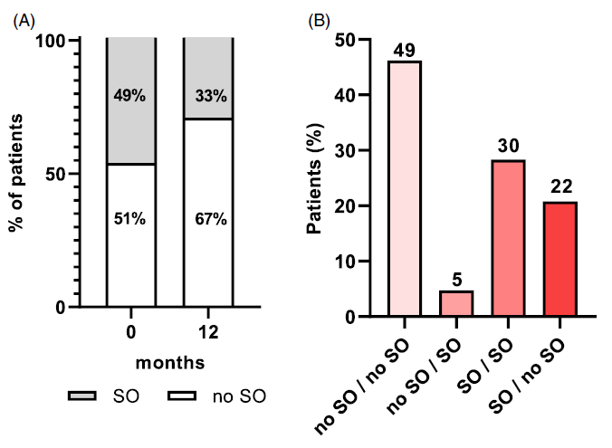
Results
Change in Sarcopenia
Patients with sarcopenic obesity decreased significantly from baseline (49%) to M12 (33%).
22% of patients who were sarcopenic at baseline were no longer sarcopenic at M12; 49% of patients maintained their non-sarcopenic status at M12; and 5% of patients developed sarcopenic obesity at M12
SO, Sarcopenic Obesity
Alissou M. Diabetes Obes Metab. 2025;1–10. DOI: 10.1111/dom.70141

Slide 40
Conclusion
Semaglutide 2.4 mg led to substantial weight loss in patients with obesity: on average, a 10% reduction at 7 months and 13% at 12 months. These results confirm the high efficacy of Semaglutide in real-world clinical practice, consistent with previous clinical trials.
Total fat mass decreased by 14% at 7 months and 19% at 12 months. Visceral adipose tissue (VAT) also showed significant reduction. Lean mass initially decreased (about 3 kg at 7 months) but then stabilized; the proportion of lean mass relative to total body weight actually increased.
Handgrip strength improved significantly (+4.1 kg at 12 months). The prevalence of sarcopenic obesity decreased from 49% at baseline to 33% at 12 months. Despite some loss of lean mass, muscle function improved and the risk of sarcopenic obesity was reduced, suggesting a qualitative improvement in body composition.
Resting energy expenditure (REE) decreased at 7 months (as expected with weight loss), but increased again at 12 months when normalized to lean mass. This suggests a positive adaptation in metabolic efficiency, which may help with long-term weight maintenance.
This study underscores the need for a comprehensive approach to obesity management, focusing not only on weight loss but also on preserving muscle mass, improving muscle function, and supporting metabolic health.

Slide 41
Factors Affecting Muscle Loss
Muscle loss is inevitable in a significant calorie deficit — regardless of GLP-1s or diet — but it can be minimized.
FEATURE
GLP-1 RECEPTOR AGONISTS
CONVENTIONAL DIET
Typical Lean Loss
~25–40%
~10–30%
Magnitude of Weight Loss
Higher (15–25%)
Lower (10–20%)
Primary Driver
Rapid reduction in food intake
Calorie deficit
Preventative Action
SAME FOR BOTH Resistance training + high protein intake
Source: Advances in Motion / Wiley (+6)

Slide 42
Comparative Summary Table
(GLP-1 VS Caloric Restriction)
Parameter | GLP-1 Receptor Agonists | Caloric Restriction (Diet)
Total weight loss | 15–20% over 1–1.5 years (semaglutide/tirzepatide) | 10–20% over 6 months
Fat mass loss | Predominant; ~75–80% of weight lost is fat mass | ~60% of weight lost is fat mass
Lean mass (LBM) loss | ~20–40% of total weight loss; absolute decline modest | ~30% of total weight loss; comparable overall
Relative LBM proportion | Increases (+~3%) relative to total body weight | Generally preserved or slightly reduced
Muscle function / strength | Generally preserved; some studies show improvement in handgrip strength | Maintained or improved with adequate protein
Muscle quality | Improved: reduced intramuscular fat, better mitochondrial efficiency, microvascular benefits | Improved with weight loss; dependent on dietary composition
Sarcopenic obesity prevalence | Reduced (49% → 33% at 12 months in SEMALEAN) | Variable; risk increases with severe restriction in elderly
Resting energy expenditure | Decreases initially; normalises to lean mass over 12 months | Decreases; metabolic adaptation is a known challenge
Malnutrition risk | ~20% incidence at 1 year; nutritional counselling advised | Variable; depends on dietary quality and restriction severity
Source: Advances in Motion / Wiley (+6)

Slide 43
CASE STUDY
37 year old male, businessman.
Presented for weight loss and improved quality of life
HXN:
Living with the disease of chronic obesity since childhood
1. School – Chubby
2. Secondary School – Obese

Slide 44
MHXN: Reflux many years
      Hiatus hernia (2016) Esomeprazole 40mg daily
      H/T – 5years. Cozaar (Losartan) 50mg daily
FHXN: ♂ Overweight, stroke
      ♀ Obese died of stomach cancer +- 6years ago (70year old)

Slide 45
WEIGHTLOSS HXN
Typical hxn of yoyo pattern of dieting.
Grade 11 (16yrs old) Atkins Diet, Planet fitness. Lost 15kg, struggled to maintain weight loss.
Early 20’s. Dietician, boxing. Lost 20kg , Had first child. Regained the lost weight and a bit more.
COVID (Overweight). Diet (Restrictive), exercise. Lost 22kg
Slowly regained despite continuing to exercise, boxing and weights
Weight range 90kg – 100kg

Slide 46
RELEVANT DETAILS IN HISTORY
SMOKING : 15-20 Cigarettes a day +- 15years
          Stopped 5 years ago
          Currently Vapes
ALCOHOL: Fridays, Saturdays 4-5 tots of whiskey each day.

Slide 47
DIETARY
WEEKDAYS: REGULAR – 3 balanced meals per day
                Following dieticians plan
  PROBLEMS – Portion size
  Decreased protein: Carbohydrate Increased
  Late night eating
  Exercise: 2-3x week. Mix boxing, weights and cardiac. (one hour sessions)

Slide 48
O/E CENTRAL ADIPOSITY
Central Adiposity
Weight = 103.8
Height = 162
Waist cm = 112cm
Hip cm = 108cm
BP = 140/90
BMI = 39
W: height = 0,69 ( Ideally less than 0,5) (0,69+ is highest risk of central adiposity)
W: hip = 1,03 (Less than 0,90 males, less 0,85 females) (> than 1is highest risk of central adiposity)

Slide 49
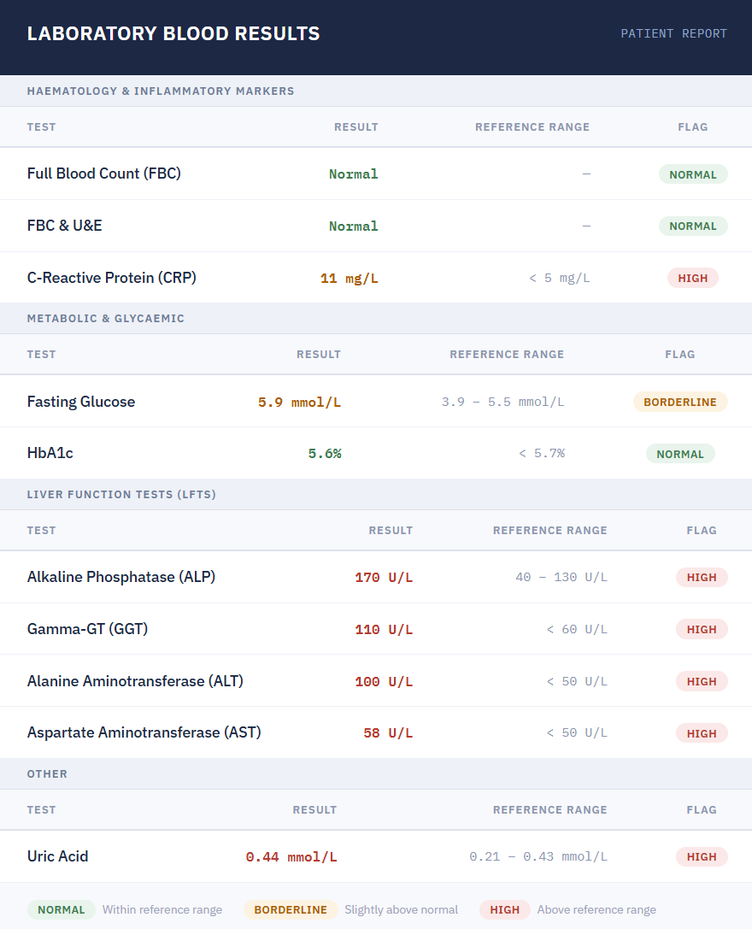
BLOOD RESULTS

Slide 50
TREATMENT PLAN
DIETARY:
Increase protein intake: 1-1.6g. 1kg weight
Decreased portion control, late night eating
Increased consumption of fruit and vegetables
Decreased alcohol consumption over weekends

Slide 51
EXERCISE
Increase strength and resistance training. 4x a week.
Increase cardiac from 1x a week to 2x a week
PHARMACOTHERAPY
Initiate Semaglutide 0.25mg o/w sc.
Counseled re-adverse effects

Slide 52
FOLLOW UP
One month follow Up
Travelling
DIETARY: Higher fat content foods – Cramps, Diarrhea
Decreased appetite, portion size
Decreased cravings
Decreased urge eating late night
EXERCISE : Difficult traveling
WT= 99.4 (lost 4.4kg)
P. Increased Semaglutide to 0.5mg o/w sc
(Felt effect of GLP-1 had decreased in the last week)

Slide 53
TWO MONTHS FOLLOW UP
One month later: Patient couldn’t come (Telephonic discussion, ↑ Semaglutide1mg o/w sc.
DIETARY: Compliant, If consume high fat, sugary foods = Reflux, diarrhea
EXERCISE: Trainer: Strength and resistance 4-5 x a week. Cardiac 2x a week
WT: 92.4
P. Continue on Semaglutide 1mg o/w sc.
            Probiotic daily
            Creatine 5mg daily ( prescribed by trainer)

Slide 54
FOLLOW UP (3 MONTHS LATER)
FOLLOW UP AFTER DECEMBER BREAK (3 MONTHS LATER)
Coastal Holiday: Self catering
Dietary ( Easier to follow a routine on holiday)
        Focused on protein intake (1.5g/kg daily)
        Smaller, more frequent meals. Snacking on protein snacks
        Increased fresh fruit and vegetables
        Increased H2O intake
  Exercise (more time on holiday)
  Running 4x a week. Joined a gym. 4-5 x a week. Heavier weights

Slide 55
FOLLOW UP
  Constipated since starting creatine. Using Movicol
  WT = 86 (lost 6.4kg in 3 months
  P. Increased Semaglutide to 1.7mg ow/sc (during the break)
  Increased Semaglutide to 2.4mg o/w sc
ONE MONTH LATER
WT = 80.4kg
Body Composition Analyses done.

Slide 56
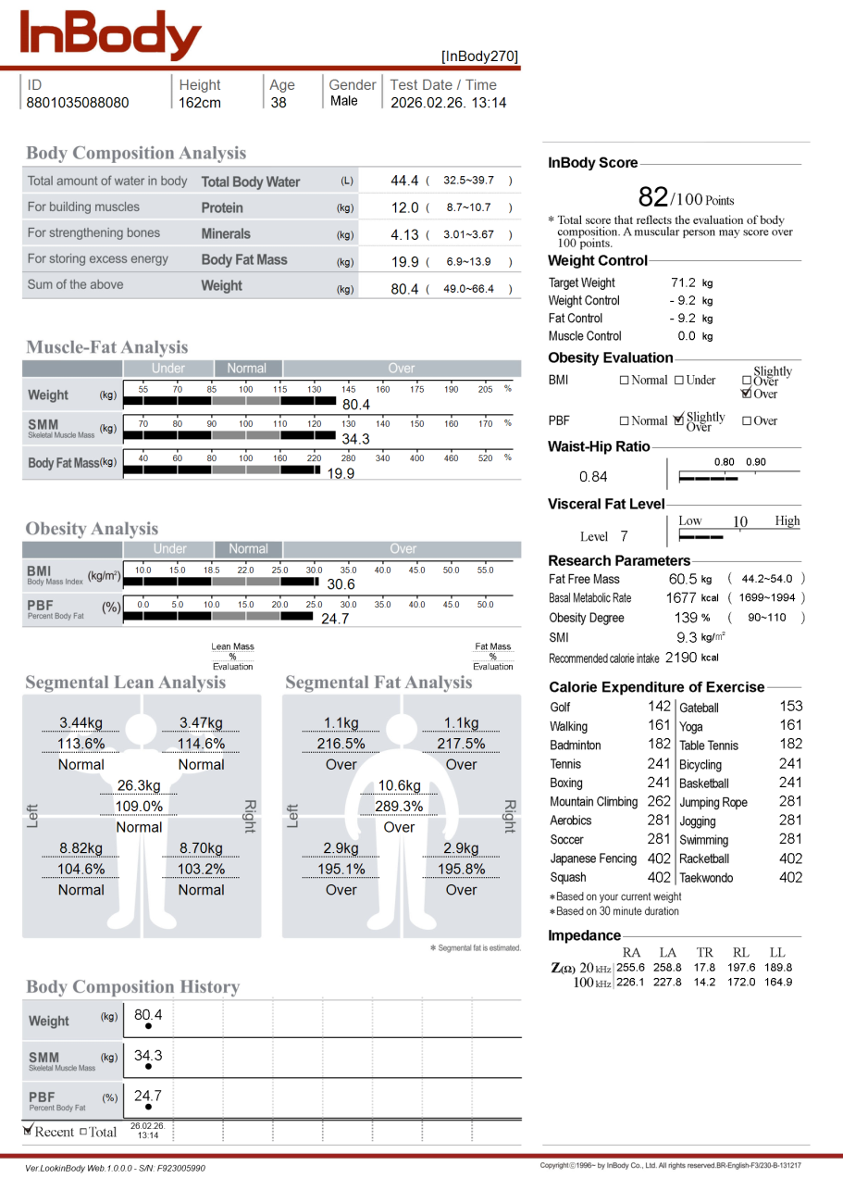
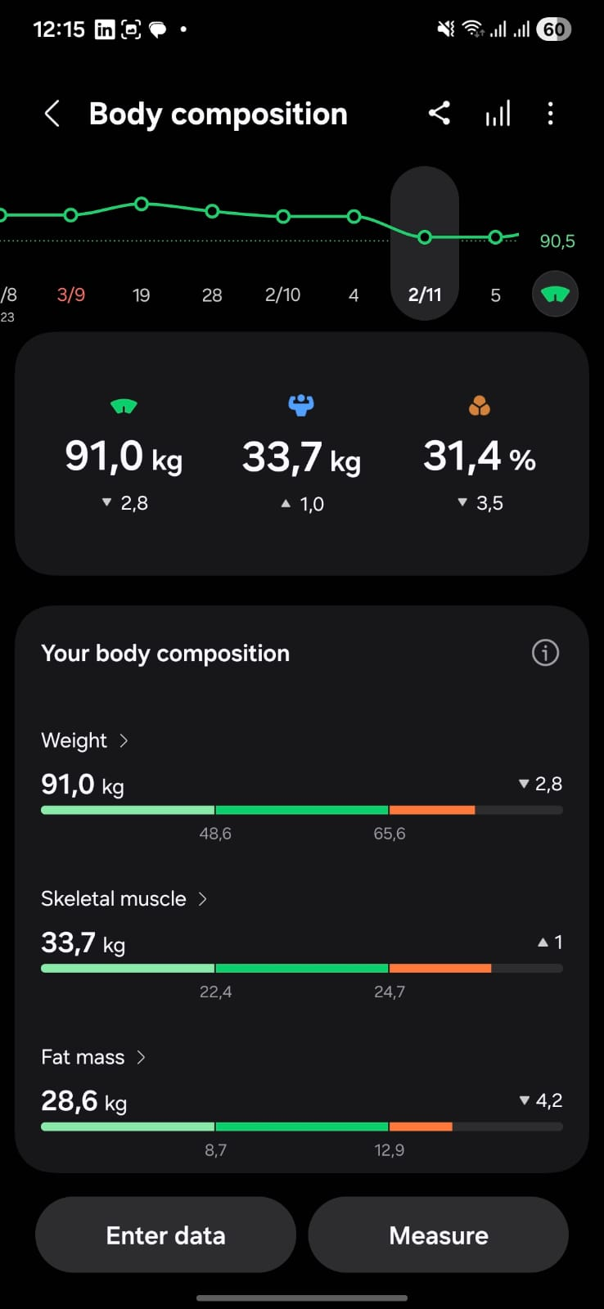
BODY COMPOSITION ANALYSIS

Slide 57


Slide 58

Please take a few moments to complete this evaluation form.
We appreciate your comments
90 Grayston Drive, Sandown, Sandton, 2031,Gauteng
ZA26OB00261 April 2025
Novo Nordisk (Pty) Ltd. Reg. No.: 1959/000833/07. 90 Grayston Drive, Sandown, Sandton, 2031, Gauteng
Tel: (011) 202 0500 Fax: (011) 807 7989. www.novonordisk.com. ZA26OB00261 April 2025

