Slide 1

Vertigo & Vestibular Testing
Presented by dr tarryn M reddy (phd)
Vestibular audiologist
Notes:
Good afternoon everyone, and thank you for having me.
My name is Tarryn Reddy, I’m a vestibular audiologist, and today I’ll be speaking about vertigo and vestibular testing — but more importantly, how we approach the dizzy patient in clinical practice.
Dizziness is one of those symptoms that we all see regularly… but it’s also one of the most challenging to assess

Slide 2
Making sense of dizziness:
“I feel like the room is spinning”
“I’m not dizzy, I just feel off-balance”
“I feel like I’m going to faint”
“It’s worse when I lie down or turn in bed”
“I feel like I’m walking on a slope”
“My head feels heavy / foggy”
Notes:
I want to start with something very simple.
These are the kinds of things patients say when they come into your rooms.
And I’m sure as you’re reading through these… you’re thinking — you’ve heard every single one of these before.
This is what makes dizziness difficult – it is a symptom and not a diagnosis, we need to make sense of the patient’s descriptions in order to recognize patterns

Slide 3
Dizziness
Cardiovascular
Neurological
Musculoskeletal
Vestibular
MI; Arrhythmias, Orthostatic Hypertension
CVA, TIA, Cerebellar Disorders, MS
Cervicogenic
BPPV, Labyrinthitis, MD, VN
……..
Notes:
We refer to dizziness as an umbrella term and, and there are several causes of dizziness, ranging from cardiovascular to neurological and cervicogenic causes, as well as central and peripheral vestibular pathologies. Peripheral vertigo accounts for over 90% of all vertigo cases and results from dysfunction in the inner ear. The most common peripheral vestibular pathologies that we have seen in practice is BPPV, Meniere’s Disease and unilateral vestibulopathy. Today we will focus on the assessment of peripheral pathologies and look specifically at the test battery we would use for a patient complaining of vertigo.

Slide 4
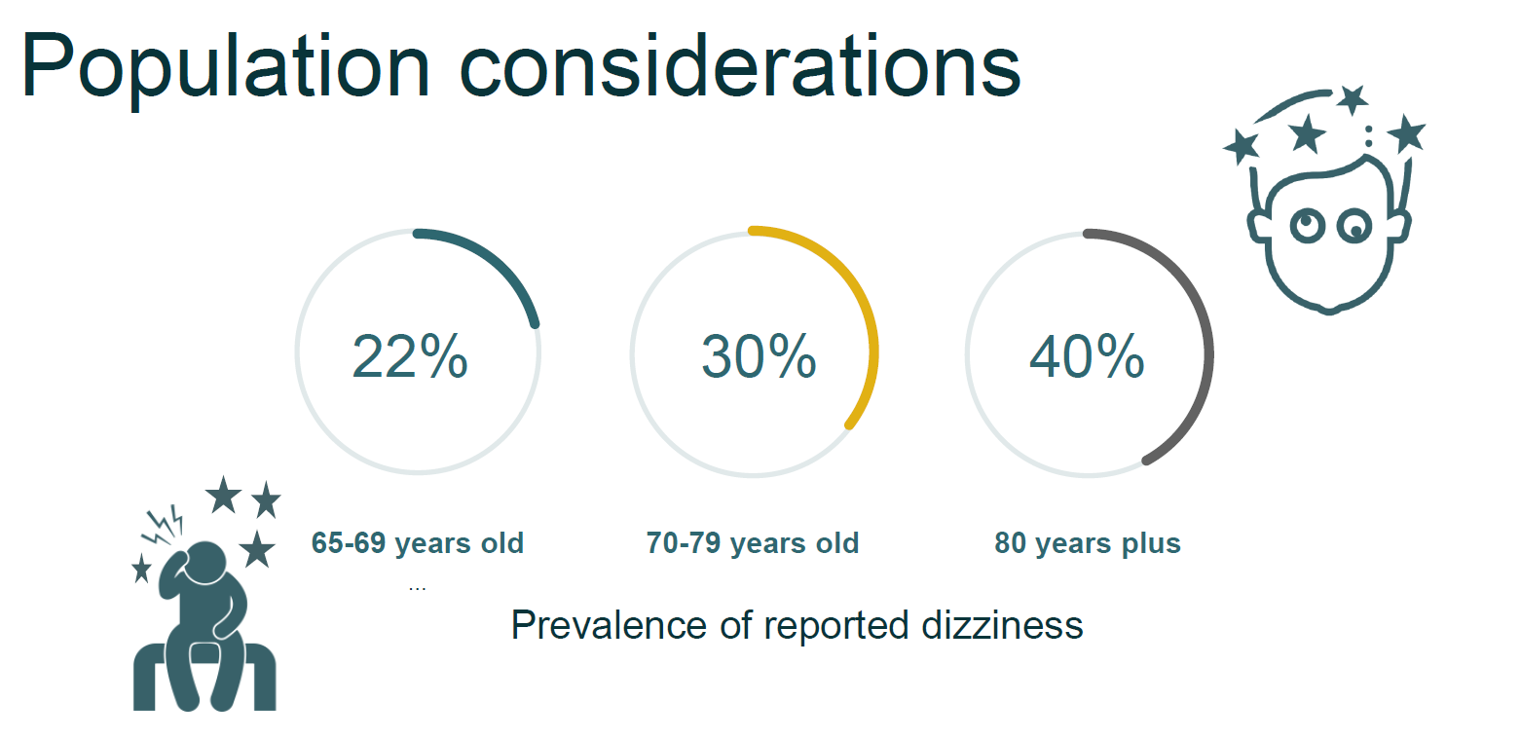
Notes:
Global Data
20–30% of people experience dizziness/vertigo in their lifetime
~25% of adults report dizziness annually
Up to 35% of adults >40 years show vestibular dysfunction on testing
~5% of the population has chronic dizziness

Slide 5
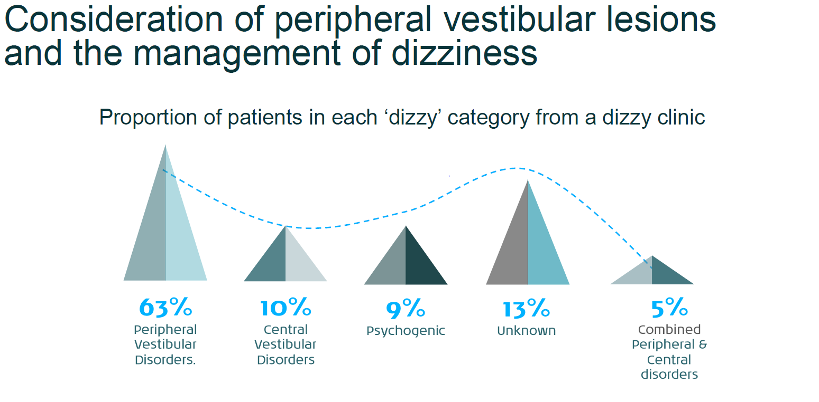

Slide 6
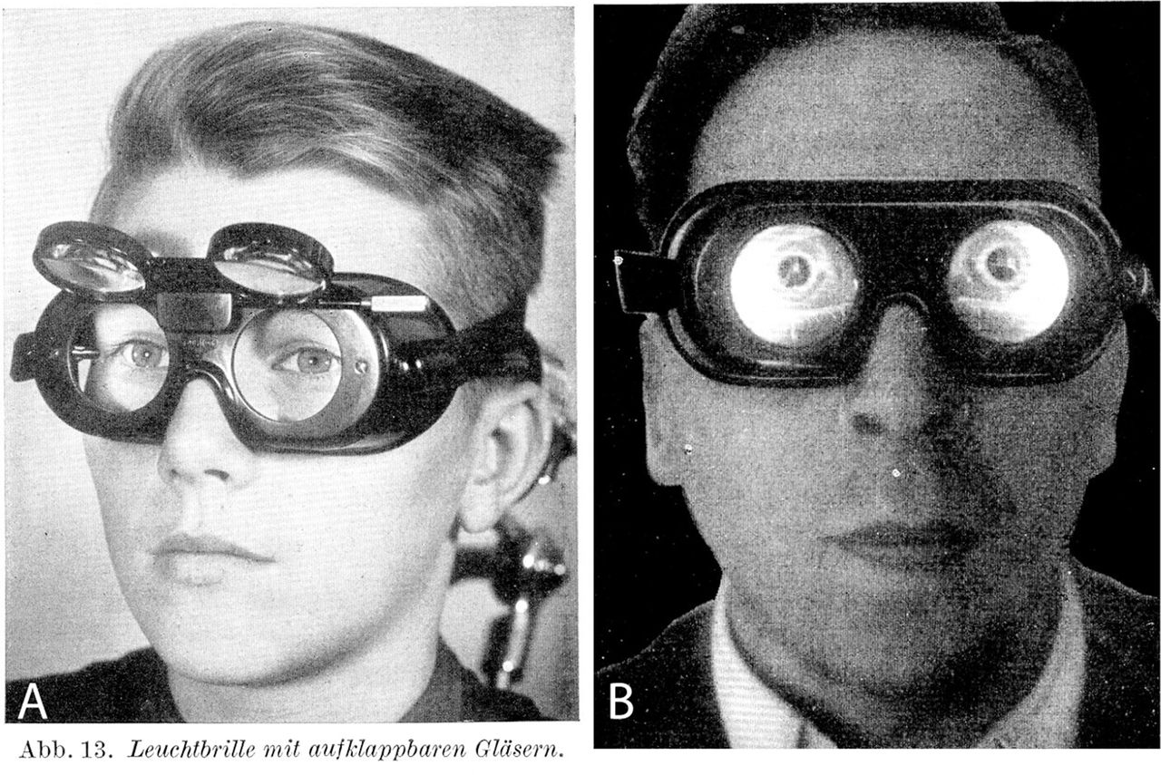
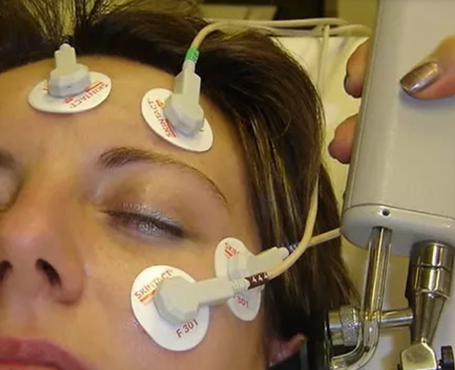
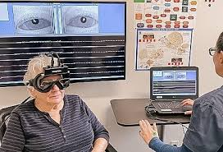
The evolution of the vestibular test battery
Videonystagmography (VNG)
Frenzel lenses
Electronystagmography (ENG)
Notes:
Historically, we relied on observation. Today, we have infrared tracking and myogenic potentials. We aren't just looking for nystagmus anymore; we are quantifying the gain of the VOR and the threshold of the otoliths

Slide 7
The role of the modern vestibular clinic
Make a Diagnosis
Make appropriate referrals within a multidisciplinary team
Monitor disease progression
Expectation management
Guide rehabilitation
Monitor recovery

Slide 8
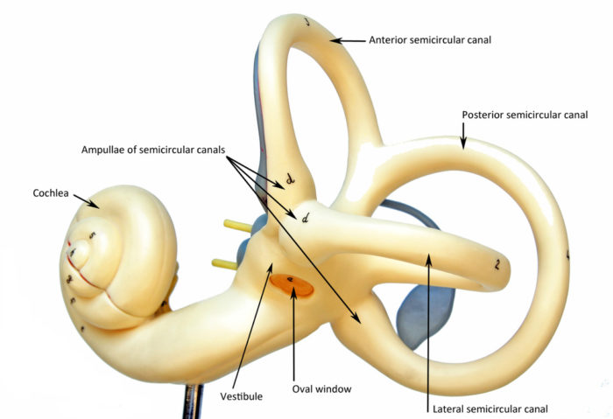

Slide 9
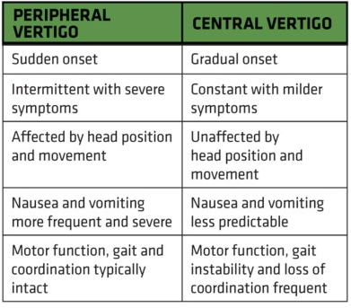
Signs and Symptoms: Peripheral vs Central Disorder
Notes:
We spend a lot of time trying to differentiate central and peripheral causes and I thought I would spend a minute highlighting some of the signs and symptoms. Refer to slide.

Slide 10
SO STONED – case history questionnaire
S: What are the Symptoms
O: How Often do the symptoms occur
S: Since when did it start
T: Trigger of symptoms
O: Otological additional symptoms
N: Neurological additional symptoms
E: Evolution of symptoms
D: Duration of symptoms

Slide 11
Common Vestibular Disorders
Bárány Society Clinical Patterns
🟢 BPPV
Seconds (<1 min)
Triggered by position
No symptoms between episodes
🔵 Ménière’s Disease
20 min – 12 hrs
Hearing loss + tinnitus + fullness
Recurrent episodes
🟣 Vestibular Migraine
5 min – 72 hrs
Migraine features (± headache)
Normal exam between attacks
🟠 Vestibular Neuritis/ Labyrinthitis
Acute onset, lasts days
Severe vertigo + nausea
Positive head impulse
🔴 Bilateral Vestibulopathy
Chronic imbalance
Oscillopsia
Worse in dark/uneven ground
⚫ PPPD
≥3 months persistent dizziness
Worse upright, motion, visual stimuli
Often follows acute vestibular event

Slide 12
Nystagmus
Spontaneous Nystagmus
Positional Nystagmus
Direction changing Nystagmus
Pressure/Sound-induced Nystagmus
Horizontal, vertical, torsional, square-wave jerk Nystagmus
Geotropic/Ageotropic
Persistent or Fatigable
Fast Phase and Slow Phase of the Nystagmus
Notes:
Nystagmus is a rapid involuntary movement of the eye
Nystagmus always beats towards the healthy/more active side – in some cases of Meniere’s Disease, in an attack, the nystagmus will beat to the affected side.
Bilateral vestibulopathy – there may be no nystagmus

Slide 13
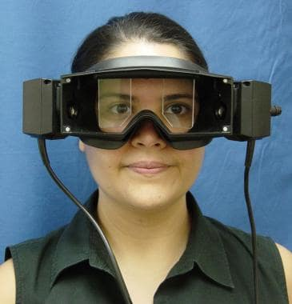
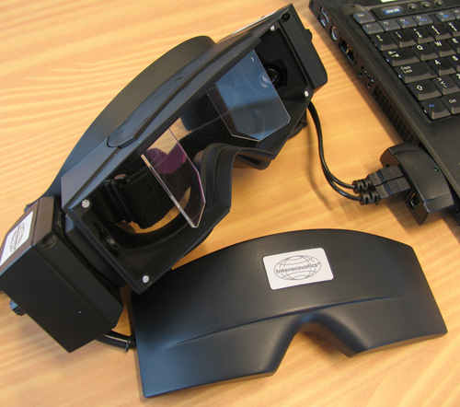
Videonystagmography (VNG)
Infrared Goggles
Fixation light
Cameras
Notes:
With vs without fixation
Light inside the goggles
Horizontal-torsional spontaneous nystagmus in peripheral vestibular disorders is suppressed by fixation, and the suppression requires intact functioning of brainstem and cerebellum. Nystagmus that is purely vertical, or torsional usually has a central cause.

Slide 14
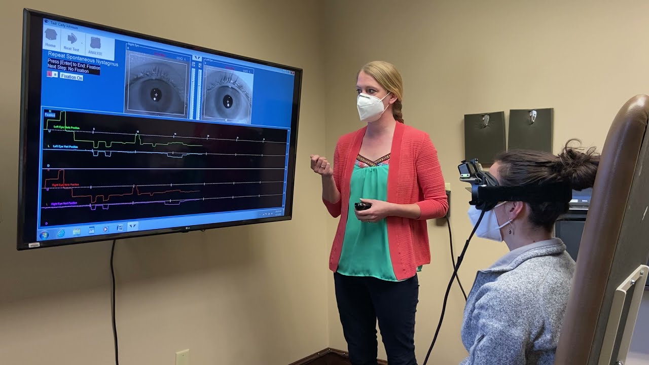
Spontaneous nystagmus

Slide 15
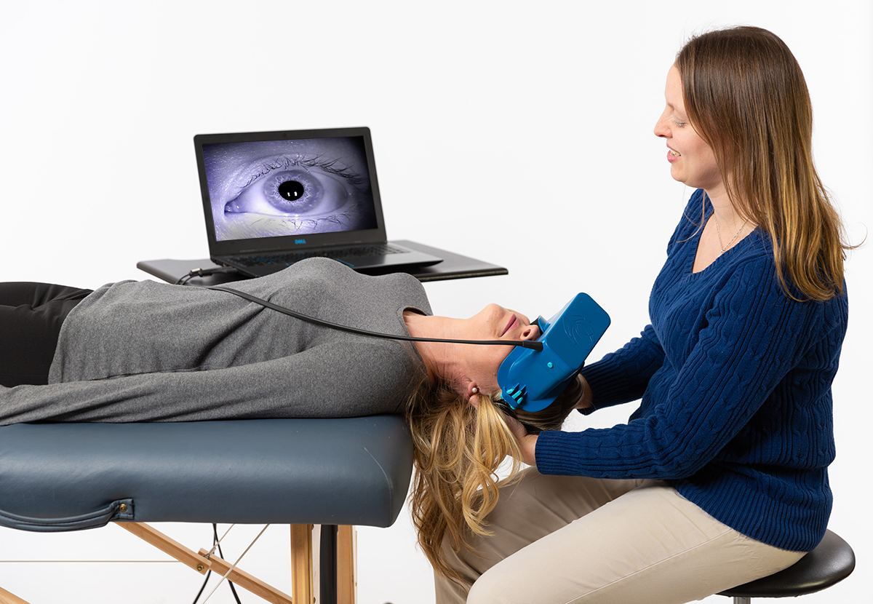
Positional Testing

Slide 16
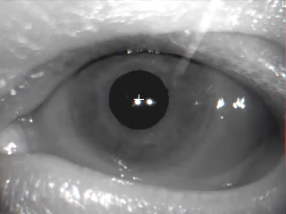
Torsional Nystagmus
Notes:
Left posterior canal
If nystagmus is present it must be delayed in onset, torsional, fatigable, reverse direction when the patient is returned to a sitting position and will be present in the horizontal and vertical channels.
Criteria for bppv

Slide 17
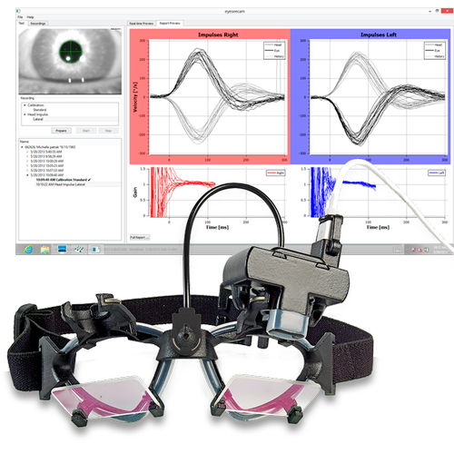
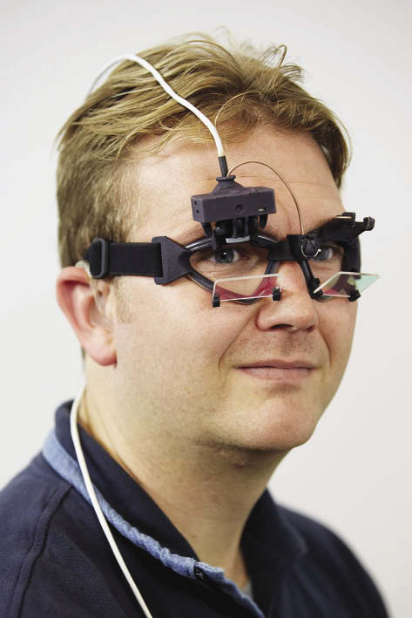
Video head impulse test

Slide 18
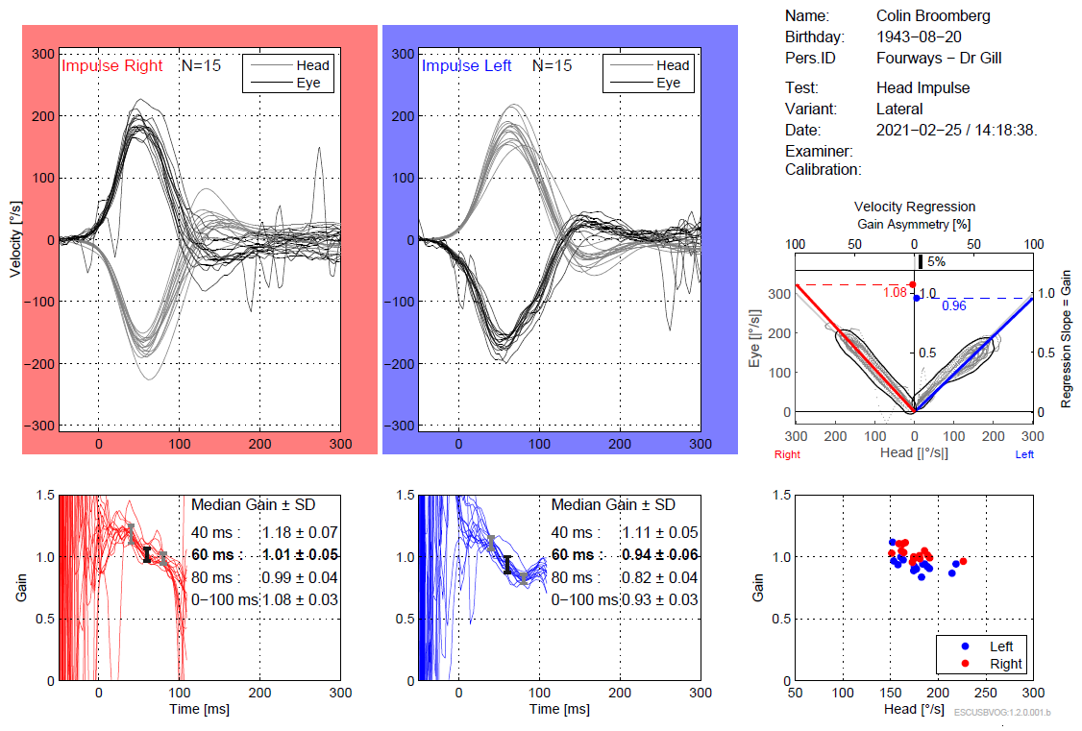

Slide 19
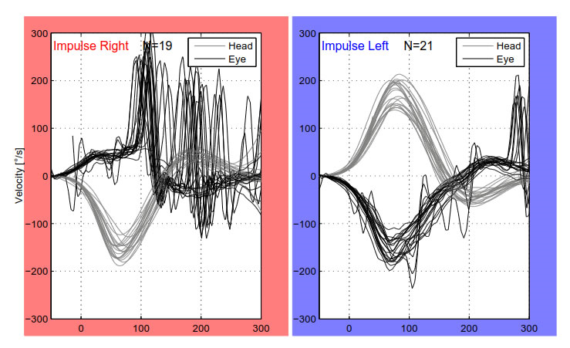

Slide 20
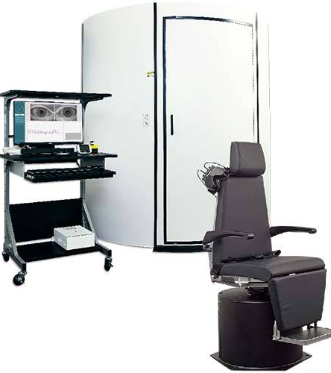
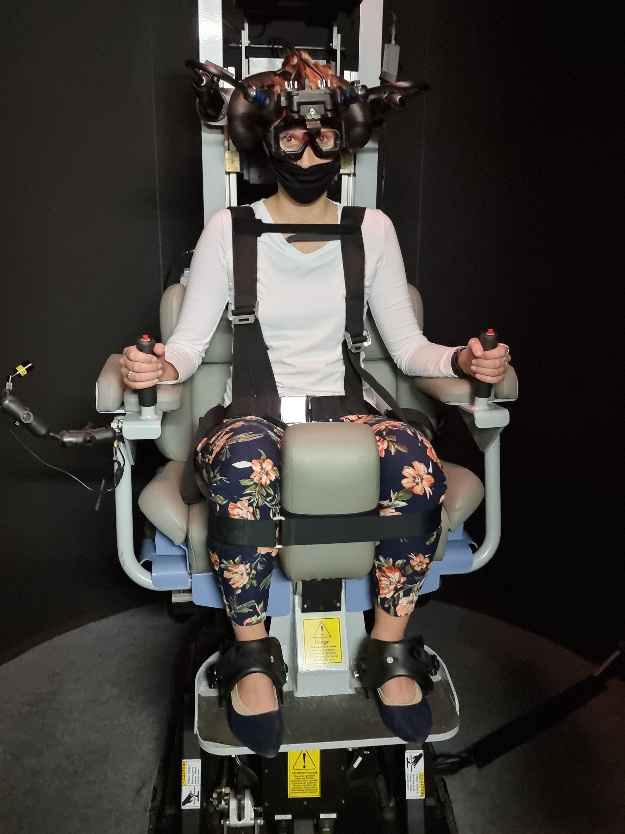
Rotary chair

Slide 21
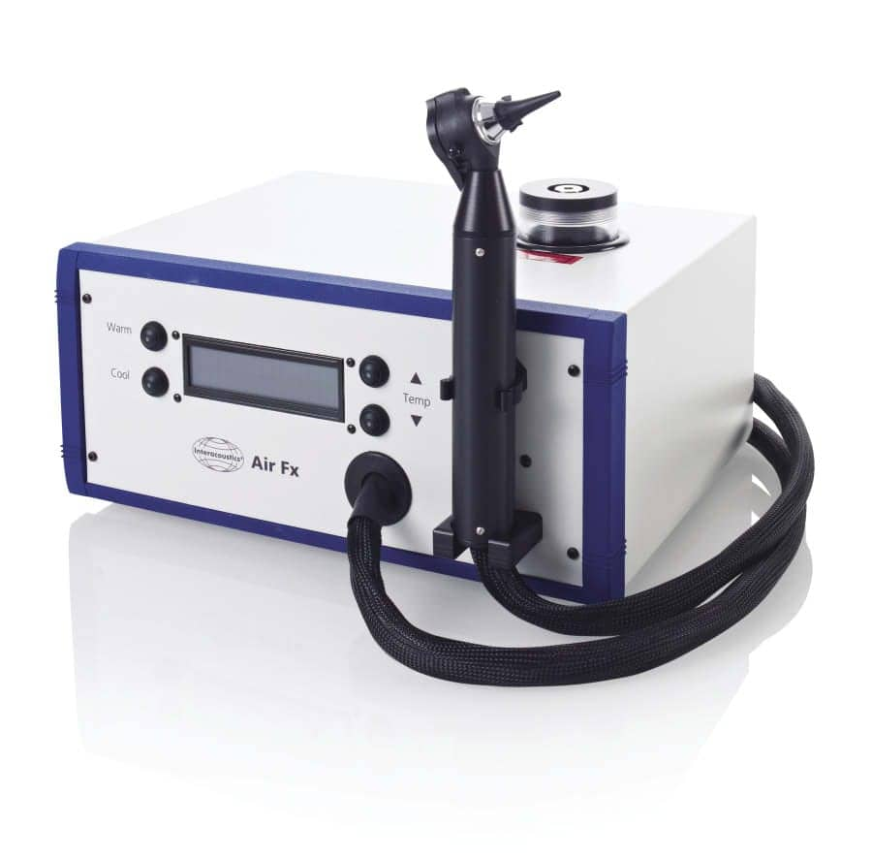
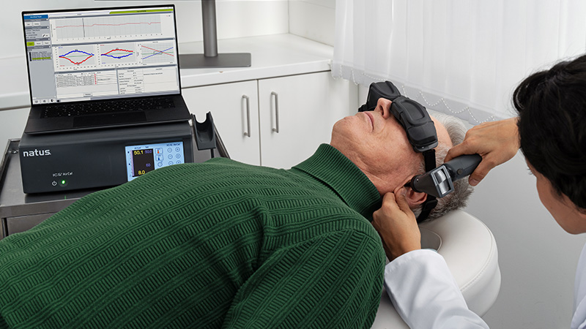
Caloric irrigation test

Slide 22
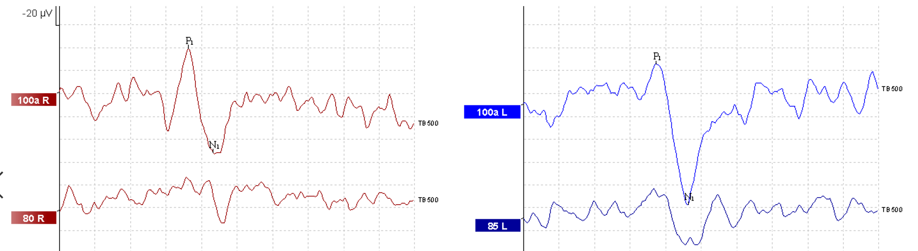
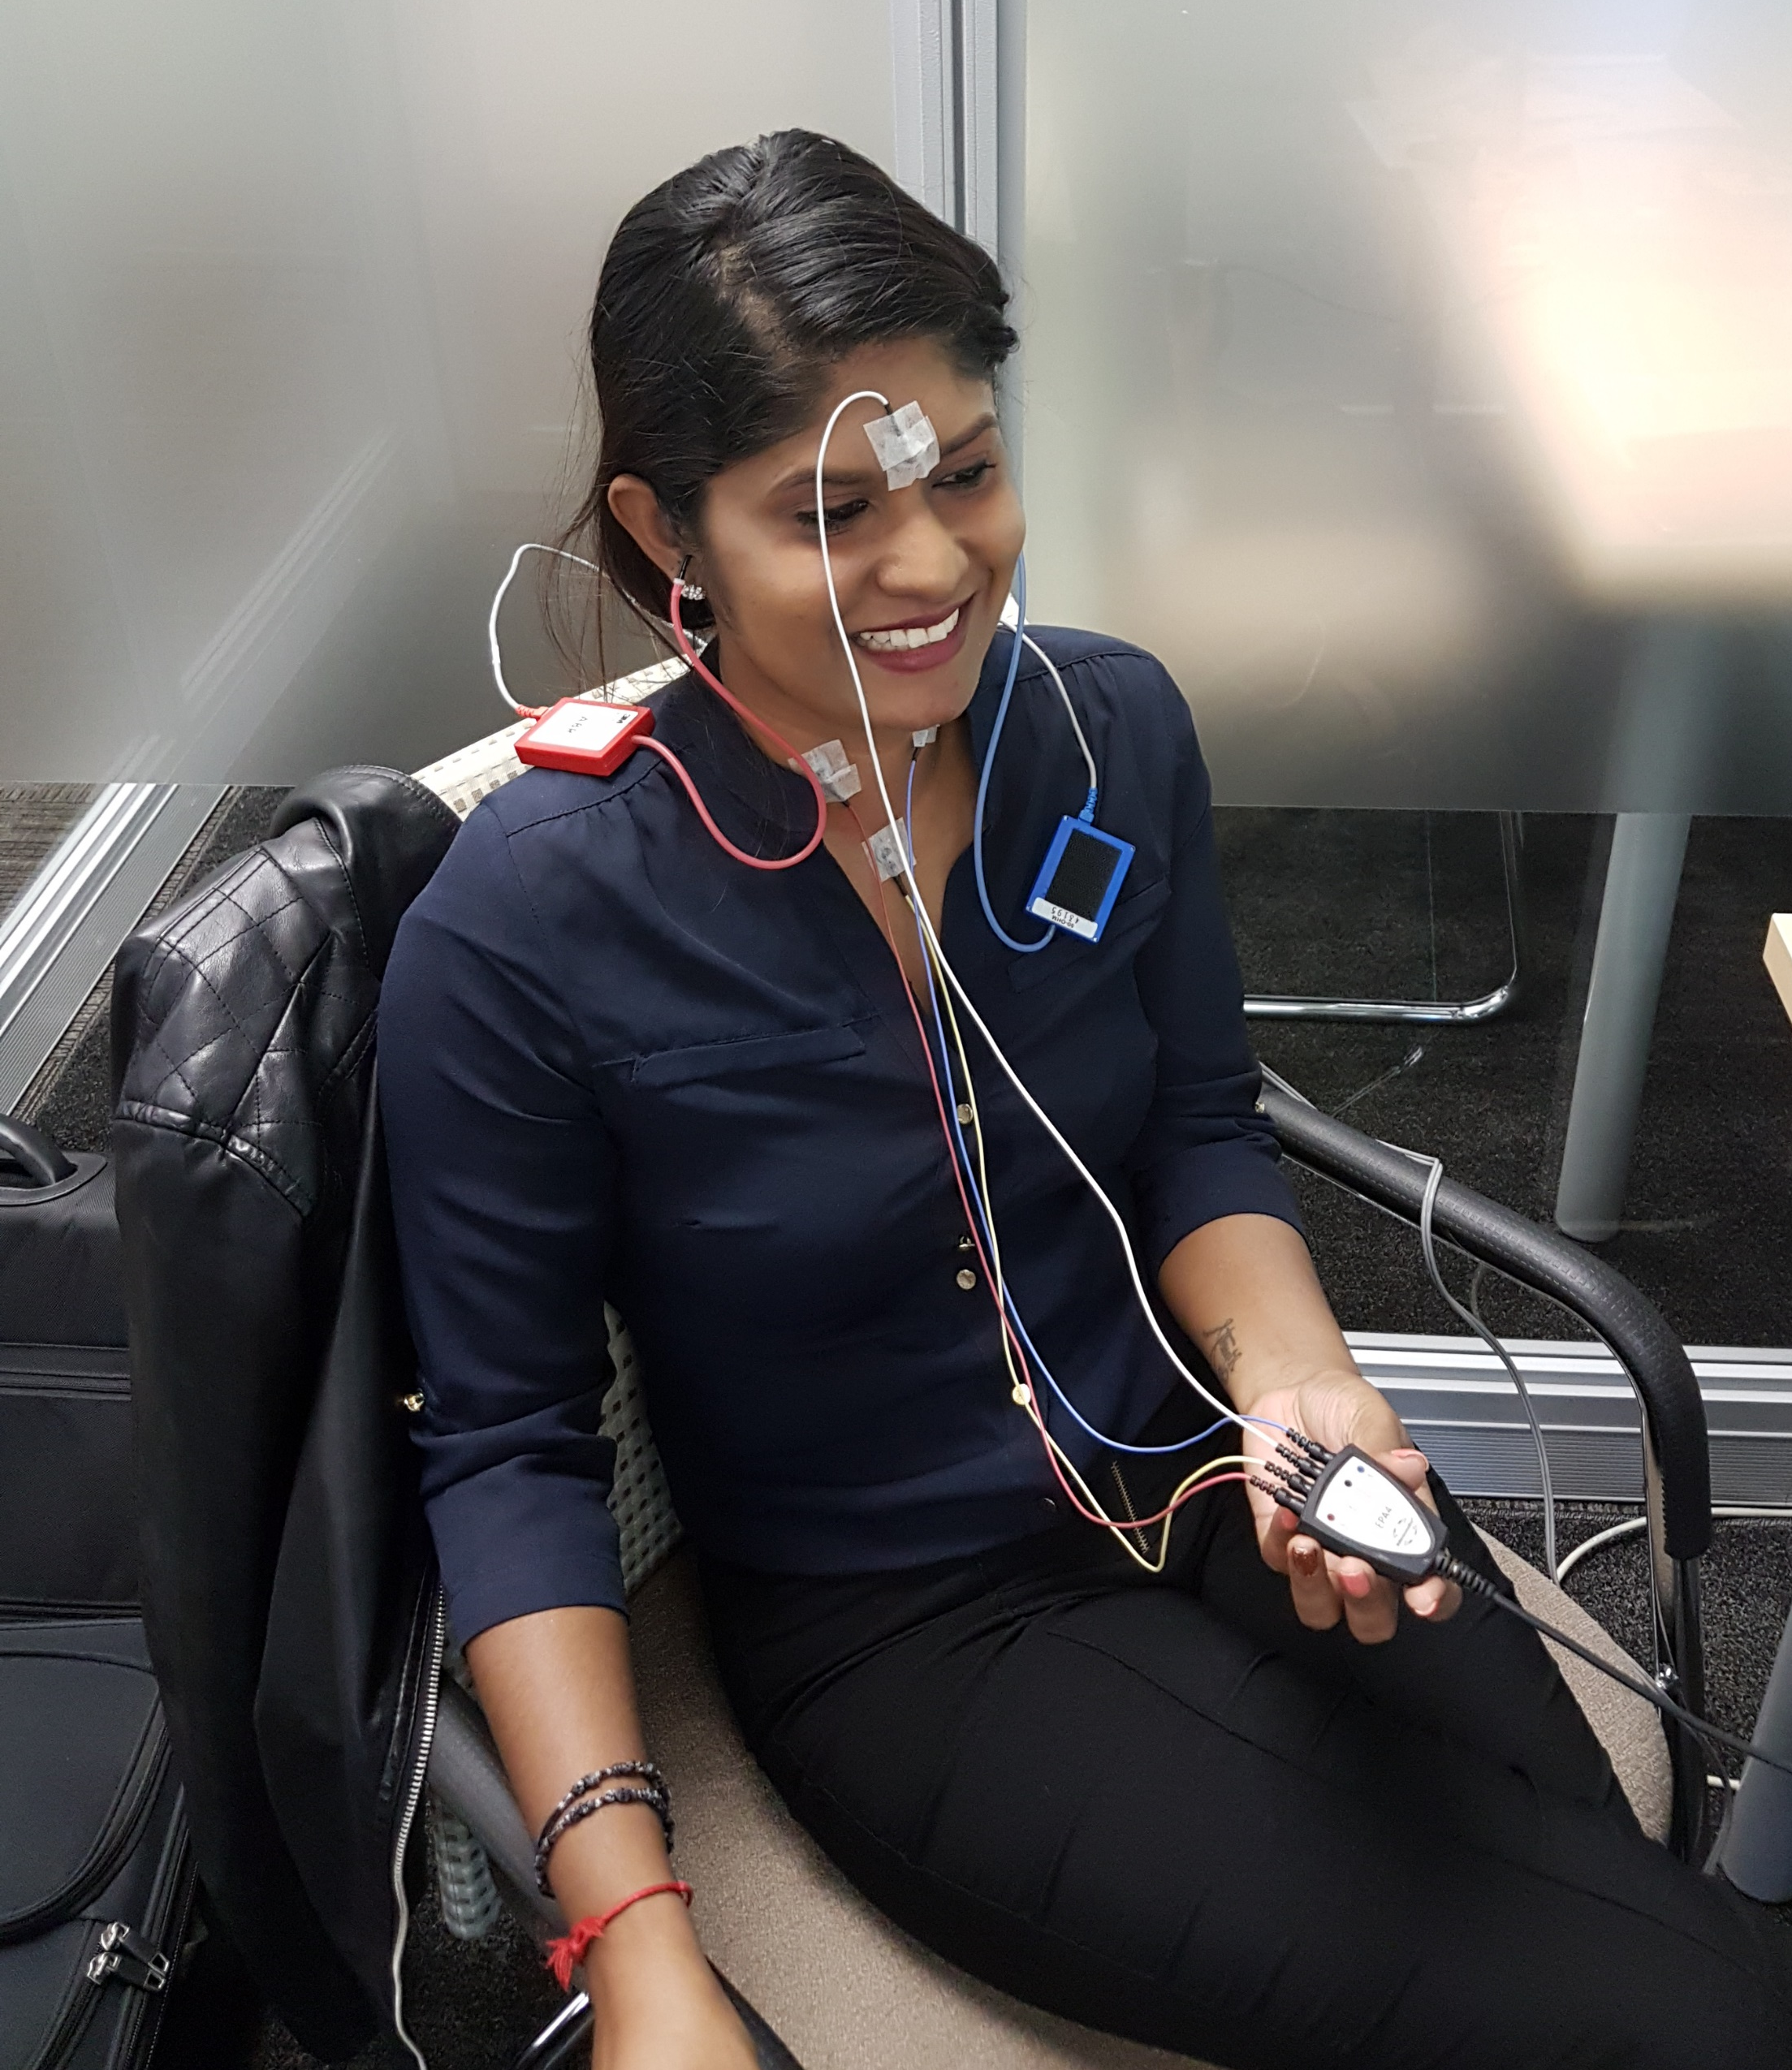
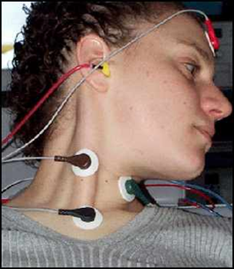
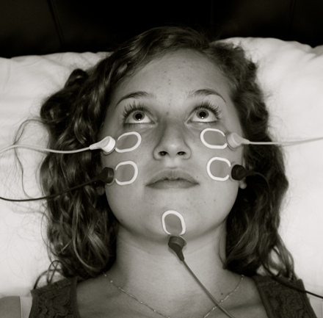
Vestibular evoked myogenic potentials (vemp)

Slide 23
Why this matters for you:
Confirms your clinical suspicion
Differentiates central vs peripheral
Identifies site of lesion
Guides rehabilitation & referral
When to refer:
Unclear diagnosis after bedside exam
Persistent dizziness (>2–4 weeks)
Suspected bilateral vestibulopathy
Recurrent unexplained vertigo
Failed BPPV treatment
Suspected central vs peripheral uncertainty

Slide 24
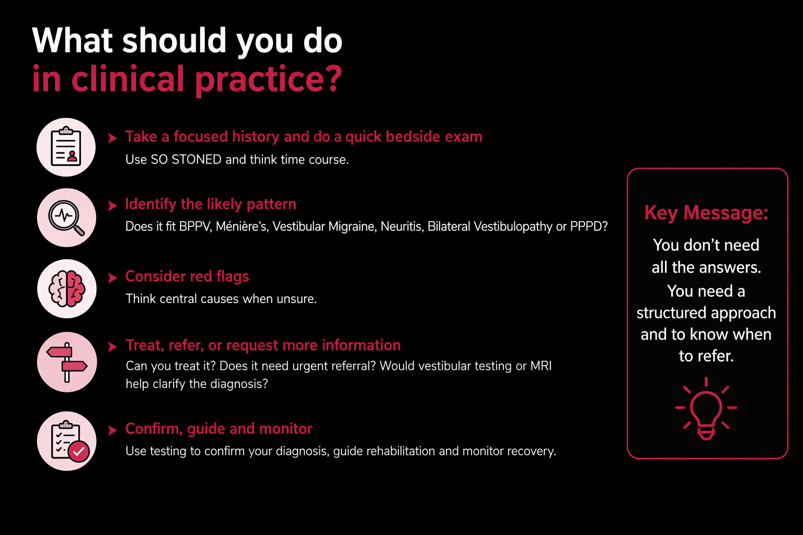

Slide 25

info@tmraudiology.co.za
Whatsapp: 079 497 4827

