Slide 1
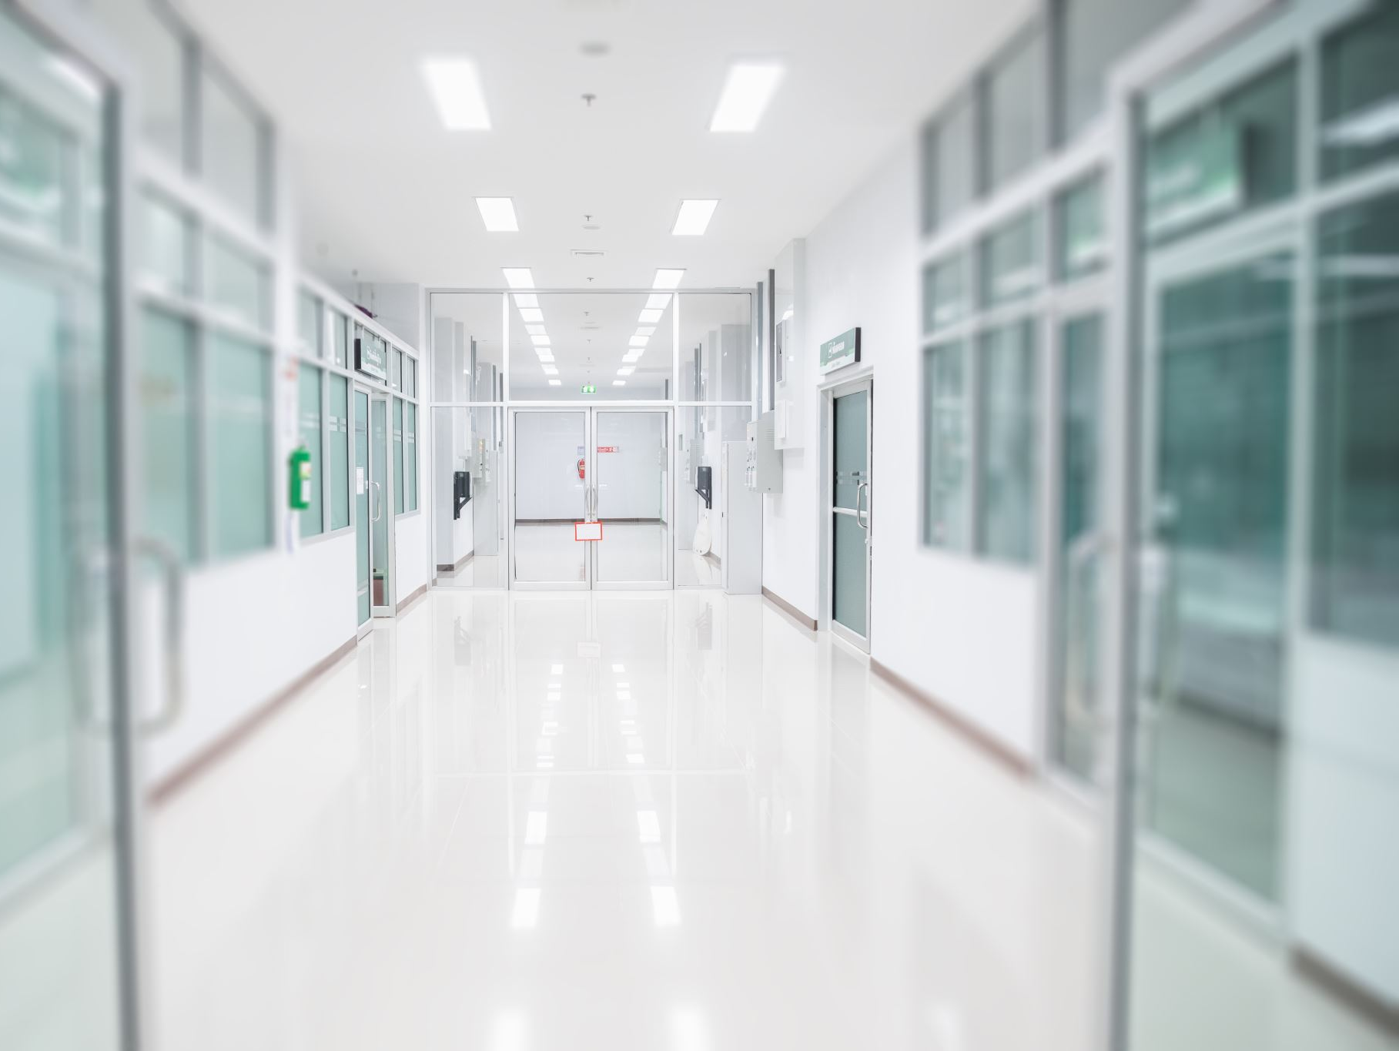
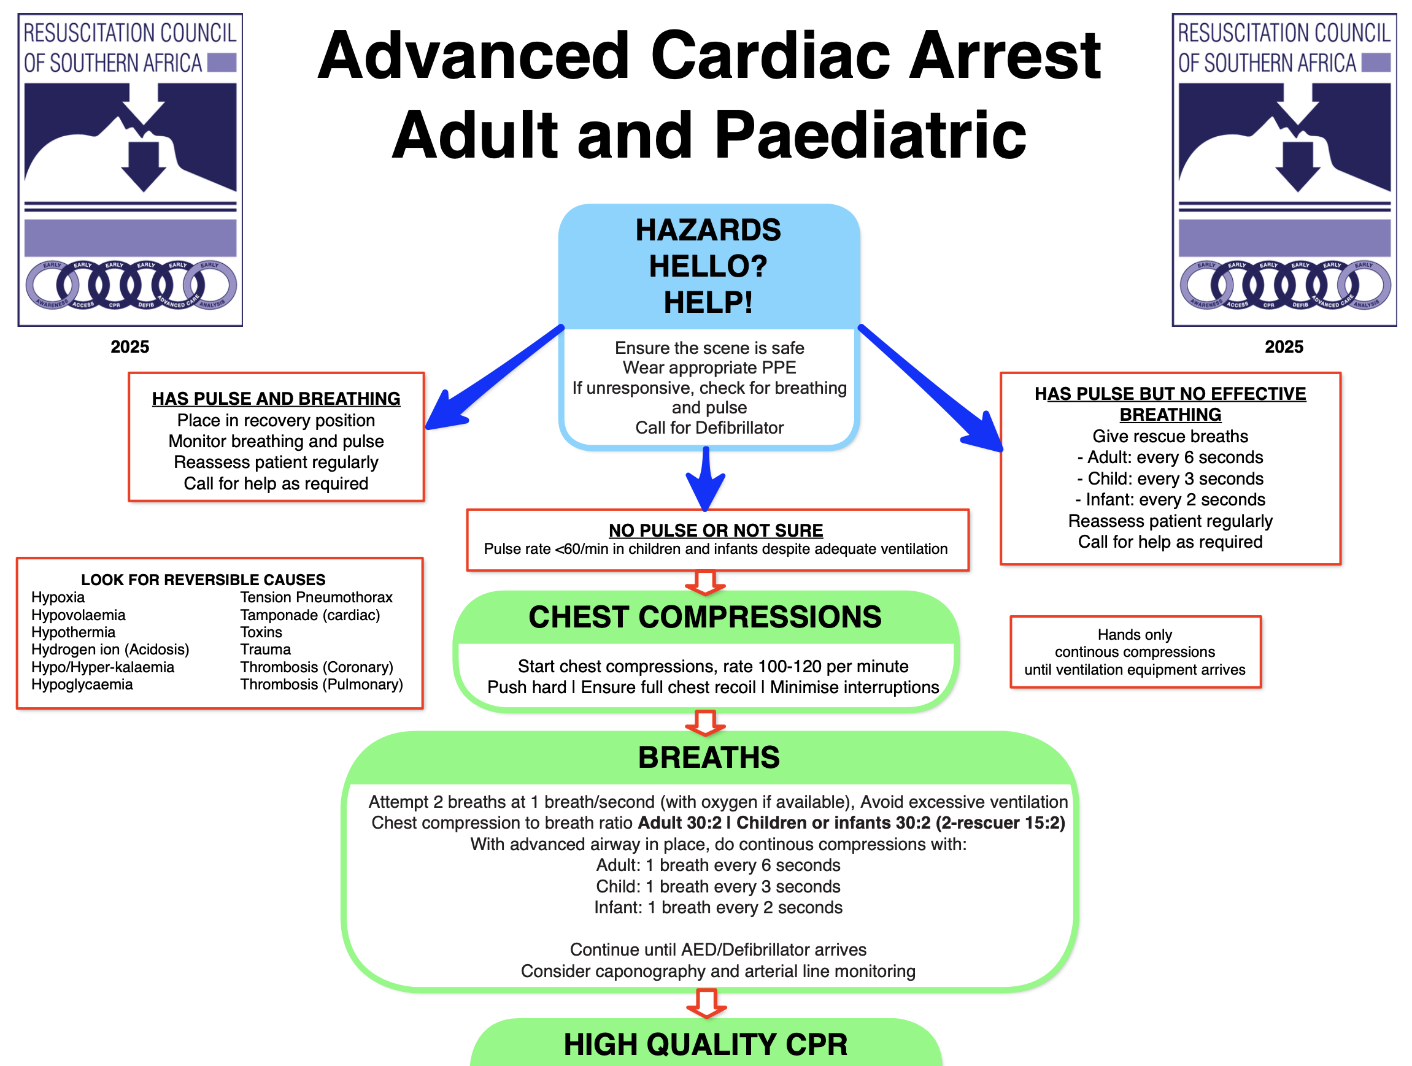
Emergencies in the consultation room: ‘The First 10 Minutes'
Dr Michelle Myburgh
Notes:
Introduce topic and emphasise importance of first 10 minutes.

Slide 2
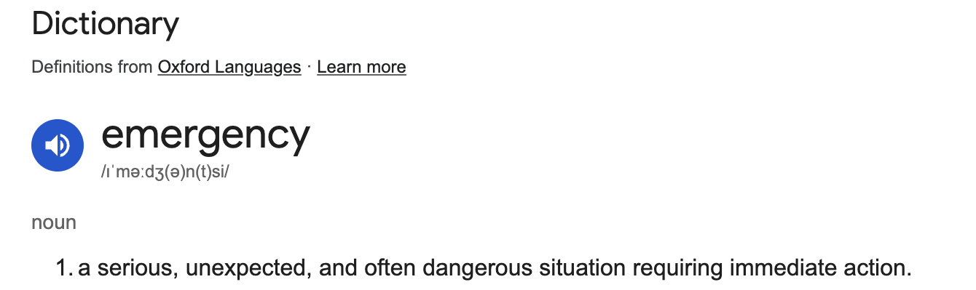
Why This Matters
Emergencies can happen anytime
Need to recognise and manage
sometimes minutes count
Notes:
a serious, unexpected, and often dangerous situation requiring immediate action.
Most general practitioners are not exposed to emergencies on a regular basis- and thankfully so.

Slide 3

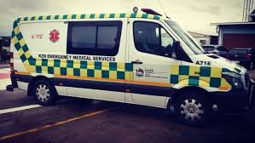

Slide 4

Key actions
Recognise
Stabilise
Refer

Slide 5
Systematic approach
Initial impression
Unconscious
BLS assessment
Conscious
Primary assessment
Pulse
No Pulse
Start CPR

Slide 6
High Quality CPR
Early defibrillation
H’s and T’s

Slide 7

ABCDE Approach
A – airway
B – breathing
C – circulation
D – disability (AVPU + glucose)
E – exposure
Notes:
Walk through each step slowly and clearly.

Slide 8
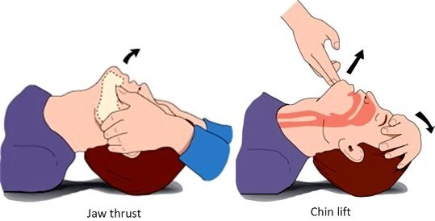
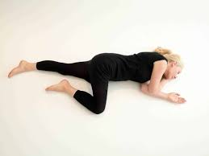
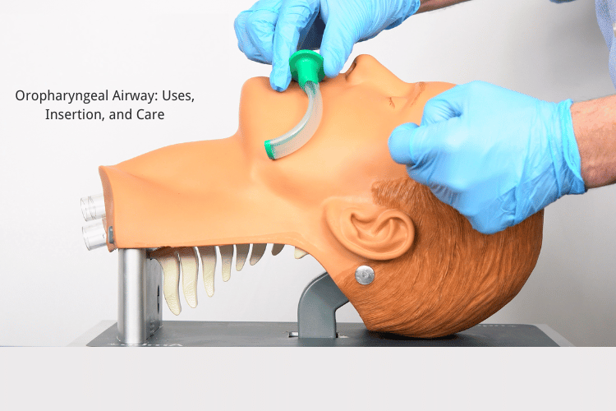
Airway

Slide 9
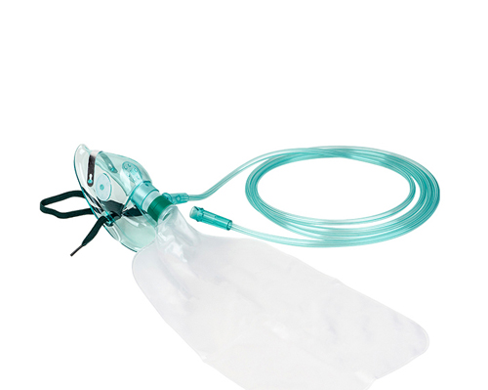
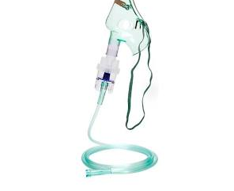
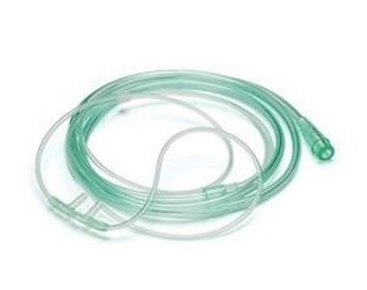
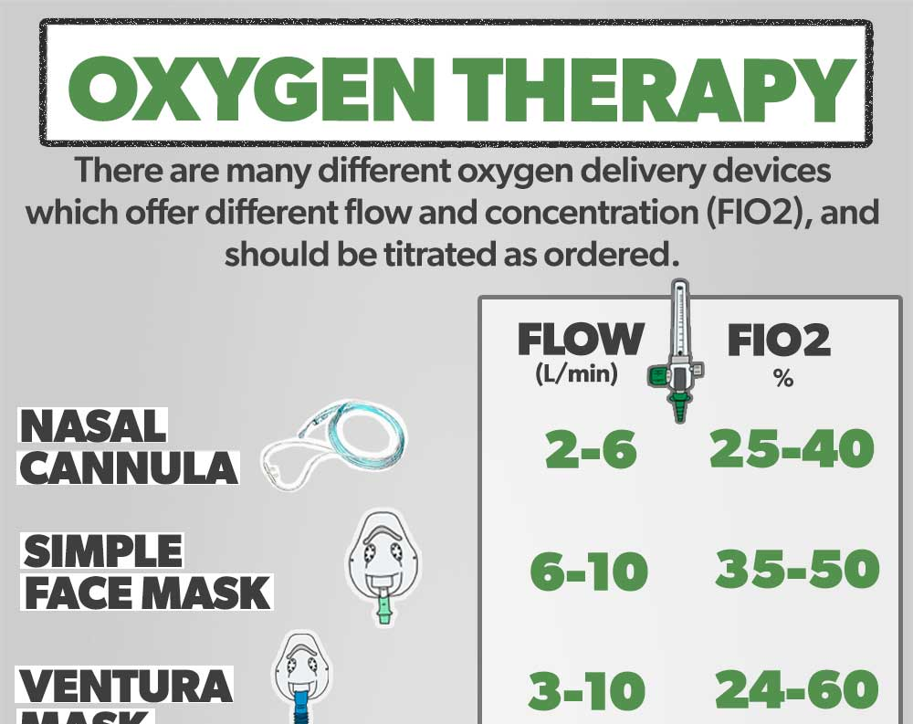
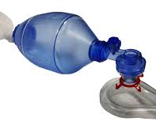

Breathing
Respiratory rate
Auscultation
Saturation

Slide 10
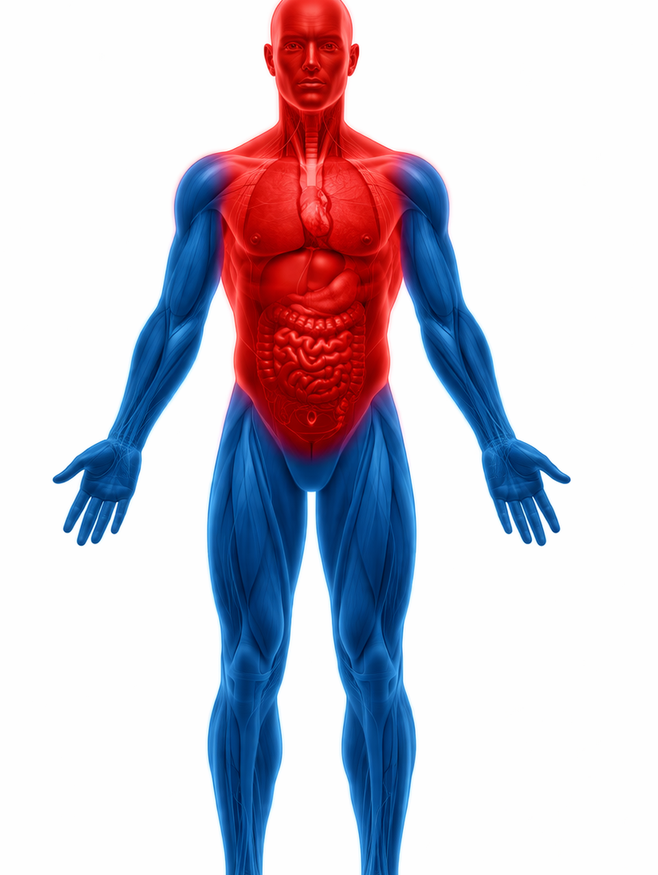
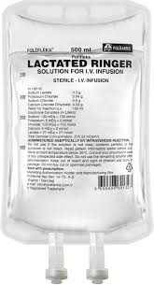
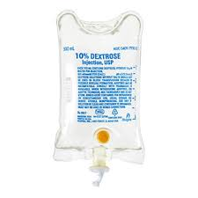
Circulation
Peripheral circulation
Blood pressure
12 lead ECG

Slide 11
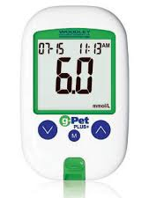
Disability
Level of consciousness
Pupils
Glucose

Slide 12
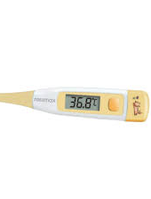
Exposure
Temperature
Trauma
Rashes

Slide 13
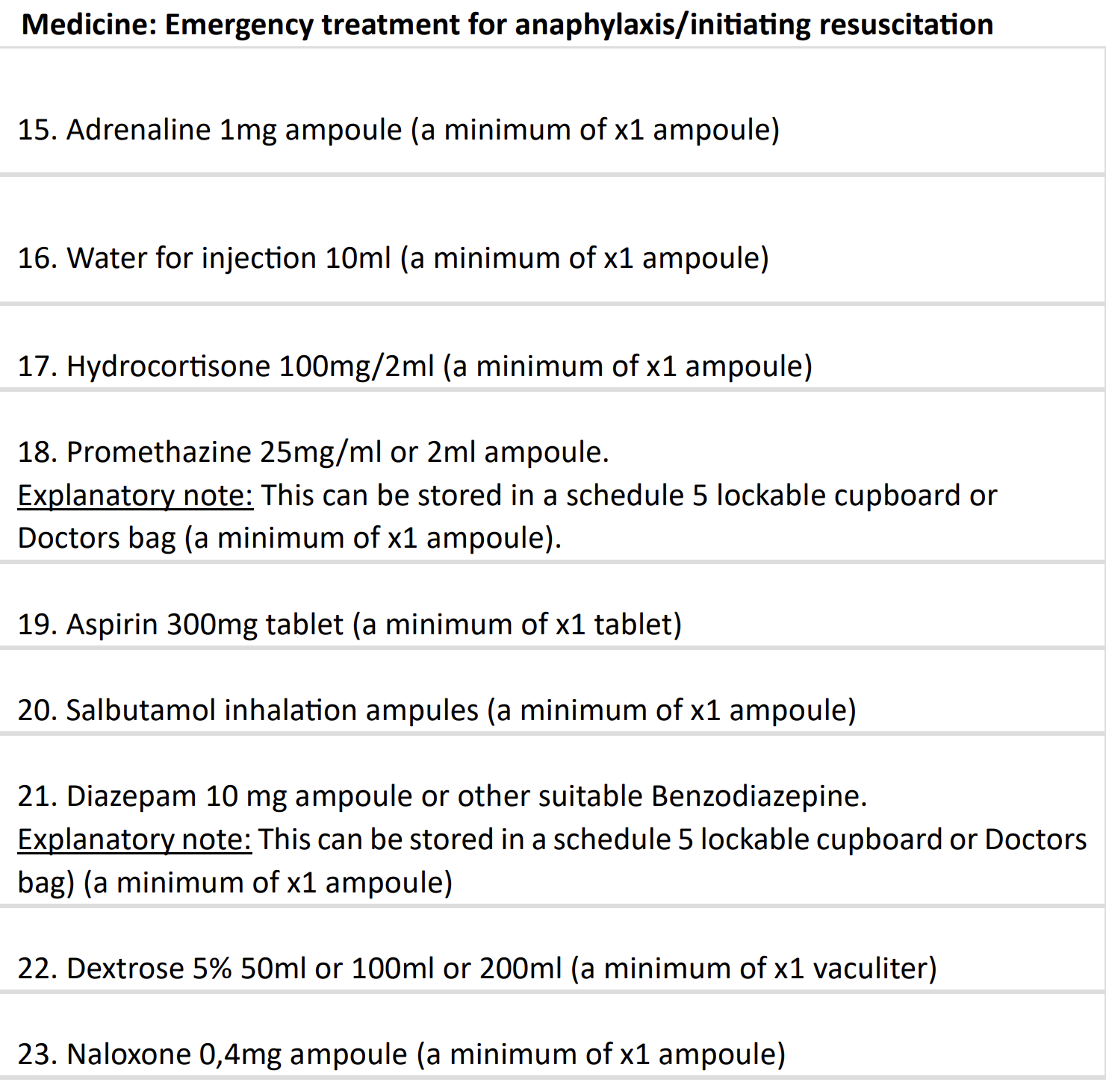

Specific drugs and potential emergencies

Slide 14

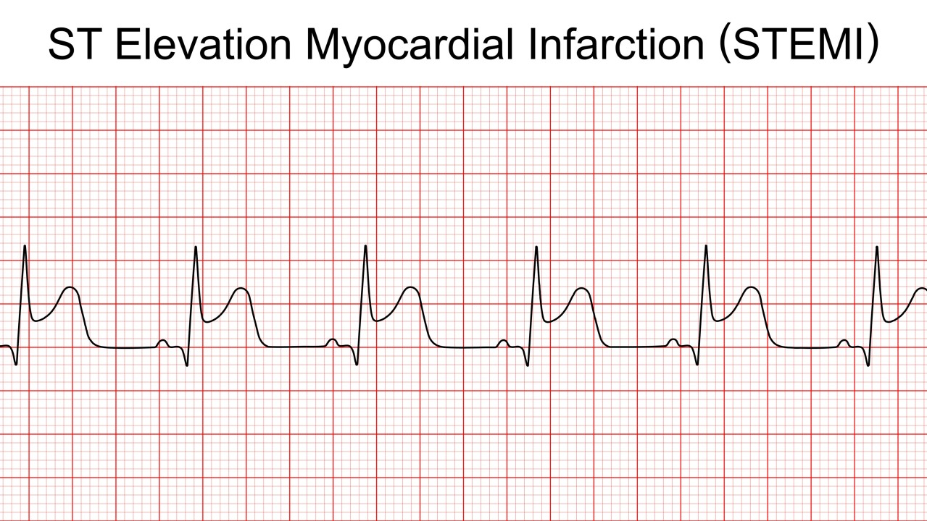
Chest Pain
ECG within 10 min
Give aspirin- 300mg chew
Oxygen only if hypoxic
Refer early- reperfusion
Notes:
Focus on life-threatening causes and early management.

Slide 15
Convulsions
Treat if >5 minutes: Benzo
Protect airway
Check glucose
Notes:
Keep management simple and focused.

Slide 16
Anaphylaxis
Notes:
Adrenaline is life-saving.

Slide 17
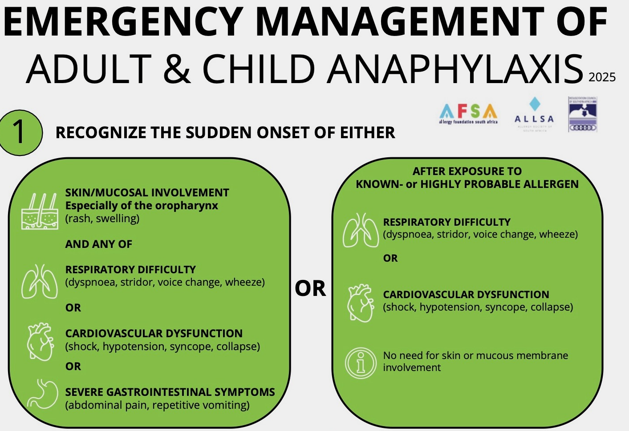

Slide 18
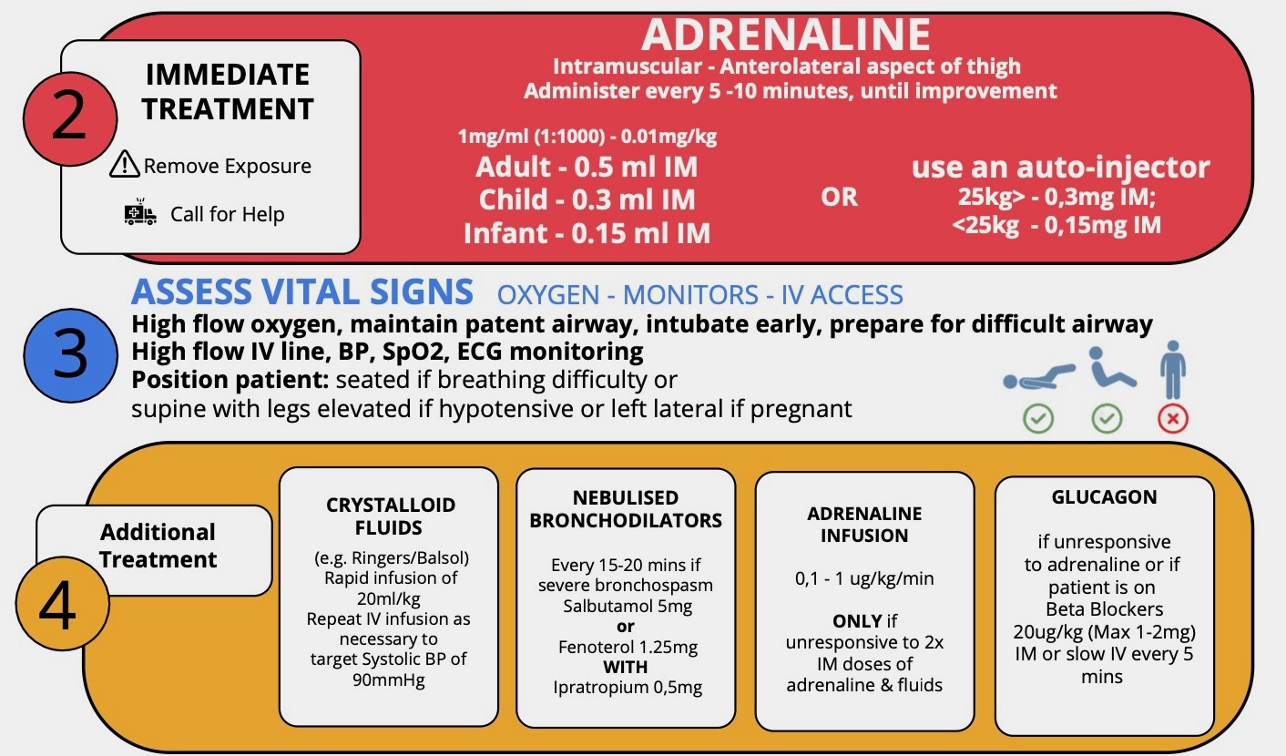

Slide 19
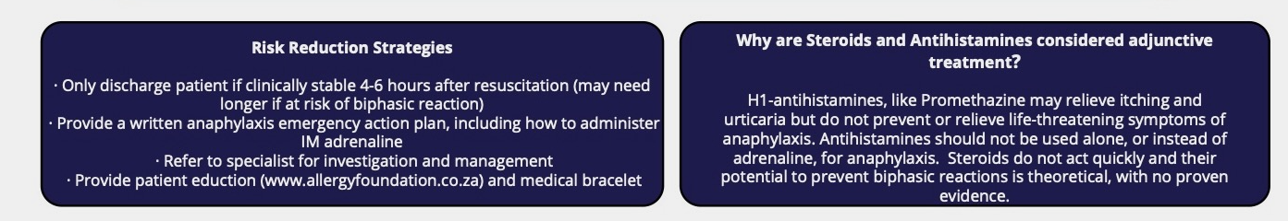

Slide 20
Take Home
ABCDE- Stay systematic
Recognise and Stabilise
Know when you don’t have time
Notes:
End with strong summary message.

