Slide 1

Coronary Artery Disease
Gauteng General Practitioner Forum
Nqoba Tsabedze
Academic & Clinical Head -Division of Cardiology
Department of Internal Medicine

Slide 2

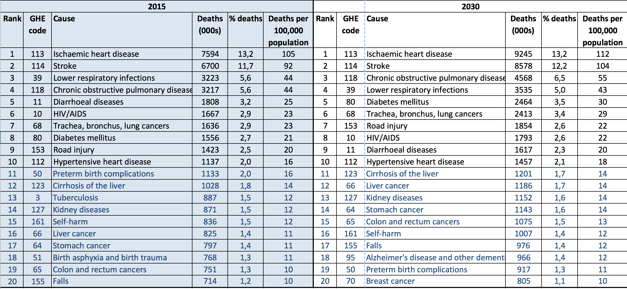
World Top 20 Leading Causes of Death: http://www.who.int/healthinfo/global_burden_disease/projections/en/
Notes:
Ischaemic Heart Disease – Number cause for morbidity and mortality world wide
Increasing need for cardiac interventions
Two Principal strategies for treating IHD – CABG and PCI
PCI – Less invasive, Safer that CABG, Quick return to Baseline functionality.

Slide 3
Risk Factors for Ischaemic Heart Disease
Non Modifiable | Major Modifiable | Other Factors
Age | Smoking | Obesity
Sex | Blood pressure | Homocysteine
Family History | Cholesterol | C Reactive Protein
Ethnic Group | Diabetes | Alcohol
 | Sedentary lifestyle | Infection

Slide 4
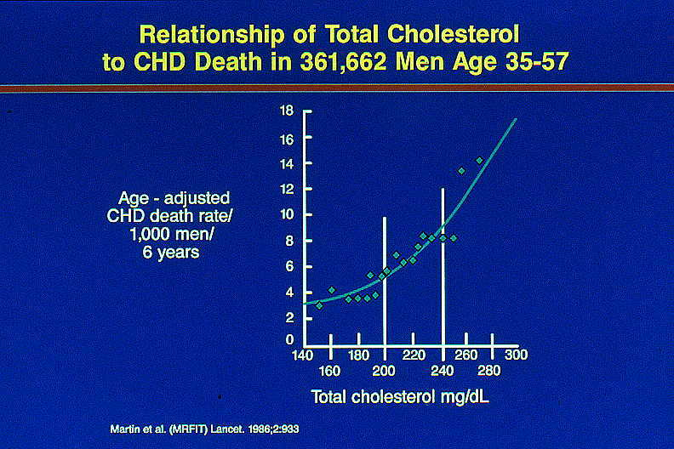

Slide 5
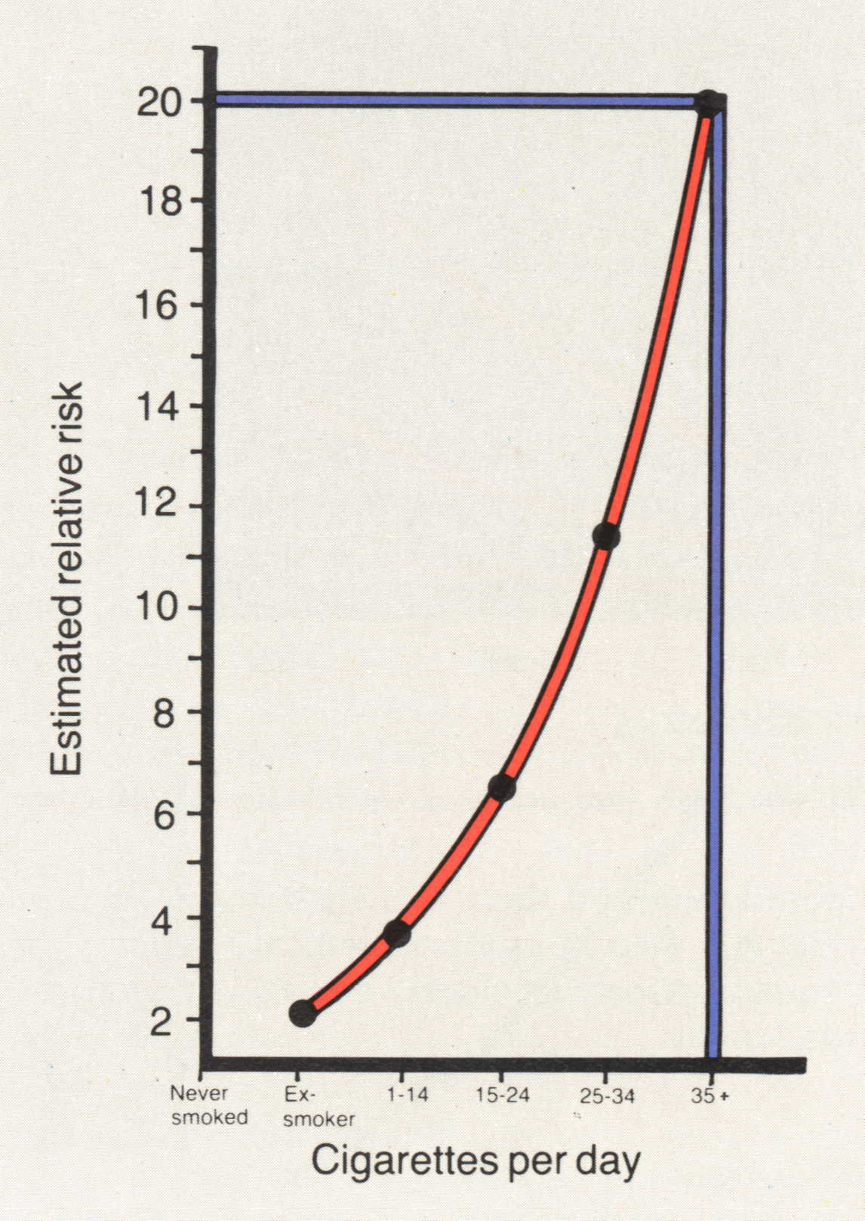

Slide 6
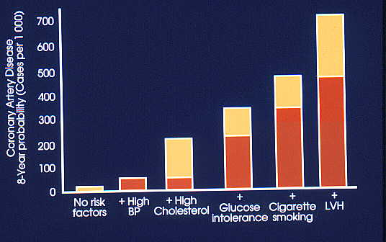
Picture of hypertension
Circulation 1995;92:3350

Slide 7
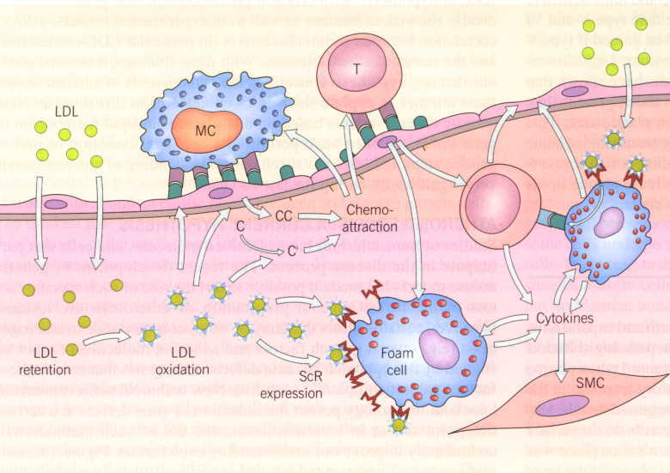
Notes:
Mechanism of atherosclerosis

Slide 8
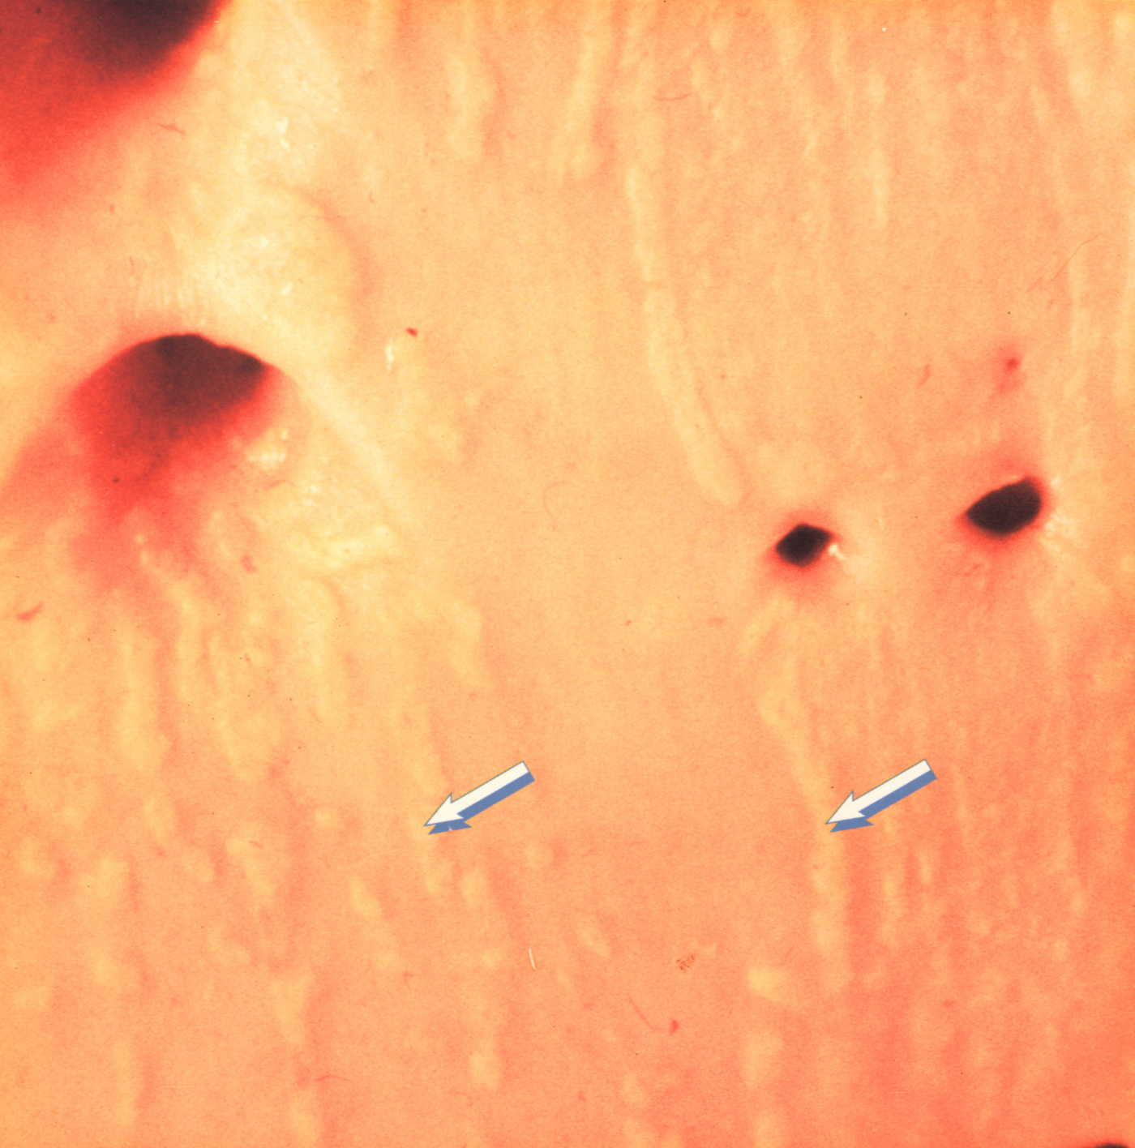
Notes:
Fatty streaks in aorta

Slide 9
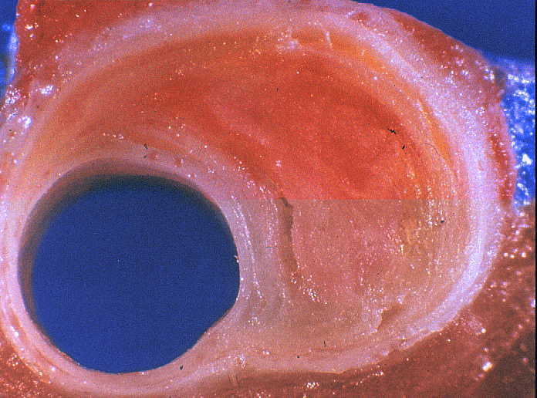
Notes:
Coronary plaque obstructing lumen

Slide 10
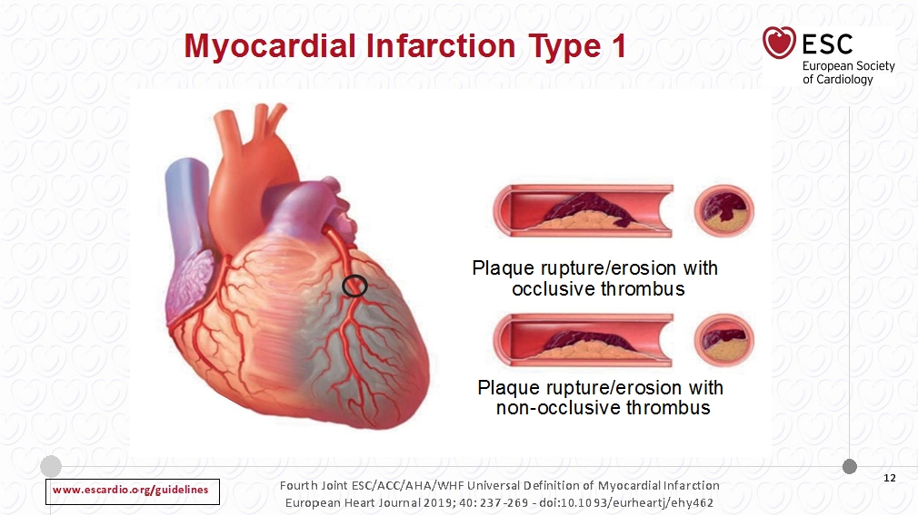

Slide 11
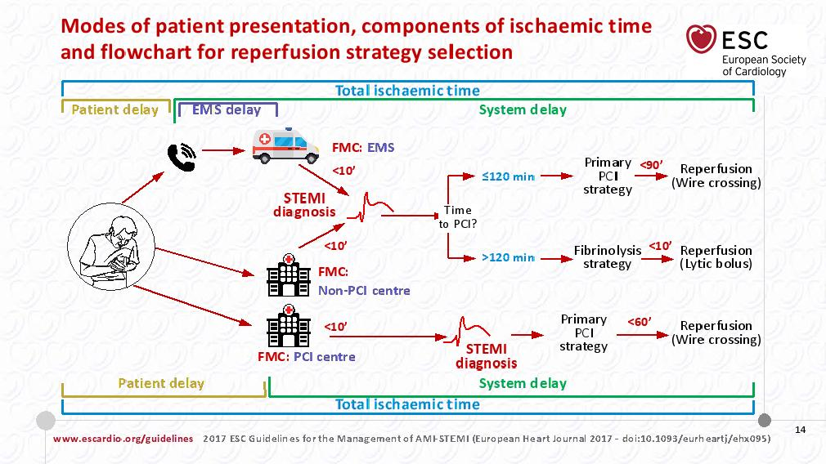

Slide 12
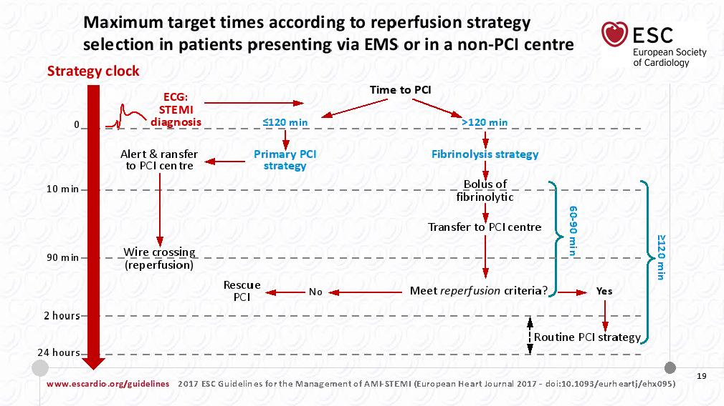
Notes:
The Public Sector which provides health care for 80% of the population of South Africa relies on 10 Cath Labs - affiliated with the university teaching hospitals for medical students, and medical specialists.
Naturally, the vast majority of patients presenting with STEMI will be diagnosed at non PCI capable medical centres.
As such a fibrinolytic strategy becomes an essential cornerstone for health care, because timeous treatment for STEMI can be given without delay in all primary and secondary hospitals.

Slide 13
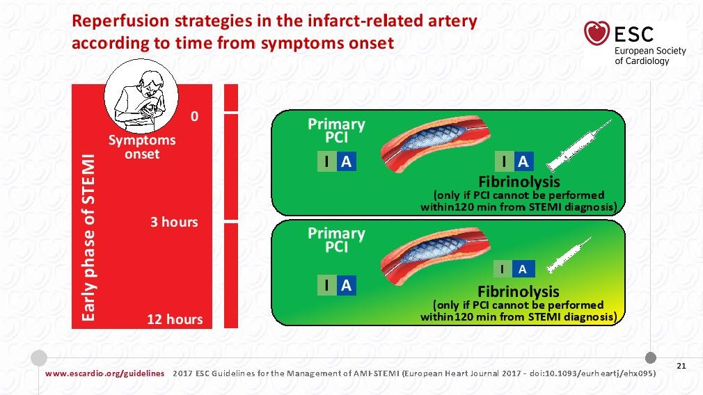

Slide 14
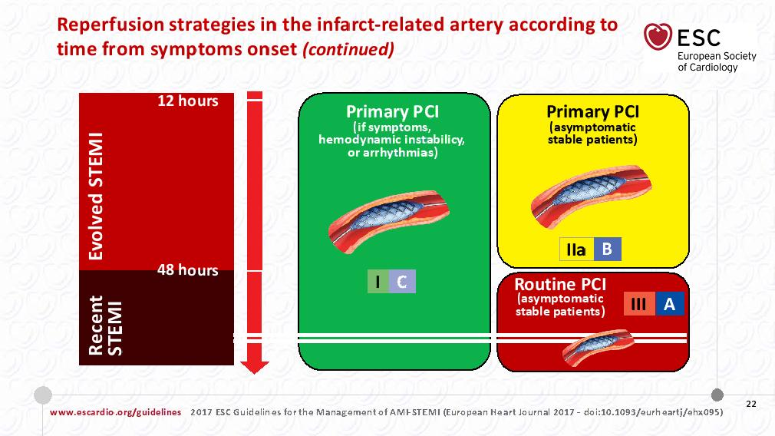

Slide 15
Chronic Coronary Syndromes

Slide 16
Notes:
CAD is a dynamic process of atherosclerotic plaque accumulation and functional alterations of the coronary circulation that can be modified by lifestyle, pharmacologica tharapies and revascularisation which result in disease stabilistaion or regression

Slide 55
Thank you

