Slide 1
CHRONIC PELVIC PAIN IN WOMEN.
THE ADVENT OF INTERVENTIONAL RADIOLOGY AND CPP MANAGEMENT WITH A SPECIAL FOCUS ON FIBROIDS AND UTERINE FIBROID EMBOLIZATION.
Dr j. Padi
Notes:
Dr Padi

Slide 2
Why Interventional Radiology
Interventional Radiologists perform a broad range of procedures such as treating tumors, taking organ biopsies or placing stents by inserting tiny instruments and thin plastic tubes (catheters) into the body via an artery or vein.
The images are used to guide the catheters and instruments to the exact area where the procedure or treatment is to be performed.
Disruptive Innovation in the medical field with what is now known as Minimally Invasive Procedures.

Slide 3
Continued…
This reduces the need for traditional (open) or keyhole (laparoscopic) surgery as treatment can be given via a small plastic tube about the size of a straw.
Continuing advances in technology mean the range of conditions that can be treated by Interventional Radiology is continuing to expand.
Unlike vascular surgeons, We perform both vascular and non-vascular procedures.

Slide 4
DR JOSIAS PADI
So, Who am I?
1993-1995-BSc.
1996-2000-MBChB(MEDUNSA) .
2006-2010-FC Rad((D)SA . (WITS)
2016-2017-Int. Rad(WITS Donald Gordon Medical Center)
2017-date-Interventional & Diagnostic Radiologist, Wits Circuit.
Which covers CHBAH,CMJAH,HELEN JOSEPH HOSPITAL and all other referring hospitals.

Slide 5

Dr J. Padi

Slide 6
Continued…
I have also worked in all levels of health care provision, from primary to quaternary.
After Community Service, I worked as a GP for a year.
And now I have founded NIRIS, short for Neologic Imaging & Radio-Intervention Services since May 2017.
This Company which is located in Fourways, provides both Diagnostic & Interventional Services to the greater Gauteng region and beyond.
So clearly I am a glutton for punishment.
But more importantly, I am very passionate about my craft other than being young and ambitious.
I also would like to see this discipline grow and establish itself as a viable alternative to you the referring clinician and the end-user, Our patients.

Slide 7
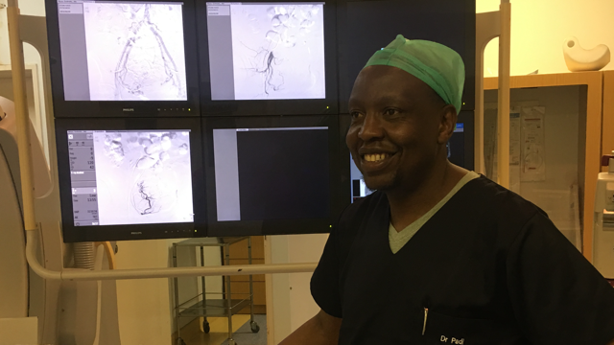
IR

Slide 8
So what does that mean for you and your patients?
A definite choice in terms of treatment options.
Availability of minimally invasive procedures on request.
A clinician who is available and willing to engage you on management of both common and uncommon ailments.
Availability of Day Cases, less hospital stay and reduced patient morbidity and mortality.
World-class treatment/management of dread diseases using focal and non-systemic approaches which are less debilitating to patients.

Slide 9
CHRONIC PELVIC PAIN IN WOMEN.
The causes are multifarious and can never be exhausted in one sitting.
There are common and known causes as well as uncommon and unknown causes.
Most causes are either mis- or under-diagnosed.
This could be due to incomplete or incoherent patient history, confused symptomatic presentation or clinicians lack of familiarity with symptomatic presentation of certain conditions.
Lack of information on which diagnostic tools can be used to confirm or rule out diseases is also a major contributory factor.

Slide 10
Common causes of CPP.
These are mostly gynecological and occur in the reproductive ages of between 15-45 years.
They are mostly cyclical and occur with menstruation. They may also be acyclical.
They are said to be chronic if they last more than 3months or typically 6months.
They are incapacitating and affect the quality of life of the affected individual.
They are hardly responsive to normal or OTC Analgesia.
They are mis- or under-diagnosed or summarily dismissed as normal
The common misdiagnosis is irritable bowel syndrome.
Most females stop consulting about them from sheer despondency or fear of being put through multiple invasive procedures with no real definite diagnosis.

Slide 11
Common Gynecological Conditions.
Multifibroid Uterus(Fibroids/Leiomyomas)
Adenomyosis
Endometriosis
Pelvic Congestion Syndrome.
Pelvic Inflammatory disease
Ovarian remnant

Slide 12
Non-gynecological conditions
Interstitial cystitis(Painful bladder syndrome).
Musculoskeletal problems
Psychological factors(Psychosomatic).
Pelvic floor Neuralgias.
Prostatitis (Male)
Benign Prostate Hypertrophy (Male)

Slide 13
Uterine Fibroids/Leiomyomas
These are lesions that develop in the womb/uterus.
They are typically benign/non-cancerous.
They can grow to massive sizes and be symptomatic.
In other cases they may be asymptomatic.
The cause is generally unknown.
Hormones, Estrogen and Progesterone may stimulate their growth.

Slide 14
Pregnancy due to increased production oestrogen and progesterone lead to development and rapid growth of fibroids.
They occur at Ages of 30 0r older , but may occur earlier at age 25.
They can be familial , they follow a strong maternal lineage.(Grandmother, mother and sister).
They have a higher predilection for women of African descent.
They are mostly associated with obesity.

Slide 15
Symptoms & Signs of Presentation.
Heavy bleeding between or during periods that include blood clots(Metromenorrhagia).
Prolonged periods(Menorrhagia).
Pelvic or Lower back pain.
Increased menstrual cramps.
Increased urination.
Fatigue

Slide 16
Other symptoms and signs.
Pain during sexual intercourse(Dyspareunia).
Pressure or fullness in your lower abdomen
Swelling or enlargement of the abdomen.
Anaemia-Pallor and tachycardia
Anxiety and psychological depression.
Infertility(Primary or Secondary).

Slide 17
Diagnosis
Proper gynecological exam.
Exhaustive History taking
Meticulous bedside examination
Bedside Test e.g. Urinalysis
Confirmatory Laboratory Tests

Slide 18
Medical Imaging / Radiology
Ultrasound
-Transabdominal
-Transvaginal
*Bulky, mixed echogenicity Uterus
*Myometrial Lesions of varying sizes.
*Appear darker than uterine wall.
*Show increased blood supply on Doppler.
*Multi-sited and may compress on Urinary bladder.

Slide 19
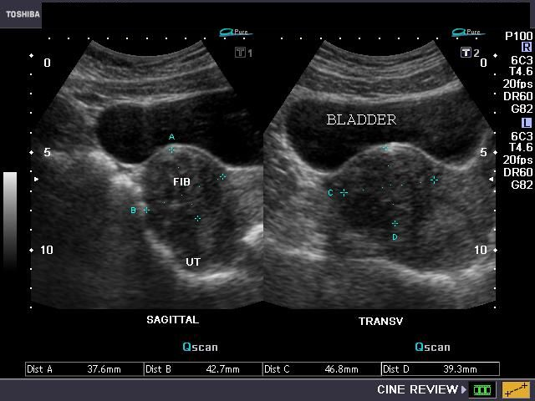
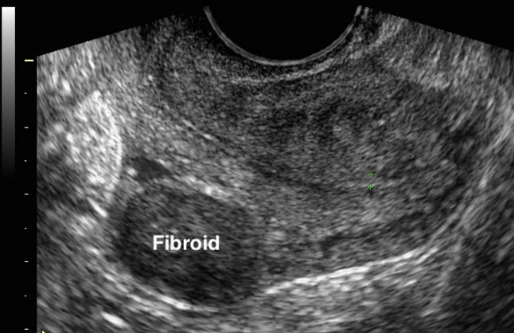
Ultrasound Images of Fibroids

Slide 20
Pelvic MRI
Confirmatory Imaging that is non-ionizing.
Better characterizes the architecture of the the fibroids(Hypointense Lesions).
Gives proper geographical location and sizes of fibroids.
Fibroids can be typified according to location.
Uses FIGO Classification to locate and typify Fibroids.
CT can be used as an alternative in the absence of an MRI.Not readily used because of ionizing radiation.

Slide 21
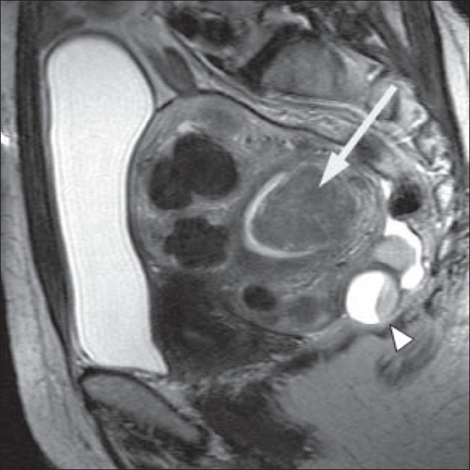
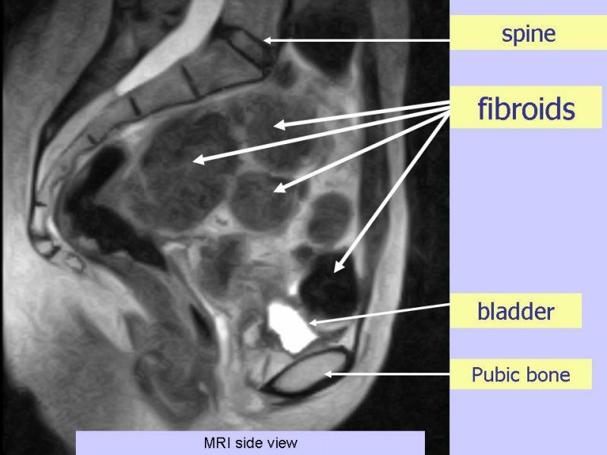
Pelvic MRI

Slide 22
FIGO CLASSIFICATION.
Intramural fibroids-within the wall of the Uterus.
Subserosal fibroids-extend outside the myometrium.
Pedunculated fibroids-subserosal with a stalk or slender base that supports the tumor.
Submucosal fibroids-in the middle muscle layer or myometrium of the uterus
*Fundal
*Body
*Cervix

Slide 23
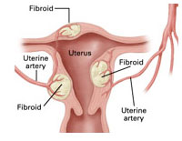
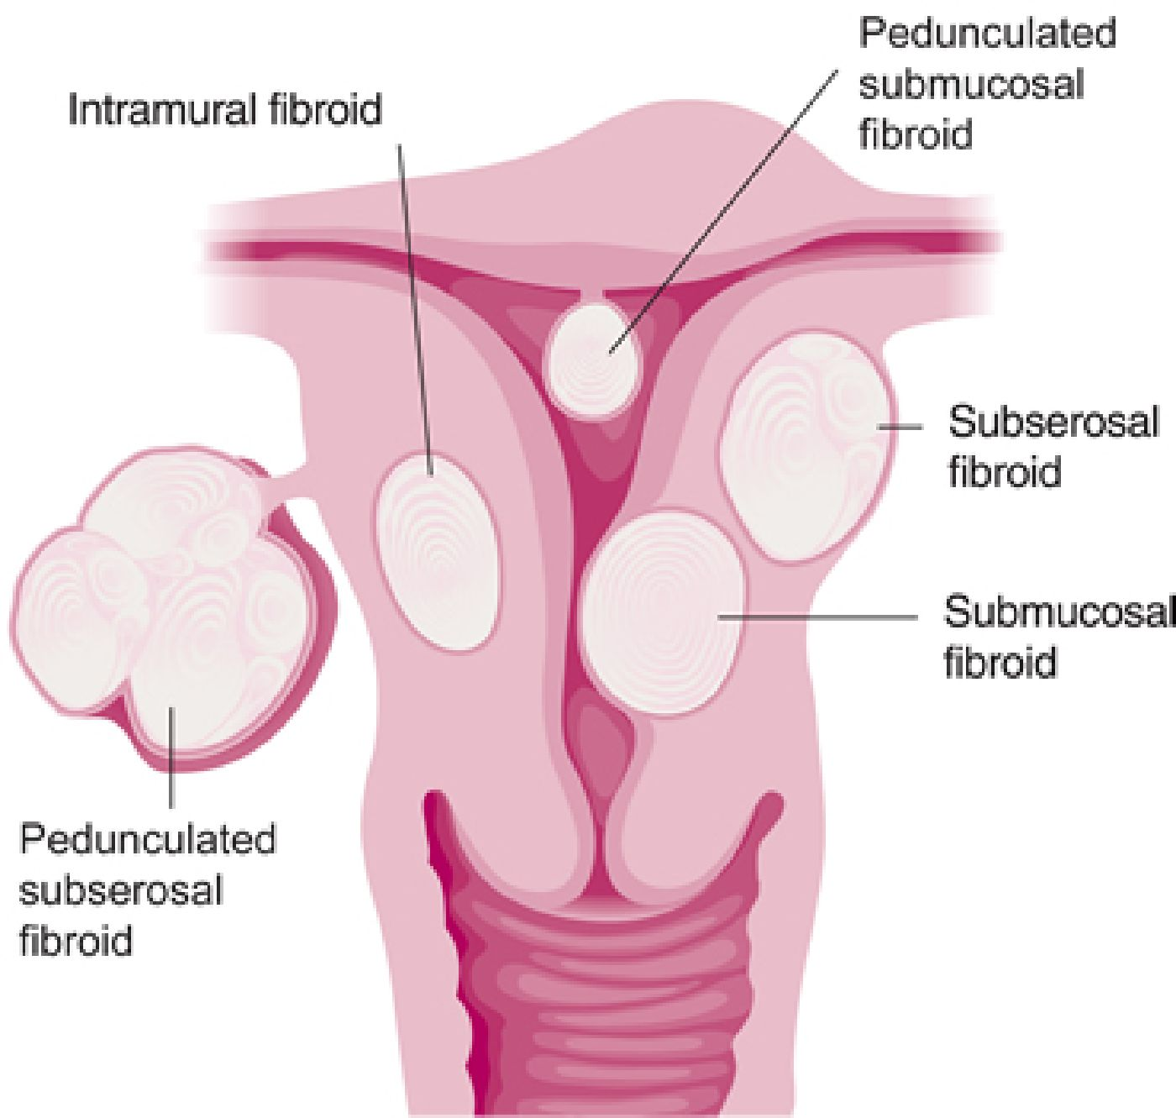
Multifibroid Uterus & FIGO Classification

Slide 24
Uterine Fibroid(Artery) Embolization
(Modern Treatment of MFU).
It’s a Radiologic Image-guided, Catheter-based endovascular minimally invasive interventional procedure.
It is done via the trans-femoral or trans-radial artery route.
It can be done in theatre with a C-arm.
It is usually done in the Cath-lab/Hybrid angio-suite.
It is done with or without General anesthesia.
UFE is done for Patients who want non-surgical intervention and have not responded to medical treatment.

Slide 25
Pre-UFE Planning
General Workup
Blood Tests-Hb,Plt,INR and U&E
Ultrasound,MRI and CT/MR Angiography.
Full,informed consent from the patient.
Contra-indications:
Absolute:
-Pregnancy
-Confirmed Gynecological malignancy.
-Active Pelvic Infection.
-Prior radiation/connective tissue disease.

Slide 26
Relative Contra-indications.
Patient who wishes to conceive within period of 6 months post UFE.
Intra-cavitatory, pedunculated lesions.
Narrow stalk subserosal lesions
Fibroids of more than 15cm in size.
Auto-infarcted Fibroids.
Allergies to iodine-based products (Needs proper steroid preparation before procedure).

Slide 27
UFE Procedure…
Wires and catheters are used to access the uterine arteries via the femoral or radial arteries.
Usually a 0.035 hydrophilic wire and a 4 or 5Fr catheter(65cm/125cm) is used for this procedure.
Embolic materials of varying sizes(500-700mcg & 700mc-900mcg) are then deposited into the uterine arteries ones the tip of the catheters is lodged in the uterine arteries.
Care is taken not to embolize the ovarian or vaginal arteries by super-selecting past these branches.

Slide 28
UFE Continued…
Also catheter tips are not placed to deep so as not to embolize the myometrium.
Choice of embolic material size also preserves the endometrium.
Embospheres/Embozenes/Contours/PVA particles are used to embolize the uterine arteries to occlusion or standing column.
Pre- and Post-embolization runs are done to plan and ascertain adequacy of treatment.

Slide 29
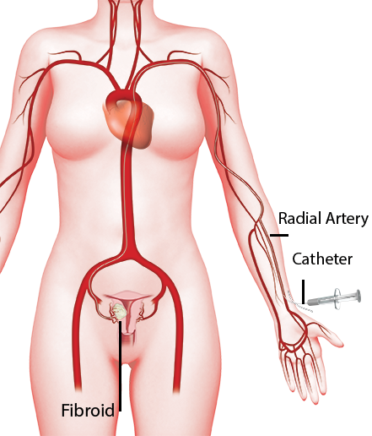
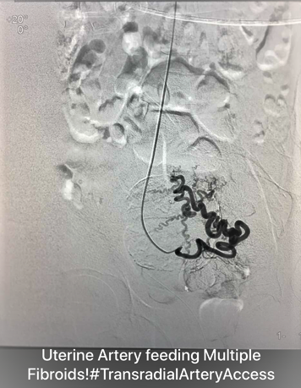
Trans-radial Artery Approach

Slide 30
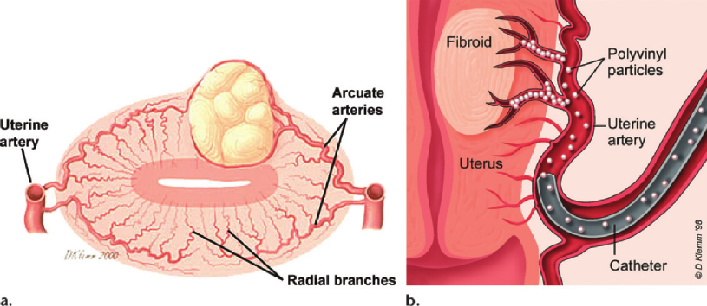
Catheter and Particles(Microspheres)

Slide 31
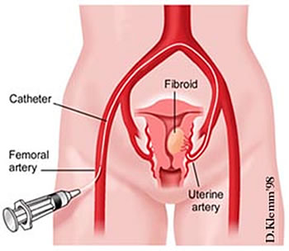
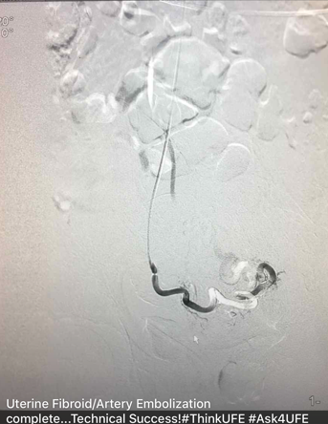
Trans-femoral UFE Approach

Slide 32
Trans-femoral vs Trans-radial approach
Preference of Interventionist
However:
Benefits of TRA access approach.
-Immediate ambulation post-procedure.
-No need for crossover of bifurcation(Direct Access).
-Navigating difficult arterial anatomy made easier.
-Catheter manipulation is less cumbersome.
-Patient prefer it.Able to recover in seated position.
-Day cases are made possible and easier, patient can be discharged an hour or 2 post-procedure.

Slide 33
Post-Procedure pain management.
Morphine PCA
Intra-arterial lignocaine
Hypogastric block with Marcaine
Oral anti-inflammatories and analgesics.

Slide 34
Post-Embolization Syndrome
Extreme lower abdominal pain.
Fever
Nausea and Vomiting
Management of PES
-Anti-emetics
-Antipyretics
-Analgesia

Slide 35
Response to UFE
The effective treatment period of UFE is 6months.
The maximal effect is within the first 3months.
Then the effect is attenuated to 50% in the last 3months.
Post-6 months there is minimal/insignificant effect
Symptomatic relieve is as high as 83-95% Post-UFE.
No correlation between the size of fibroid shrinkage to clinical outcome.
*Percentage shrinkage is dependent on the original size of fibroids and it’s anything between 13-87%.

Slide 36
Patients not good candidates for UFE.
Bulk symptoms.
Pain with dubious relation to fibroids.
Chronic pelvic pain and small fibroids.
Auto-infarcted fibroids.
Relative
-Patient desiring immediate conception

Slide 37
Treatment (Traditional)
Medical
*IUCD that release progestin.
*OTC Analgesia.
*Oral Contraceptives.
Surgical
*Open Myomectomy
*Laparoscopic myomectomy
*Hysterectomy.

Slide 38

Contact details

Slide 39
Q & A Session.
Any questions?
Clarity Seeking?
Comments?

Slide 40
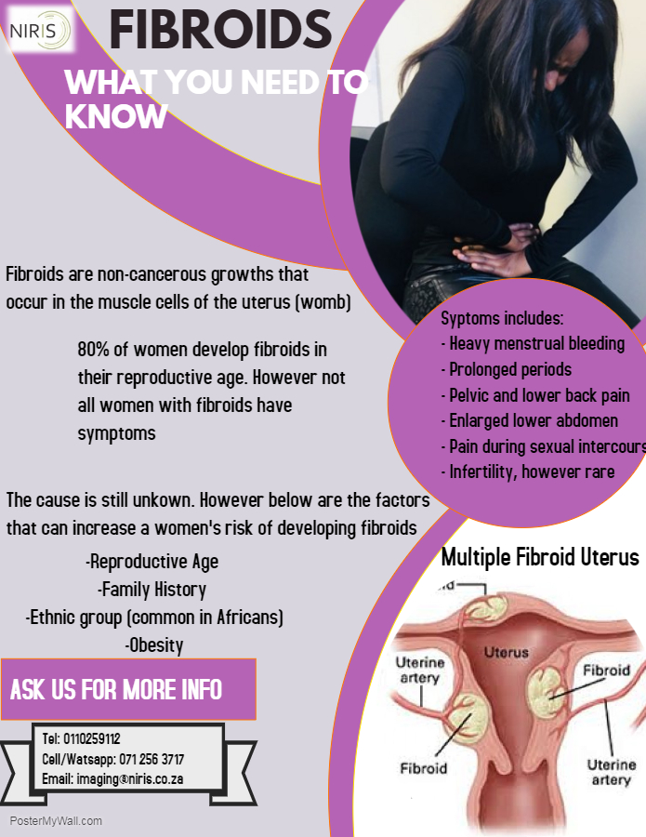
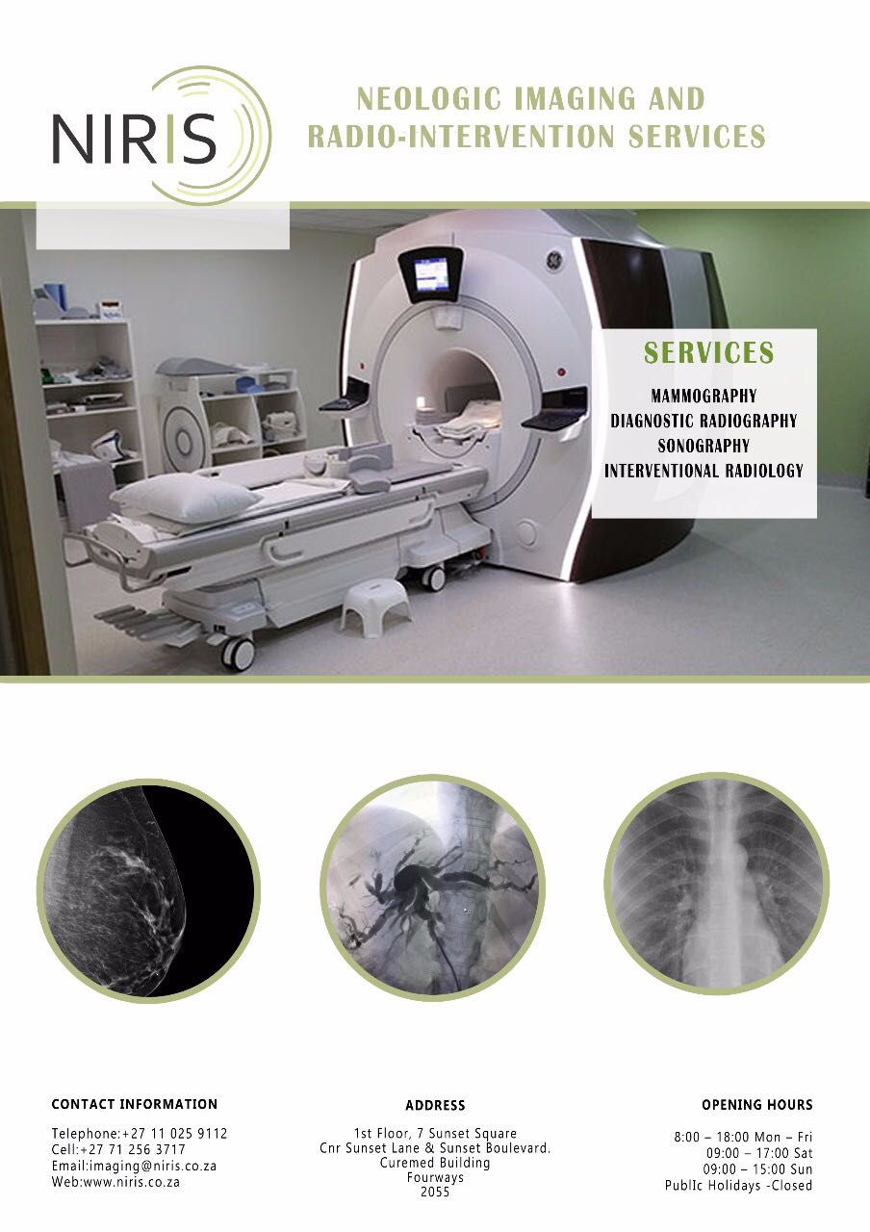
Thank You!!

