Slide 1



CHRONIC OBSTRUCTIVE PULMONARY DISEASE
Michelle Wong
Chris Hani Baragwanath Academic Hospital
Faculty of Health Sciences, University of the Witwatersrand
19 April 2026

Slide 2
Editorial in Lancet Respiratory Medicine Feb 2014
Primary care in the UK remains at the frontline of respiratory medicine, not only for the acute care of upper respiratory tract infections, but also for the more serious and chronic respiratory disorders such as asthma and chronic obstructive pulmonary disease (COPD).
70% of estimated 1.5 million contacts per year by Scottish GPs for circulatory and respiratory symptoms such as coughs, wheezing or breathlessness were with a GP.

Slide 3
Having a good primary care doctor is more important today than it has ever been, especially for patients with chronic diseases. The medical profession has become increasingly specialised in secondary care and the unique position of a GP to have an overview of a patient’s treatment from all the specialist teams involved in their management is crucial.
Primary care practitioners are the gatekeepers of the health-care system, a challenging and sometimes thankless task, but... can use their often longstanding knowledge of a patient’s history… to manage patients in a holistic way, avoiding unnecessary or duplicative investigations and limiting inappropriate and costly secondary care visits.

Slide 4
OUTLINE
Definition
Diagnosis of COPD and some new concepts
Management of COPD
  Pharmacological management
  Exacerbations of COPD
  Non-pharmacological management
Multimorbidity in COPD

Slide 5
COPD: THE SIZE OF THE PROBLEM
Estimated that number of COPD cases will approach 600 million by 2050
Mortality due to COPD
  3rd most common cause of death worldwide (90% of COPD deaths occur in LMIC)
  3 million deaths annually
  5.4 million deaths by 2060
Economic burden
  In European Union, COPD accounts for 56% (€ 38.6 billion) of cost of respiratory disease

Slide 6
Cost of copd
Direct costs
Hospital admissions*
Medications (inhalers, steroids, antibiotics)
Outpatient visits
Indirect costs
Lost productivity / absenteeism
Early retirement
Caregiver burden
Hidden costs
Transport
Out-of-pocket expenses
Home care
Oxygen therapy

Slide 7
ESTIMATED ANNUAL COST PER PATIENT
SEVERITY | PUBLIC SECTOR | PRIVATE SECTOR
Mild (stable disease) | R3 000 – R10 000 | R10 000 – R25 000
Moderate | R10 000 – R25 000 | R25 000 – R70 000
Severe / frequent exacerbations | R25 000 – R60 000 | R70 000 – R150 000+

Slide 8
DEFINITION OF COPD
  Heterogeneous lung condition
  Characterized by chronic respiratory symptoms
  (dyspnoea, cough, sputum production and/or exacerbations)
  Due to abnormalities of the airways (bronchitis, bronchiolitis)
  and/or alveoli (emphysema) that cause
  Persistent, often progressive, airflow obstruction
Global Initiative for Obstructive Lung Disease (GOLD) 2026

Slide 9
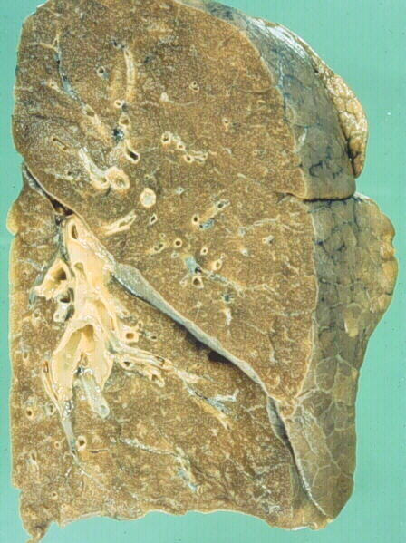
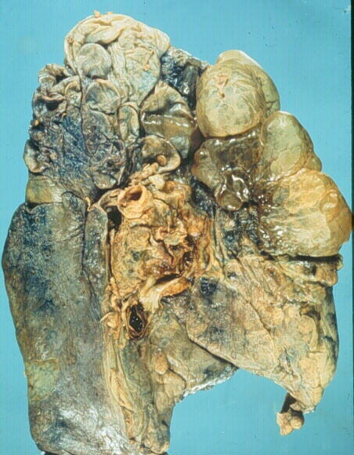
normal
COPD

Slide 10
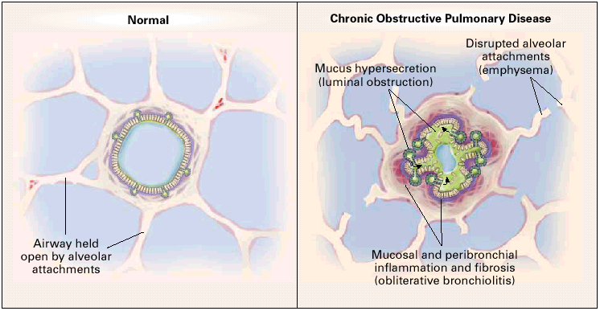
Barnes PJ. N Engl J Med 2000

Slide 11
Clinical presentation
Risk factors (e.g. tobacco smoke, biomass exposure, occupational, host factors)
Symptoms
  Dyspnoea (persistent, progressive over time, worse with activity)
  Limitation of physical activity
  Chronic cough (with or without sputum production, may be intermittent)
Course often punctuated by acute exacerbations

Slide 12
DIAGNOSIS OF COPD
3 important criteria:
Spirometry: fixed or partially reversible airflow obstruction
    Post-bronchodilator FEV₁/FVC < 0.7 (GOLD)
    FEV₁/FVC less than LLN (GLI: less than 5th percentile or z-score less than -1.64)
Appropriate clinical context
Technically acceptable spirometry
Global Initiative for Obstructive Lung Disease (GOLD) 2026

Slide 13
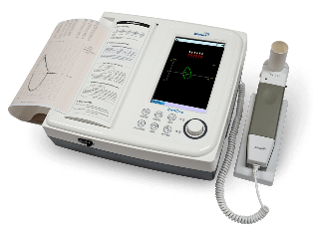
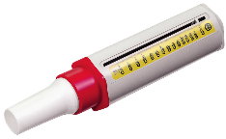
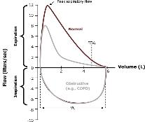
Peak flow vs spirometry
vs
Peak flow
Only measures maximum expiratory flow rate
Cannot measure FEV₁ or FVC
Effort dependent
Low peak flow may occur in asthma, restrictive lung disease, upper airway obstruction, poor effort

Slide 14
LIMITATIONS OF SPIROMETRY IN DIAGNOSIS OF copd
Spirometry is not sensitive to structural changes associated with COPD
  40% of smokers will have emphysema on HRCT scan, but “normal” lung functions
  Increased risk of developing COPD (FEV₁/FVC < 70%) within 5 years
    2 x higher in those with airway wall thickening (chronic bronchitis) on CT scan
    4 x higher in those with emphysematous changes on CT scan
50% of current or former smokers without airflow obstruction have respiratory symptoms

Slide 15
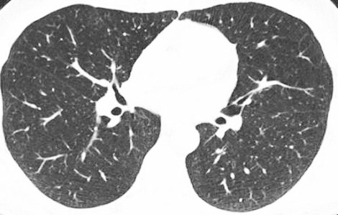
HIGH RESOLUTION CT SCAN
Normal
Emphysema
Chronic bronchitis

Slide 16
MULTIDIMENSIONAL APPROACH TO COPD DIAGNOSIS
9416 COPDGene participants
Re-classification
  15.4% without airflow obstruction classified as COPD using minor criteria
  6.8% with airflow obstruction did not have COPD
Compared to those without COPD, newly classified COPD individuals had increased
  All-cause mortality
  Respiratory-specific mortality
  Exacerbations
  Decline in FEV₁
Impact greater in Black than White individuals
Bhatt SP et al. JAMA 2025

Slide 17
Copd: some lesser known facts
About 1/3 of individuals with COPD are non-smokers
COPD should be regarded as the pulmonary component of a systemic and multimorbid syndrome – it is not exclusively a pulmonary disease!
COPD is not always self-inflicted
  4 – 12% of the general population do not attain the FEV₁ peak predicted for their age and sex in early adulthood

Slide 18
AETIOTYPES OF COPD
CLASSIFICATION |  | DESCRIPTION
Genetically determined | COPD-G | Αlpha1-AT deficiency, others
Abnormal lung development | COPD-D | Premature birth, low birthweight, etc.
Environmental Cigarette smoking Biomass and pollution | COPD-C COPD-P | Tobacco smoke, vaping, cannabis Household pollution, air pollution, wildfires, occupational
Infections | COPD-I | Childhood infections, TB, HIV
With asthma | COPD-A | Especially childhood asthma
Unknown cause | COPD-U | Unknown causes
Global Initiative for Obstructive Lung Disease (GOLD) 2026

Slide 19
Study in Cape Town
Confirmation of diagnoses made ≥ 8 weeks after admission for exacerbations of chronic respiratory diseases
Stolbrink M et al. Health Sci Rep 2025

Slide 20
Early diagnosis with guideline-based care vs usual care results in
Lower annualized rate of healthcare utilization
Improved SGRQ
Lower CAAT score
Increased FEV₁
N Engl J Med 2024;390:2061-73

Slide 21
MANAGEMENT OF COPD
Reduce symptoms
· Relieve symptoms
· Improve exercise tolerance
· Improve health-related QoL
Reduce risk
· Prevent disease progression
· Prevent and treat exacerbations
· Decrease mortality

Slide 22
PHARMACOLOGICAL TREATMENT

Slide 23
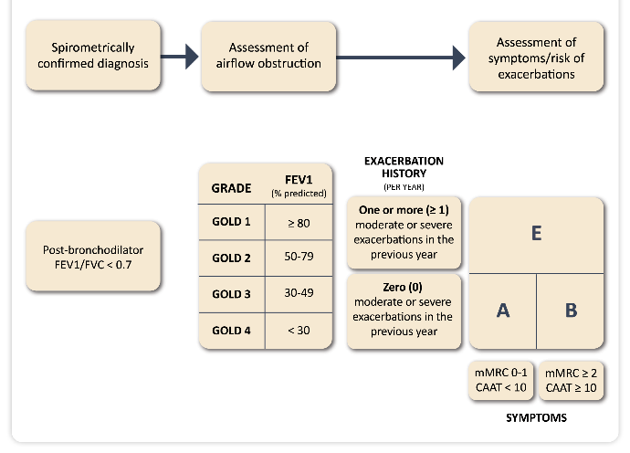
GOLD ABE ASSESSMENT TOOL
Global Initiative for Obstructive Lung Disease (GOLD) 2026

Slide 24
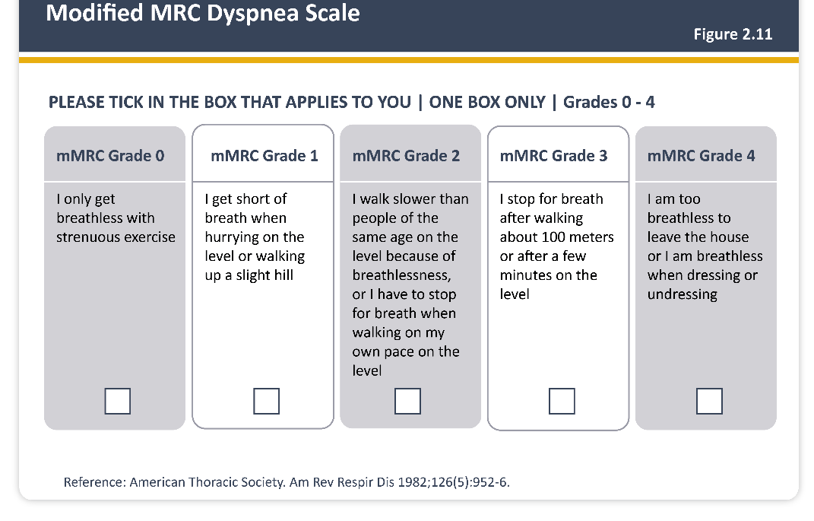

Slide 25
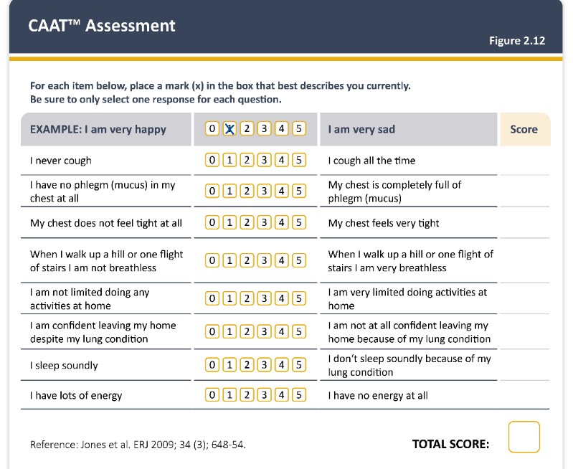

Slide 26
PHARMACOLOGICAL TREATMENT:
COPD (SMOKING-RELATED)
Inhaled corticosteroids
Mucolytics
Methylxanthines
(PDE 3- and/or 4-inhibitors)
(Biologics)
Inhaled bronchodilators
anti-muscarinics
β₂-agonists

Slide 27
INHALED BRONCHODILATORS
LONG-ACTING
ANTI-MUSCARINICS
LONG-ACTING
β₂-AGONISTS
  Tiotropium
  Glycopyrronium bromide
  Umeclidium
  Formoterol*
  Salmeterol
  Indacaterol
  Vilanterol

Slide 28
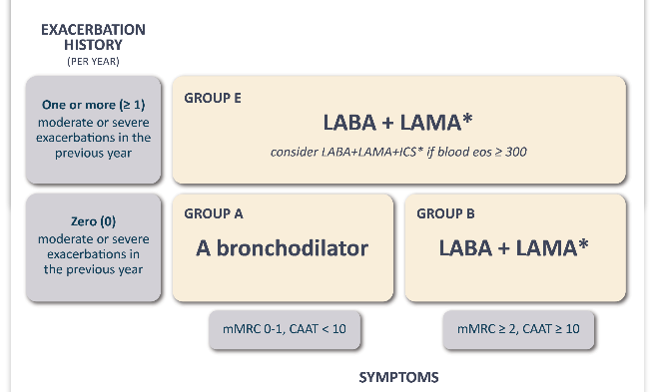
INITIAL PHARMACOLOGICAL MANAGEMENT
Global Initiative for Obstructive Lung Disease (GOLD) 2026

Slide 29
FREQUENT EXACERBATORS
Initial Rx: LABA or LAMA
Frequent exacerbations
Blood eosinophils < 300/μL
Blood eosinophils ≥ 300/μL:
LABA + LAMA + ICS
LABA + LAMA
Inadequate response + blood eosinophils ≥ 100/μL:
LABA + LAMA + ICS
Adapted from Global Initiative for Obstructive Lung Disease (GOLD) 2026

Slide 30
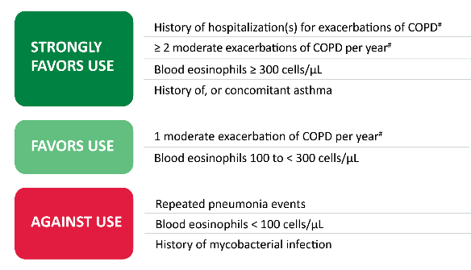
Addition of ics to bronchodilators
Inhaled corticosteroids should generally be avoided in COPD
LABA + ICS not advocated
Eosinophilia associated with response to ICS
?
Global Initiative for Obstructive Lung Disease (GOLD) 2026

Slide 31
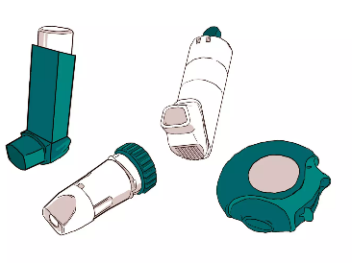
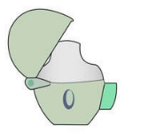
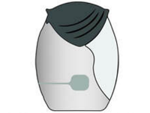
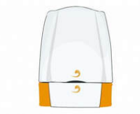
inhalers
Repeated education and training
Choice dependent on access, cost, patient preference
Types of inhaler devices
  Dry powder inhalers (DPI)
  Metered dose inhalers (MDI)
Single vs combination inhalers
Spacer devices (MDIs)

Slide 32
PEAK INSPIRATORY FLOW & INHALER PRESCRIPTIONS IN COPD
optimal PIF suboptimal PIF
Dry powder inhalers require forceful inhalation (inspiratory flow ≥ 30 L/min)
SUBOPTIMAL PEAK INSPIRATORY FLOW: BMI
Underweight: 83.3%
Normal weight: 29.3%
Overweight: 21.8%
Obese: 16.7%
Pankovitch S et al. Chest 2025

Slide 33
ESTIMATED ANNUAL COST OF MEDICATION
INHALER THERAPY | PUBLIC SECTOR | PRIVATE SECTOR
LABA or LAMA | R500 – R2 000 | R3 000 – R8000
Triple therapy (LABA/LAMA/ICS) | Limited access ~R2 000 – R5 000 (non-single inhaler therapy or non-similar devices) | R8 000 – R20 000+

Slide 34
Acute exacerbations of copd

Slide 35
EXACERBATIONS OF COPD
Acute event
Worsening symptoms over up to 14 days
Increased dyspnoea and/or cough and sputum production
May be accompanied by tachypnoea or tachycardia
Often associated with increased local and systemic inflammation
Caused by infection, pollution or other insult to the airways
Global Initiative for Obstructive Lung Disease (GOLD) 2026

Slide 36
IMPACT OF EXACERBATIONS OF COPD
Hurst JR et al. Eur J InternMed 2020

Slide 37
Risk of further exacerbations increased following severe exacerbation and with longer duration of exacerbation
Lung function does not return to baseline within 5 weeks in 25% of exacerbations, and within 3 months in 7%
Frequency of exacerbations correlate with poorer QoL and decrease in physical activity
In patients hospitalized for exacerbation for first time, > 20% die within
one month of discharge, and only 50% are alive within 3.6 years
Anxietiy, depression and post-traumatic stress common in patients with frequent exacerbations (and their care-givers)

Slide 38
CONDITIONS THAT MAY WORSEN OR MIMIC EXACERBATIONS
Viral or bacterial bronchitis
Cardiac failure
Myocardial infarction
Cardiac arrhythmias
Pulmonary embolism
Pneumonia
Pneumothorax

Slide 39
TREATMENT OF EXACERBATIONS
Bronchodilators (SABA ± SAMA) – initial bronchodilators
Systemic corticosteroids for 5 days (REDUCE trial, JAMA 2013)
Antibiotics for 5 days if features of bacterial infection
Global Initiative for Obstructive Lung Disease (GOLD) 2026
Leuppi JD et al. JAMA 2013

Slide 40
THEOPHYLLINE
Modest bronchodilator effect
Narrow therapeutic range with risk of serious adverse effects
Significant drug-drug interactions
No benefit in acute exacerbations
Low dose has anti-inflammatory activity of uncertain significance
May have a place as adjunctive therapy in resource-limited settings
Scurek M, Brat K. J Thorac Dis 2024
Mallik S et al. Cureus 2025

Slide 41
MUCOLYTICS
Carbocisteine, N-acetylcysteine, (erdosteine, cineole, others)
Limited no. of studies, comparison with placebo, different doses, different stages of COPD, variable follow-up periods
GOLD 2026: may reduce exacerbations, modest improvement in health status
Review and meta-analysis (2026):
  Erdosteine most effective for improving lung function and decreasing oxidative stress
  Outperformed NAC for lowering exacerbation rate
Real world study (2025)
  Erdosteine or NAC for 2 years, in addition to usual care, decreased COPD exacerbations over 5 year follow-up period
  Benefit occurred more in patients with cough and stage 3 and 4 COPD, and was independent of use of ICS
Global Initiative for Obstructive Lung Disease (GOLD) 2026
Zhao Y et al. BMC Pulm Med 2026
Zatloukal J et al. Lung 2025

Slide 42
MACROLIDES
Consider adding macrolide in frequent exacerbators already receiving LABA + LAMA and eosinophils < 100 cells/μL
  Azithromycin 250 mg/day or 500 mg 3x weekly
  Erythromycin 250 mg bd
No data on safety or efficacy beyond 1 year; less effect in active smokers
Caveats
  Development of bacterial resistance
  Hearing loss
  Prolongation of QT interval
Han MK et al. Am J Resp Crit Care Med 2014
Uzun S et al. Lancet Respir Med 2014
Albert RK et al. N Engl J Med 2011

Slide 43
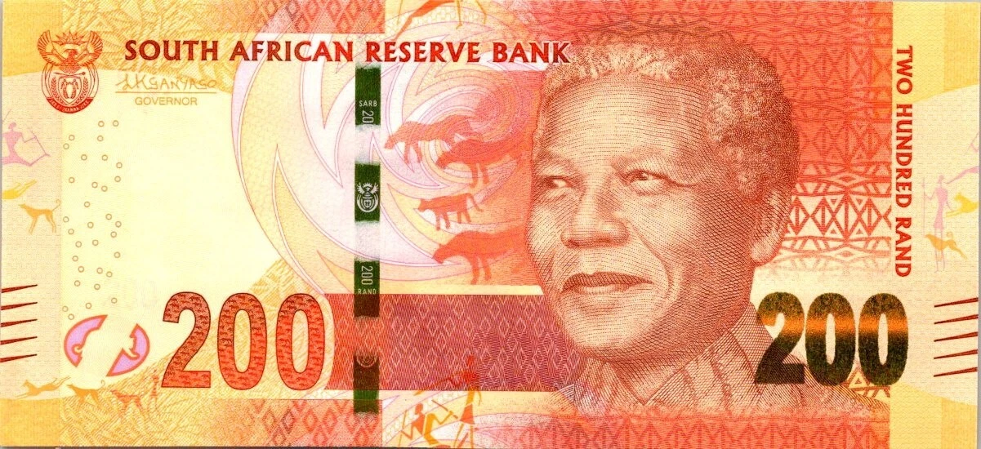
ESTIMATED COST: EXACERBATIONS
SEVERITY | PUBLIC SECTOR | PRIVATE SECTOR
Mild (home-treated) | R200 – R800 | R500 – R1 500
Moderate (clinic/ER) | R800 – R3,000 | R2 000 – R8 000
Severe (hospitalisation) | R10 000 – R30 000 | R30 000 – R120 000+
ICU admission | Rare / limited | R100 000 – R300 000+

Slide 44
NON-PHARMACOLOGICAL MANAGEMENT

Slide 45
Smoking cessation
Vaccination
Influenza
Pneumococcal
Pertussis
(Shingles, RSV, COVID-19)
Physical activity and exercise, pulmonary rehabilitation
Long-term domiciliary oxygen
Manage comorbidities
End-of-life discussions

Slide 46
MULTIMORBIDITY IN COPD
MORBIDITY CLUSTERS ASSOCIATED WITH COPD
On average, COPD patients have
5 other identifiable comorbidities that
Independently impact their health
Increase mortality risk
Celli BR et al. Eur J Intern Med 2025

Slide 47
Depression & anxiety 35%
Cognitive impairment 25%
OSA 10%
Hypertension 48-54%
Coronary artery disease 7-20%
Mild PH 5-30%
Severe PH 5%
Osteoporosis 18-30%
Sarcopaenia 22%
CRF 3 x more common
Anaemia 7-34%
Type 2 DM 20%
MASLD 30%
GORD 15-78%

Slide 48
TAKE HOME MESSAGES
Diagnose COPD early
Prevention
  Encourage smoking cessation and physical activity
  Vaccination
Rational prescribing
Check inhaler technique at every follow-up visit

Slide 49
COPD is not only a pulmonary disease
Acute exacerbations of COPD
  Significant impact on prognosis and QoL
  Major contributor to healthcare costs
Additional points not covered in this presentation
  Cardioselective β-blockers are not contraindicated in patients with COPD
  Screen for lung cancer if your patient has a new or worsening cough, haemoptysis or is losing weight

Slide 50


