Slide 1

Aspects of Asthma Care and Control – Overuse of SABA and Underuse of ICS
Charles Feldman
Distinguished Professor of Pulmonology
Department of Internal Medicine
Faculty of Health Sciences
University of the Witwatersrand

Slide 2
Topics for discussion
Epidemiology of Asthma
Asthma control
Studies on asthma control
Over-reliance on SABA and underuse of ICS
The SMART concept
Changing GINA recommendations for management of asthma

Slide 3

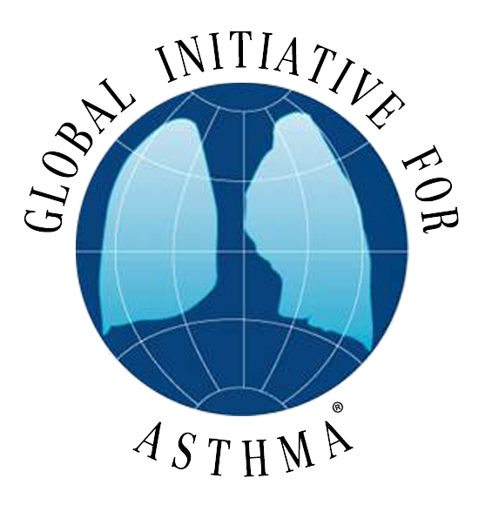
G
IN
A
lobal
itiative for
sthma
© Global Initiative for Asthma

Slide 4
What is known about Asthma?
Asthma is a common and potentially serious chronic disease that imposes a substantial burden on patients, their families, and the community. It causes respiratory symptoms, limitation of activity, and flare-ups (attacks) that sometimes require urgent healthcare and may be fatal
Fortunately…asthma can be effectively treated and most patients can achieve good control of their asthma.
Pocket guide for Asthma Management and Prevention GINA 2019 www.ginasthma.org

Slide 5
What is known about Asthma?
When asthma is under good control patients can
Avoid troublesome symptoms day and night
Need little or no reliever medication
Have productive, physically active lives
Have normal or near normal lung function
Avoid serious asthma flare-ups (exacerbations or attacks)
Pocket guide for Asthma Management and Prevention GINA 2019 www.ginasthma.org

Slide 6
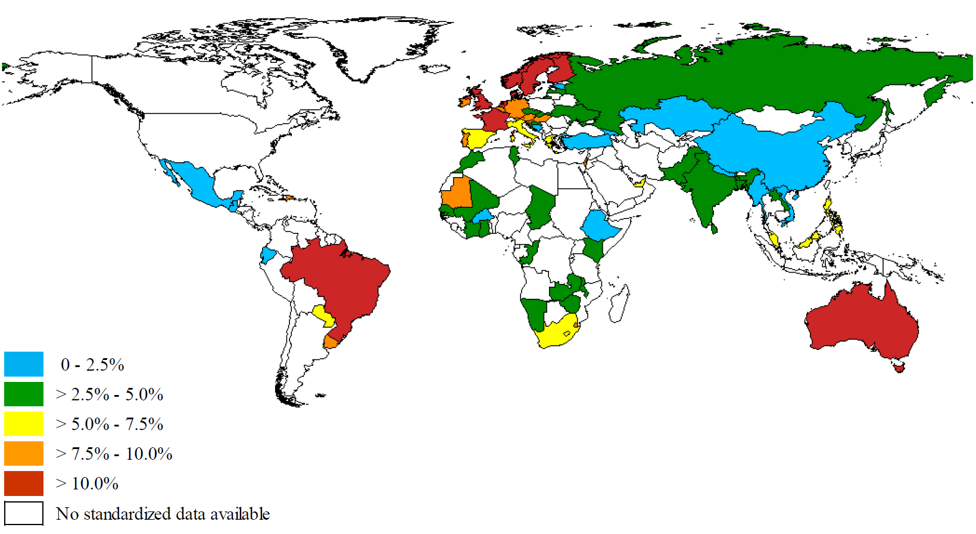
Asthma is a global health concern
Up to 334 million people worldwide are estimated to have asthma¹, but prevalence varies^{2,3}
Figure source: To T et al. 2012³
Global Asthma Report 2014, available from http://www.globalasthmanetwork.org/publications/Global_Asthma_Report_2014.pdf; 2. Vos T, et al. Lancet. 2012;380:2163–96; 3. To T, et al. BMC Public Health. 2012;12:204
Notes:
Lifetime risk of developing asthma high

Slide 7

Asthma Death Rate per 100,000 Population
Rank
1
2
3
4
5
6
7
8
9
10
11
12
13
14
15
16
17
18
Country
New Guinea
Myanmar
Solomon Isl.
Liberia
Laos
Mali
Lesotho
Fiji
Philippines
Swaziland
Morocco
Timor-Leste
Nepal
India
Zimbabwe
Sierra Leone
Namibia
Ethiopia
Rate
46.56
34.30
33.11
29.98
25.90
25.39
23.08
21.85
21.20
20.29
19.42
19.24
18.99
17.16
16.81
14.83
14.62
14.47
Rank
19
20
21
22
23
24
25
26
27
28
29
30
31
32
33
34
35
36
Country
Indonesia
Sri Lanka
Chad
Afghanistan
Central Africa
Bangladesh
Equ. Guinea
Burkina Faso
Angola
Niger
Maldives
Cambodia
Guinea-Bissau
Bhutan
Cote d’Ivoire
DR Congo
Guinea
South Africa
Rate
14.44
13.98
13.63
13.62
13.51
23.92
12.31
12.21
12.18
11.65
11.62
11.59
11.43
11.18
10.86
10.86
10.72
10.71
http://www.worldlifeexpectancy.com/cause-of-death/asthma/by-country

Slide 8
Control vs. Severity
Control
Good Poor
Mild Severe
Severity

Slide 9
How can asthma control be measured?
Lung
function?
Day-time symptoms?
Inflammation?
Healthcare resource use?
Night-time awakenings?
Asthma
Control
Satisfaction
with care?
Use of rescue therapy?
Functional status?
Patient self-report of control?
Missed work and/or school?
Notes:
Speaker ready note: Ask Hal to end on patient self-report of control to bridge to next section.

Slide 10
What tools are available to assess asthma control in practice?
Asthma Therapy Assessment Questionnaire (ATAQ) ¹
Asthma Control Scoring System (ACSS) ²
Asthma Control Questionnaire (ACQ) ³
  Validated
  7 items
  Requires peak flow measurement
¹Volmer et al AJRCCM 1999; ²Boulet et al Chest 2002 ; ³Juniper et al. Eur Resp J 1999
Notes:
A variety of tools are available for assessing asthma control in practice.
The Asthma Control Questionnaire (ACQ) is self-administered questionnaire consisting of 7 questions, including one on β₂-agonist use. It has been extensively validated within the clinical trial setting and is responsive to changes in asthma control over time. Because of this, it is particularly suitable for use in clinical trials rather than in everyday practice.
The 30-second asthma control test is a simple test that can be used by patients, and is suitable for screening for uncontrolled asthma. To date, it is unvalidated.
The Rules of Two is a simple test with 3 yes/no questions designed to help patients determine whether their asthma is out of control. This is also unvalidated.
The British Thoracic Society and the UK Royal College of Physicians developed a simple questionnaire but this has not been validated or widely used in clinical practice.
The ACT has been designed for use in a ‘real life’ situation and is intended for use in primary care practice by both patients (not necessarily under guidance from their doctor) and primary care physicians.
Juniper EF, O'Byrne PM, Guyatt GH et al. Development and validation of a questionnaire to measure
asthma control. Eur Respir J 1999; 14: 902–7.
Canadian Thoracic Society: http://www.asthmaincanada.com/
Baylor Health Care System: http://www.baylorhealth.com/MedicalSpecialties/Asthma/asthmaprograms.htm#Two
http://www.brit-thoracic.org.uk/sign/management_tools.html

Slide 11
What tools are available to assess asthma control in practice?
Asthma Therapy Assessment Questionnaire (ATAQ) ¹
Asthma Control Scoring System (ACSS) ²
Asthma Control Questionnaire (ACQ) ³
Asthma Control Test (ACT) ⁴
  Validated
  5-item self administered questionnaire
  Does not require peak flow measurement
¹Volmer et al AJRCCM 1999; ²Boulet et al Chest 2002 ; ³Juniper et al. Eur Resp J 1999
Notes:
A variety of tools are available for assessing asthma control in practice.
The Asthma Control Questionnaire (ACQ) is self-administered questionnaire consisting of 7 questions, including one on β₂-agonist use. It has been extensively validated within the clinical trial setting and is responsive to changes in asthma control over time. Because of this, it is particularly suitable for use in clinical trials rather than in everyday practice.
The 30-second asthma control test is a simple test that can be used by patients, and is suitable for screening for uncontrolled asthma. To date, it is unvalidated.
The Rules of Two is a simple test with 3 yes/no questions designed to help patients determine whether their asthma is out of control. This is also unvalidated.
The British Thoracic Society and the UK Royal College of Physicians developed a simple questionnaire but this has not been validated or widely used in clinical practice.
The ACT has been designed for use in a ‘real life’ situation and is intended for use in primary care practice by both patients (not necessarily under guidance from their doctor) and primary care physicians.
Juniper EF, O'Byrne PM, Guyatt GH et al. Development and validation of a questionnaire to measure
asthma control. Eur Respir J 1999; 14: 902–7.
Canadian Thoracic Society: http://www.asthmaincanada.com/
Baylor Health Care System: http://www.baylorhealth.com/MedicalSpecialties/Asthma/asthmaprograms.htm#Two
http://www.brit-thoracic.org.uk/sign/management_tools.html

Slide 12
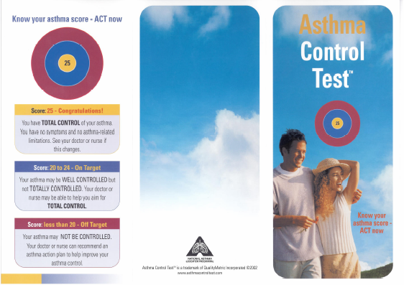

Slide 13
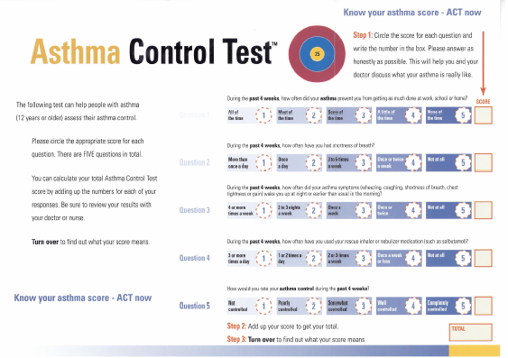

Slide 14
Asthma Control Test™ (ACT)
In the past 4 weeks, how much of the time did your asthma keep you
from getting as much done at work, school or at home?
Score
During the past 4 weeks, how often have you had shortness of breath?
During the past 4 weeks, how often did your asthma symptoms
(wheezing, coughing, shortness of breath, chest tightness or pain) wake you up at night, or earlier than usual?
4. During the past 4 weeks, how often have you used your rescue
inhaler or nebulizer medication (such as salbutamol)?
How would you rate your asthma control during the past 4 weeks?
Copyright 2002, QualityMetric Incorporated.
Asthma Control Test Is a Trademark of QualityMetric Incorporated.
Patient Total Score

Slide 15
Correlation between ACT and Asthma Control Questionnaire (ACQ)
Good
control
25
20
r = - 0.89 (p<0.001)
ACT
score at baseline
15
10
Poor
control
5
0
1
2
3
4
5
6
Good
control
ACQ score at baseline
Poor
control
Schatz M et al. J Allergy Clin Immunol 2006

Slide 16
There is an unmet need for improved understanding and attainment of asthma control – REALISE Study
REALISE study (N=8,000)
45.1%
of patients had GINA-defined
uncontrolled asthma
(n=3,611)
83.7%
of these patients perceived
their asthma as controlled
(n=3,023)
69.9%
of these patients perceived
their asthma as not serious
(n=2,523)
The REALISE study demonstrated a large gap between patients’ perception of asthma control, and the clinical reality of asthma control
The REALISE survey was conducted in patients aged 18–50 years who were active on social media.
.
Price D et al. NPJ Prim Care Respir Med 2014; 24:14009
Notes:
Study/survey details:
Nathan 2015 – The AIM study was conducted from 2009 to 2011 in 20 countries in North America, Europe, Latin America, and the Asia Pacific region. A total of 10,302 patients or parents of adolescents with asthma were interviewed, using a common set of questions. Responses to these are reported as proportions of patients with asthma for each country individually, and as totals for all regions.
Fuhlbrigge 2009 – A brief, four-page survey regarding asthma and associated symptoms was administered from May to July 2007 (spring/summer) to a representative national sample of 134,401 U.S. households via the mail. Subjects with physician-diagnosed asthma were asked to complete the ACT-5. An ACT score of ≤19 is cutoff point identifying not well-controlled asthma (NWCA) while those with ACT scores of ≥19 are considered to have well-controlled asthma (WCA).
Demoly 2012 – Data on 3157 asthma patients were obtained from the cross-sectional, self-reported, European National Health and Wellness Surveys conducted in France, Germany, Italy, Spain and the UK. Asthma control and health status (Short Form (SF)-12 health survey and the Work Productivity Loss and Activity Impairment questionnaire) were assessed.
Reddel 2015 – Cross-sectional web-based survey, conducted 1–27 November 2012. 2686 participants completed the survey (57.1% female; median age group, 40-49 years). Participants were classified according to asthma symptom control and frequency of preventer medication usage.
Price 2014 – Online surveys were conducted among 8,000 patients with asthma (aged 18–50 yrs, ⩾2 prescriptions in the previous 2 years, use of social media) from 11 European countries.
Price 2016 – An online/face-to-face, questionnaire-based survey of 375 respiratory specialists and primary care physicians from eight Asian countries/region was carried out.

Slide 17
Survey design – REALISE Survey
Questionnaires started (n=88,611)
Excluded
Did not meet criteria (n=69,646)
- Did not have asthma (n=68,479)
- Fewer than 2 prescriptions (n=39,537)
- Not aged 18-50 years (n=15,239)
- Do not use social media (n=7,459)
Incomplete questionnaires (n=4,560)
National representation quota (n=6,035)
Respondents completing questionnaire (n=8,370)
Excluded
Data cleaning quality checks (n=370)
Respondents included in final survey (n=8,000)
Price D et al. NPJ Prim Care Respir Med 2014; 24:14009

Slide 18
Asthma impacts on patients’ everyday lives
GINA-defined control:
■ Controlled (n=1,604)
■ Partially controlled (n=2,785)
■ Uncontrolled (n=3,611)
N=8,000
Patients affected within each
GINA-define control category (%)
Days with symptoms*
Normal activities
affected by symptoms*
Night-time
awakening*
Reliever use*
*In the previous 7 days
The REALISE survey was conducted in patients aged 18–50 years who were active on social media.
Price D et al. NPJ Prim Care Respir Med 2014; 24:14009
Notes:
Study details
Price 2014 – Online surveys were conducted among 8,000 patients with asthma (aged 18–50 yrs, ⩾2 prescriptions in the previous 2 years, use of social media) from 11 European countries.
This survey assessed symptoms and levels of asthma control in a real life setting and evaluated how symptoms and indicators of acute exacerbations relate to guideline-defined control and different treatment levels; in addition, current asthma control was analysed in relation to exacerbation history. Patients’ perceptions of asthma control and symptoms were also explored.

Slide 19
Patients are most affected by breathlessness, coughing and wheezing
In the REALISE study, 8,000 patients ranked symptoms on most impact on daily life
Breathlessness, coughing and wheezing were rated as the most impactful symptoms
Respondents (%)
The REALISE survey was conducted in patients aged 18–50 years who were active on social media
Price D et al. NPJ Prim Care Respir Med 2014; 24:14009
Notes:
Study details
Price 2014 – Online surveys were conducted among 8,000 patients with asthma (aged 18–50 yrs, ⩾2 prescriptions in the previous 2 years, use of social media) from 11 European countries.
This survey assessed symptoms and levels of asthma control in a real life setting and evaluated how symptoms and indicators of acute exacerbations relate to guideline-defined control and different treatment levels; in addition, current asthma control was analysed in relation to exacerbation history. Patients’ perceptions of asthma control and symptoms were also explored.

Slide 20
Adherence to preventer medication is poor
48
I take it every day
40
44
53
I take it some days but others I do not
27
15
26
33
I used to take it but now I do not
6
6
7
5
I take it only when I have symptoms
18
36
22
9
1
I never take it
2
1
1
0
10
20
30
40
50
60
Respondents (%)
Overall (n=3,481)
Partially controlled (n=1,171)
Controlled (n=620)
Uncontrolled (n=1,690)
Price D et al. NPJ Prim Care Respir Med 2014; 24:14009

Slide 21
Respondents’ attitudes towards their inhalers
I find it a real nuisance having to use my inhaler
41
29
36
50
I feel embarrassed having to use my inhaler in front of others
36
24
30
46
I feel embarrassed carrying my inhaler with me
26
13
19
37
14
I find my inhaler difficult to use
5
8
23
0
10
20
30
40
50
60
Respondents (%)
Overall (n=8,000)
Partially controlled (n=1,604)
Controlled (n=2,785)
Uncontrolled (n=3,611)
Price D et al. NPJ Prim Care Respir Med 2014; 24:14009

Slide 22
Sources of information about asthma
HCP (combined)
79
Family doctor
59
Specialist respiratory doctor
46
Pharmacist
24
Nurse
13
Online sources (combined)
61
A search engine (Google, Bing, Yahoo, etc)
44
Specific disease or health websites
30
Online health forums
22
Pharmaceutical companies vis their website
7
Facebook
4
Twitter
2
YouTube)
2
Friends and family (combined)
25
Family
18
Friends
17
Magazines, TV or radio
8
Other
2
None – I don’t look for information
5
0
10
20
30
40
50
60
70
80
90
100
Respondents (%)
Price D et al. NPJ Prim Care Respir Med 2014; 24:14009

Slide 23
Asthma control is poor across disease severity
In the MAGIC study of patients with physician-diagnosed asthma (N = 1286), the incidence of uncontrolled asthma increased with increasing GINA* Steps 2–5¹
Asthma control was poor, even at GINA Step 1¹
Asthma control according to treatment step (n = 624)¹
 | Step 1 | Step 2 | Steps 3&4 | Step 5
 | 2006 GINA treatment step²
Reliever | As-needed SABA
Controller |  | Low dose ICS | ICS/LABA | ICS/LABA plus Oral GCS or Anti-IgE
*Based on 2006 GINA guidelines².
1. Olaguibel JM et al. Respir Res 2012, 13: 50; 2. Bateman ED, et al. Eur Respir J 2008; 31: 143–78.
Notes:
Study details:
Olaguibel 2012 – An epidemiological descriptive study, with prospective data collection. Asthma control following GINA-2006 classification and 7-item ACQ was assessed. The study population was split in two parts: 2/3 for finding the cut-off points (development population) and 1/3 for validating the results (validation population).
Results: A total of 1,363 stable asthmatic patients were included (mean age 38 ± 14 years, 60.3% women; 69.1% non-smokers).

Slide 24
Asthma Control and undertreatment - AIRE Study
Patient perceived level of asthma control
Complete
Well
Even patients with pronounced
symptoms consider their asthma
completely or well controlled
100
80
60
% patients
40
Patients expect their asthma
to cause certain disabilities
20
0
Severe
Moderate
Mild
Actual level of asthma control
(symptom severity in past 4 weeks)
Survey in Europe assessing current levels
of asthma control as reported by patients
Rabe KF et al. Eur Respir J 2000; 16: 802-807
Notes:
Bateman, Bousquet, Braustein, ERJ 2001; 17: 589-595.
„The aim of therapy is to achieve overall control, defined by management guidelines as achieving a number of treatment goals. These goals reflect expert opinion, rather than being evidence based...
Asthma control, as defined by management guidelines, can be achieved...similar proportions of patients achieved control irrespective of disease severity, suggesting that outcome expectations should not be reduced for patients with more severe disease...Substantially more patients achieved the target values for individual goals than achieved overall control, indicating that reliance on individual end-points is likely to result in significant overestimation of true control.
There is no apparent relationship between asthma severity and the proportion of asthma patients achieving overall control.
Consideration should be given to exploring alternative measures of asthma control...suitable for use in clinical practice..“

Slide 25
Patients over-rely on SABAs vs. ICS irrespective of asthma severity
SABA and ICS use according to symptom severity
90
80
81%
76%
75%
70
63%
60
50
Patients using medication (%)
44%
40
30
26%
30%
23%
26%
20
18%
10
0
AIRE Total
Severe
Persistent
Moderate
Persistent
Mild
Persistent
Mild
Intermittent
Anti-inflammatory (ICS) Quick relief medication (SABA)
Rabe KF et al Eur Respir J 2000; 16: 802-807
Notes:
Overuse of reliever medication (short-acting β₂-agonists [SABA]), without concomitant inhaled corticosteroids (ICS) therapy, is an important issue in asthma management.
To control underlying inflammation, Global Initiative for Asthma (GINA) guidelines¹ recommend the use of ICS as maintenance therapy for all patients with persistent asthma.
The Asthma Insights and Reality in Europe (AIRE) survey² reported that, in the previous month, patients used reliever medication approximately three times more often than their anti-inflammatory therapy. Poor ICS use was observed across all degrees of symptom severity and over 70% of patients with moderate and severe persistent asthma had not used an ICS in the previous month.
Over-reliance on SABA and underuse of ICS leads to undertreatment of asthma and increases the risk of exacerbations.
1. www.ginasthma.com (last accessed March 2007).
2. Rabe KF, et al. Eur Respir J 2000;16:802–807.

Slide 26
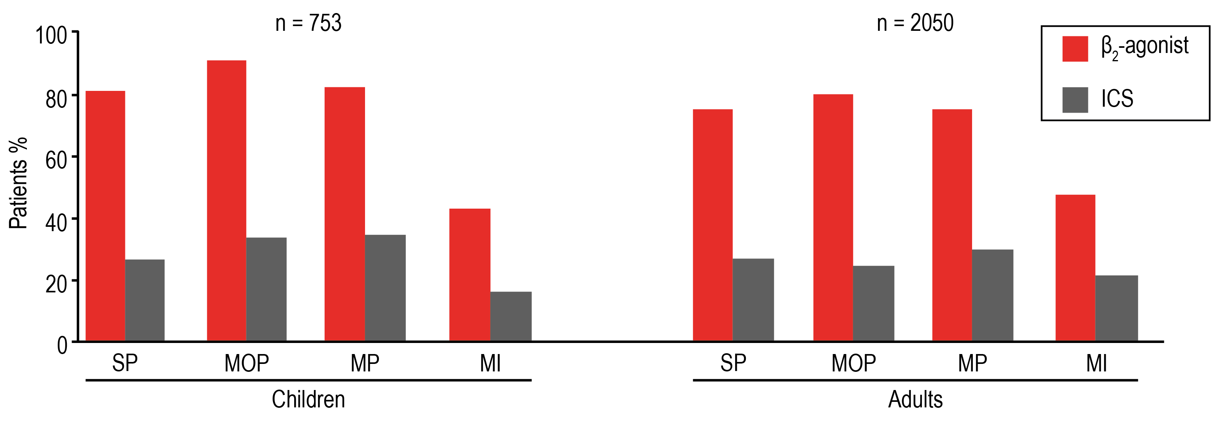
Over-reliance on SABA occurs in children and adults and is irrespective of asthma severity
In the AIRE survey, ~3 times as many patients were using only rescue medication (SABA) rather than their maintenance inhaler (ICS) over a 4-week period
Medicines used to treat asthma by Symptoms Severity Index:
Anti-inflammatories versus quick-relief medications
Figure adapted from Rabe et al. 2000
ICS, inhaled corticosteroid; MI, mild intermittent; MP, mild persistent; MOP, moderate persistent; SABA, short-acting β₂-agonist; SP, severe persistent
Rabe KF et al Eur Respir J 2000; 16: 802-807
Notes:
Study details
Rabe 2000 – Current asthma patients were identified by telephone by screening 73,880 households in seven European countries. Designated respondents were interviewed on healthcare utilization, symptom severity, activity limitations and asthma control. Current asthma patients were identified in 3,488 households, and 2,803 patients (80.4%) completed the survey.

Slide 27
Patients’ perception of asthma control does not match the reality
INSPIRE study (N = 3,415)
51%
of patients had uncontrolled asthma, based on ACQ scores (n = 1,732)
55%
of these patients perceived their asthma control as ‘relatively good’
Levels of asthma control were poor in the INSPIRE study
However, most patients with poorly controlled asthma were unaware of their asthma control status
In addition, 74% of patients used ≥1 SABA inhalation every day in the previous 7 days
Partridge MR et al. BMC Pulmonary Med 2006;6:13
Notes:
Study details
Partridge 2006 – This study examined the attitudes and actions of 3415 physician-recruited adults aged ≥ 16 years with asthma in 11 countries who were prescribed regular maintenance therapy with inhaled corticosteroids or inhaled corticosteroids plus long-acting β₂-agonists.
Structured interviews were conducted to assess medication use, asthma control, and patients' ability to recognise and self-manage worsening asthma.

Slide 28
Patient flow – INSPIRE Study
Patients enrolled = 3893
Questionnaires not completed:
Refusal = 81
Patients used reliever only = 156
Other reasons* = 77
Questionnaires not included:
Patient used reliever only = 85
Patient used preventer only = 19
No patient consent form = 9
Completed questionnaires = 3415
* Did not have asthma, under 16 years, used preventer only, communication difficulties
Partridge MR et al. BMC Pulmonary Med 2006;6:13

Slide 29
Asthma Control Questionnaire
- worsenings experienced by patients
Uncontrolled (n=1732)
Not well controlled (n=714)
Well controlled (n=965)
0
5
10
15
20
Number of worsenings/patients/year
Partridge MR et al. BMC Pulmonary Med 2006;6:13

Slide 30
Despite ICS or ICS/LABA therapy, 74% of patients used rescue therapy every day
SABA use (inhalations/day in the last week)
None
1-2
Number of inhalations/day
3-4
5-8
9+
0
10
20
30
40
Patients (%)
Base: all respondents (n=3,415)
Partridge MR et al. BMC Pulmonary Med 2006;6:13
Notes:
Patients were asked how many puffs or inhalations , on average, of short-acting bronchodilator (SABA) Ventolin or Bricanyl they used each day during the past week.
Base: All respondents (n=3,415)
According to GINA guidelines, the use of rapid-acting inhaled β₂-agonists as required for symptom control is recommended and provides a good indication of the need for further therapy.
However, increased use — or even daily use — of reliever medication indicates that the patient’s asthma is not well controlled at the current treatment level and there is a need to institute or to intensify the regular anti-inflammatory therapy.

Slide 31

Patient compliance
When well
During worsening
Compliant Plus
(21%)
Compliant
(37%)
21%
21%
37%
37%
Compliant
(45%)
45%
45%
Compliant Plus
(45%)
45%
45%
Compliant Minus
(34%)
Compliant Minus
(34%)
18%
34%
18%
34%
n=3415
Partridge MR et al. BMC Pulmonary Med 2006;6:13

Slide 32
Use of short-acting β₂-agonist rescue medication
5
ICS plus LABA
ICS with no LABA
Salmeterol/fluticasone
Budesonide/formoterol
Combined group total
Mean no. of inhalations per day
4
3
2
≥4-fold increase at worst
1
Early adjustment
0
When well
Signs/warnings
At worst
Recovery
n=3411
Partridge MR et al. BMC Pulmonary Med 2006;6:13

Slide 33
Use of inhaled corticosteroid maintenance medication
5
ICS plus LABA
ICS with no LABA
Salmeterol/fluticasone
Budesonide/formoterol
Combined group total
Mean no. of inhalations per day
4
3
2
1
0
When well
Signs/warnings
At worst
Recovery
n=3411
Partridge MR et al. BMC Pulmonary Med 2006;6:13

Slide 34
Daily-life activities are substantially limited by asthma
Asia Pacific
Europe
USA
60
50
40
% of patients with limitations
30
20
10
0
Social
activities
Career
choice
House-
keeping
Lifestyle
Normal
physical
activity
Sleeping
Sport
Lai et al. Eur Respir J 2001, Rabe et al. Eur Respir J 2000, Rickard et al. J Allergy Clin Immunol 1999
www.asthmainamerica.com

Slide 35
Asthma symptom frequency amongst responders in SA
N=710
30
25
20
15
% of patients with limitations
10
5
Never
0
Every day
Most days
More than once a week
More than once a month
Never
Coughing Wheezing Night-time symptoms
Green RJ, Rens H. Asthma related quality of life in South Africa.
Notes:
Asthma control in South Africa, have demonstrated that most asthmatics, despite diagnosis and treatment, are still poorly controlled. This South African study reveals that only about 6% of asthmatics are meeting the ‘Goals of asthma management’ as defined in guidelines.

Slide 36
Over-reliance on SABA and under-use of ICS are both associated with an increase in mortality
Over-reliance on SABA at the expense of ICS controller therapy is associated with an increased risk of asthma-related death, as a result of under-treatment of inflammation¹
Episodes of high reliever use (>6 inhalations/day on at least one day) are also predictive of an increased risk of exacerbations³
2.5
250
200
2.0
150
1.5
Rate ratio for death from asthma
Asthma deaths/10,000 patient-years
100
1.0
50
0.5
0.0
0
1
2
3
4
5
6
7
0.0
0
1
2
3
4
5
6
7
8
9
10
11
12
Canisters of SABA per month/20,000 μg¹
Canisters of ICS per year²
1. Suissa S et al. Am J Respir Crit Care Med 1994; 149: 604–10; 2. Suissa S et al. N Engl J Med 2000; 343: 332–6; 3. Buhl R et al. Respir Res 2012; 13: 59.
Notes:
Study details
Suissa 1994 – based on a nested case-control study of 129 cases and 655 control subjects selected from a cohort of 12,301 users of asthma drugs followed during the period 1980 – 1987. In this paper we examine the question of asthma and non-asthma mortality using data from the entire cohort of 12,301 asthmatics. There were 46 asthma and 134 non-asthma deaths in this cohort, for which there were 47,842 person-years of follow-up. The overall rate of asthma death was 9.6 per 10,000 asthmatics per year. This rate varied significantly according to the use of fenoterol, albuterol, or oral corticosteroids in the prior 12 months and the number of asthma hospitalizations in the prior 2 years. The rate increased significantly with the use of all β-agonists, and more so for fenoterol than for albuterol. Change-point dose-response curves showed that the risk of asthma death began to escalate drastically at about 1.4 canisters (of 20,000 μg each) per month of inhaled β -agonist, the recommended limit
Suissa 2000 – The Saskatchewan Health data bases were used to form a population-based cohort of all subjects from 5 – 44 years of age using antiasthma drugs from 1975 through 1991. We followed subjects until the end of 1997, their 55th birthday, death, emigration, or termination of health insurance coverage. We conducted a nested case–control study in which subjects who died of asthma were matched with controls within the cohort according to the length of follow-up at the time of death of the case patient (the index date), the date of study entry, and the severity of asthma. The cohort consisted of 30,569 subjects. Of the 562 deaths, 77 were classified as due to asthma.
We matched the 66 subjects who died of asthma for whom there were complete data with 2681 controls. 53% of the case patients and 46 % of the control patients had used ICS in the previous year, most commonly low dose beclometasone. The mean number of canisters was 1.18 for the patients who died and 1.57 for the controls. On the basis of a continuous dose–response analysis, we calculated that the rate of death from asthma decreased by 21 percent with each additional canister of inhaled corticosteroids used in the previous year (adjusted rate ratio, 0.79; 95 percent confidence interval, 0.65 to 0.97).
The rate of death from asthma during the first three months after discontinuation of inhaled corticosteroids was higher than the rate among patients who continued to use the drugs.

Slide 37

NRAD report reveals excessive prescribing of SABAs and under-prescribing of preventer medication
The NRAD report was an investigation of recent asthma deaths in the UK by the Royal College of Physicians
Evidence of excessive prescribing
of reliever medication
Evidence of under-prescribing
of preventer medication
To comply with recommendations, most
patients would usually need at least
12 preventer prescriptions per year
39%
of patients who were on short-acting relievers at the time of death had been prescribed
more than
12 short-acting reliever inhalers in the year before they died
38% of patients on preventer inhalers* received fewer than
4 inhalers in the year leading up to their death…
4% had been prescribed more than
50
reliever inhalers
and 80% received fewer than 12 preventer inhalers
*Of those patients for which the number of prescriptions was known. Among 189 patients who were on short-acting relievers at the time of death, the number of prescriptions was known for 165. Among 168 patients on preventer inhalers at the time of death, either as stand-alone or in combination, the number of prescriptions was known for 128.
NRAD, National Review of Asthma Deaths; SABA, short-acting β₂-agonist
Royal College of Physicians. Why Asthma Still Kills? The National Review of Asthma Deaths (NRAD) [online] 2014. Available from: https://www.rcplondon.ac.uk/projects/outputs/why-asthma-still-kills [Last accessed: December, 2016].
Notes:
Study details
NRAD 2014 – Asthma deaths occurring between February 2012 and January 2013 were identified through the Office for National Statistics (ONS) for England and Wales, the Northern Ireland Statistics and Research Agency (NISRA) and the National Records of Scotland (NRS). Extensive information about each death was sought from multiple sources, including primary, secondary and tertiary care, as well as ambulance, paramedic and out-of-hours care providers. 374 local coordinators were appointed in 297 hospitals across the NHS to collect and submit information to the project team, and 174 expert clinical assessors were recruited from primary, secondary and tertiary care throughout the UK to join expert panels that reviewed data. Each assessor participated in one or more expert panels, during which all information gathered on each death, including post-mortem reports, was reviewed by two assessors in detail, and this was followed by discussion and a consensus agreement of avoidable factors and recommendations by the whole panel.
Data were available for analysis on 195 people who were thought to have died from asthma during the review period and the key findings relate to this group. Denominators vary according to where data were missing.

Slide 38
Strobe flow chart
Sampled population
n = 1392
n = 29 excluded, for not meeting all inclusion criteria
n = 1363
n = 77 excluded, for being out of the age range
n = 1286
Development population
n = 855
Validation population
n = 431
Measurements made
n = 302
n = 804
n = 852
n = 855
n = 140
n = 402
n = 429
n = 431
FeNO
ACQ7
miniAQLQ
GINA06
FeNO
ACQ7
miniAQLQ
GINA06
Olaguibel JM et al. Respiratory Research 2012;13:50

Slide 39
Asthma control - GINA 2006 guidelines
60%
52.3%
50%
40%
34.5%
30%
20%
13.6%
10%
0%
Controlled asthma
Partially controlled asthma
Uncontrolled asthma
Olaguibel JM et al. Respiratory Research 2012;13:50

Slide 40
Asthma control - perceptions
70%
64.5%
Patients’ perceptions
Physicians’ perceptions
60%
51.3%
50%
40%
K = 0.53
32.6%
30%
27.8%
20%
16.1%
10%
6.9%
0%
Controlled asthma
Partially controlled asthma
Uncontrolled asthma
Olaguibel JM et al. Respiratory Research 2012;13:50

Slide 41
Assessment of asthma control
Patient
Doctor
33.2%
Not controlled
66.8%
Controlled
50.4%
Not controlled
49.6%
Controlled
Greenblatt M et al. Respir Med 2010; 104: 356-361

Slide 42
Number of exacerbations experienced by each subject during each treatment period
14
Regular β-agonist
As needed β-agonist
12
10
8
Number of subjects
6
4
2
0
0
1
2
3
4
5
6
7
8
9
10+
Number of exacerbations in 24 weeks
Study of 64 adults with mild-moderate asthma
Taylor DR et al. Thorax 1993; 48: 134-138

Slide 43
Subjects not experiencing an exacerbation by duration of treatment period
60
50
40
As needed β-agonist
No. of subjects without exacerbations
30
20
10
Regular β-agonist
0
0
20
40
60
80
100
120
140
160
Days of treatment
Taylor DR et al. Thorax 1993; 48: 134-138

Slide 44
Treatment effects for morning PEFR
Treatment effects for FEV₁
520
3.4
500
3.2
480
PEFR (L/min)
FEV₁ (litres)
3.0
460
2.8
440
420
2.6
Placebo
Terbutaline
Budesonide
Combined
Placebo
Terbutaline
Budesonide
Combined
Aldridge RE et al. Am J Respir Crit Care Med 2000; 161: 1459-1464

Slide 45
Treatment effects for PD₁₅ saline
Treatment effects for PD₂₀ methacholine
32
8.00
16
4.00
8
1.00
PD₂₀ methacholine (µmol)
PD₁₅ saline (mls)
4
1.00
2
0.50
1
0.25
Placebo
Terbutaline
Budesonide
Combined
Placebo
Terbutaline
Budesonide
Combined
Aldridge RE et al. Am J Respir Crit Care Med 2000; 161: 1459-1464

Slide 46
Treatment effect on % sputum eosinophils
50
TPC
PBC
PT
T
40
30
% sputum eosinophils
30
20
0
Placebo
Terbutaline
Budesonide
Combined
Aldridge RE et al. Am J Respir Crit Care Med 2000; 161: 1459-1464

Slide 47
Window of opportunity for Symbicord®* anti-inflammatory reliever to prevent exacerbations?
Profile of 425 exacerbations
% Change from day –14
Night-time symptoms
100
SABA rescue use
Window of opportunity
to increase anti-inflammatory?
80
60
40
20
0
–15
–10
–5
0
5
10
15
Days before and after an exacerbation
SABA, short-acting β₂-agonist; *Symbicord® maintenance and reliever therapy.
Adapted from Tattersfield A et al. Am J Respir Crit Care Med 1999; 160:594-599 (FACET)

Slide 48
Symbicord®† reduced risk of severe exacerbations vs comparator therapies
Budesonide + SABA
Symbicord®†
Symbicord® + SABA
Symbicord® + formoterol
SAL/FLU + SABA
50
50
50
50
50
50
40
40
40
***
40
40
***
40
***
***
***
***
**
*
30
30
30
30
***
30
30
Exacerbations (per 100 patients/year)
20
20
20
20
20
20
10
10
10
10
10
10
0
0
0
0
0
0
Rabe et al.¹
STEAM
Scicchitano et al.²
O’Byrne et al.³
STAY
Rabe et al.⁴
SMILE
Kuna et al.⁵
COMPASS
Bousquet et al.^{6‡}
AHEAD
STEP
*P = 0.039 vs. Symbicord®†; **P = 0.0048 vs. Symbicord®†; ***P < 0.001 vs. Symbicord®†; †Symbicord® maintenance and reliever therapy;‡This study did not achieve its primary endpoint (time to first severe exacerbation)^{6;} SABA, short-acting β₂-agonist; SAL/FLU, salmeterol/fluticasone.
1. Rabe KF, et al. Chest 2006;129:246–256 (STEAM); 2. Scicchitano R, et al. Curr Med Res Opin 2004;20:1403–1418 (STEP); 3. O’Byrne PM, et al. Am J Respir Crit Care Med 2005;171:129–136 (STAY); 4. Rabe KF, et al. Lancet 2006;368:744–753 (SMILE); 5. Data on file, not in main publication (Kuna P, et al. Int J Clin Pract 2007;61:725–736); CSR SD-039-0735, table 17, footnote; data extrapolated from 6 mo data (COMPASS); 6. Bousquet J, et al. Respir Med 2007;101:2437–2446 (AHEAD).

Slide 49
Exacerbations with Symbicord® plus Symbicord® as-needed vs Symbicord® plus as-needed formoterol or terbutaline
₂₅
Symbicord® + Symbicord® as needed decreased instantaneous risk by:
27% vs Symbicord® + formoterol
45% vs Symbicord® + terbutaline
Symbicord® + Terbutaline as-needed (n = 1141)
Formoterol as-needed (n = 1140)
Symbicord® as-needed (n = 1113)
₂₀
P<0.01
P<0.0001
₁₅
P<0.005
Patients with severe exacerbations (%)
₁₀
The number of as-needed reliever inhalations taken was significantly reduced in the Symbicord as-needed treatment arm vs as-needed formoterol and as-needed terbutaline (p<0.0001)
₅
₀
₀
₆₀
₁₂₀
₁₈₀
₂₄₀
₃₀₀
₃₆₀
_{Days since randomisation}
Severe exacerbation was defined as deterioration in asthma resulting in emergency treatment or hospitalisation or the need for oral steroids for 3 days or more (as judged by the investigator)
Rabe K et al. Lancet 2006; 368: 744–53
Notes:
In addition to number of events;
Total numbers of days with event (number of days due to hosp/ER treatments):
Symbicord+Bricanyl: 3030 (392)
Symbicord+Oxis: 2214 (282)
Symbicord+Symbicord: 1353 (218)

Slide 50
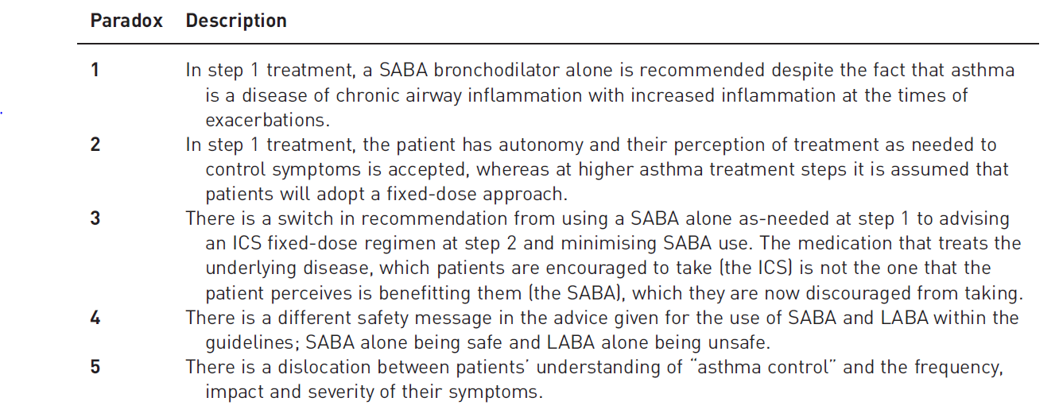
Paradoxes in asthma management potentially contributing to over-reliance on SABA and under-use of ICS
Symbicord is authorised for use in GINA steps 3-5. For more information please see Product Information.
ICS, inhaled corticosteroid; LABA, long-acting β₂-agonist; SABA, short-acting β₂-agonist.
O’Byrne PM, et al. Eur Respir J 2017;50. pii:1701103.

Slide 51
A Major Change in GINA 2019 Recommendations for Mild Asthma
From 2019, for safety, GINA no longer recommends starting with SABA- only treatment, but recommended that all adults and adolescents with asthma should receive ICS-containing controller treatment, to reduce their risk of serious exacerbations and to control symptoms.
The new ICS controller options now include:
(for mild asthma) as-needed low dose ICS-formoterol*, or if not available, low dose ICS taken whenever SABA is taken†, or
regular ICS or ICS-LABA every day, plus as-needed SABA, or
maintenance and reliever treatment with ICS-formoterol with the reliever being low-dose budesonide-formoterol or BDP-formoterol.
*Off-label; evidence only with budesonide-formoterol; †Off-label, combination of separate inhalers
www.ginasthma.org

Slide 52
A Major Change in GINA 2019 Recommendations for Mild Asthma
Why has GINA changed these recommendations?
These new recommendations represent the culmination of a 12-year campaign by GINA to obtain evidence for strategies to improve the treatment of mild asthma. Our aims were:
to reduce the risk of asthma-related exacerbations and death, including in patients with so-called mild asthma,
to provide consistent messaging about the aims of asthma treatment, including prevention of exacerbations, across the spectrum of asthma severity,
to avoid establishing a pattern of patient reliance on SABA early on the course of the disease.
www.ginasthma.org

Slide 53
A Major Change in GINA 2019 Recommendations for Mild Asthma
Why are these concerns about SABA-only treatment?
Many guidelines recommend that patients with mild asthma should be treated with as-needed SABA reliever alone. This dates back more than 50 years, to when asthma was thought of primarily as a disease of bronchoconstriction. However, airway inflammation is found in most patients with asthma, even in those with intermittent or infrequent symptoms.
Although SABA provides quick relief of symptoms, SABA-only treatment is associated with increased risk of exacerbations and lower lung function. Regular use increases allergic responses and airway inflammation. Over-use of SABA (e.g. ≥3 canisters dispenses in a year) is associated with an increased risk of severe exacerbations, and dispensing of ≥12 canisters in a year is associated with increased risk of asthma-related death.
www.ginasthma.org

Slide 54
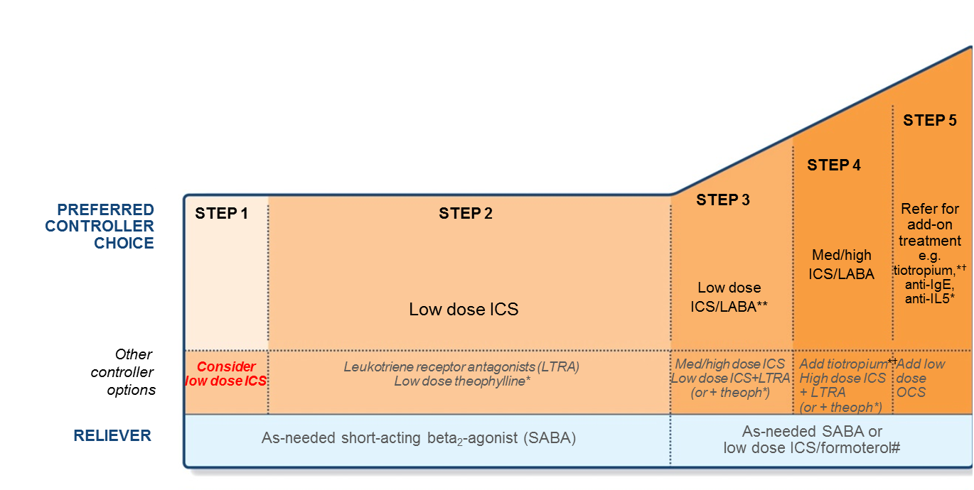
Asthma guidelines have moved towards earlier ICS use
GINA recommendations have moved towards considering ICS from the initial diagnosis, but still with SABA as a reliever
*Not for children <12 years; **For children 6–11years, the preferred Step 3 treatment is medium dose ICS; #Low dose ICS/formoterol is the reliever medication for patients prescribed low dose budesonide/formoterol or low dose beclometasone/formoterol maintenance and reliever therapy; †Tiotropium by mist inhaler is an add-on treatment for patients with a history of exacerbations; it is not indicated in children <12 yearsGlobal Initiative For Asthma (GINA), Global strategy for asthma management and prevention, http://ginasthma.org. Last accessed May 2017.
Notes:
National guidelines
UK BTS/SIGN 2016 – The 2016 update includes a complete revision of the section on diagnosis, a major update to the section on pharmacological management of asthma, and updates to the sections on supported self management, non-pharmacological management of asthma, acute asthma, difficult asthma, occupational asthma, and organisation and delivery of care.
The updated section on pharmacological management suggests even earlier initiation of low-dose ICS than previous versions.

Slide 55
The GINA Asthma Treatment Strategy
Adults & adolescents 12+ years
Confirmation of diagnosis if necessary
Symptom control & modifiable risk factors (including lung function)
Comorbidities
Inhaler technique & adherence
Patient goals
Personalised asthma management:
Assess, Adjust, Review response
Access
Symptoms
Exacerbations
Side-effects
Lung function
Patient satisfaction
Review
response
Adjust
Treatment of modifiable risk factors & comorbidities
Non-pharmacological strategies
Education & skills training
Asthma medications
Asthma medication options:
Adjust treatment up and down for individual patient needs
Step 5
High-dose
ICS-LABA
refer for phenotypic assessment ± add-on therapy eg. tiotropium, anti-IgE, anti-IL-5/5R, anti-IL4R
Step 4
Medium-dose
ICS-LABA
Step 3
Low-dose inhaled
ICS-LABA
PREFERRED
CONTROLLER
to prevent exacerbations
and control symptoms
Step 2
Daily low-dose inhaled corticosteroid (ICS),
or as-needed low dose ICS-formoterol*
Step 1
As-needed low dose ICS-formoterol
Other
controller options
Low dose ICS taken whenever SABA is taken †
Leukotriene receptor antagonist (LTRA), or low dose ICS taken whenever SABA taken†
Medium dose
ICSA, or low dose
ICS+LTRA#
High dose
ICS, add-on tiotropium, or add-on LTRA#
Add low dose QCS, but consider side-effects
PREFERRED RELIEVER
As-needed low dose ICS-formoterol*
As-needed low dose ICS-formoterol‡
Other
reliever options
As-needed short-acting β₂-agonist (SABA)
* Off-label; data only with bud-form
† Off-label; separate or combination ICS and SABA inhalers
‡ Low-dose ICS-form is the reliever for patients prescribed bud-form or BDP-form maintenance and reliever therapy
# Consider adding HDM SLIT for sensitised patients with allergic rhinitis and FEV1 >70% predicted
For children 6-11 years, preferred Step 3 treatment is low-dose ICS-LABA or medium dose ICS

Slide 56
Summary – asthma disease and management
Asthma remains a highly prevalent global health concern, with suboptimal levels of control^{1–3}
Asthma control levels are low, regardless of severity, and asthma control is often overestimated by patients^{3,4}
Poor adherence to medication and over-reliance on SABAs represent major hurdles to improving asthma control rates^{4–6}
The over-use of SABA and under-use of ICS both increase the risk of mortality^{7,8}
The importance of ICS early in disease is now reflected in GINA guidelines⁹
1. Vos T, et al. Lancet. 2012;380:2163–96; 2. To T, et al. BMC Public Health. 2012;12:204; 3. Olaguibel JM et al. Respir Res 2012, 13: 50; 4. Price D, et al. NPJ Prim Care Respir Med. 2014;24:14009;
5. Rabe KF et al. Eur Respir J 2000; 16: 802–7; 6. Partridge MR et al. BMC Pulm Med 2006; 6:13; 7. Suissa S et al. Am J Respir Crit Care Med 1994; 149: 604–10; 8. Suissa S et al. N Engl J Med 2000; 343: 332–6; 3. Buhl R et al. Respir Res 2012; 13: 59; 9. Global Initiative For Asthma (GINA), Global strategy for asthma management and prevention, http://ginasthma.org. Last accessed May 2017.

