Slide 1
HIV – Out with the Old,
In with the New
overall_0_131961096163329026 columns_1_131961096163329026
Dr K.D. Mahomed
Netcare Garden City Hospital
011 837 8300
083 294 7007

Slide 2
Goals of Treatment
overall_1_131961098581929933 columns_1_131961098581929933
ART is the cornerstone of HIV management
Maximal suppression of viral replication (undetectable VL)
Restoration of immune function (CD4 cell count)
Reduction in HIV related morbidity and mortality
Preservation of future therapeutic options
Improvement in quality of life
ART is lifelong, 100% adherence is essential
New drugs have lesser s/e and toxicity profile
Greater selection of drugs to fit into patient’s profile
FDC and daily dosing

Slide 3
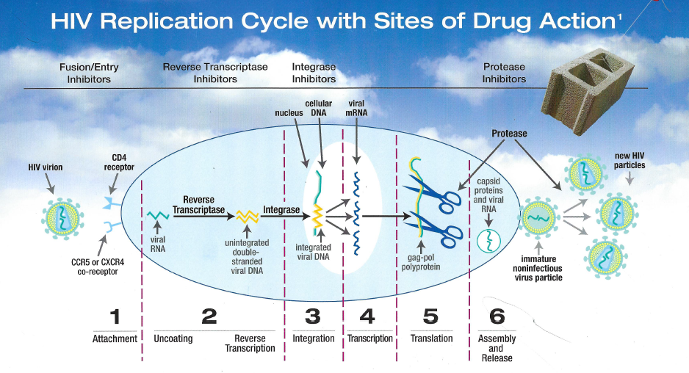
overall_1_131944393982961746 columns_1_131944393982961746

Slide 4
ARVs
overall_1_131961098581929933 columns_1_131961098581929933
Nucleoside reverse transcriptase inhibitors (NRTI)
Non-nucleoside reverse transcriptase inhibitors (NNRTI)
Protease inhibitors (PI)
Integrase inhibitors (INSTI)
Fusion inhibitors
Entry inhibitors.

Slide 5
Therapeutic Strategies
overall_1_131961098581929933 columns_1_131961098581929933
Always use three agents.
2 NRTIs + 1 NNRTI.
2 NRTIs + 1 PI + low dose RTV
2 NRTIs + 1 Integrase Inhibitor
2 NRTIs + 1 Integrase Inhibitor + 1 PI + low dose RTV
1 NNRTIs + 1 Integrase Inhibitor + 1 PI + low dose RTV
Triple therapy has a pronounced and prolonged Impact on viral load.
Can do a one drug switch for side effects. Need to do a regimen
change if there is no viral suppression.

Slide 6

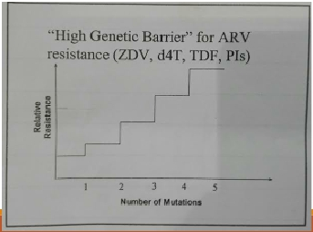
overall_0_131944393991898498 columns_1_131944393991898498
NRTIs
Stavudine (D4T) Tenofovir (TDF) renal failure/ anaemia
DDI
Lamivudine (3TC)
Emtricitabine(FTC)
Zidovudine(AZT)
IF TDF C/I, no anaemia/bone marrow failure
Abacavir (ABC)
If TDF C/I, watch VL
Tenofovir (TDF)
TAF (25mg daily, less renal and bone density)
◦ The back bone of haart
Drugs with high and low barriers to resistance
NRTIs inhibit viral reverse transcriptase enzyme,
by incorporating into the newly developed chain of viral
DNA competitively as building blocks.

Slide 7

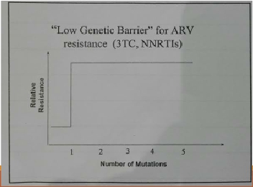
overall_0_131944393995326689 columns_1_131944393995326689
NNRTIs
Nevirapine (NVP)
Efavirenz(EFV)
(Boobs, hepatoxic, CNS)
Rilpivirine (Edurant)
Cautious TB/ VL/Ulcers
Etravirine
Doravarine (less neuro, active even with resistance in this class, effective regardless of CD4 / VL)
Part of the ‘First line’ of HAART
Cross–resistance
“Low genetic barrier” to resistance (Resistance
develops rapidly).
NNRTIs inhibit the viral reverse transcriptase enzyme.
JOH

Slide 8

overall_0_131944394056215543 columns_1_131944394056215543
Protease Inhibitors (PI)
Lopinavir/Ritonavir
(Aluvia) raise cholesterol, BD, GIT s/e
Ritonavir
Booster
Atazanavir (yellow eyes)
Darunavir (once daily)
• Protease enzymes are responsible for
cleaving larger polyproteins into
structuralproteins and is needed to form
a fully mature functional virus.
• Major mutations are V32I,147V/A ,V82A
• 7 or 8 mutations confers complete
resistance.

Slide 9
Integrase inhibitors (INSTI)
New Darlings of ART
overall_1_131961081119076224 columns_1_131961081119076224
Raltegravir (RTG)
  Fewer CNS adverse events ( EFV) ,
  drops VL quicker
  Pep
  BD dose
Dolutegravir (DTG)
  50mg once daily
  Double dose with Rifampicin
  FDC WITH ABC/3TC
  FDC WITH TDF/3TC
  Increases metformin levels
  Shift workers
  High barrier to resistance
  Pep

Slide 10
Newer INSTI
overall_1_131961081119076224 columns_1_131961081119076224
Juluca (Dolutegravir 50mg / Rilpivirine 25mg)
Bictegravir
  Non-inferior to DTG
  No emergence of resistance
  Less neuro effects (insomnia)
Carbitegravir
  Oral non-inferior
  Reformulated, can be given as an injection

Slide 11
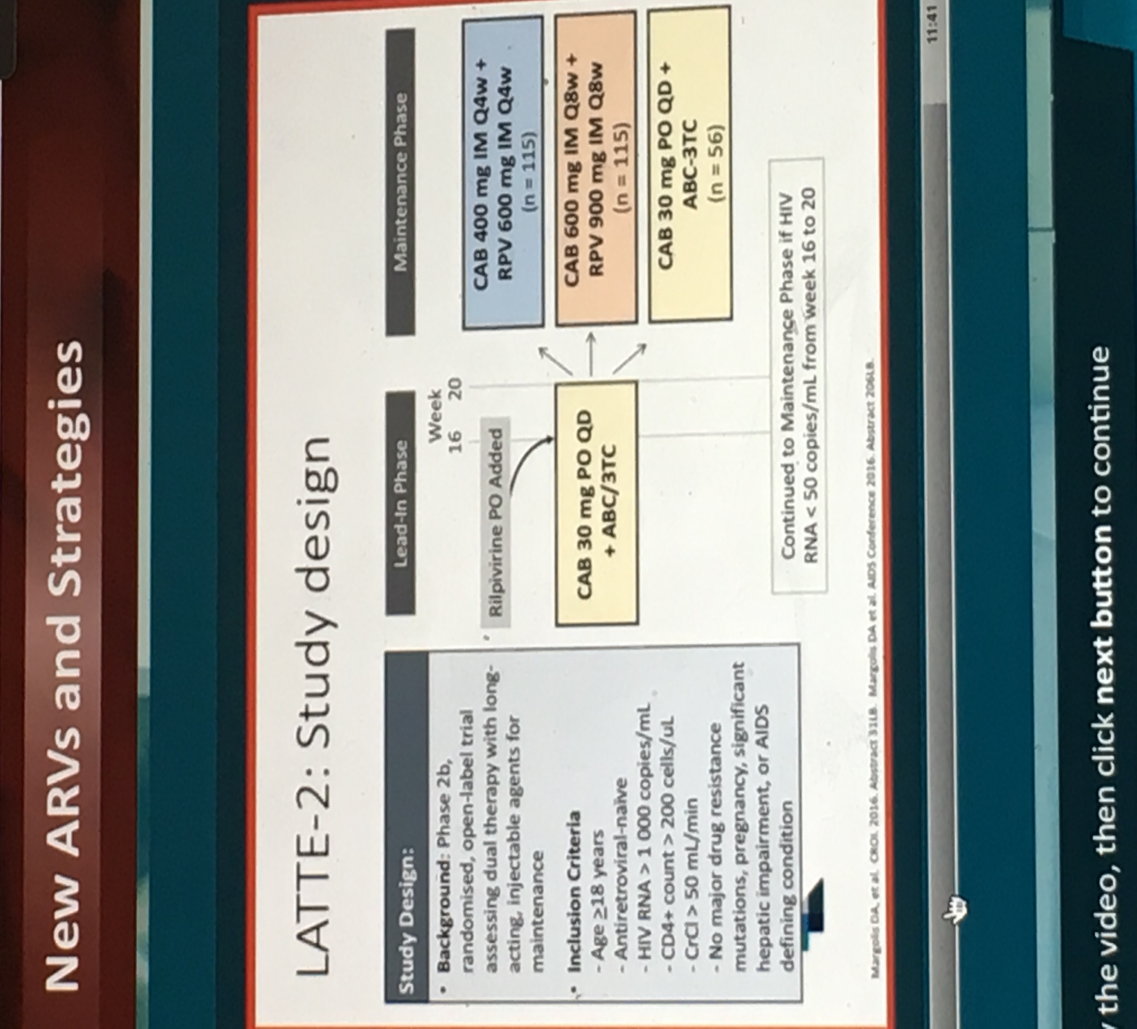
Carbitegravir
overall_1_131961085439393732 columns_1_131961085439393732

Slide 12
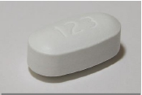
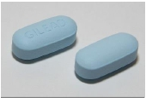
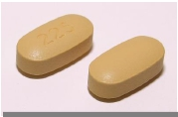
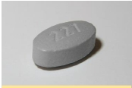
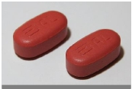
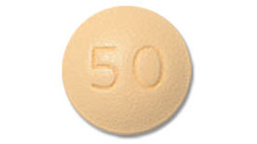
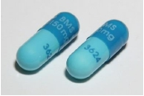
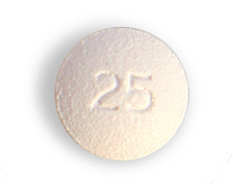
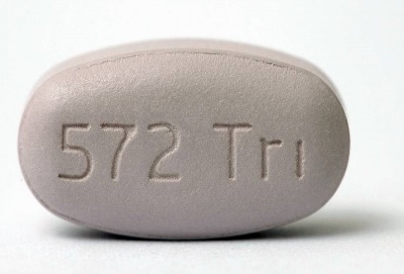
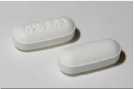
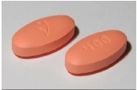
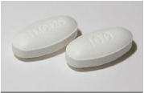
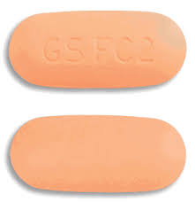

overall_0_131944394064381023 columns_1_131944394064381023
ART: NEW DRUGS, NEW REGIMENS, NEW DIRECTIONS.
FDC
NRTIs
NNRTIs
INSTIs
BPIs
NRTIs
INSTIs
bPIs
TDF+FTC+EFV
TDF+FTC
EFV
Raltegravir
Lopinavir/r
Atripla
Truvada
raltegravir
TDF+FTC/3TC
Dolutegravir
Atazanavir
AZT+3TC
Rilpivirine
ABC+3TC+DTG
Lamzid
Bictegravir
Trelavue
TDF+FTC+EFV
Carbitegravir
Darunavir
Etravine
NOVIR
TDF+FTC+DTG
ABC+3TC
AZT+3TC
Dumiva
Doravirine
darunavir
Acriptega

Slide 13
overall_0_131944394100387553 columns_1_131944394100387553
THE EVOLUTION OF CURRENT
ANTIRETROVIRAL THERAPY
Decade of HAART
AIDS 1st reported
1981
1987
1991
1992
1994
1995
1996
1997
1998
1999
2000
2001
2002
2003
2004
2005
2006
ZDV
FIXED-DOSE
COMBINATION THERAPY
ddI
ddC
d4T
3TC, SAQ
RTV, IDV, NVP
NFV, DLV, ZDV+3TC, SAQ-gc
COMBIVIR
APV
LPV/r, ddI-EC, ZDV+3TC+ABC
TRISIVIR TDF
EFV-600, 3TC-300, d4T-XR
T-20, NFV625, ATV, FTC, FPV
KIVEXA TRUVADA
SQV500, TPV, ZDV generic, LPV/r caps
EFV, ABC
ENTRYIs
NRTIs
NNRTIs
PIs
FDC: dual
and triple
3TC+ABC, TDF+FTC, ddI generic
ATRIPLA
DRV, EFV+FTC+TDF

Slide 14
overall_0_131944394106228704 columns_1_131944394106228704
Saag MS. New and InvestigationalAntiretroviral Drugs for HIV Infection:
Mechanisms of Action and Early Research Findings.
Topics in Antiviral Med 2012; 20 (5): 162-167
ENTRY INHIBITORS: ALBUVIRTIDE: fusion inhibitor
320mg once-a week. Prolonged half-life
ENTRY INHIBITORS: BMS-663068: attachment
inhibitor binds to gp-120 and prevents viral binding to CD4
ART: THE SECOND (and THIRD) DECADES
TPV
ETR, MVR, RAL
COMPLERA
STRIBILD
2007
2008
2009
2010
2011
2012
2013
2014
2015
2016
2017
2018
2019
2020
RPV,
RPV+TDF+FTC,
EGV+CBS+TDF+FTC
DTG, ABC +3TC/FTC + DTG
TRIUMEQ
NRTI: TENOFOVIR ALAFENAMIDE (TAF): FDA-approved,
tenofovir pro-drug, lower dose 25mg daily, less renal and bone toxicity,
greater intracellular concentrations/activity
ENTRYIs: include attachment and Fusion inhibitors
NRTIs: nucleoside/tide reverse transcriptase inhibitors
NNRTIs: non-NRTIs
ISTIs: integrase strand-transfer inhibitors
PIs: protease inhibitors
New Agents in the South African private
HIV Clinic or Anticipated in 2016-2018
NNRTI: DORAVIRINE: FDA-approved, active against resistant virus,
once-daily dose, can be co-formulated, minimal toxicity, well absorbed.
ISTI: ELVITEGRAVIR: EGV+CBS (cobicistat)+TDF+FTC, less effect on
CPY 3A4 and 2D6: perhaps fewer drug interactions, less effect on TC,
LDL-cholesterol, TGL than TDF+FTC+EFV. Cross-resistanceto RAL-mutated virus.
ISTI: DOLUTEGRAVIR (DTG): FDA-approved, active in patients resistant
to RAL and EGV; 50mg daily po in Tx-naïve and 50mg bid in prior ISTI failure;
DTG+ABC+3TC = combination therapy, FDA-approved and registered
in SA, more potent than TDF+FTC+EFV in
Tx naïve patients
ISTI: CABOTEGRAVIR: A long acting ISTI given SC or IM and
active x 24 weeks at dose of 800mg; active against RAL and EGV-
resistant strains

Slide 15






overall_0_131944394110453070 columns_1_131944394110453070
ANTIRETROVIRAL TREATMENT: THREE CONSECUTIVE STAGES
TDF
XTC
EFV
1.
ATRIPLA/ATROIZA/ODIMUNE etc.
XTC=
3TC or FTC
AZT
XTC
PI
2.
Zidovudine+3TC+lopinavir/r
(lopinavir or atazanavir)
Darunavir
Raltegravir
Etravirine or
Rilpivirine
3.
OPTIMISED BACKGROUND THERAPY ?

Slide 16
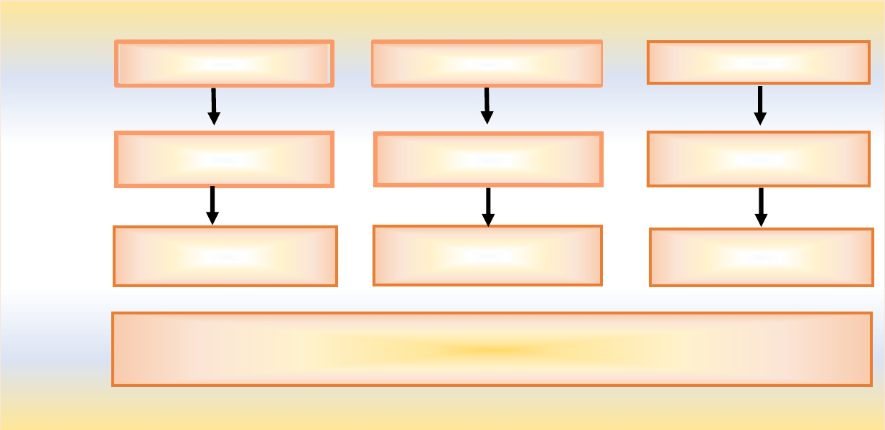









overall_0_131944394616142728 columns_1_131944394616142728
Standardof Care– RecommendedAntiretroviralRegimens
NNRTI-based Regimen
FDC: TDF+ FTC/3TC+ EFV
INSTI (1 or 2) ± LPV/r
± 2 active NRTIs
DRV/r ± INSTI ± NNRTI
±2 active NRTIs
PI-based Regimen
TDF/AZT+ 3TC+
LPV/r or ATV/r
INSTI ± NNRTI or DRV/r
±2 active NRTIs
NNRTI(2) ± INSTI(2)
±2 active NRTIs
INSTI-based Regimen
FDC: ABC+ 3TC+ DTG
TDF + 3TC +DTG
NNRTI ± LPV/r +
2 active NRTIs
NNRTI(2) ± DRV/r
±2 active NRTIs
First-line
Preferred
Regimens
Second-line
Recommended
Regimens
Third-line
Recommended
Regimens
Salvage
INDIVIDUALIZE ART ACCORDING TO GENOTYPE RESULT,
KNOWN DRUG TOXICITY PROFILE
AND PAST DRUG HISTORY

Slide 17
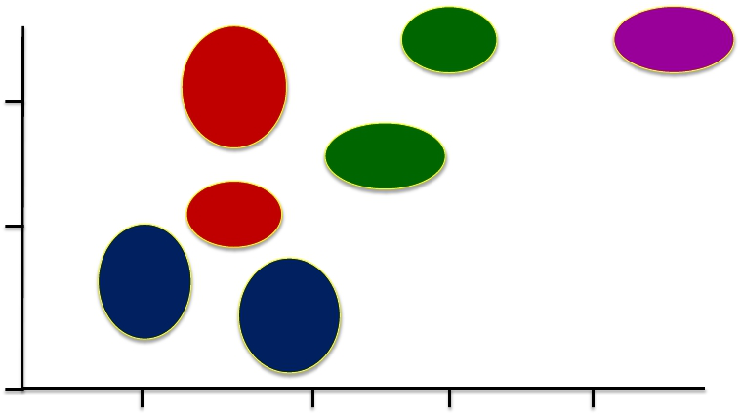
overall_0_131944394633340046 columns_1_131944394633340046
Antiviral Drug Potency and Genetic Barrier to Resistance
DTG
DRV/R
TV
EVG
3 log
RAL
EFV
ATV/R
TV
Potency (Estimated log change in viral load)
2 log
RPV
FTC
3TC
ABC
TDF
1 log
1
2
3
4
Genetic Barrier to Resistance
(Approximate no. of mutations needed to fail)
Danielle Ciuffetelli, Pharm.D CROI, 2016
Ambulatory Hepatology/Infectious Diseases Clinical Pharmacist
Hospital of the University of Pennsylvania, Philadelphia, Pennsylvania

Slide 18
overall_0_131944394671681791 columns_1_131944394671681791
SINGLE: DTG + ABC/3TC Superior to EFV/TDF/FTC Through Wk 144
DTG + ABC/3TC
(n = 414)
EFV/TDF/FTC
(n = 419)
Δ 7.4%
100
(2.5% to 12.3%)
Δ 8.0%
100
88
(2.3% to 13.8%)
Δ 8.3%
(2.0% to 14.6%)
72
63
81
80
80
60
80
60
73
73
71
64
69
64
61
60
56
HIV-1 RNA < 50 copies/mL (%)
HIV-1 RNA < 50 copies/mL (%)
40
20
40
20
204/185/
92/ 80/
262/230/
34/ 35/
0
0
280 288 134 131
≤ 100,000 > 100,000
357 357
> 200
57 62
≤ 200
Wk 48
Wk 96
Wk 144
All Pts
Pappa K, et al. ICAAC 2014. Abstract H-647a.
HIV-1 RNA
(c/mL)
CD4+ Cell Count
(cells/mm3)

Slide 19
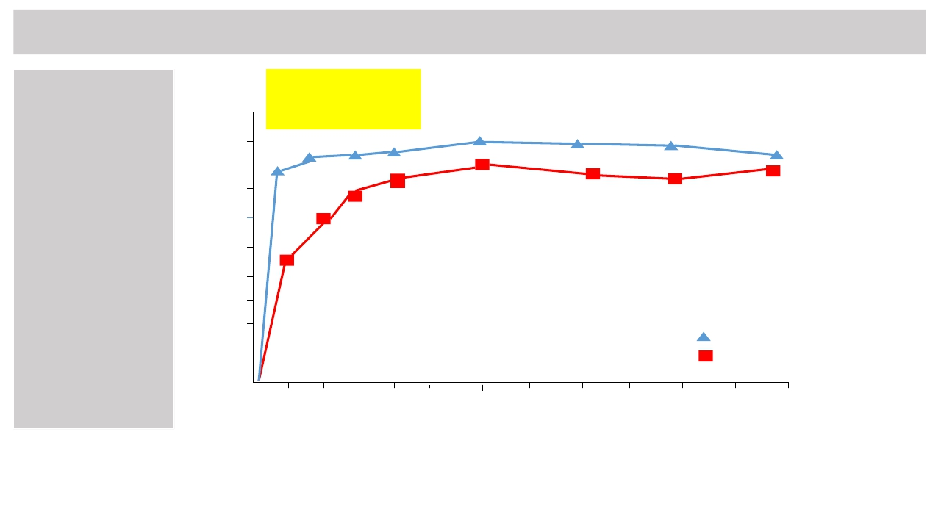
overall_0_131944394692582774 columns_1_131944394692582774
The SECOND-LINE Study: RAL+LPV/r vs. 2NRTIs+LPV/r
N = 541randomised
N=271 NRTI+LPV/r
N=270 RAL+LPV/r
Median time to reaching
the primary endpoint was
12.0w in the control group
and 4.1 w in the RAL
group viz. HR 1.41, 95%
CI 1.2-1.7; p=0.001)
At 48w., n=223 of 270 (83%)
RAL group vs n=219 of 271
(81%) of control group,
VL<200cp/mL
At week 48, difference 1.8%,
95% CI -4.7to 8.3
NON-INFERIORITY
RAL+LPV/r
NRTI+LPV/r
100
90
80
70
60
50
40
30
20
10
Non-inferiority
of viral
suppression
achieved at 48w
but earlier
viral suppression
on raltegravir
vs.
on
the
lopinavir/ritonavir
study arm
Proportion of participants (%)
0
4
8
12
16
20
24
28
32
36
40
44
48
Time (weeks)
Figure. Proportion of participants with plasma HIV viral load less than 200cp/mL.
In the modified intention to treat population.
SECOND-LINE Study Group. Lancet 2013; 381: 2091-99

Slide 20
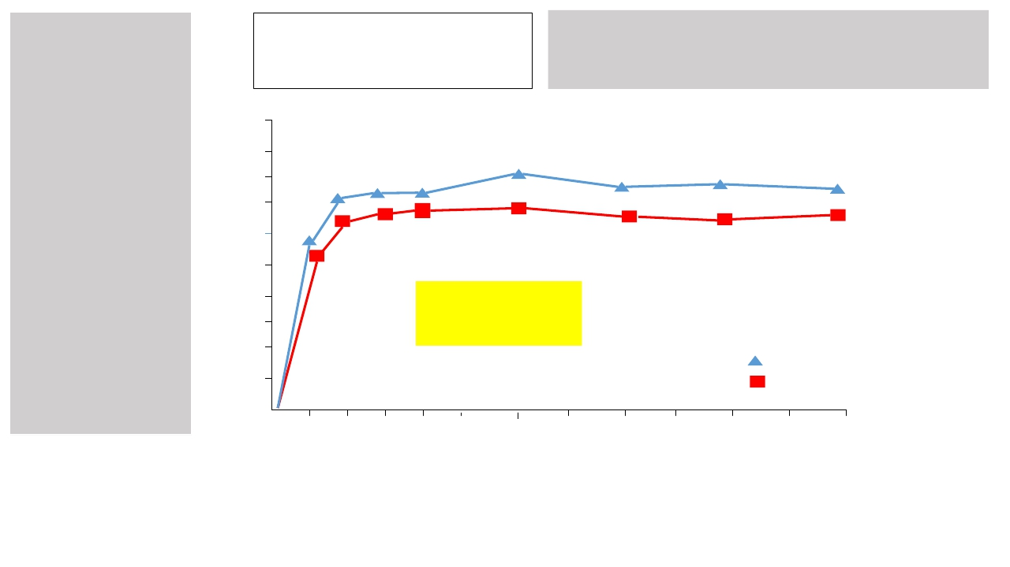
overall_0_131944394710183325 columns_1_131944394710183325
SAILING STUDY
ARV-experienced
INSTI-naive
N = 724 randomised
N=357 DTG
N=362 RAL
Treatment for antiretroviral
experienced patients.
N=251(71%) DTG of 354
VL<50 at 48w
P=0.03
N=230 (64%) RAL of
361 VL<50 at 48w
P=0.003 for difference at week 24
P=0.03 for difference at week 48
Dolutegravir
Raltegravir
100
90
80
70
60
50
40
30
20
10
Superiority
demonstrated at
48w of DTG over
RAL in ART-
experienced
patients
Patients (%)
0
4
8
12
16
20
24
28
32
36
40
44
48
Time (weeks)
Snapshot analysis of proportion of patients with plasma HIV-1 RNA lower than50 copies per mL,
by visit. Analysis included all participants randomly assigned to treatment groups who
received at least one dose of study drug, excluding participants at one site
with violations of good clinical practice.
Cahn P, et al. The SAILING Study. Lancet 2013; 382: 700-08

Slide 21
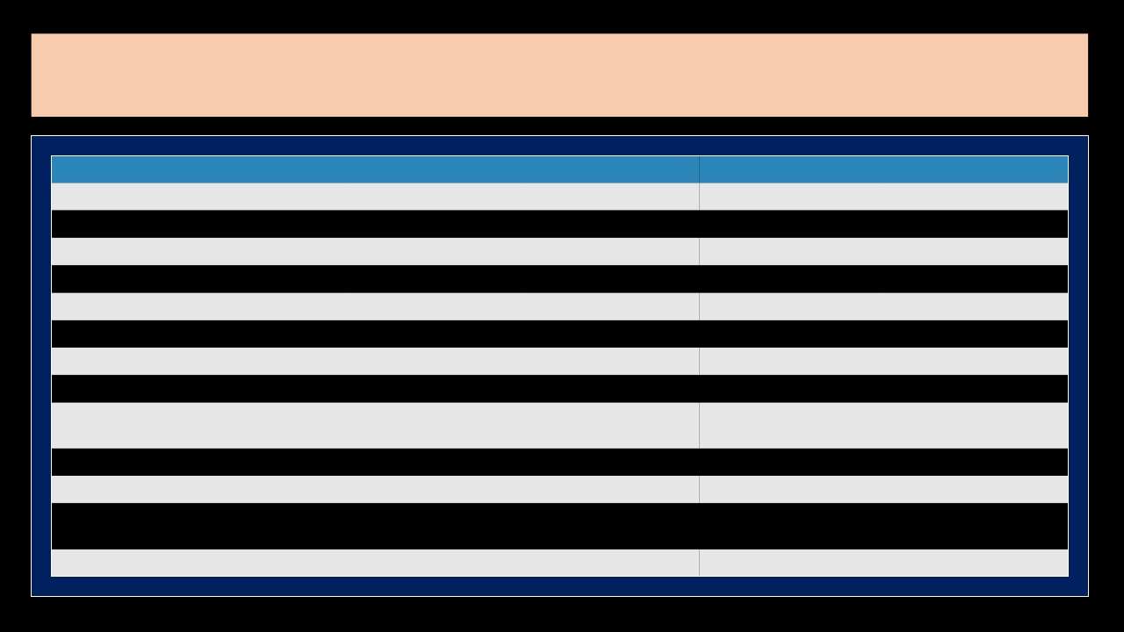
overall_0_131944394743700193 columns_1_131944394743700193
Comparing Fixed-Dose Regimens
Characteristic
Clinical experience
Virologic efficacy
Tolerability
Switch data
Absence of meal restrictions
Absence of DDIs
Use in HLA-B*5701+
Use in advanced HIV
Use in pts with renal
impairment
Use in pts with HBV/HIV
Use in pts with bone disease
Use in pts with CVD risk
factors
Use in pregnancy
EFV/TDF/FTC
+++
++
+
-
+
+
+++
++
-
+++
+
++
++
RPV/TDF/FTC
++
+(+)
+++
++
-
+
+++
+
-
+++
+
+++
++
EVG/C/TDF/FTC
++
++
++
++
++
+
+++
+++
-
+++
+
++
++
DTG/ABC/3TC
+
++(+)
+++
-
+++
+++
-
+++
+++
-
++
+
++

Slide 22
HIV 2020
overall_0_131944395341477432 columns_1_131944394801680293 7_1_131944395703714022 14_1_131944396114541942 15_1_131944396114732830 33_1_131944397730980639
VL (normal creat)
VL <100 000
VL >100 000
Truvada (TDF / FTC) Edurant (Rilpivirine)
Acriptega (TDF / FTC / DTG)
VL (abnormal creat)
VL <100 000
VL >100 000
Dumiva (ABC / FTC) Edurant (Rilpivirine)
Trelavue (ABC / FTC / DTG)
Pitfalls
Edurant
Not with TB
Not with high VL
Acriptega:
Creat (TDF)
TB double dose
When switching from TDF, if creat deteriorates, do HBsAg

