Slide 1


Rheumatoid Arthritis:
Diagnosis & Management
Nimmisha Govind
FCP(SA), Cert Rheum(SA), Mmed, PhD
Chris Hani Baragwanath Academic Hospital
University of the Witwatersrand
Notes:
Commonest inflammatory arthritis – 1% of population
Carries a significant morbidity - a third of RA patients become permanently work-disabled in the first 2 to 3 years of the disease onset
Patients with RA demise 5-10 years earlier than the gen population
Health RQoL scores among RA patients are worse than those of patients with other chronic illnesses such as cardiovascular disease and diabetes

Slide 2
Outline of presentation
Clinical features and diagnosis
Current treatment strategy:-
  Early diagnosis
  Early initiation of DMARDs
  Synthetic, biological and targeted synthetic DMARDs
  Treat to target
Milestones in the treatment
Co-morbidities
Take home messages
Notes:
Clinical recognition of the disease
Emphasis on the benefits of early diagnosis
And treating to a target

Slide 3
Introduction
Rheumatoid arthritis (RA) – chronic progressive multi-system autoimmune disorder with a predilection for synovial lining of joints and tendons
Prevalence of RA: ~1% of the population (F:M = 4:1 ; Age of onset: 30-50 years)
Early and common involvement of the small joints of the hands
Joint damage and subsequent deformity leads to considerable functional disability
Black South Africans with established RA have significantly worse functional disability compared to SLE patients
Alamanos Y et al. Autoimmun Rev 2005
Paco MJ et al. Arthritis Rheum 2001
Benitha R et al. Clin Rheumatol 2007
Notes:
Delay in diagnosis and/or inadequate disease control can lead to permanent joint deformities /disability

Slide 4
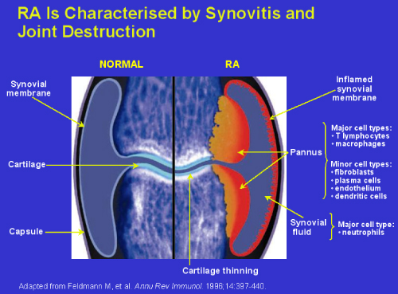
Notes:
Synovial infiltration by lymphocytes, plasma cells, and formation of lymphoid germinal centre are the key pathological features in RA results in
Proliferative synovitis with angiogenesis
Pannus erodes into subchondral bone and cartilage causing marginal erosions and joint space narrowing

Slide 5
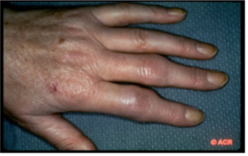
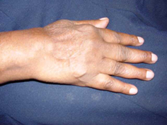
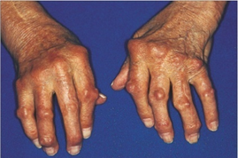


Early Diagnosis
Inflammation
Deformity
  Severity
Window of
Opportunity
Time
Quinn MA et al. Clin Exp Rheumatol 2003
Notes:
In the 1990s early 2000s there was much development identifying effective therapies – both conventional and biological DMARDs
With a realization that these drugs were most effective when initiated early in the onset of the disease
Numerous studies in the early 2000s showed that initiating drugs early results in less sutural joint damage which results in ess deformities and less functional impairment
And secondly, the odds of patients achieving remission which is a low inflammatory state and even drug free remission i.e maintaining this state off therapy is higher in those patients where DMARDs where stated early
This image shows the severity of inflammation and deformity over time.
Early in the disease inflammation is high and there is minimal deformities
If this inflammation is not controlled by DMARDS it can lead to deformities
Deformities is a function of inflammation over a period of time
Inflammation is reversible whereas deformities are not
How wide is this window – how optimal results – 3 months but benefits are seen up to 1 year even a bit more.
Primary care (PC), provided by general practitioners (GPs), is the first level of contact for the population with the healthcare system. consequently, the main tasks of GPs for the management of RA are early detection of the disease, fast referral to a specialist, first-line treatment, and the prevention of complications

Slide 6

Potential RA - the 3 Ss
Alarm signals
Morning Stiffness ≥ 30 minutes
≥ 3 Swollen joints
MTP/MCP involvement
(Squeeze Test positive)
Emery et al. Ann Rheum Dis 2002
Notes:
The clinical features of Early RA may be subtle, so Emery in the early 2000s developed a practical 3S (Stiffness, swollen joints and squeeze test) alarm signals to detect RA
Which includes:
Stiff – unable to make a fist, difficulty squeezing a wash cloth, stiffness getting better after a warm shower or as the day progresses
3 or more swollen joints
If patient have these 3 S prompt referral to a rheumatologist for definitive diagnosis and initiation of DMARD treatment

Slide 7
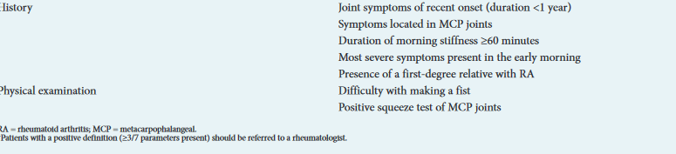
Clinically suspect arthralgia
van Steenbergen HW, et al. Ann Rheum Dis 2017
Notes:
Recently, there has been recognition that some patients have joint symptoms but no clinically apparent synovitis.
The symptomatic phase preceding clinical arthritis is the first opportunity to clinically recognize patients who are at risk for progression to RA.
and that a proportion of patients with CSA did indeed progress to RA during follow-up (∼20%
Patients with three or more of seven clinical features have an increased risk of progression to RA and are termed ‘clinically suspect arthralgia’ (CSA), and should be referred to a rheumatologist

Slide 8

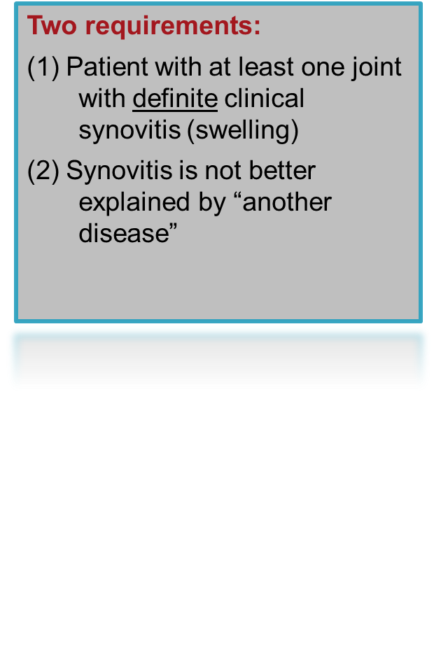
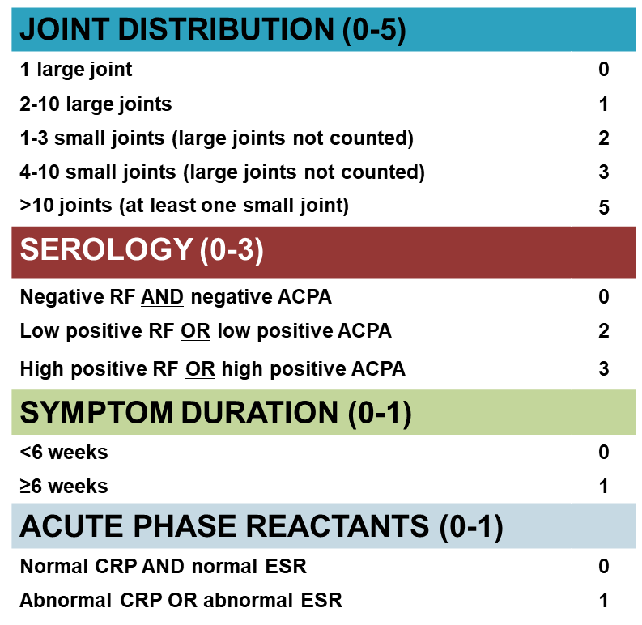

2010 ACR/EULAR
Classification Criteria for RA
Aletaha d et al. Ann Rheum Dis 2010
Notes:
with this in mind – The latets classification criteria was developed with the aim of improving sensitive to detect early RA
The previous 1987 ACR criteria detected patients with RA that had a disease duration of around 10 years – some of you may recall that presence of SC nodules and x-ray erosions were criteria, bth features of late disease
The latest criteria, the 2010 ACR/EULAR -needs two requirements: at least one joint with definite synovitis and the synovitis is not better explained by another disease
Consists of 4 domains:- no. and size of joint involvement, serology – ACPA has been included in this set of criteria as it is better in detecting early disease and it is more specific for RA, symptom duration and acute phase reactants
A score of 6 or more is classified as definite RA

Slide 9
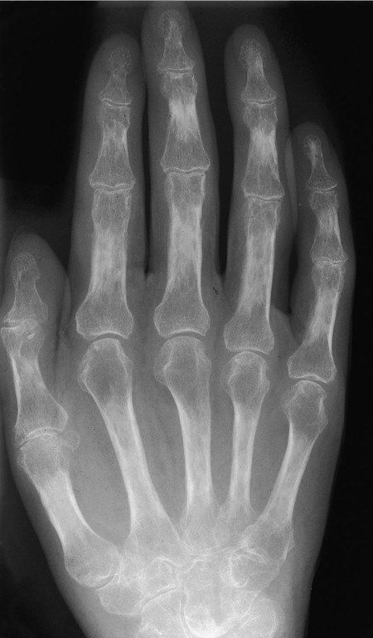
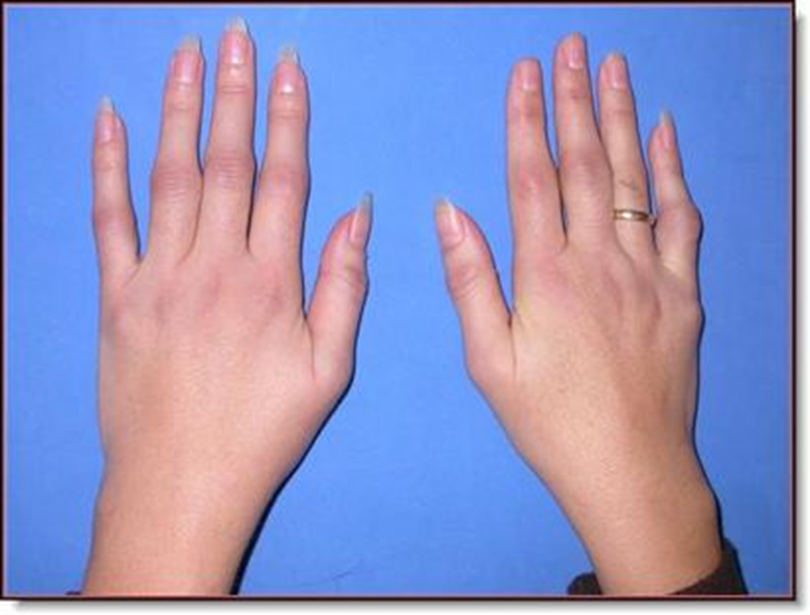
Clinical features
Notes:
This is the articular features of a patient with early RA, note the lack of significant deformities, predominantly ST swelling over the wrists, MCPs and PIPjs resulting in fusiform swelling of the digits.
Early radiographic changes are ST swelling, PAOP and JSN – no bony erosions
80 % of patients will start this way

Slide 10
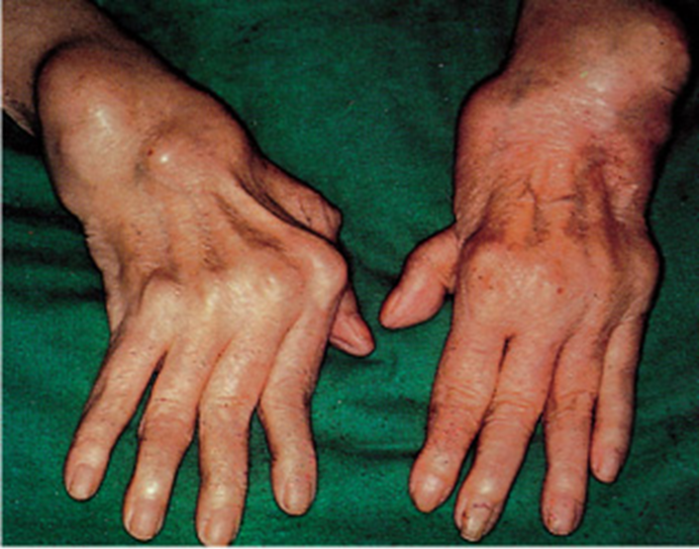
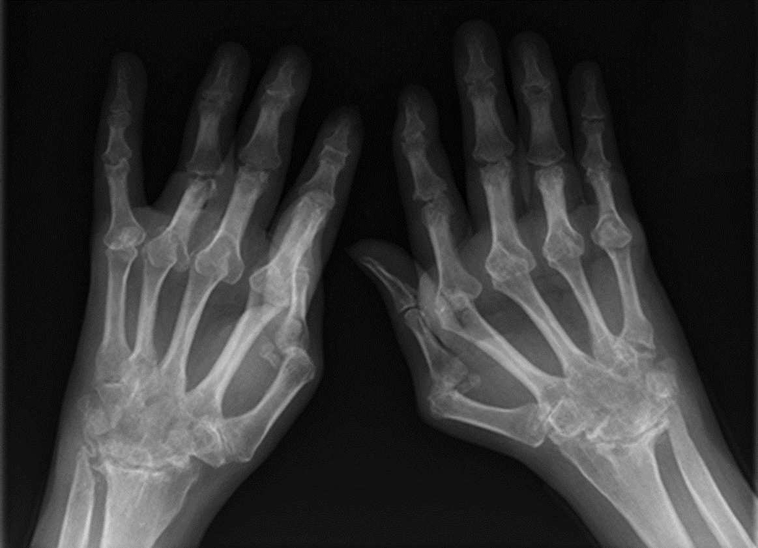
Clinical features
Notes:
Then compare that to this patient with longstanding established RA-
we can see the significant structural deformities of the wrist with chronic synovial swelling and subluxation of the MCPJs, multiple swan neck deformities, Marked muscle wasting.
The most significant features that one can notice on the radiographs are the presence of multiple periarticular bony erosions especially In the wrists – loss of carpal bone definition, carpal crowding and destruction of the distal ulnar and styloid process.
All these changes represent irreversible structural damage and functional disability.

Slide 11
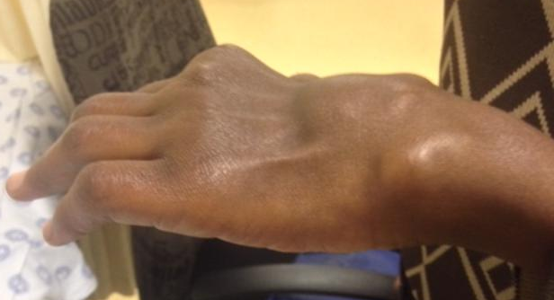
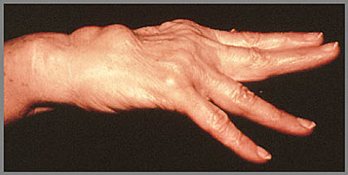
Clinical features
Notes:
Volar sublux of wrist, prominent ulnar styloid
Tuck sign distal swelling
Rupture of extensor tendons due to erosions of the ulnar styloid which causes attrition of the most lateral extensor tendons with subsequent ruptor –
= vaughan Jackson deformity

Slide 12
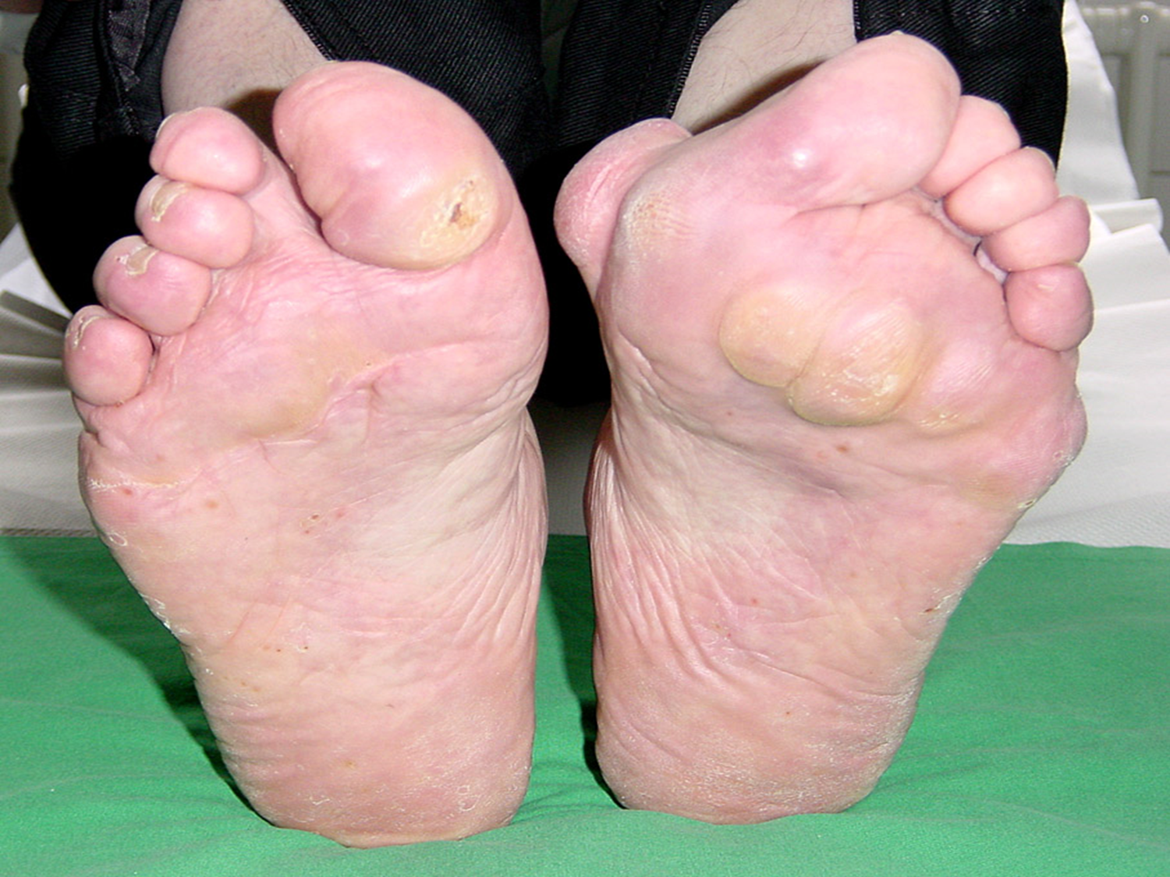
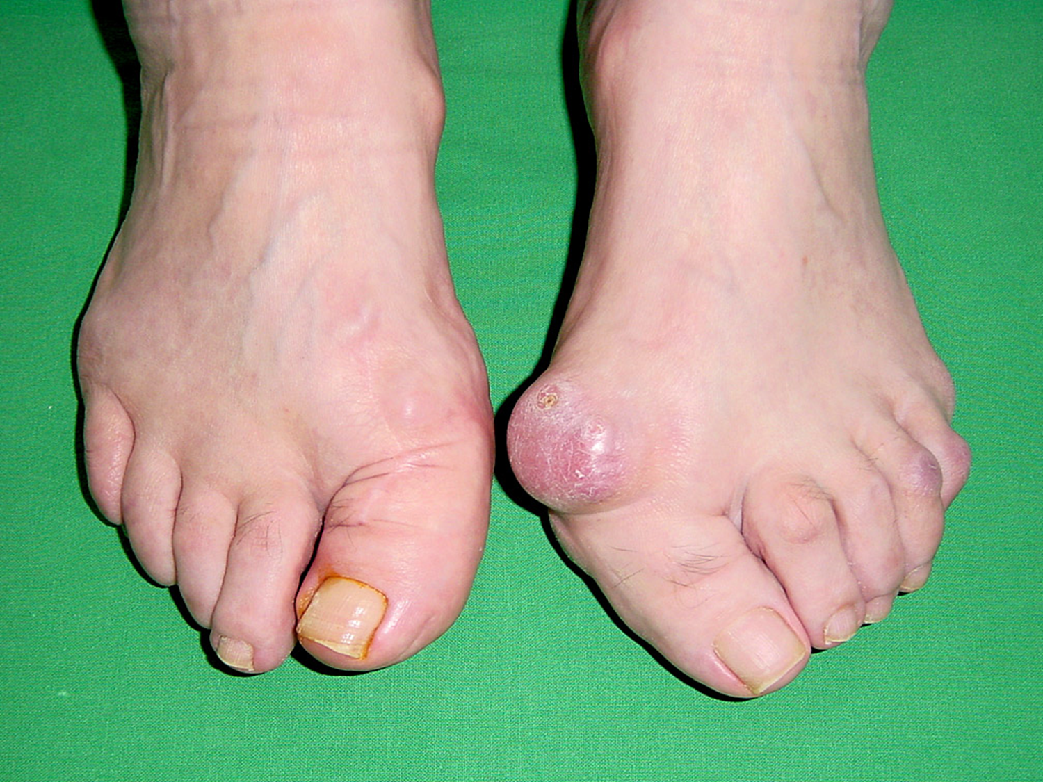
Clinical features
Notes:
Forefoot and hindfoot deformities common in RA
This patient has marked forefoot deformities
Bilateral hallux Valgus and bunion formation
Subluxation of the MTPS with the Sensation of walking on cobblestones and Callosities on plantar surface over MTP
Widening of the forefoot and Distal displacement pf footpads
Overriding toes

Slide 13
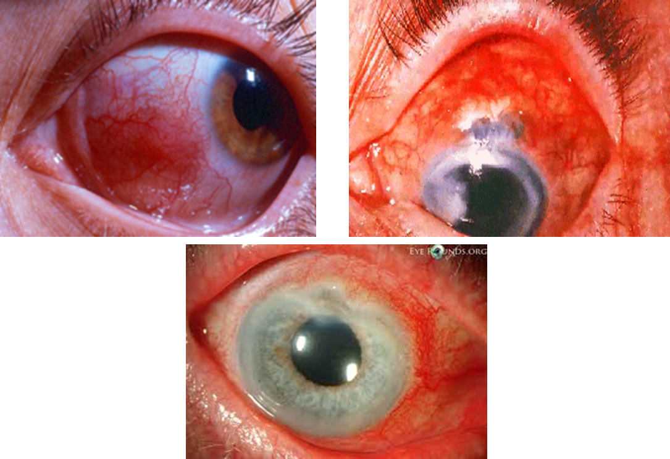
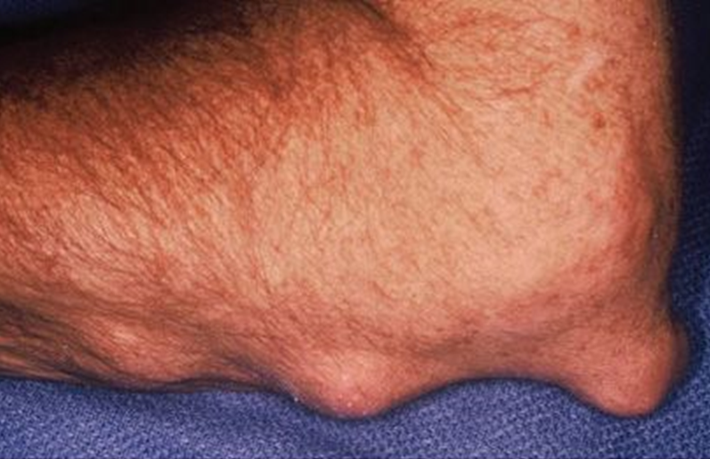
Extra-articular features
Notes:
RA is a systemic disease - not limited to joint inflammation
Some extraarticular manifestations occur early, other late and some throughout the disease
rheumatoid nodules are the most common EAF of RA (20%)
The eye is commonly affected in RA
Sicca – dry gritty eyes, sensation of sand in the eyes
Scleritis which is a form of vasculitis causes painful red eye which can lead to thinning of the sclera and rarely perforation
The corneal can also be affected with PUK, peripheral ulcerative keratitis

Slide 14
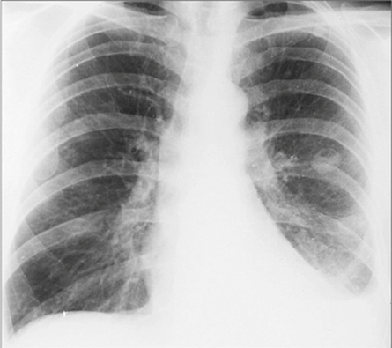
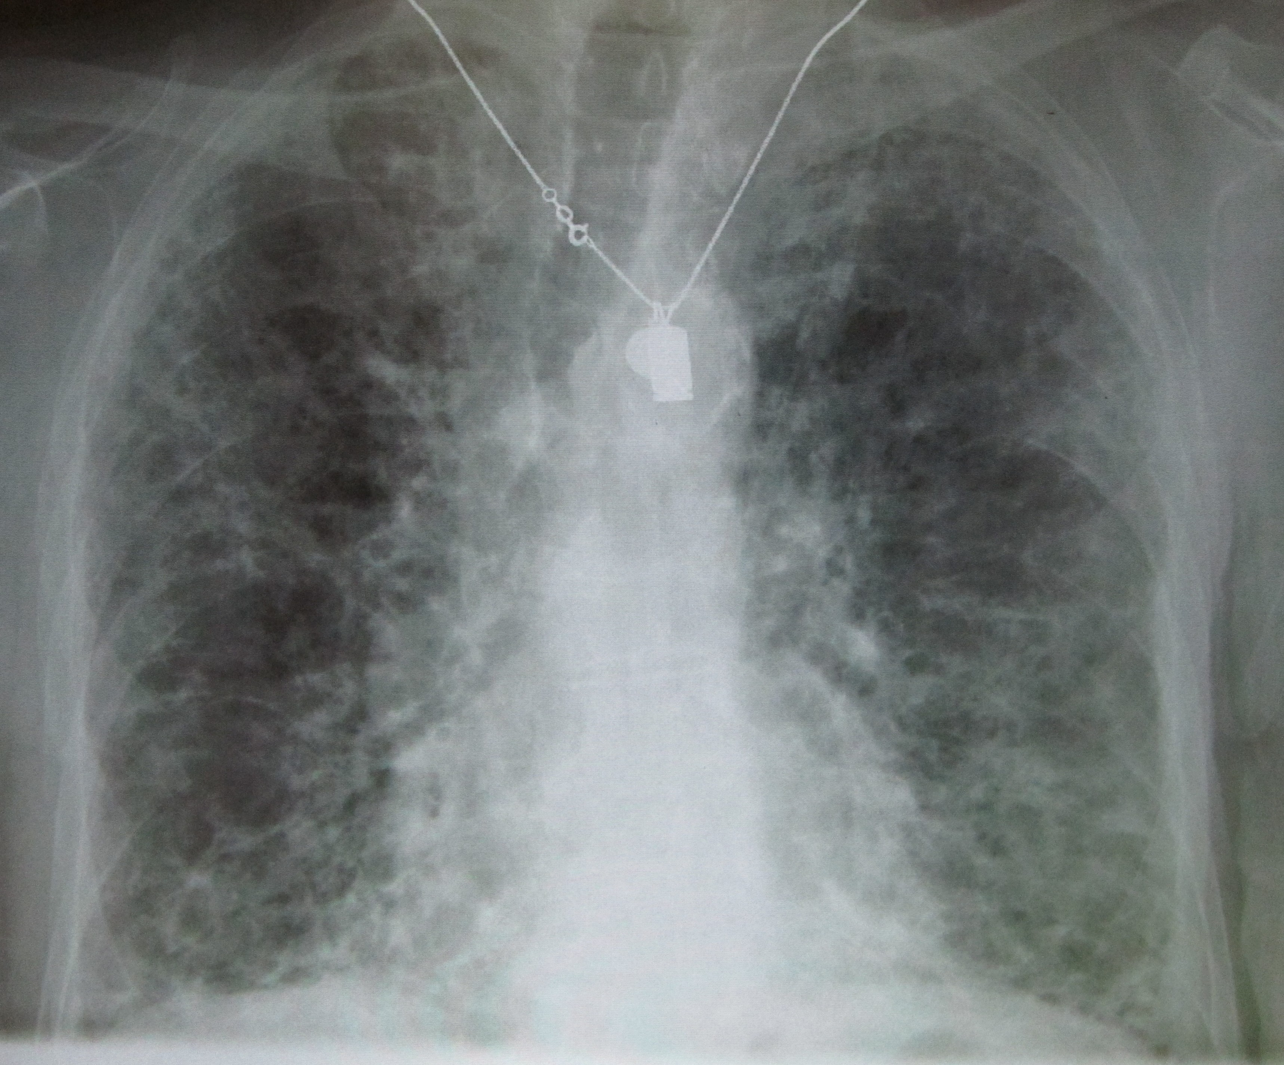
Extra-articular features
Notes:
Other organs that are involved are the lungs – rheumatoid nodules (incidental), pleural effusions and ILD.
.

Slide 15
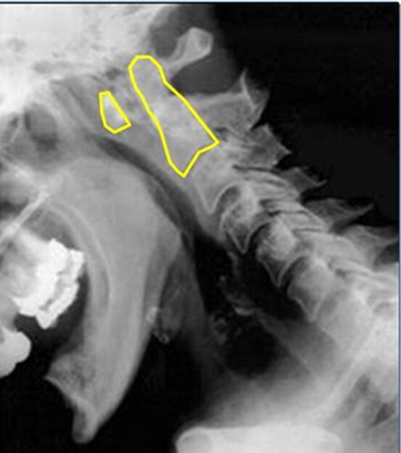
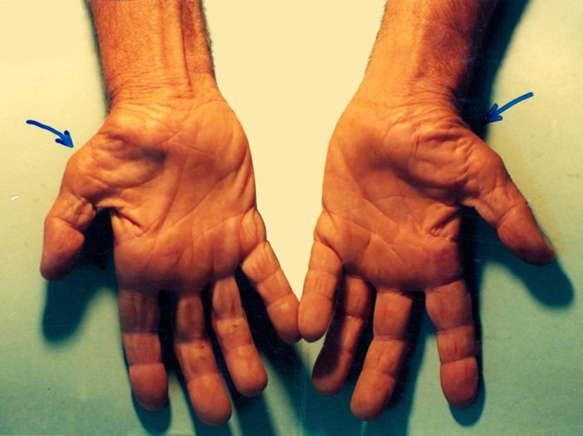
Extra-articular features
Notes:
Cervical myelopathy secondary to atlanto-axial subluxation of the C-spine
Entrapment neuropathies can also occur, such as CTS pictured here with wasting of the thenar muscles due to entrapment of the median nerve due to wrist synovitis

Slide 16
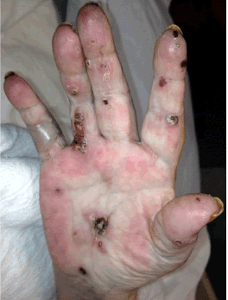
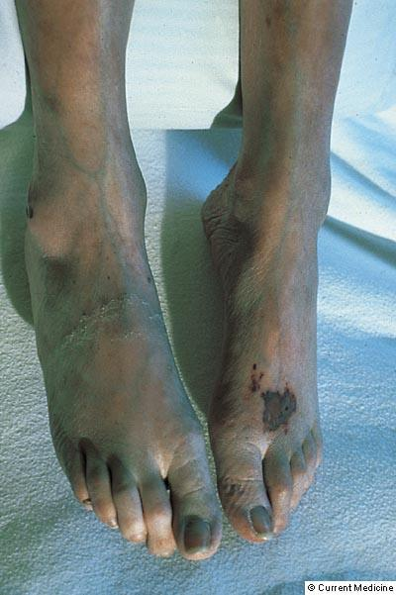
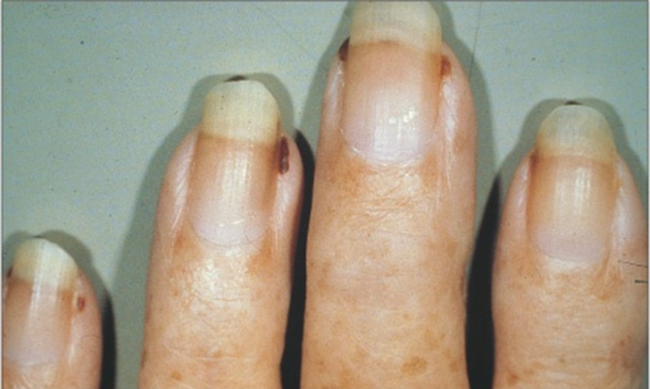
Extra-articular features
Notes:
Manifestations are rheumatoid vasculitis – vasculitc papules on the palms with ulceration and gangrene and a mononeuritis multiplex with bilateral foot drop and associated gangrene. Isolated nail fold infarcts are known as Bywater lesions and these are benign lesions that are self-limiting and doesn’t require immunosuppressive therapy.

Slide 17
Investigations - Laboratory
FBC – ACD, thrombocytosis
Elevated Acute phase reactants – ESR and CRP
Antibodies:
  RF:- sensitivity = 75% ; specificity = 74%
  aCCP:- sensitivity = 68% ; specificity = 98%
  aCCP is useful in the diagnosis of early disease
Schellekens GA et al, Athritis Rheum 2000

Slide 18
Tighe H et al, Rheumatoid factors. In Textbook of Rheumatology 1997
Notes:
RF is poorly specific meaning that there are many other causes of an elevated RF other than RA, eg
Other rheumatic diseases
Infections
Malignancies
Other chronic illnesses
healthy population

Slide 19
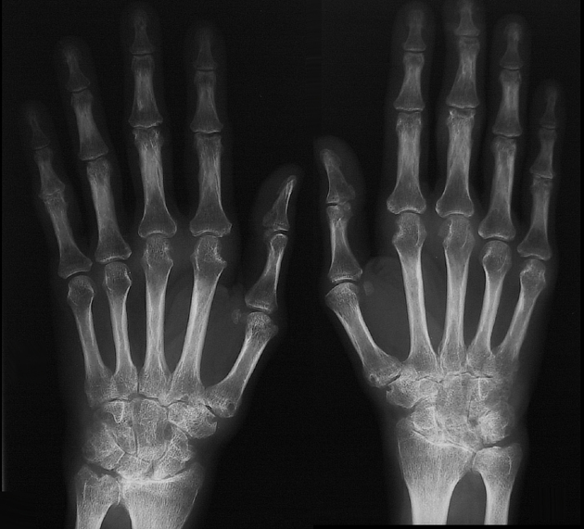
Investigations - Imaging

Slide 20
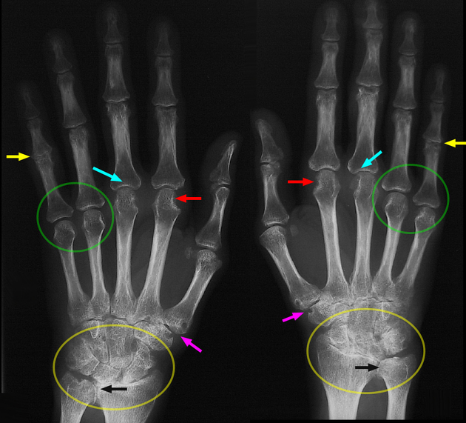
Radiology - Imaging
Joint space narrowing
Marginal erosions
Juxta articular osteopenia
Notes:
Baseline hand and feet radiographs should be performed for diagnostic (marginal erosions, joint space narrowing and juxta-rticular osteopenia) and prognostic purposes. These images are not sensitive enough to detect changes early in the disease, but are readily available, reliable and low in cost.A chest radiograph is appropriate to exclude rheumatoid lung disease or tuberculosis (TB) prior to commencing therapy.
bilateral and symmetrical involvement
proximal interphalangeal joint space narrowing (yellow arrows)
metacarpal heads erosions (red arrows)
metacarpophalangeal joint space narrowing (blue arrows)
metacarpophalangeal joint osteopenia (green circles)
pancarpal and radiocarpal involvement with erosions (yellow circles)
carpometacarpal erosion (purple arrows)
distal radioulnar joint loss of space (black arrows)
distal interphalangeal joints spared
soft tissue swelling

Slide 21
Radiology
Notes:
Musculoskeletal ultrasound. is safe and relatively inexpensive, and allows accurate assessment of soft-tissue inflammation and joint erosions, and placement of intra-articular injections that is superior to clinical examination.
A trained and experienced rheumatologist or MSUS technician is required
Magnetic resonance imaging (MRI), particularly contrast-enhanced MRI, is highly sensitive, demonstrating synovitis and tenosynovitis, and can detect erosions up to 3 years before they are evident on conventional radiographs. Bone marrow oedema may be seen on MRI in early RA, and is a strong predictor of bone damage
Limited access to MRI scans together with cost limit the availability of this modality.
While MSUS-detected tenosynovial hypertrophy with Doppler signal and MRI-detected tenosynovitis at the metatarsophalangeal joints are very specific for RA, recent studies have found that MRI and MSUS did not add value to the diagnosis of RA compared with the 2010 ACR/EULAR classification criteria. MSUS is useful when there is diagnostic doubt
At present, MSUS and MRI scans are not part of routine diagnosis and should be used to visualise soft-tissue and bone lesions of a problem joint, or to confirm or exclude synovitis where there is clinical uncertainty.
Regular routine imaging of RA joints is not necessary: there is no evidence that follow-up assessments with either MSUS or MRI lead to better outcomes than clinical assessments, and they have the potential to lead to over-treatment

Slide 22
Differential diagnoses
Connective tissue disease: SLE, systemic sclerosis
Crystal arthropathies: Gout, calcium pyrophosphate deposition disease
Seronegative spondyloarthropathies: psoriatic arthritis
Endocrinopathies : hypothyroidism
Infection: HIV, hepatitis
Others :Malignancy, sarcoidosis
Erosive osteoarthritis

Slide 23
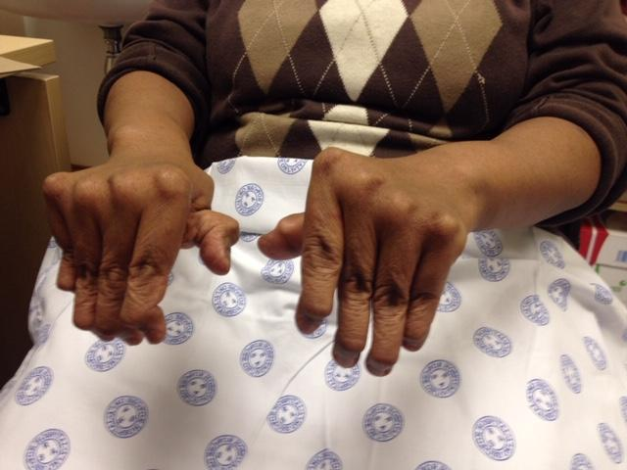
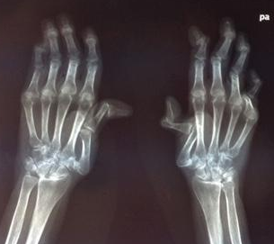

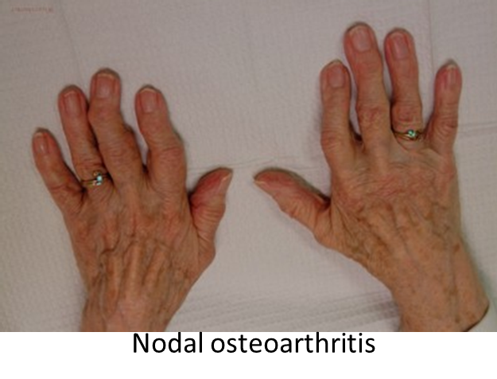
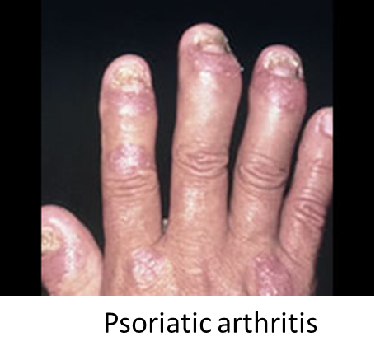
Differential diagnoses
Jaccouds arthropathy

Slide 24
Milestones in the treatment of RA
Year | 1980s | 1990s | 2000s | 2010s
RA Management | Salicylates + Steroids Gold Salts D-penicillimine Chloroquine (CHQ) Sulphasalazine (SZP) Cyclophosphamide Azathioprine (plasmaphoresis) (Lymphoid irradiation) | NSAIDs + Steroids Methotrexate (MTX) MTX plus CHQ SZP Leflunomide | MTX/Triple therapy + Steroids MTX/Leflunomide + TNF-inhibitors Switch TNF-inhibitors | MTX + Biologic Continue or switch biologic Jak-inhibitor Reduce DMARDs
Treatment Target | Clinical improvement | Poorly defined | Treat to Target Remission | ? Drug-free remission
Anastassiades TP. Can Med Assoc J 1980
Saag K et al. Arthritis Rheum 2008
Singh j et al. Athritis Care Res 2012
Smolen J et al. Ann Rheum Dis 2017
Notes:
There has been major developments and advancements in the management of rheumatoid arthritis over the past 30 years.
-in the 1980s, gold salts were the preferred remission-inducing drug with a host of other 2nd line therapy, plasmaphoresis and total lymphoid irradiation were even attempted in refractory patients with minimal efficacy; treatment target was based on improvement of symptoms
-1990s, MTX came onto the scene, used as either monotherapy or combination therapy and it was in the mid 90s that we realized the importance on initiating DMARDs early.
-2000s, the biologics or more specifically the anti-TNFs were incorporated into the treatment of RA when patients had an inadequate response to MTX, target remission using composite scores to measure disease activity.
- Now, we have even more biologics with different molecular targets and targeted synthetic DMARD – tofacitinib/baracitinib; treatment target – sustained remission and perhaps ?drug-free remission

Slide 25
Disease-modifying anti-rheumatic drugs (DMARDs)
Conventional synthetic DMARDs | Biological DMARDs | Targeted synthetic DMARDs
Methotrexate | TNF-inhibitors Etanercept Adalimumab Infliximab Golimumab Certolisumab pegol | JAK-inhibitors Tofacitinib Baracitinib
Leflunomide | Rituximab
Sulfasalazine | Abatacept
Anti-malarials Hydroxychloroquine Chloroquine | Tocilizumab Sarilumab
Notes:
DMARDS have the potential to alter the course of the disease.
They work to decrease pain and inflammation, to reduce or prevent joint damage, and to preserve the structure and function of the joints
It is important to stress that whilst NSAIDS, Analgesia have a role to play in the adjunctive management of RA they are not disease modifying
DMARDS are divided into three broad groups: conventional synthetic (csDMARDs), biologic (bDMARDs) and targeted synthetic DMARDs (tsDMARDs).
csDMARDs to treat RA include methotrexate (MTX), leflunomide (LEF), sulfasalazine (SSZ) and antimalarials (AMAs)
bDMARDs may be either biologic original (boDMARDs) or biosimilar (bsDMARDs). Among the bDMARDs registered for use in RA in SA, four are tumour necrosis factor inhibitors (TNFis): receptor blockers (etanercept (original and biosimilar)) or monoclonal antibodies (infliximab (original and biosimilar)), adalimumab (original and biosimilar) and golimumab; and three non-TNFis: ritixumab (original and biosimilar), tocilizumab and abatacept.
tsDMARDs include the Janus kinase (JAK) inhibitors tofacitinib, baricitinib and upadacitini

Slide 26
DIAGNOSIS
Education
Physio
OT
Podiatry
NSAID
Analgesia
IAS
DMARD
ACTIVE DISEASE
Increase
DMARD
ACTIVE DISEASE
Combination
csDMARD
ACTIVE DISEASE
Biologic agent
Notes:
Monitoring and modification of therapy, including multiple successive therapies, may be required; up to 60% of patients will not meet treatment goals after their first disease-modifying antirheumatic drug (DMARD), and >60% of these will require at least a third DMARD course.[4] With optimal treatment strategies, remission or low disease activity (LDA) can be achieved in up to 80% of patients.
The aim of treatment is to maintain a good quality of life and physical function. A management plan should be developed based on shared decision-making between patients and clinicians, predicated on patients’ values, goals, preferences and comorbidities. Patient education should include information about RA disease and complications, assessment of disease, treatment goals, medications and adherence.[24]Self-management interventions, including medication management, physical activity, disease-related problem solving, emotional wellbeing, communication skills, and use of community resources including patient support groups, should be emphasised.[25] Lifestyle improvements complement medical treatment but do not replace it.There is strong evidence that being cared for primarily by a rheumatologist improves outcomes for persons with RA.[26,27] All RA patients should ideally be seen by a rheumatologist, particularly those with diagnostic uncertainty, moderate or high disease activity, functional impairment, intolerance to DMARDs, and extra-articular disease. Care of the RA patient requires a multidisciplinary holistic approach that may include an occupational therapist, podiatrist, physiotherapist, orthopaedic surgeon, psychologist and social worker. A rheumatology nurse can offer patient education and support, with positive effects on adherence to therapy and HRQoL

Slide 27
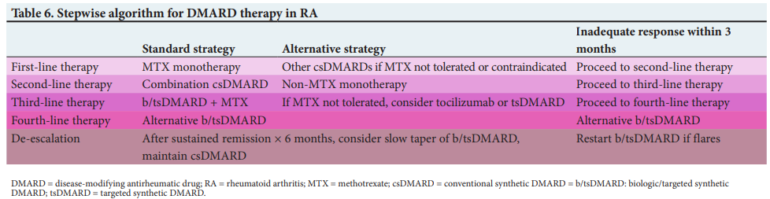
Treatment – SARAA recommendations
Low dose GC (≤7.5mg daily) as “bridging therapy” for 1-3 months when initiating DMARDs, then GC should be reduced and discontinued.
Tarr G, S Afr Med J 2024;
Notes:
This algorithm has recently published in the SAMJ and is the latest SARAA recommendation on the DMARD therapy for RA.
First line therapy is ….

Slide 28
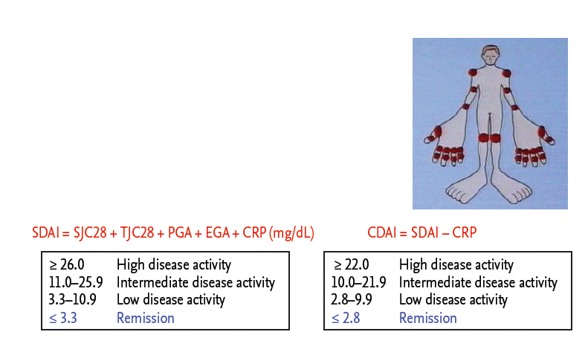
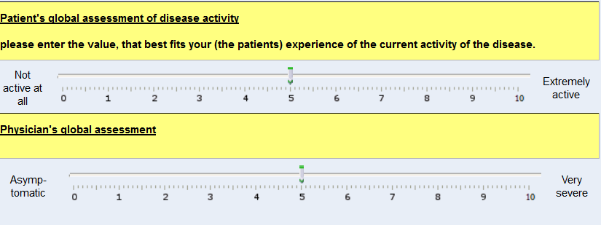
Instruments assessing RA disease activity – variables for determining therapy
SJC, swollen joint count;
TJC, tender joint count;
PGA, patient’s global health assessment (0–10.0 cm visual analogue scale [VAS]);
EGA, evaluator’s global health assessment (0–10.0 cm VAS);
CRP, C-reactive protein.
Anderson J et al. Arthritis Care Res 2012
Notes:
Similar to how HBA1C is used to montor diabetic control – disease activity scores are used to measure joint inflammation
Ongoing inflammation is measured by Disease activity score which are composite disease activity score should be performed at every visit.
The most widely used is the SDAI and CDAi score includes the number of tender and swollen joints (using 28 joint counts);
global assessment of disease activity from the patient (‘How has your arthritis been over the last week?’), scoring between 0 (very well) and 10 (very poor);
and global assessment of disease activity by the physician, scoring between 0 (very well) and 10 (very poor), with or without a serum acute-phase reactant
Disease activity can be classified into states of remission or low, moderate or high disease activity.
The goal of therapy is to achieve at least LDA, i.e. CDAI ≤10.
While remission is a reasonable goal for patients with early disease, aiming for remission may not be realistic for all RA patients

Slide 29
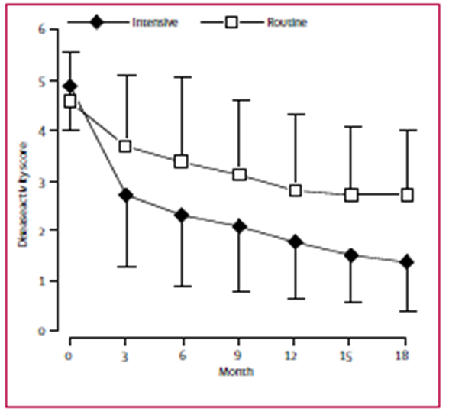
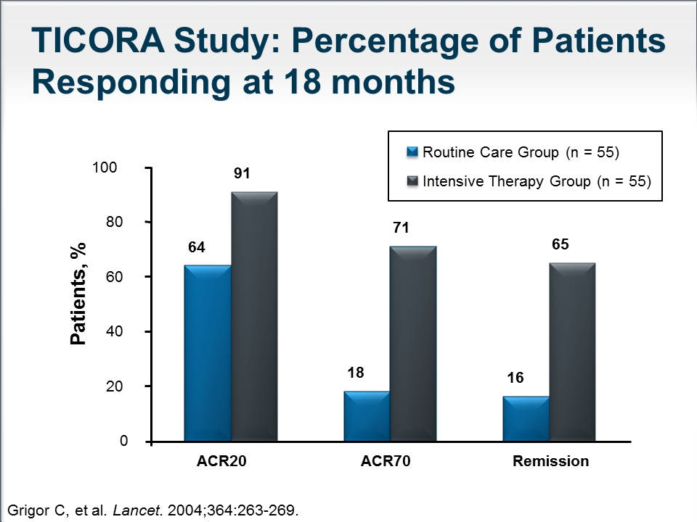
TIght COntrol in Rheumatoid Arthritis (TICORA) study
Grigor C,et al. Lancet 2004
Notes:
One of the landmark studies – TICORA (tight control in RA) done in the UK in 2004 showed the differences in treating patient using routine care (reviewing patients every 3 months and altering treatment with no specific composite scores)
and intensive care patients (monthly review and using composite scores and a set protocol to intensifying drug therapy to aim for remission).
Graph showing fall in disease activity scores in both groups and the mean fall in DA score was significantly greater in the intensive group – sustained throughout the trial. Hence the intensive group also showed greater improvements in physical function and QoL
Patients who achieve LDA/remission have a low risk of damage progression compared with those with moderate or high disease activity states, with better physical function, improved HRQoL, and fewer comorbidities including normalisation of cardiovascular risk factors, particularly when therapy is commenced in early disease.[38,39]A treat-to-target strategy entails:• Use of a composite disease activity score at each visit• Escalation or switching of DMARD therapy until the goal of LDA is achieved• Frequent follow-up every 1 - 3 months during the first 6 - 18 months of treatment or until LDA/remission is achieved.Clinicians must aim to achieve LDA in all patients as soon as possible – aiming for 50% improvement in disease activity score within 3 months, and LDA at 6 months. Frequent evaluation is needed (every 1 - 3 months) in patients with active disease, with adjustment of therapy until LDA/remission is reached, after which time less frequent assessments (3 - 6-monthly) are acceptable

Slide 30
In a local setting
 | Tight Control Strategy (n=98) | Historical Cohort (n=134) | p-value
Remission, n (%) | 33 (33.7) | 13 (10.4) | <0.0001
LDA, n (%) | 30 (30.6) | 24 (17.9) | 0.028
Patients lost to follow-up, n (%) | 2(2.0) | 35 (20.5) | <0.0001
Hodkinson B et al. Rheumatology 2015
Notes:
65% in the TC cohort and 28% in the historical cohort
-improves compliance
-in a resource constrained developing setting, better disease control in RA can be achieved using a TC strategy

Slide 31
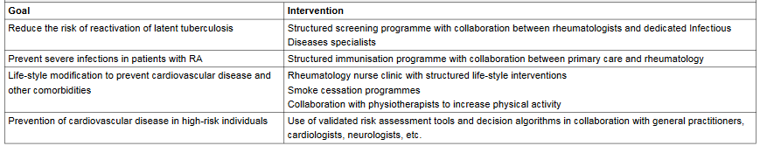
Comorbidities in RA
Cardiovascular disease (CVD): ischemic heart disease, subclinical atherosclerosis and heart failure
Infections: increase risk of serious infections
NSAID induced Peptic Ulcer disease
Mental health conditions: depression and anxiety
Malignancies: increased incidence of lymphoproliferative malignancies
Osteoporosis: increase fracture risk
Michaud K et al. Best Pract Res Clin Rheumatol 2007
Dougados M et al. Ann Rheum Dis 2013
Notes:
In recent years there has been an improvement in clinical outcomes of RA and a reduction in the need for orthopaedic surgery. This likely reflects the more extensive use of conventional and biologic DMARDs.
However there still remains an increased mortality in RA with a reduced life expectancy of 3-10 years or more, this is largely due to comorbidities especially CVD and infections. Apart from an increased mortality, comorbidities are associated with increased morbidity.
Compared to the general population RA patients have a 60% increased risk of CV mortality and the prevalence was 5%. RA as an entity is now considered an independent risk factor for CVD of the same magnitude as diabetes. The absolute risk of a cardiovascular event is estimated to be similar to that seen in a non-RA person 5-10 years older. Ra patients have an increased likelihood of multi-vessel coronary artery disease AND 6 x more likely to have silent MI

Slide 32
Take home messages
Inadequately treated RA leads to significant functional disability and morbidity
Early diagnosis and referral
Prompt initiation of DMARDs and escalation of therapy
Tight control strategy (based on measurement of disease activity)
Treat to target remission or LDA
Monitor and treat comorbidities

Slide 33
Thank You

Slide 34
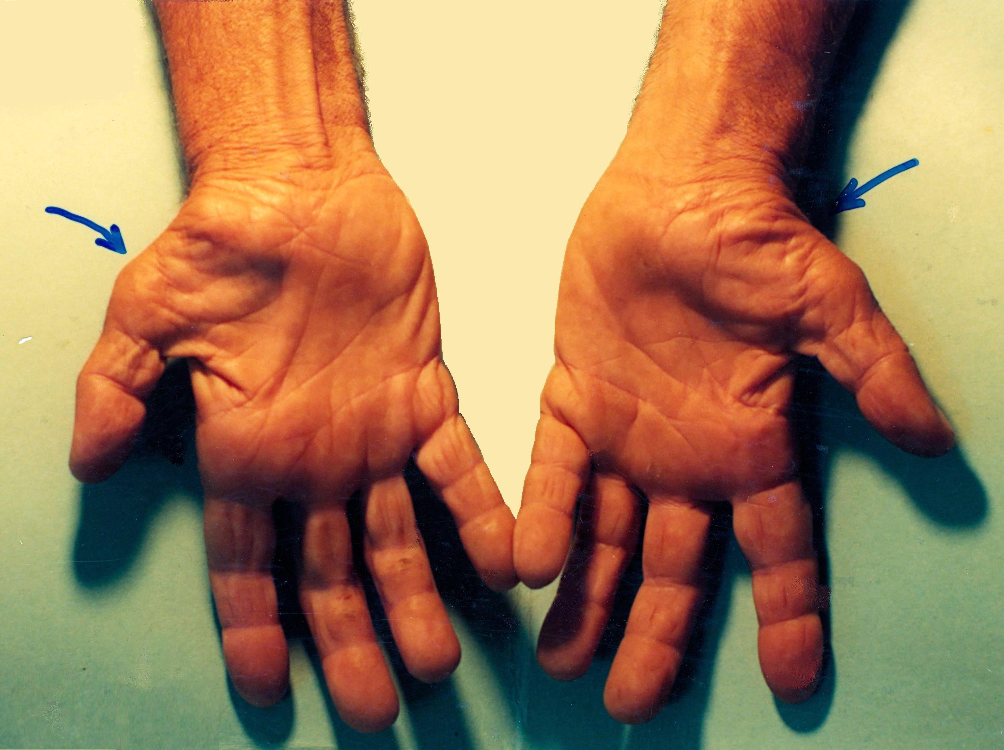
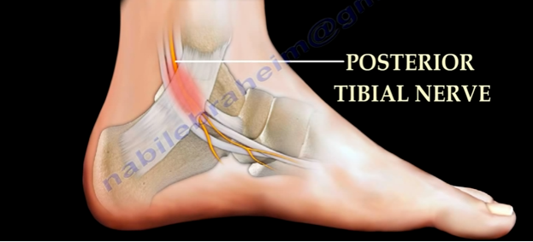
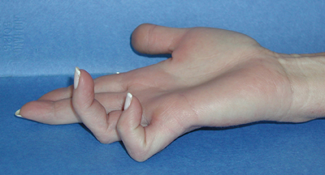
Extra-articular features

Slide 35
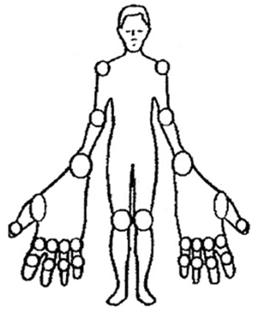
Instruments assessing RA disease activity – variables for determining therapy
 | Score Range | Remission | Low | Moderate | High
DAS28 | 0-9.4 | <2.6 | ≥2.6 to <3.2 | ≥3.2 to ≤5.1 | >5.1
SDAI | 0.1-86.0 | ≤3.3 | >3.3 to ≤11 | >11 to ≤ 26 | >26
CDAI | 0-76.0 | ≤2.8 | >2.8 to ≤10 | >10 to ≤22 | >22
Tender Joint Count (TJC)
Swollen Joint Count (SJC)
Anderson J et al. Arthritis Care Res 2012
Notes:
A composite disease activity score should be performed at every visit. This score includes the number of tender and swollen joints (using 28 joint counts); global assessment of disease activity from the patient (‘How has your arthritis been over the last week?’), scoring between 0 (very well) and 10 (very poor); and global assessment of disease activity by the physician, scoring between 0 (very well) and 10 (very poor), with or without a serum acute-phase reactant (Table 3). Disease activity can be classified into states of remission or low, moderate or high disease activity.[13] The three validated scores currently in use in South Africa (SA) are the Clinical Disease Activity Index (CDAI), the Simplified Disease Activity Index (SDAI) and the 28-joint Disease Activity Score (DAS-28).[14-16] The CDAI is the easiest measurement to perform, and the final score ranges from 0 to 76 (higher scores indicate higher disease activity).
The goal of therapy is to achieve at least LDA, i.e. CDAI ≤10.Remission, or a state of no disease activity, may be defined by a composite disease activity score or by ACR/EULAR remission criteria.[37] While remission is a reasonable goal for patients with early disease, aiming for remission may not be realistic for all RA patients
Physical disability can be measured with the Health Assessment Questionnaire-Disability Index (HAQ-DI).[17] This self-administered questionnaire should ideally be completed 6 - 12-monthly, and with motivation/remotivation for biologic therapy, work assessment and disability boarding.

Slide 36
Morbidity and Mortality
Median life expectancy:- shortened by 7 years in men and 3 years in women
40% of all deaths are attributable to cardiovascular causes
Increased mortality equals that of all patients with Hodgkin’s disease, diabetes mellitus or stroke.

