Slide 1
Dr L Machaba-Simelani
Paediatrician
MBChB, FcPAED, MMED
Netcare Sunninghill Hospital
Gauteng
Characteristics of Probiotics

Slide 2
DISCLAIMER
This presentation is intended to facilitate continuing medical education.
The views expressed in this presentation are those of the presenters and do not necessarily reflect the views of Sanofi.
Sanofi does not recommend the use of its products in any manner inconsistent with that described in the local package insert.
Before using any product mentioned here-in please refer to the full local prescribing information.
For full prescribing information on any products mentioned in this presentation, refer to the Package Insert approved by the Regulatory Authority.

Slide 3
Outline
History of probiotics
Advancements in GI disease management
World Gastroenterology Organisation Guidelines
Probiotic labelling
Probiotic qualities
Probiotic considerations

Slide 4
Discovery of Probiotics: pre 1900
Fermented milk products were pictured in Egyptian hieroglyphs.
Fermented yak milk has traditionally been used by Tibetan nomads to preserve milk during their long treks.
The apparent health effect of ingesting quantities of fermented milk products was noticed by scientists in the 1800s

Slide 5
History Of Probiotics
1900s- Louis Pasteur
Identified the organism that is responsible for the process of fermentation.
English | World Gastroenterology Organisation

Slide 6
History of probiotics- 1900
“Father of Probiotics”
Nobel Prize in 1908 for work on phagocytosis
E. Metchnikoff attributed Bulgarian rural people’s increased longevity to their regular consumption of fermented dairy, products such as yoghurt
He proposed that lactobacilli may operate as a putrefactive agent in GIT metabolic abnormalities that related to disease and aging
English | World Gastroenterology Organisation

Slide 7
History of Probiotics
Disorders of the intestinal tract were frequently treated with viable non-pathogenic bacteria to change or replace the intestinal microbiota.
In 1917, before Sir Alexander Fleming’s discovery of penicillin, the German professor Alfred Nissle isolated a non-pathogenic strain of Escherichia coli from the faeces of a First World War soldier who did not develop enterocolitis during a severe outbreak of shigellosis.
The resulting Escherichia coli strain Nissle 1917 is an example of a non-LAB probiotic.
English | World Gastroenterology Organisation

Slide 8
1935
Minoru Shirota began his medical studies at Kyoto Imperial University in 921
IJapan, DR Minoru Shirota isolated Lacticaseibacillus paracase strain Shirota to battle diarrheal outbreaks.
A probiotic product with this strain has been commercially available since 1935.
English | World Gastroenterology Organisation

Slide 9
Evidence of Probiotic Research
Today, a search of human clinical trials in PubMed shows that over 1500 trials have been published on probiotics.
Accumulated evidence supports the view that benefits are measurable across many different outcomes that have been assessed.
English | World Gastroenterology Organisation

Slide 11
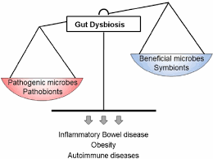
Advancement In Gi disease management
Gut Microbiome has a pivotal role in modulating body health
1. Round et al. Nature reviews immunology 9.5 (2009): 313

Slide 12
Advancement In Gi disease management
Effect of mode of delivery on the colonization by Bifidobacterium²
Gut colonisation starts at Birth
Regardless of antibiotic timing, microbiome colonisation is strongly affected by C-section delivery :
Microbial diversity was significantly reduced in at day 28
Bacteroides and Bifidobacteria were reduced
■ Vaginal delivery (n=80)  C-section (n=28)
Time
Chua et al 2017²
2. Guidelines for maternity care in South Africa, manual for clinics, community health centres and district hospitals, Fourth Edition 2016, Departement of Health

Slide 13
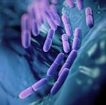
Advancement in GI Disease management
The number of viable cells contained in a probiotic qualifies it
Certain Probiotics like B. Clausii are recommended for acute, persistent diarrhea in children
Probiotics have ability to preserve/ restore gut barrier function
Probiotics have antimicrobial and immunomodulatory activity
Frontiers in Medicine: March 2018, volume 5, article 59

Slide 14
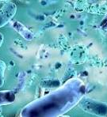
Probiotics definition
The word ‘probiotic’ is derived from the Greek meaning ‘for life’ and has had several different meanings over the years.

Slide 15
WGO Guidelines: Definition
WGO Guidelines are globally applicable by the nature of their cascades, which identify other ways of achieving the best possible outcome by taking the available resources into account.
Probiotics are live microorganisms that, when administered in adequate amounts, confer a health benefit on the host. Lactobacilli, along with species of Bifidobacterium, have historically been common probiotics.
Prebiotic is defined as a selectively fermented ingredient that results in specific changes in the composition and/or activity of the gastrointestinal microbiota, thus conferring benefit(s) upon host health.

Slide 16
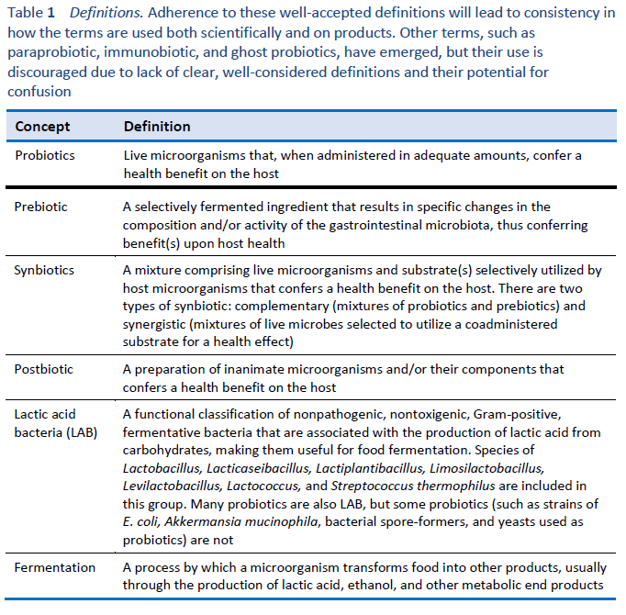
Important Well Accepted Definitions
8. International Scientific Association pf pre-biotics and probiotics ( SAPP)

Slide 17
Lactic Acid bacteria
Lactobacilli, along with species of Bifidobacterium, have historically been common probiotics.
Used in the process of food fermentation for thousands of years.
In2020,genus Lactobacillus underwent a major restructuring to better address the wide diversity of microbes assigned to the genus.
Twenty-three new genera were defined, including some with well-studied probiotic species
English | World Gastroenterology Organisation

Slide 18
Names of Some Important Former Lactobacillus Probiotics Species

Slide 19
WGO Guidelines: Probiotic labelling
From a scientific perspective, suitable descriptions of a probiotic product as reflected on the label should include:
Genus, species (and subspecies, if applicable) identification, with nomenclature consistent with current scientifically recognized names
Strain designation
Viable count of each strain at the end of shelf-life
Recommended storage conditions
Recommended dose, which should be based on induction of the claimed physiological effect
An accurate description of the physiological effect, as allowable by law
Contact information for post-market surveillance

Slide 20
Probiotic Qualities

Slide 23
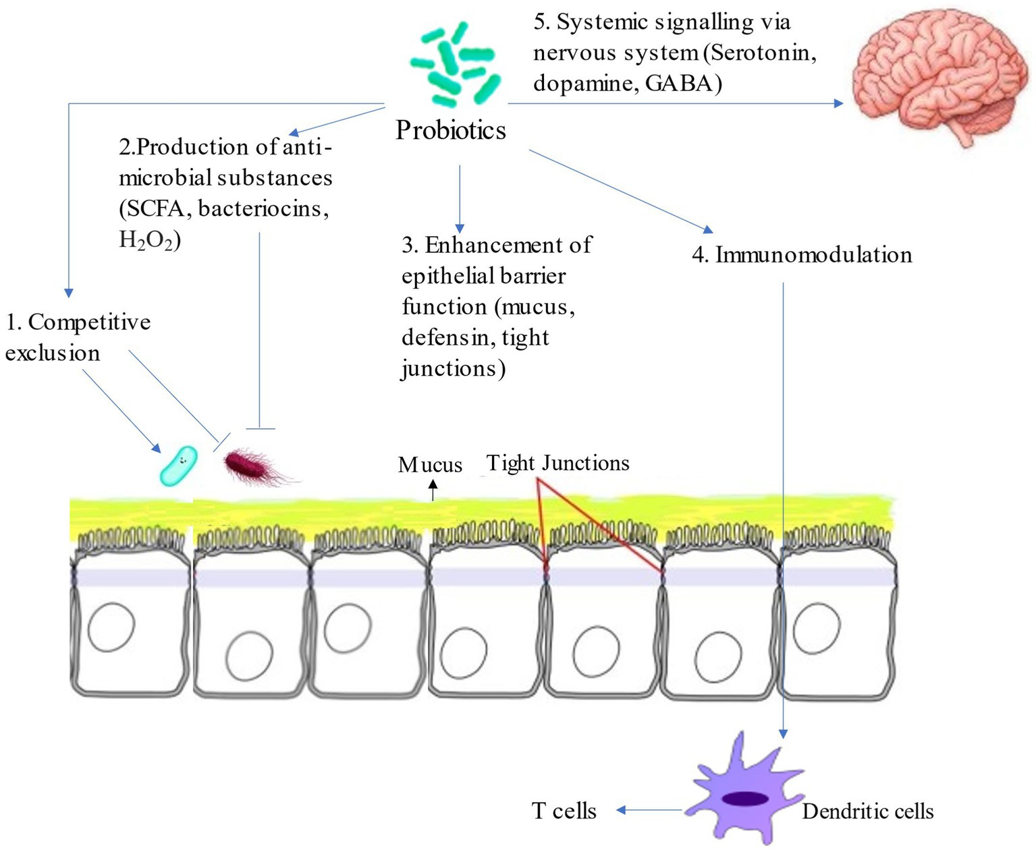
Mechanism of Action

Slide 24
Shared Mechanism of Action
Shared mechanisms within taxonomic groups go beyond strain-specific effects.
•Probiotic benefits may derive from mechanisms that are shared among strains.
•A shared mechanism may lead to a shared benefit exerted by most members of a taxon.
•One example of a shared mechanism is short chain fatty acid production.
•Another shared mechanism is cell surface components that enhance GI survival.
•Another shared mechanism is effector molecules which signal the immune system.
•Not all microbes expressing these mechanisms are necessarily probiotics or beneficial.
•Shared mechanisms may allow assignment of probiotic benefits to taxa beyond a strain.

Slide 25
Beneficial Effects of Probiotics
Immunomodulatory
Decreasing allergies, Inflammatory Bowel disease and auto-immune disease
Metabolic
Anti-inflammatory
Competitive Exclusion of pathogens
Enhancement of intestinal barrier function
Normalization of perturbed microbiota
Alessandra Vecchione et al. Compostional Quality and Potential Gastrointestinal Behaviour of Probiotic Products Commercialized in Italy. Frontiers in Medicine. March 2018, vol 5, article 59 accessed at www.frontiersin.org

Slide 26
Genus, species identification, with nomenclature consistent with current scientifically recognized names
The classification and identification of a probiotic strain may give a strong indication of its typical habitat and origin.
The species, or even genus name, may also indicate the strain’s safety and technical applicability for use in probiotic products.
Molecular typing methods such:
as pulsed-field gel electrophoresis,
repetitive polymerase chain reaction,
and restriction fragment length polymorphism
are extremely valuable for specific characterization and detection of such strains selected for application as probiotics.

Slide 27
Probiotic Nomenclature - Example
Probiotic strains are identified by genus, species and alphanumeric designation
Genus | Species | Strain
Lactobacillus | rhamnosus | GG
Lactobacillus | casei | DN-144 001

Slide 28
Probiotic Quality: Q&A
In your Opinion what probiotic Characteristic is most important?

Slide 29
Quality of probiotics
Assurance of potency (maintenance of viability, typically indicated by colony-forming units, through the end of shelf-life)
Purity (manufacturing processes that sufficiently reduce any pathogens of concern)
Identity (current nomenclature used to specify the genus, species, and subspecies, if applicable, and a strain designation for each strain in the product).

Slide 30
Viable count of each strain at the end of shelf-life
A Study In South Africa undertook an evaluation of 9 products currently available on the shelves in South Africa:
Only 3 of the 9 products tested contained the bacteria indicated on the label
5 products contained sufficient bacteria for a probiotic effect.
Enterococcus faecium, a potential pathogen and Saccharomyces cerevisiae found in 2 of the products are of concern.
This evaluation confirms that the contents of several probiotics available in South Africa do not correspond to the label claims

Slide 31
Ability to survive shelf-life, temperature fluctuations, gastric acid and bile salt
Nevertheless, several reports have indicated a relatively poor survival of probiotic strains during most of the technological processes used by the food industry [11, 24, 30].
Strains with increased stress tolerance would open new opportunities for the development of novel products.
Moreover, in addition to technological stress, once they are ingested, probiotics must overcome biological barriers present in the GIT to reach their place of action and exert their beneficial effects.

Slide 32
Safety of Probiotics for human consumption: must survive these conditions
Digestive Enzymes
Gastric Acid PH
Bile
Technological stress
Temperature Fluctuations
Candidate Probiotics Strains should possess the ability to resist gastric acidity and bile toxicity
BMC Microbiology (2022) 22:217

Slide 33
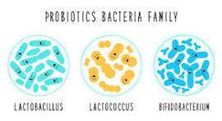
Dosage of probiotics
Although many over-the-counter products deliver in the range of 1–10 billion cfu/dose, some products have been shown to be efficacious at lower levels, while some require substantially more.
The dose needed for probiotics varies depending on the strain and product.
BMC Microbiology (2022) 22:217

Slide 34
Diarrhoea Epidemiology: Distribution of causes of death among children aged below 5 years and within the neonatal period, 2004
In 1960: Bacillus Clausii showed benefit in treatment of viral induced diarrhoea in children and antibiotic induced gut disturbance
4. WHO Web site. http://www.who.int/mediacentre/factsheets/fs330/en/index.html. Accessed 3 March 2012.
5. The World Health Organization. The Global Burden of Disease: 2004 update. 2008.

Slide 35
Accurate description of the physiological effect
Bacillus clausii spores are known to survive in the environment of gastric pH and colonize the intestinal tract mucosa, and grow into vegetative forms.
Moreover bacterium is resistant to most antibiotics due to the presence of antibiotics-resistance genes, and thus it easily colonizes the digestive tract even in the presence of antibiotic
6. Akash Kharwar et al. Quantities and qualitative characterization of commercially available oral suspension of probiotics containing Bacillus Clausii spores. BMC Microbiology (2022) 22:217 https://doi.org/10.1186/s12866-022-02631-w

Slide 36
Accurate description of the physiological effect : Bacillus Clausii
Tolerance to heat, acid, salt
Enhance Gut barrier function
Vitamin Synthesis : (for example able to secretes riboflavin ( Vitamin B2)
Antibiotic resistance
Other biochemical and metabolic properties
Including antimicrobial plus immunomodulatory activity
Frontiers in Medicine: March 2018, volume 5, article 59

Slide 37
Contact information for post-market surveillance and safety information
Systemic infections
metabolic activity
immune stimulation
gene transfer
GI side effects
BMC Microbiology (2022) 22:217

Slide 38
Probiotic Considerations
S – survivability (shelf-life)
M – multiplication
A – adaptability/adhesion
R – resistance (gastric acid, bile salt, antibiotics)
T – temperature sensitivity
BMC Microbiology (2022) 22:217

Slide 39
Summary Of Characteristic of A probiotic
Able to survive the passage through the digestive system.
Able to attach to the intestinal epithelia and colonize
Able to maintain good viability
Able to utilize substrates in a normal diet
Must be none pathogenic and none toxic
Able of exerting a beneficial effect on the host

Slide 40
References
Round et al. Nature reviews immunology 9.5 (2009): 313
2. Guidelines for maternity care in South Africa, manual for clinics, community health centres and district hospitals, Fourth Edition 2016, Departement of Health
English | World Gastroenterology Organisation accessed on April 2014 at: https://www.gastroenterology.org/guidelines/probiotics-and-prebiotics/probiotics-and-prebiotics-englis#Ref001
Alessandra Vecchione et al. Compostional Quality and Potential Gastrointestinal Behaviour of Probiotic Products Commercialized in Italy. Frontiers in Medicine. March 2018, vol 5, article 59 accessed at www.frontiersin.org
Mary Ellen Sanders et al. Shared mechanisms among probiotic taxa: Implications of probiotics claims. Current Opinion in biotechnology vol 49, feb 2018. P207 – 226
WHO website: http://www.who.int/mediacentre/factsheets/fs330/en/index.html. Accessed 3rd March 2023
The World health Organization. The Global Burden of Disease: 2004 update
6. Akash Kharwar et al. Quantities and qualitative characterization of commercially available oral suspension of probiotics containing Bacillus Clausii spores. BMC Microbiology (2022) 22:217 https://doi.org/10.1186/s12866-022-02631-w
Lynne V. McFarland. From Yaks to Yogurt: The History, Development, and Current Use of Probiotics. S90 • CID 2015:60 (Suppl 2) • McFarland
8. International Scientific Association pf pre-biotics and probiotics ( SAPP), “ The big breakup pf Lactobacillus:, available at : https:// www.nestlenutrition-institute.org/infographics/big-breakup-lactobacillus.

