Slide 1
SUBSTITUTION OF MEDICINES
GGPF – Medical Conference
Gallagher Estate
DATE: 16 October 2022

Slide 2
About Me
Adv Joe Malherbe
LLB, LLM (Cum Laude), Cert.Dir, FCG
Advocate of the High Court
Chartered Secretary (The Chartered Governance Institute of Southern Africa)
Certified Director (Institute of Directors South Africa)
Head Legal & Compliance at Lafeki Group of Companies

Slide 3
MEDICINES AND RELATED SUBSTANCES ACT 101 OF 1965
Defined in the Act –
“interchangeable multisource medicine” means medicines that contain the same active substances which are identical in strength or concentration, dosage form and route of administration and meet the same or comparable standards, which comply with the requirements for therapeutic equivalence as prescribed.
Section 22 F – dealt with ‘Generic substitution’

Slide 4
Section 22 F – Generic Substitution
Sub-Section (1) –
Subject to subsections (2), (3) and (4), a pharmacist or a person licensed in terms of section 22 C (1) (a) shall —
inform all members of the public who visit the pharmacy or any other place where dispensing takes place, as the case may be, with a prescription for dispensing, of the benefits of the substitution for a branded medicine by an interchangeable multisource medicine, and shall, in the case of a substitution, take reasonable steps to inform the person who prescribed the medicine of such substitution; and
dispense an interchangeable multisource medicine instead of the medicine prescribed by a medical practitioner, dentist, practitioner, nurse or other person registered under the Health Professions Act, 1974, unless expressly forbidden by the patient to do so.

Slide 5
Section 22 F – Generic Substitution
Sub-Section (2) -
If a pharmacist is forbidden as contemplated in subsection (1) (b), that fact shall be noted by the pharmacist on the prescription.
Sub-Section (3) –
When an interchangeable multisource medicine is dispensed by a pharmacist he or she shall note the brand name or where no such brand name exists, the name of the manufacturer of that interchangeable multisource medicine in the prescription book.

Slide 6
Section 22 F – Generic Substitution
Sub-Section (4) -
A Pharmacist shall not sell an interchangeable multi-source medicine —
if the person prescribing the medicine has written in his or her own hand on the prescription the words “no substitution” next to the item prescribed;
if the retail price of the interchangeable multisource medicine is higher than that of the prescribed medicine; or
where the product has been declared not substitutable by the Authority.

Slide 7
MEDICINES CONTROL COUNCIL (MCC) Generic substitution (as at Dec 2003)
Replaced the circular 16 of 1994 (list of non-substitutable medicines)
… substitution should NOT occur when prescribing and dispensing "generic” medicines that:
i) have a narrow therapeutic range;
ii) have been known to show erratic intra- and interpatient responses;
iii) are contained in dosage forms that are likely to give rise to clinically significant bio-availability problems, e.g. extended or delayed release preparations, as well as those known to be super bioavailable; or
iv) are intended for the critically ill and/or geriatric and paediatric patient.
Included a list of various medicines –
“been known to present bio-equivalence problems and should ideally not be interchangeable…”

Slide 8
MEDICINES CONTROL COUNCIL (MCC) Substitution of Medicines (as at April 2010)
Replaced the guidelines on Generic Substitution (Dec 2003)
Section 22F of the Medicines and Related Substances Act, 1965 (Act 101 of 1965), as amended, provides for the pharmacist or any person licensed in terms of Section 22C (1) (a) to dispense an alternative medicine to the one prescribed, subject to specific conditions.
In terms of Section 22F (4) (c) of the Act Council may declare any medicine or group of medicines not substitutable. Such medicines or group of medicines shall be reflected in this guideline until the Council determines otherwise, based on evidence and information that is available to it.

Slide 9
MEDICINES CONTROL COUNCIL (MCC) Substitution of Medicines (as at April 2010)
GROUPS OF MEDICINES THAT ARE NOT SUBSTITUTABLE –
Biosimilars are not generic products and cannot be identical to their reference products. Further, the formulations may be different and this can have a profound effect on their clinical profiles.
In addition, a biosimilar does not necessarily have the same indications or clinical use as the reference product. Therefore, given current science, they cannot be considered interchangeable with the reference product or products of the same class.
Equally, automatic substitution (i.e. the practice by which a different product to that specified on the prescription is dispensed to the patient without the prior informed consent of the treating physician) cannot apply to biosimilars.
This approach ensures that treating physicians can make informed decisions to ensure that treatment is in the interest of patients’ safety.
This guideline is effective from the date of publication of this document.
See also - Current MCC Guideline on Biosimilar Medicines, item 5.3

Slide 10
Pharmacist
The pharmacist is obliged to provide safe, quality medicine in accordance with the Medicines and Related Substances Act and is ethically bound to exercise sound judgement and professional expertise in accordance with Good Pharmacy Practice Regulations to ensure maximum safety and efficacy of the prescribed treatment.
The law on generic substitution provides the patient with the opportunity to choose to use generic medicine. The fundamental ethical requirements of the profession bind pharmacists to honour these rights and to act in the best interests of the patient.
In exercising the choice to accept a generic alternative, the patient must give his explicit consent for the substitution and, in doing so, must be guided by the professional advice of the pharmacist.

Slide 11
Good Pharmacy Practice Manual and Associated SAPC Rules
1.5 – CO-OPERATION WITH HEALTH CARE PROFESSIONALS
The Principle:
The pharmacist must co-operate with other health care professionals to achieve the best possible outcomes for the patient. The pharmacist shall respect the skills and competencies of other health care providers and endeavour to work cooperatively with them to optimise the health outcomes of mutual patients and the public.

Slide 12
Good Pharmacy Practice Manual and Associated SAPC Rules
1.6 – PROFESSIONAL INDEPENDENCE
The Principle:
A registered member of the profession should refrain from entering into, or being part of any transaction or agreement, which may reflect negatively on his or her professional independence or the professionalism, or ethics of the profession as a whole.

Slide 13
Good Pharmacy Practice Manual and Associated SAPC Rules
2.7.3.11 – GENERIC SUBSTITUTION
Repeat of Section 22 F of the Medicines Act
With a note – Interchangeable multi-source medicine – is defined in the Act.

Slide 14
Good Pharmacy Practice Manual and Associated SAPC Rules
Part 4 – Rules relating to acts or omissions in respect of which the council may take disciplinary steps.
The undermentioned acts or omissions shall be deemed to be unethical or unprofessional conduct, subject to disciplinary steps by the Council under Chapter V of the Pharmacy Act, 1974 –
Rule 2 –
Substituting or omitting a medicine or ingredient of a medicine in a prescription without first obtaining the approval of the prescriber, unless the patient requests the omission of a medicine in a prescription: Provided that such omission shall be indicated indelibly on the prescription and the copy of the prescription: Provided further that the patient be advised of the implications of the omission of a medicine in a prescription as requested by him.

Slide 15
SUMMARY
Dispensers may substitute an “interchangeable multi-source medicine”. BUT must take reasonable steps to inform the prescriber of that fact.
NO substitution may take place –
Patient forbids substitution.
The prescriber writes “NO SUBSTITUTION” in handwriting next to each line item.
The generic is more expensive that the ethical product.
The medicine is declared NON-SUBSTITUTABLE.

Slide 16
The elephant in the room – Discovery Medical Aid
PERFORMANCE BASED REMUNERATION (PBR) FORMULARY –
A subset of preferentially priced, generic medicine that is on the chronic formulary. Performance Based Remuneration incentivises compliance to the best-priced formulary generics. It integrates inflationary dispensing fee income with optimised performance.
WHAT IS THE OBJECTIVE OF PBR –
Performance Based Remuneration (PBR) is a voluntarily incentive designed to provide an additional dispensing fee to pharmacists for adhering to the Scheme’s chronic medicine formulary. The PBR model aims to create additional remuneration for pharmacies through improved prescription price efficiency.
Pharmacies without a signed and valid standard network rate contract with us cannot participate in the PBR network. The model only applies to generically substitutable medicine claims paid from the Chronic Illness Benefit, subject to specific inclusion and exclusion criteria.

Slide 17
Continued…
THERAPEUTIC REPLACEMENTS WHERE THERE ARE NO GENERIC ITEM AVAILABLE FOR SUBSTITUTION?
PBR is about cost-efficient generic substitution. Once the pharmacy has reached the compliance criteria, the lower dispensing fee applies for non-formulary items. The higher dispensing fee applies only to formulary items that either are on the formulary list or fall below the PBR-benchmark unit price.
However, whenever your client is not satisfied with a co-payment and the prescribed ingredient is not listed on the formulary (for products such as Crestor or Eltroxin), choosing the best-priced generic will avoid the lower PBR dispensing fee.
You will receive the higher dispensing fee when you dispense a formulary item or one that falls below the PBR-benchmark unit price.
It is important to note that it always has to be in the best interest of the patient and, therefore, it will always remain the decision of the pharmacist, patient and treating healthcare professional whether to make a (therapeutic) substitution or not. Discovery Health will in no way interfere with this decision.

Slide 18
Continued …
THERAPEUTIC REPLACEMENTS WHERE THERE ARE NO GENERIC ITEM AVAILABLE FOR SUBSTITUTION?
We do not expect the pharmacy to achieve a 100% compliance rate. We understand that certain patients and healthcare professionals will choose not to fully comply. It is important to understand that:
While prescriber preferences may compromise formulary compliance from time to time, this is adequately compensated for by lower compliance criteria
We continue to promote access to affordable medicine and, therefore, affordable pricing remains a key consideration in inclusion of the CIB formulary. Depending on the availability of preferentially priced generics, there may not always be a generic replacement item on the formulary.

Slide 19
Continued …
WHAT IF I OFFER GENERIC REPLACEMENT ITEMS, HOWEVER, THE PATIENT OR DOCTOR DOES NOT AGREE TO GENERIC REPLACEMENT?
You need to dispense the item on the prescription according to the patient or doctor’s decision and you will be paid the lower fee.
You always have to adhere to legislation.
While prescriber preferences may compromise formulary compliance from time to time, this is adequately compensated for by lower compliance criteria. We do not expect 100% PBR compliance.

Slide 20
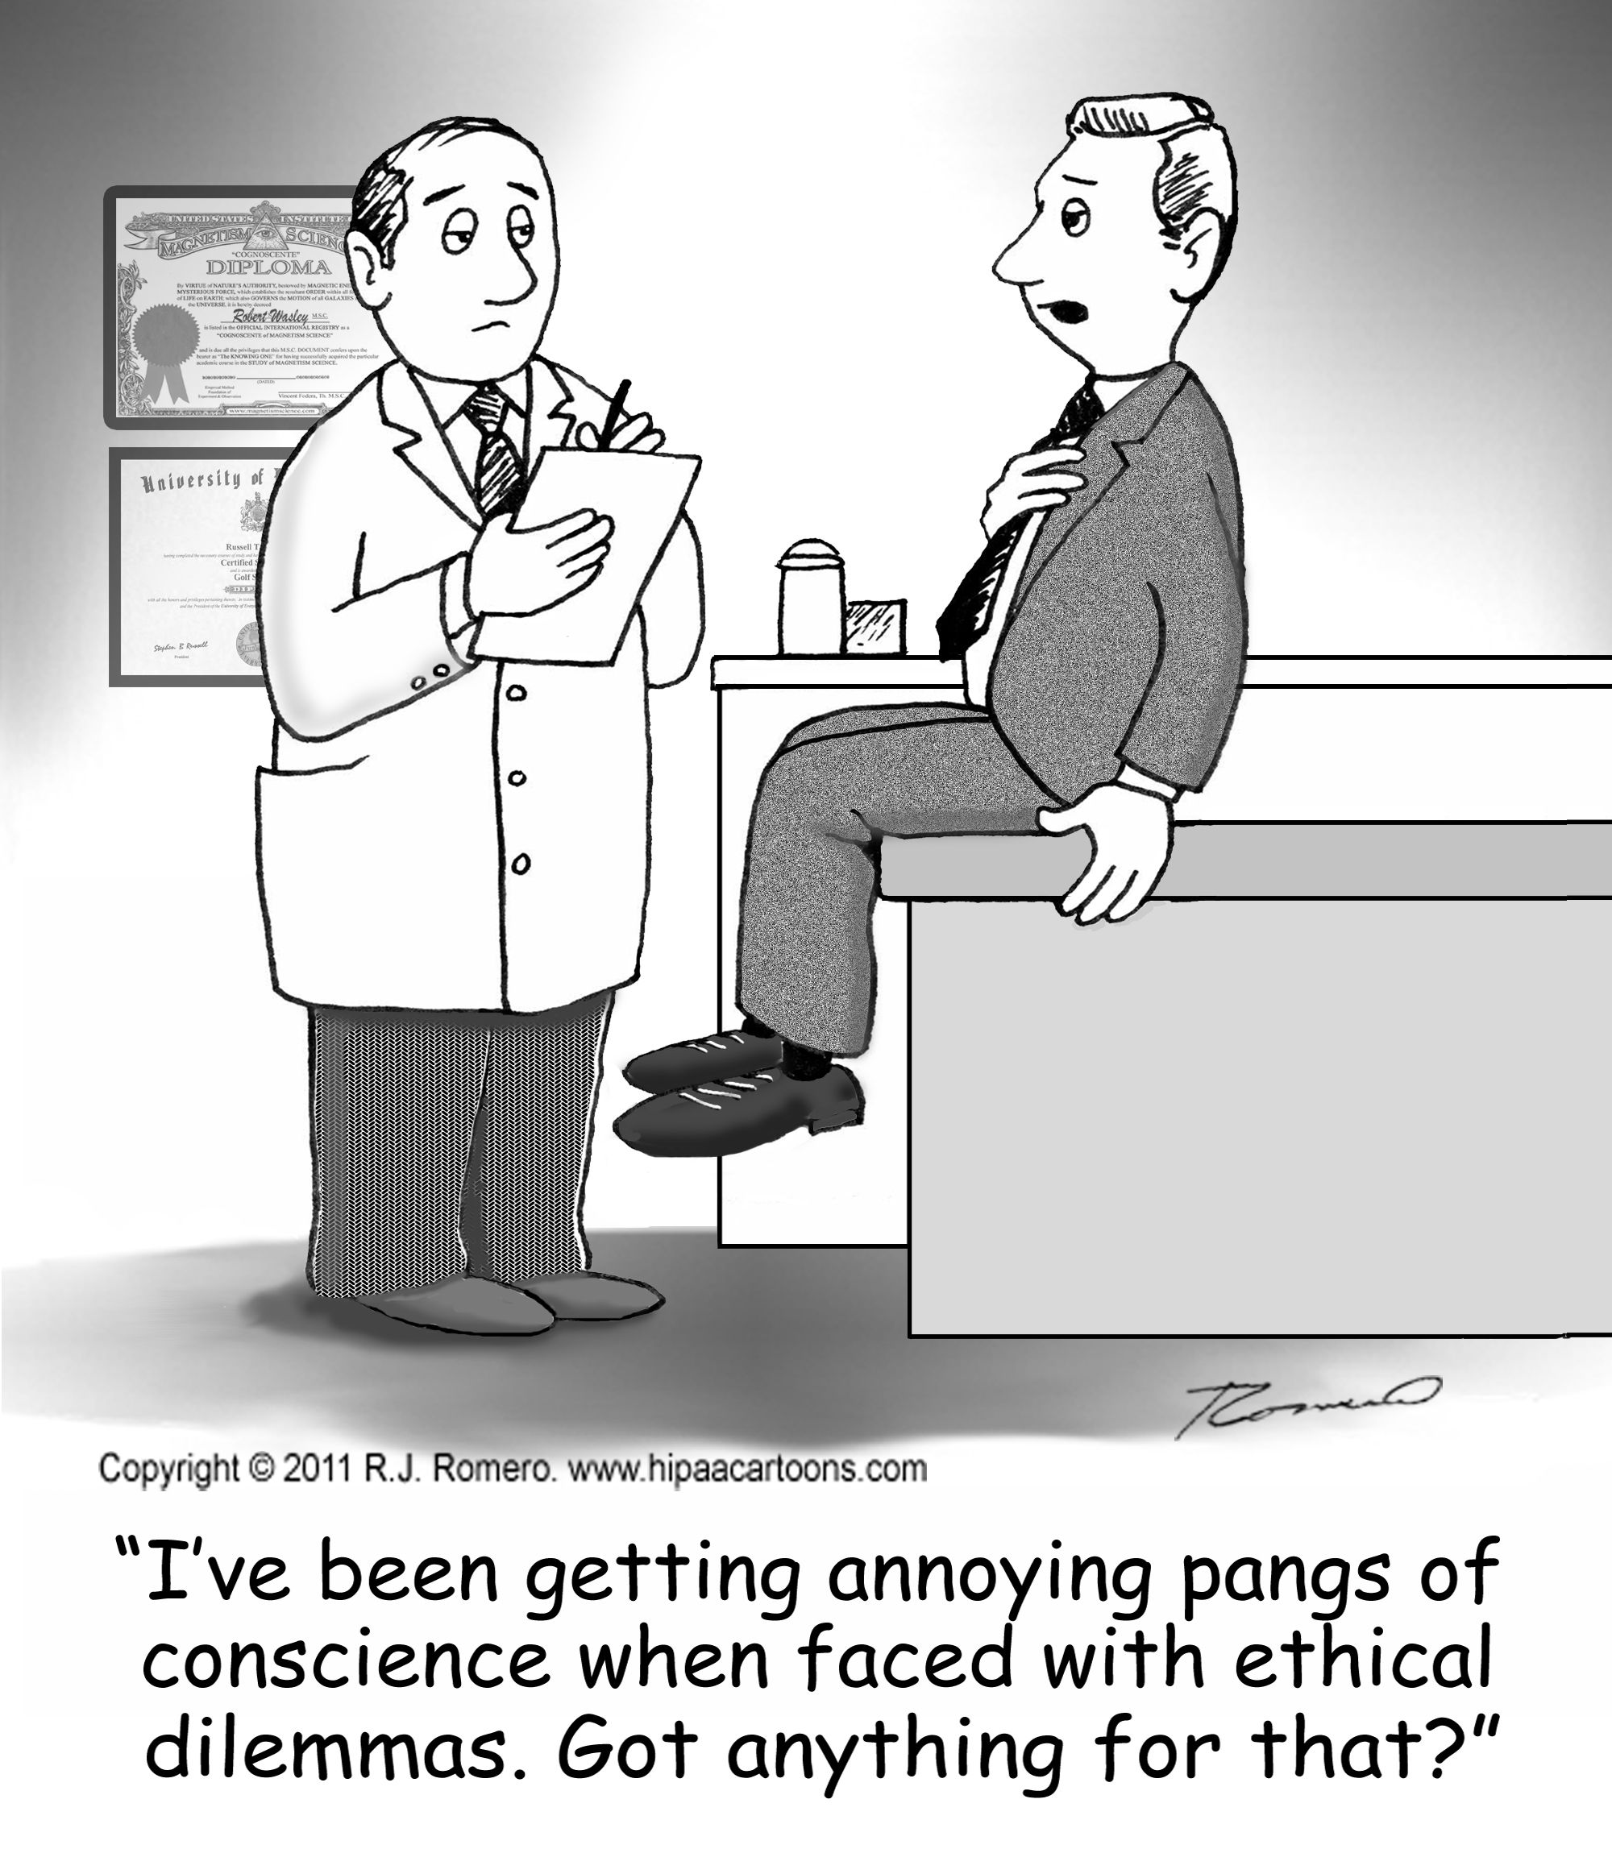
ETHICAL?

Slide 21
THANK YOU
Joe Malherbe
0834173028
joe@rsacorporate.com

Slide 22
References
MEDICINES AND RELATED SUBSTANCES ACT 101 OF 1965 (as amended)
MCC 2.10 Generic Substitution Dec03 v1 (December 2003)
Good Pharmacy Practice Manual and Associated SAPC Rules (as amended)
Discovery Health – Pharmacy Network Guide (2021)

