Slide 1
“Contraception through the phases of her life – not one-size-fits-all” WHATS NEW .
Trudy Smith
Wits Donald Gordon Medical center

Slide 2
Disclosures
Received research and travel grants as well as advisory boards for
GSK
MSD
Adcock Ingram
Bayer
Novo Nordisk
Pfizer
Aspen
Acino

Slide 3
Unintended pregnancy's
121 million pregnancies in the world are unintended
2015 -2019 65% of pregnancies in were unintended
36% ended in abortion
State of World Population Report Focus on the Impact of Unintended
Pregnancy on Women and Girls Department od Social Development

Slide 5
How to decrease Maternal Mortality
Preventing early marriage
Preventing early pregnancy through sex education, increasing education opportunities, and economic and social support programs
Increasing the use of contraception
Reducing coerced sex
Preventing unsafe abortion; and increasing the use and the safety of prenatal care, childbirth, and postpartum care programmed.

Slide 6
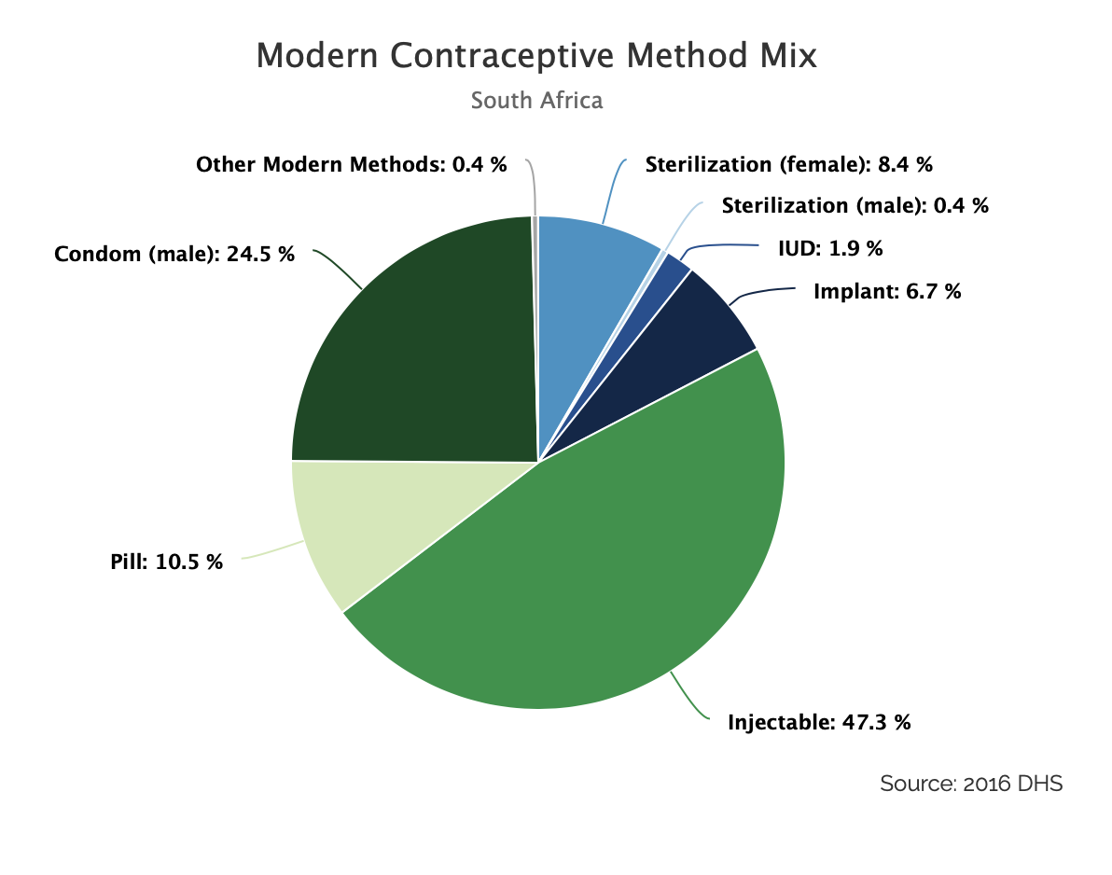
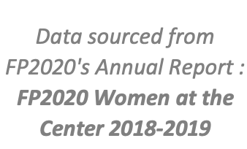

Slide 7
Contraceptive method use in the private sector RSA - units
 | 61.9%
 | 20.5%
 | 12.9%
 | 2.3%
 | 1.8%
 | 0.3%
 | 0.2%
 | 0.1%
6 769 336
units

Slide 9
934 to girls under 14

Slide 10
Considerations in Adolescence
Physical Development
Cognitive Development
Social Development
Emotional Development
Moral Development
Decision making affects adolescence differently to adults and tends to be influenced by emotions rather than reason.
J. Jaccard and N. Levitz / Journal of Adolescent Health 52 (2013) S6-S13

Slide 12
Advantages of a LARC
Does not rely on user adherence for effectiveness
Discontinuation of LARC methods requires consultation with a medical provider, which allows for additional counseling and discussion regarding side effects and replacements
Longer use without repeat visits
Discreet

Slide 13
LARC _Contraceptives to consider
IUCD – Copper T not contraindicated
Mirena- excellent for menhorragia
Nuvoring- Not very popular
Inplanon – excellent for Dysmenhorrea but may cause abnormal uterine bleeding

Slide 14
DEPO PROVERA

Slide 15
Oral Contraceptives
Pill use peaks amongst women aged between 18 and 24 years
An average of 2.7 pills per cycle are forgotten by adolescents
Discontinuation rates of more than 50% during the first 6 months of use
The home environment, such as living with one’s parents, can present problems with storing contraception.

Slide 16
Health Benefits of oral contraceptives
Treatment of dysmenorrhea
Treat abnormal uterine bleeding to decrease iron deficiency anemia
Polycystic ovarian syndrome
Endometriosis
Acne
Premenstrual syndrome and premenstrual dysphoric syndrome
Notes:
Endo 7%
Poly

Slide 17
Which oral contraceptive to use
Effective method
24/4 pill has a higher pearl index and is better in patients who you have some concerns about compliance
Amenorrhea is present in 30% of women taking Zoely
Excellent choice in adolescence because 48 hours cover
Counseling counseling!

Slide 18
Emergency contraception
4 % of teenagers used it more than once in a year
The 1,5mg levonorgestrel regime was better tolerated with less vomiting
Teens are unfortunately less likely to use a permanent form of contraception after emergency contraceptive use
Availability?

Slide 19
Older reproductive age
Lower Fecundity
Pregnancy in women age 45 to 49 years not using contraception is estimated to be 2 to 3 %
1% at 50
Less frequent intercourse
Need reliable contraception
Avoid unintended pregnancy

Slide 20
Age is but a number

Slide 21
COC benefits
Reduce hot flushes
Regulated and/or reduced menstrual bleeding in the perimenopause
Maintenance of bone health
Reduction in risk of some cancers (endometrial, ovarian, and possibly colorectal)

Slide 22
Which one?
Standard 30 /35ug ethinylestradiol to much
Use a 20ug ethinylestradiol pill
Estradiol containing pill
Amenorrhea of the estradiol pill Zoely
Less metabolic impact
Less procoagulant factors
Qlara and Mirena head to head trial
EXCELLENT solution
Transition to HT easier

Slide 23
When to stop the oral contraceptive?
Take a family history
Stop at 50
Must use an alternative
Measure the FSH at day 10
Repeat after 6 weeks and if > 30 menopausal
Assess symptoms
Start HT if necessary

Slide 24
Progestogin only Pill
Classically used in over 40 year olds
Minimizes risk of VTE
Gives a 3 hour window
Breakthrough bleeding
PMS a problem
Depression
No effect on flushes in the perimenopause

Slide 25
Does weight matter
Obesity may affect the safety and efficacy of various contraceptive methods
Contraceptive clinical trials excluded overweight or obese women
Obese women may have other comorbidities diabetes etc.
Increased risk of DVT in older women

Slide 26
OC pill
VTE risk is a very real risk
Often associated with PCOS
OC pill useful to control bleeding and acne
Category 3 in patients with a BMI 35 to 39kg/M2
Category 4 in > 40kg/m2
Worse over 35 years of age

Slide 27
Implanon
Highly effective
A prospective cohort study reported no statistical difference in contraceptive failure between overweight/obese etonogestrel implant users
Etonogesteral levels are 30 to 60% lower in obese women but still in the contraceptive range
Bleeding and additional weight gain is another problem

Slide 28
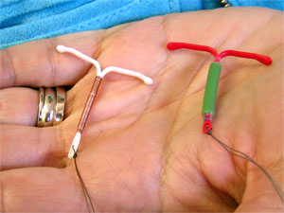
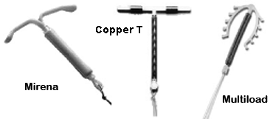
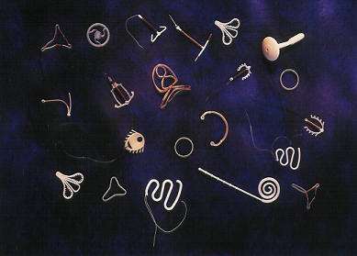

Slide 29
Copper IUCD
No weight gain
Not affected by weight
Visualizing the cervix can be a problem in obese women
Use condom over the tip to push vaginal walls aside
Ultrasound guided insertion maybe helpful
Bleeding an issue in the perimenopausal women

Slide 30
Mirena
Gives endometrial protection for hyperplasia
Has a high efficacy
No data that it needs to be changed earlier.
IS IT THE IDEAL
Good to use for progestogen in HRT

Slide 31
No data on breast cancer
Depression
Dysphoria
Breast pain and swelling
Headache
Acne
Ovarian cysts

Slide 32
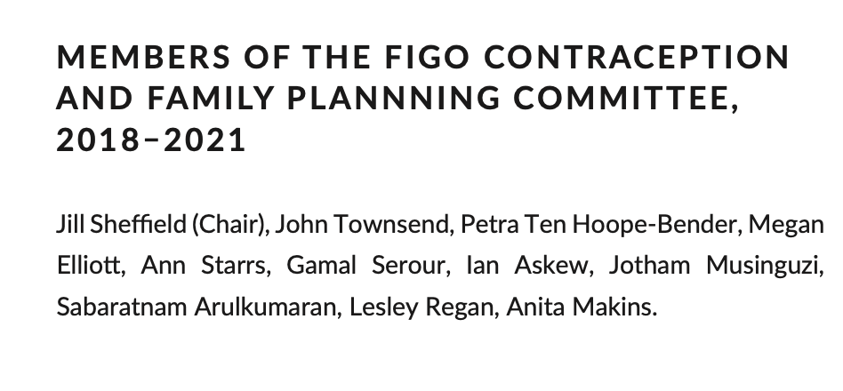
Post partum LARCs are of particular value during the pandemic
given their failure rates due to independence and the fact that
women do not need to return for constant re - supplies

Slide 33
Issues in a Pandemic
Ebola epidemic in DRC, Sierra Leone, and Liberia, contraception and routine maternal health care dropped dramatically
Stock‐outs of contraceptive methods are a constant problem for practitioners
UNFPA estimated that 46 countries that usually receive supplies experienced stock‐outs of one or more modern methods, including:
Implants; depot medroxypro‐ gesterone acetate (DMPA) intramuscular (IM) and subcutaneous (SC)
Copper intrauterine devices
Oral contraceptive pills (combined and progestin only)
Condoms.

Slide 34
Bottom Line

